Slide 1
Websites we like/dislike
2011

Slide 2

Positioning
…the process by which a business creates an image or identity in the minds of their target market for its firm.
Premier Environmental Firm
Superior Service
Local (Texas)
Healthy, Relaxed Culture

Slide 3
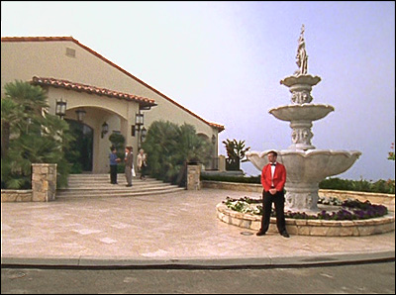
Differentiation
To perceive the difference in or between…
Local Knowledge
Efficient Execution
Personalized Service
Regulatory Savvy
To be differentiated in the eyes of the marketplace, you have to be known for something in particular. It’s not enough just to be known. (That’s name awareness, which is not the same thing as being seen as differentiated.) And you can’t have a reputation for being something specific if you only do it occasionally.
-David Maister

Slide 4

Ideal Client’s Characteristics
Sustainable Revenue
Allows Relationship Marketing
Pays Full Price
Pays On Time

Slide 5
Who are these Clients?
Industrials
Gold Metal, AT&T, KBR, General Cable
Energy
Comstock, Chesapeake, BP?
Government
Federal (FEMA, FAA, Forestry Service…)
County (Tarrant, etc.)
Local

Slide 6
Marketing Needs
Consistent image
Field workers
Reports
Emails, blog
An interactive, professionally designed website (blogs, RSS, etc.)
An efficient delivery/proposal system
Electronic SOQ

Slide 7
Websites we don’t like

Slide 8
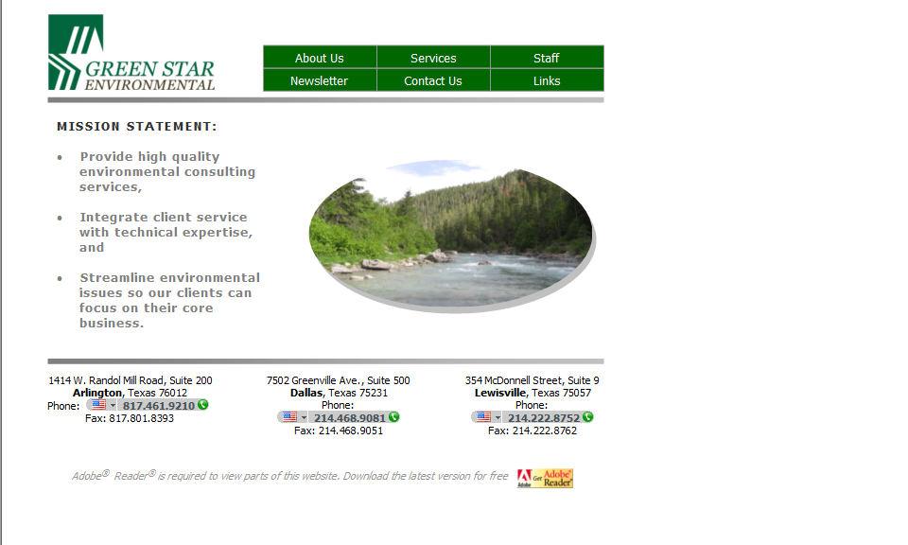
Green Star Environmental

Slide 9
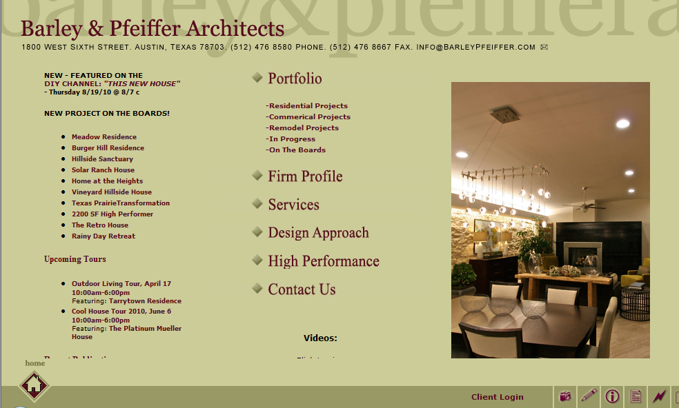
Barley & Pfeiffer Architects

Slide 10
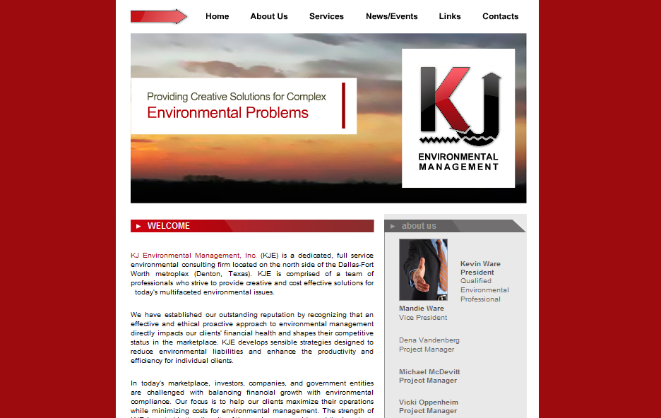
K J Environmental Management

Slide 11
Websites we do like…

Slide 12
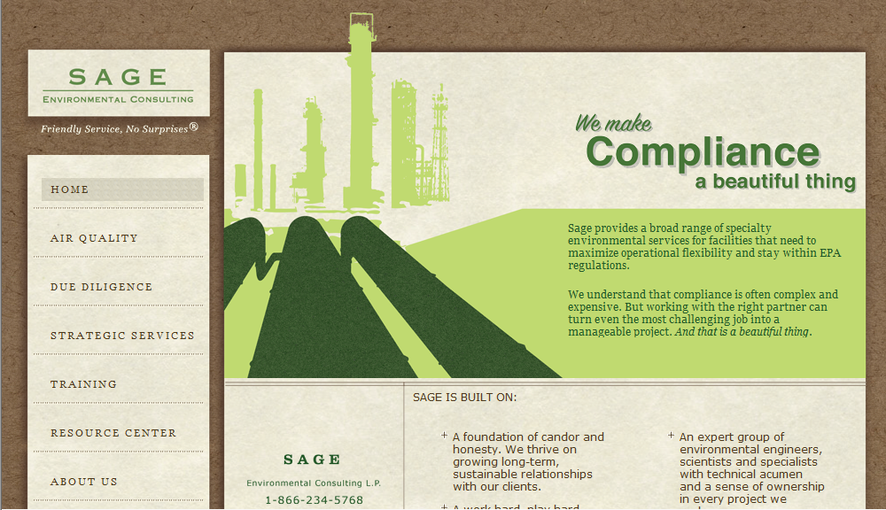
Sage Environmental
Notes:
Like how the picture was taken and used in a more artistic manner. Clean design.

Slide 13
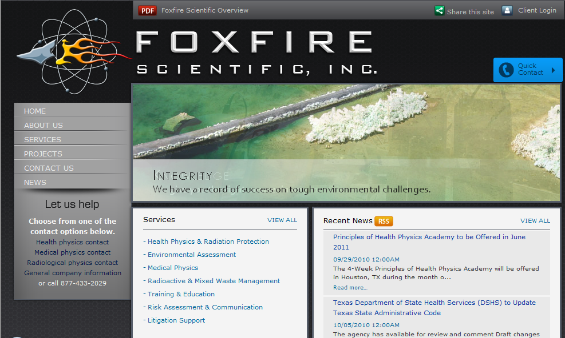
Foxfire Scientific
Notes:
They will have a client login link that is needed. This will simply click off to another web site so there is no need to leave space for a username/password. Don’t use for color guidance.

Slide 14
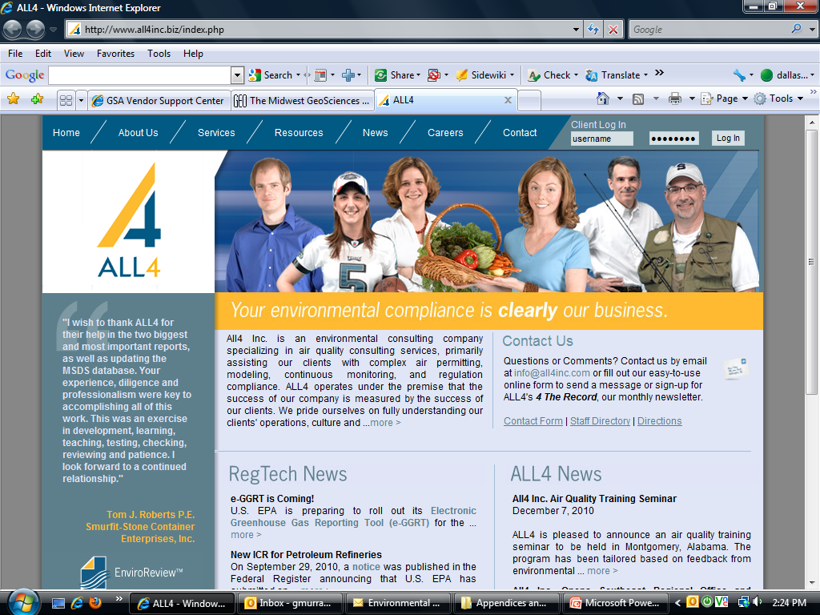
ALL4
Notes:
Like overall layout but image of people not consistent with what they need. More of a layout example.

Slide 15
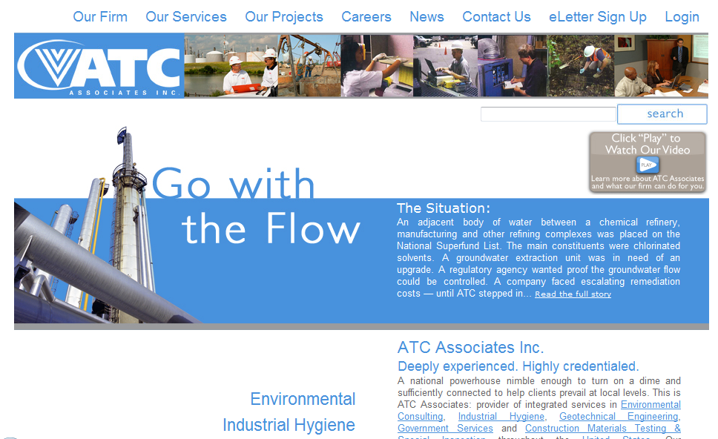
ATC Associates, Inc.
Notes:
They will have a video that is streamed from YouTube.

Slide 16
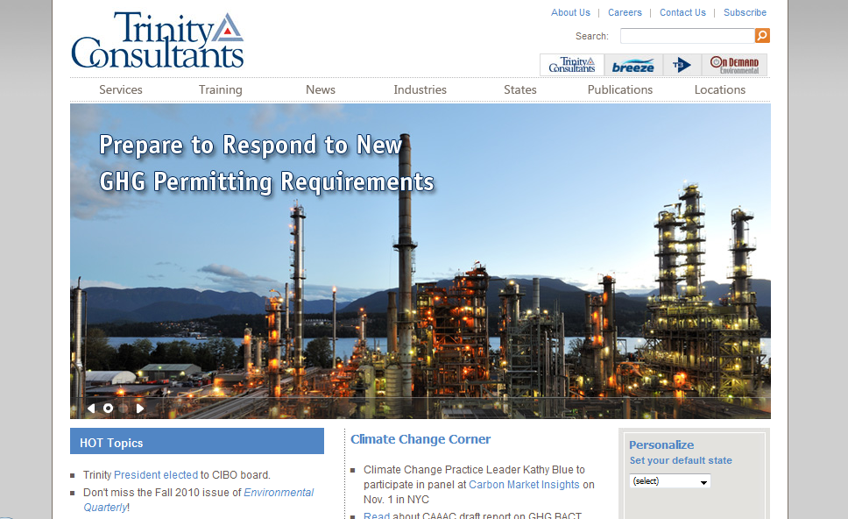
Trinity Consultants
Notes:
This is a competitor. Trinity is a HUGE company. Like the imagery used here as it shows a refinery that produces waste and the environment in the background. Also gives the impression they can work on large scale projects.

Slide 17
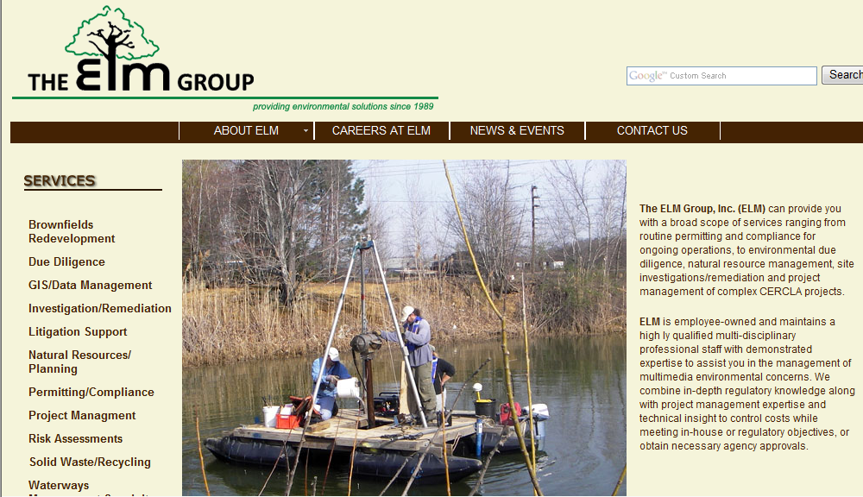
ELM GROUP
Notes:
This photo is showing a guy testing pollutants in water. This is a service they do. They like this photo because of that.

Slide 18
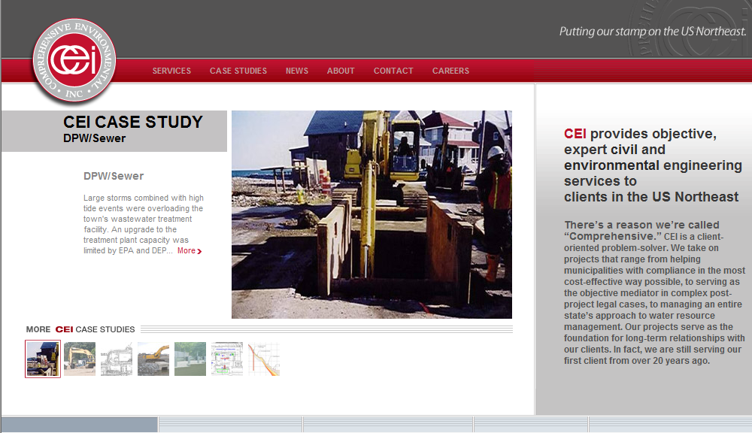
CEI
Notes:
This slide illustrates a case study. They will have several case studies on their web site. (doesn’t need to be laid out like this)

Slide 19
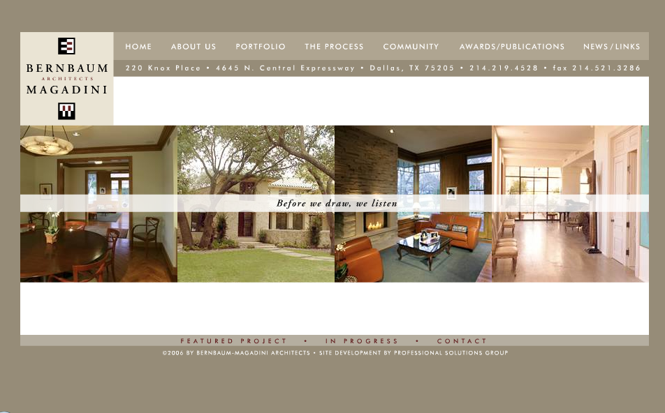
Bernbaum Magadini

Slide 20
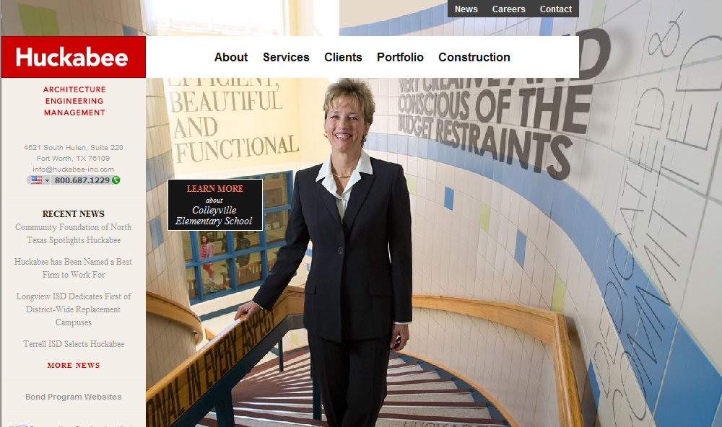
Huckabee

Slide 21
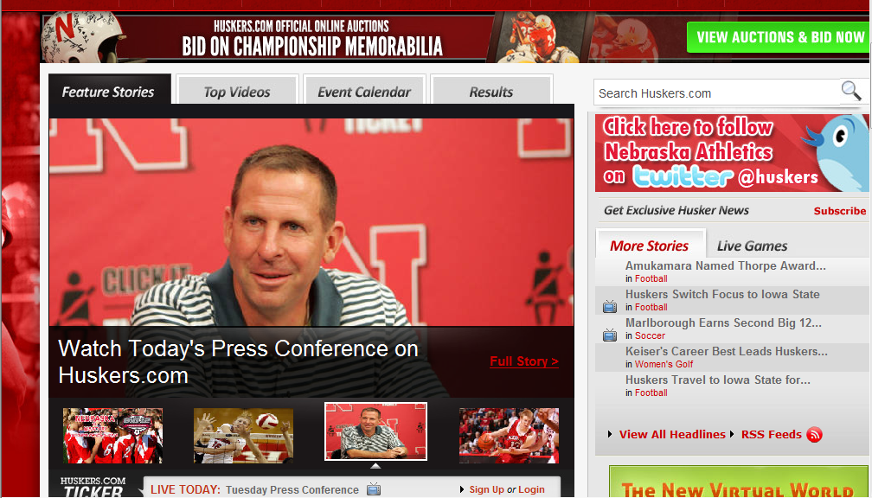
Huskers.com
Notes:
Referencing a strong call out to the Social Marketing. However; I don’t believe it needs to be this strong. I would say we would simply want to include Twitter and Facebook icons at the bottom of the pages in the footer.

Slide 22
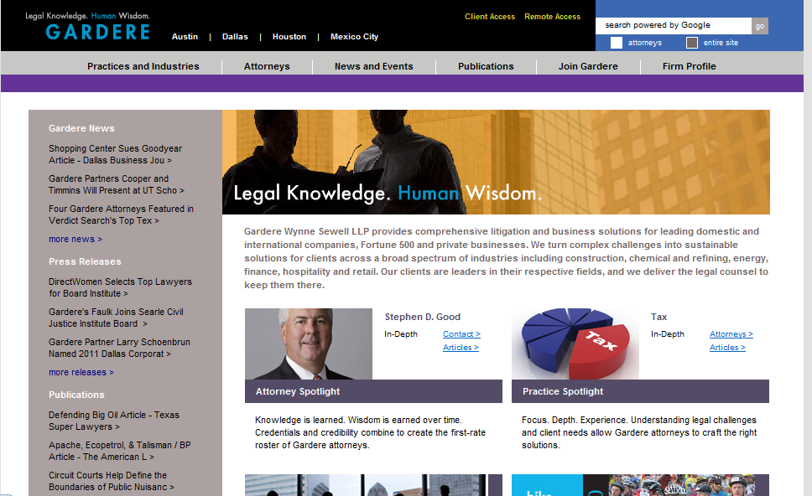
Gardere

Slide 23
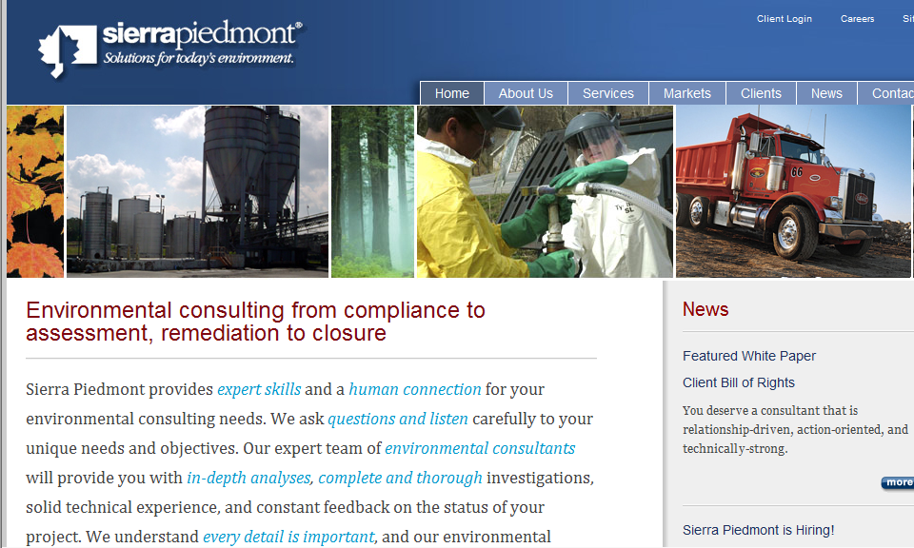
Sierrapiedmont
Notes:
They like the imagery on this site. They circled the text as it is showing the “Relationship” based buisiness and the “experts” in the enviornmental consultants.

Slide 24
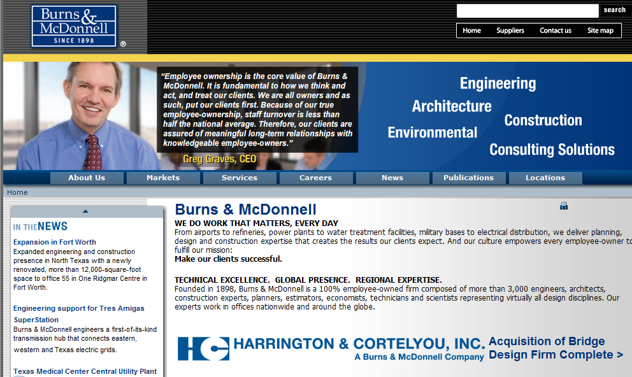
Burns & McDonnell
Notes:
Just like the colors of blue used on this page. Not the layout or design.

Slide 25
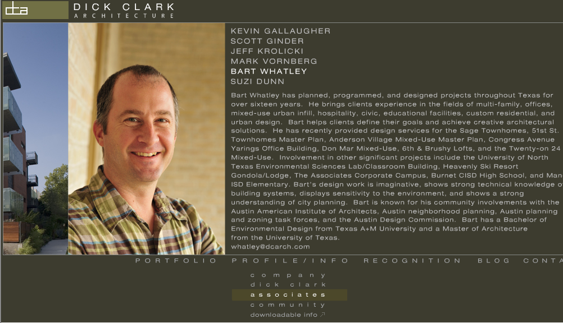
Dick Clark Architecture
Notes:
The circled area on this page is actually the nav. They were pointing out that the “section” they are currently in was highlighted to help show where you are inside the site. Don’t use this for design, colors, or layout guidance.

Slide 26
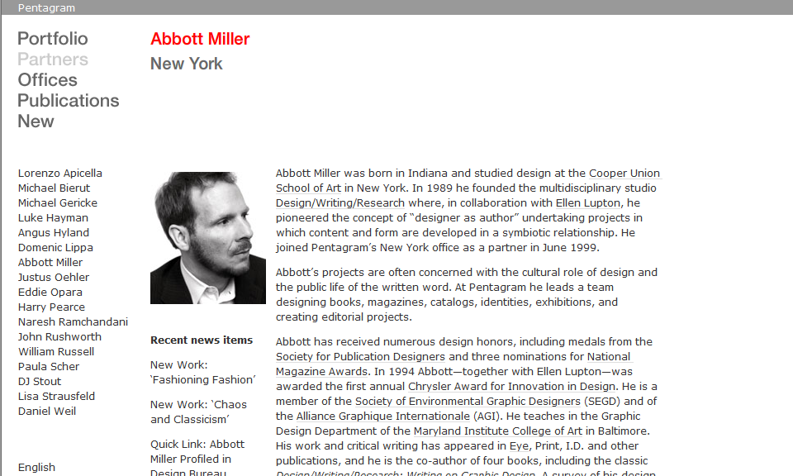
Pentagram
Notes:
Once again, the nav allows the visitor to see what section of the site they are inside. Don’t use for design, colors, or layout guidance.

Slide 27
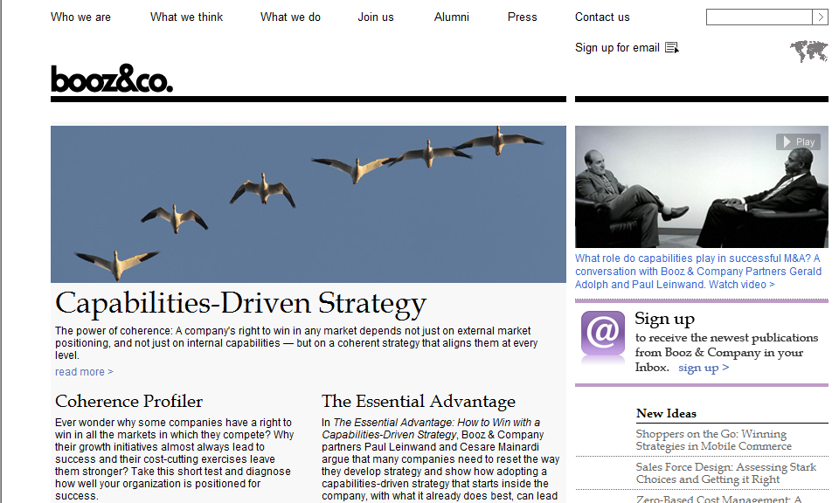
booz, inc.
Notes:
Clean site. Okay to use for layout and design guidance. Good use of Whitespace.

