Slide 1
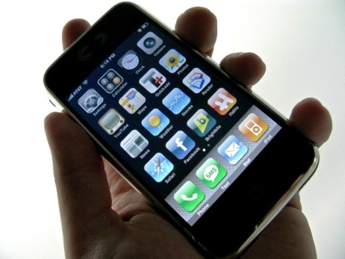
Mobile Future
Consulting

