Slide 1
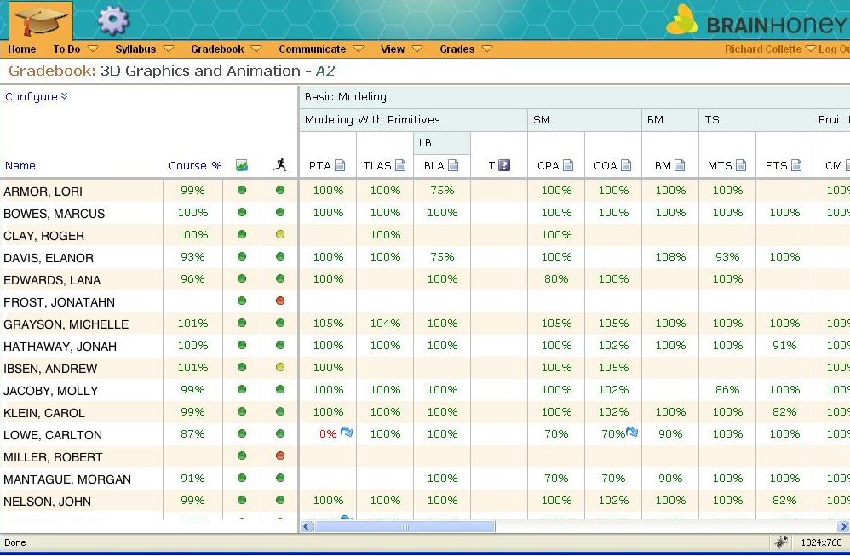
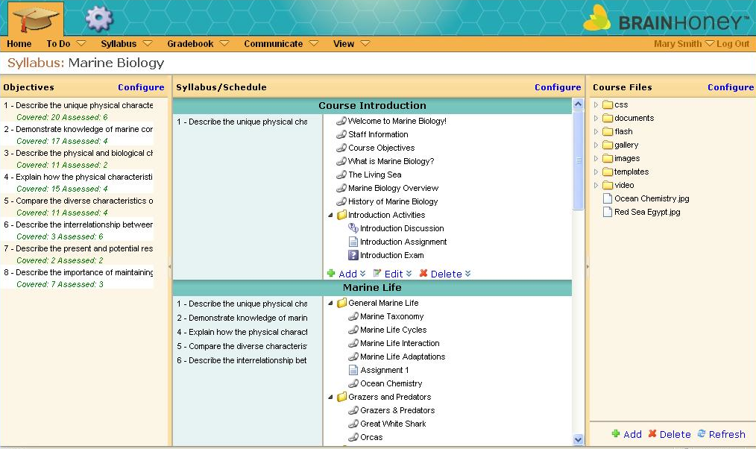
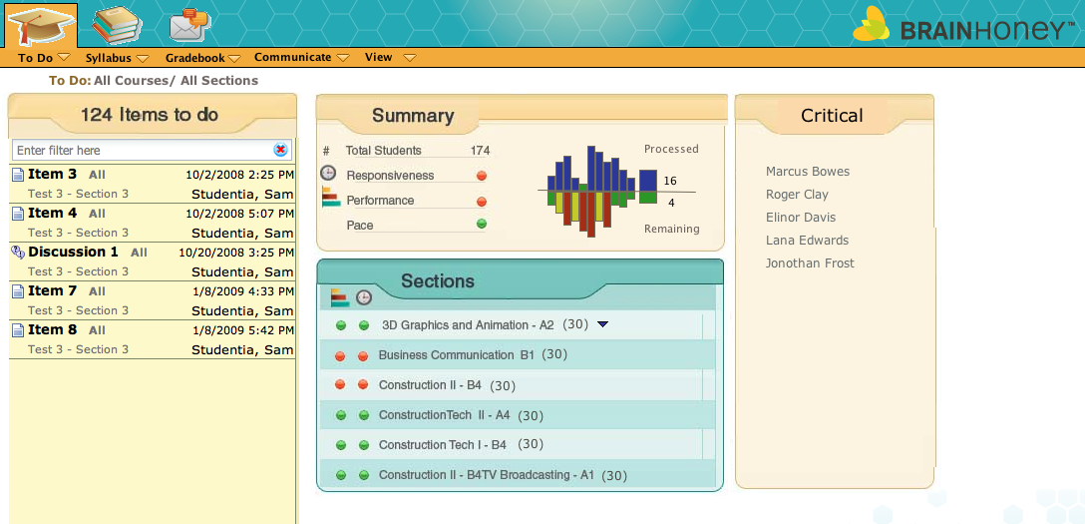
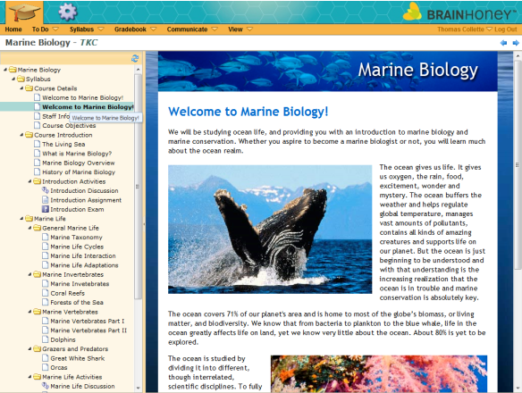
Teacher Tools
For Individualized Learning
Lesson Planning
Standards Alignment
Curriculum Mapping
Gradebook
Content Development Tools
Online Assessments
Individualized Learning Paths
Learning Outcomes Reporting
Teacher Dashboard

