Slide 1
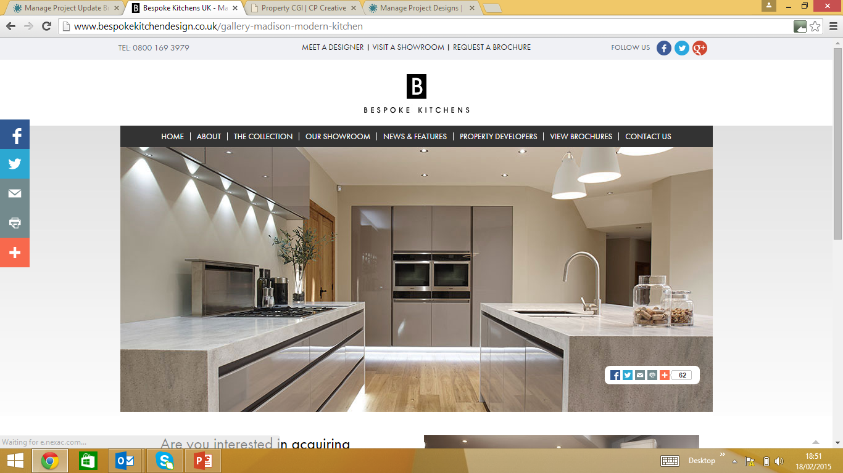

Slide 2

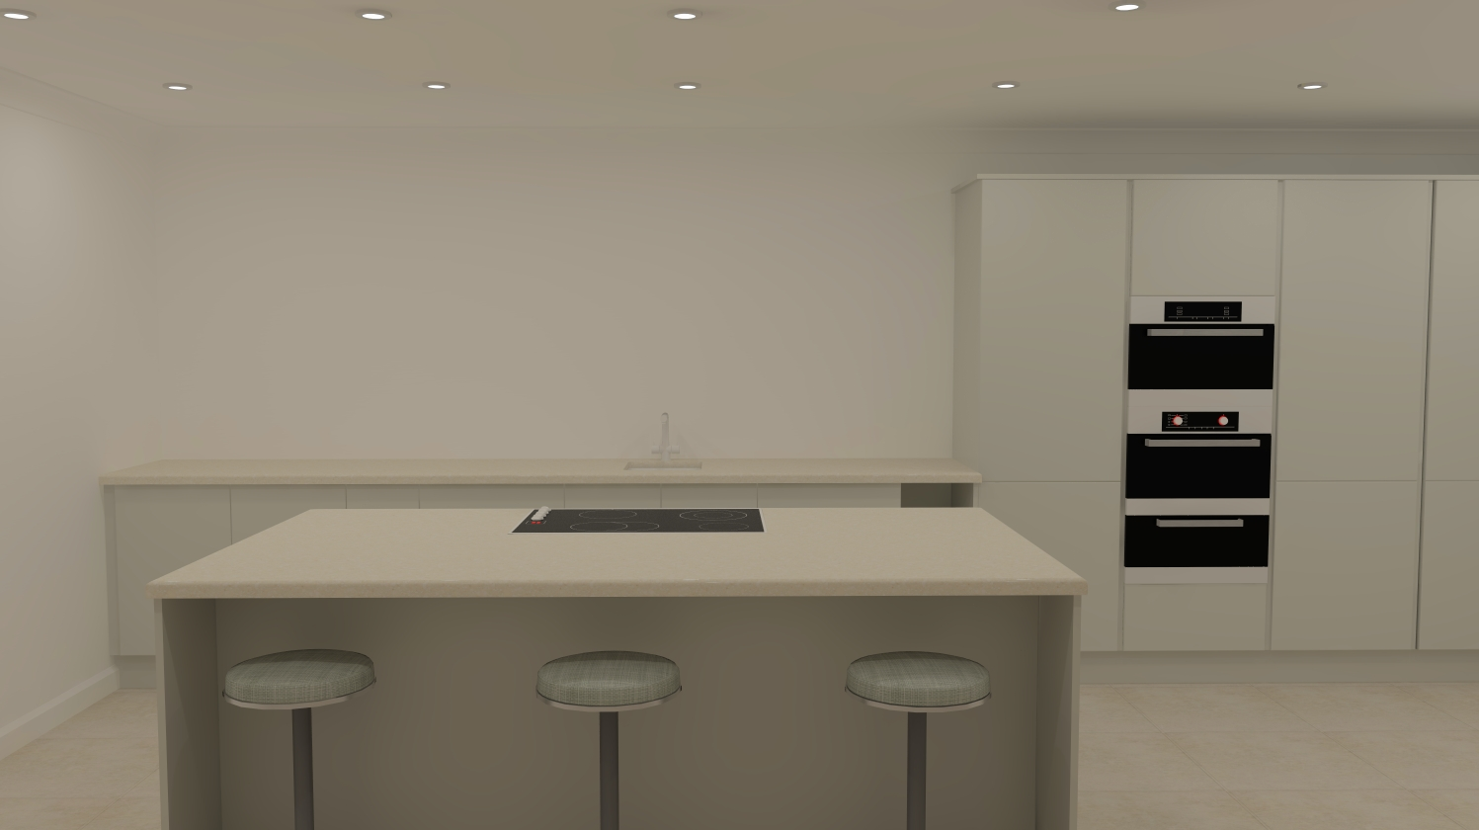
Kitchen Design – Unit 2, View 1
Customer Name:
Leach Homes
Customer Address:
Designer:
Mike Belsey
Version:
1
Furniture Style:
Finish:
Factory Primed
Subject to Bespoke Kitchen Design’s Standard Contract Terms & Conditions
Customer Approval
Signature
Date
Copyright & Design Right by Bespoke Kitchen Design, All rights reserved. No part of this drawing may be used, reproduced, translated, modified, altered or disclosed without the originators written consent

Slide 3
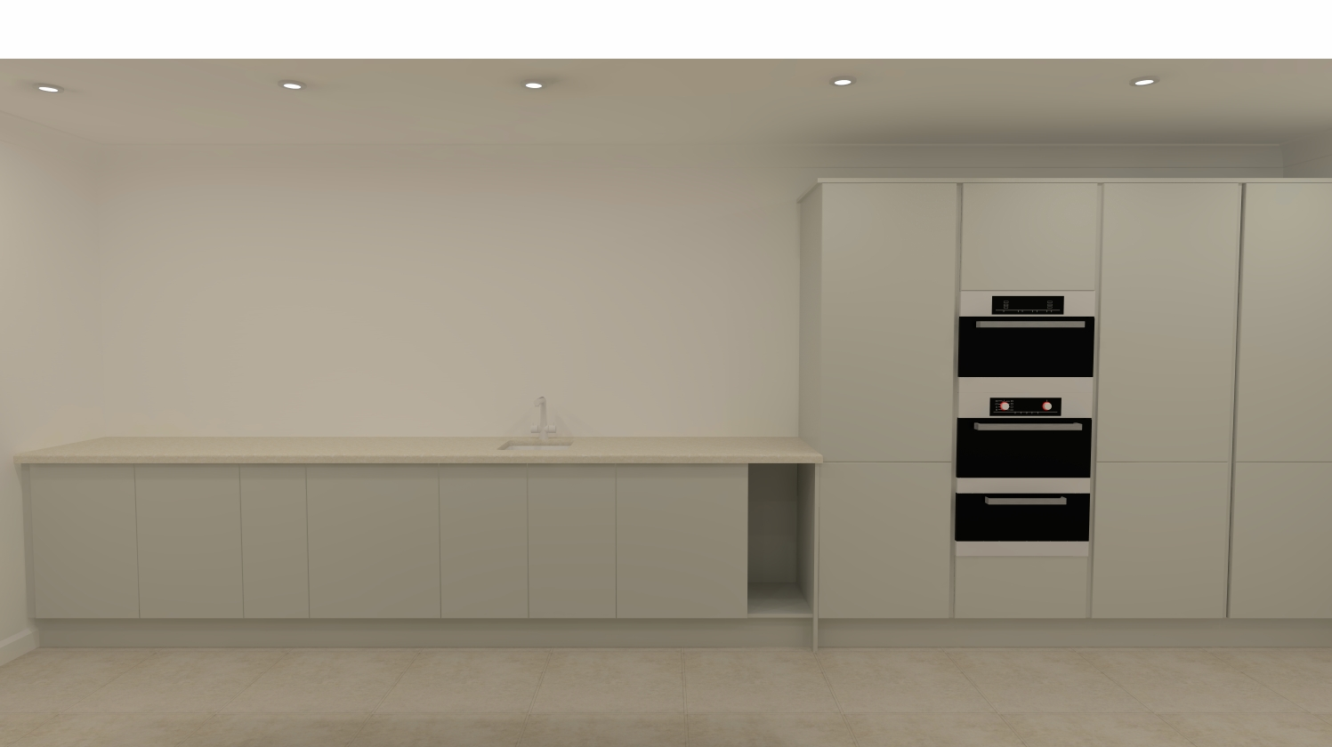
Kitchen Design – Unit 2, View 2
Customer Name:
Leach Homes
Customer Address:
Designer:
Mike Belsey
Version:
1
Furniture Style:
Finish:
Factory Primed
Subject to Bespoke Kitchen Design’s Standard Contract Terms & Conditions
Customer Approval
Signature
Date
Copyright & Design Right by Bespoke Kitchen Design, All rights reserved. No part of this drawing may be used, reproduced, translated, modified, altered or disclosed without the originators written consent

Slide 4
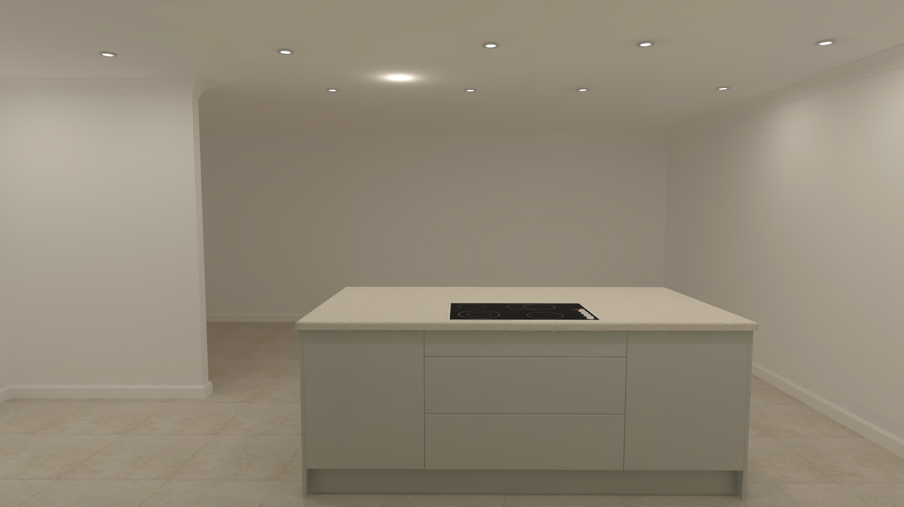
Kitchen Design – Unit 2, View 3
Customer Name:
Leach Homes
Customer Address:
Designer:
Mike Belsey
Version:
1
Furniture Style:
Finish:
Factory Primed
Subject to Bespoke Kitchen Design’s Standard Contract Terms & Conditions
Customer Approval
Signature
Date
Copyright & Design Right by Bespoke Kitchen Design, All rights reserved. No part of this drawing may be used, reproduced, translated, modified, altered or disclosed without the originators written consent

