Slide 1
Icons should be compatible to any background color.
Icons should be a vector where we can resize to any shape without distorting.
Want to see icon without border and a border
Want to see icon within a circle and a square
For some icons I would like to write 1 to 3 words below to describe what is icon

Slide 2
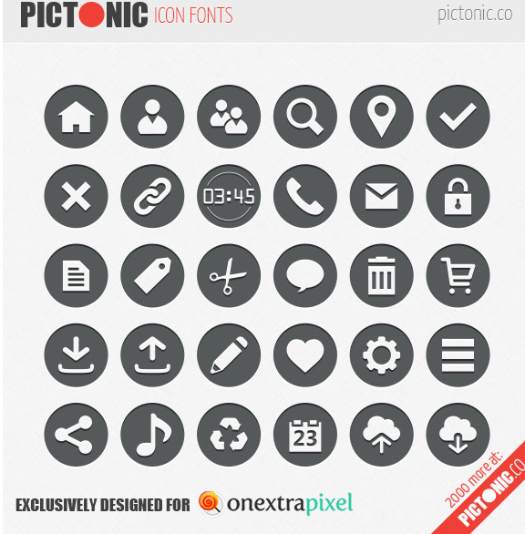




Inspiration for Type of Icons.
Same color combination.

Slide 3
Icons needed to visually represent the below topics.
Brainstorming
Ideating
Collective Human Intelligence
Crowd source
Submitting Ideas
Evaluating Other Customer Ideas
Predictive Idea/Insight
Hidden idea Within Customer Mind
Ideation Forum
Ideation Community
Am Amplified Idea
Signals from a customers mind
Trends
Purchase Barriers
Though of an Idea coming up
Contact US
Request Information
Case Studies
Articles
White Papers
Library Section
Blog
Request Information
How it Works
Team Members
Our Work
Solution
Blueprint
Employees
Customers
Word of Mouth
About US
Want Numbers – 1,2,3,4,5,6,7,8,9,10

