Slide 1

Introduction to PROCON8’s
Deliverable Based Reporting (DBR)
Alastair Davidson
Geoff Fitzhenry
17th Feb 2015
www.procon8.com

Slide 2
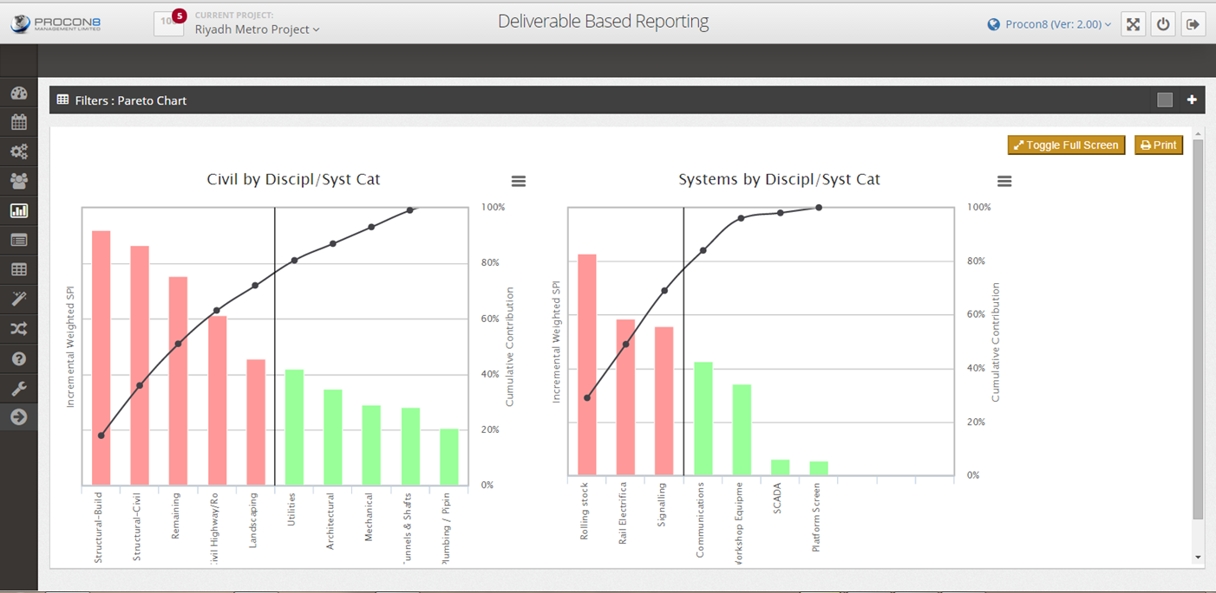
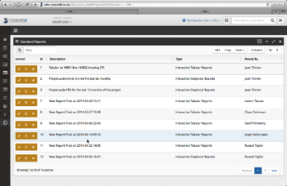
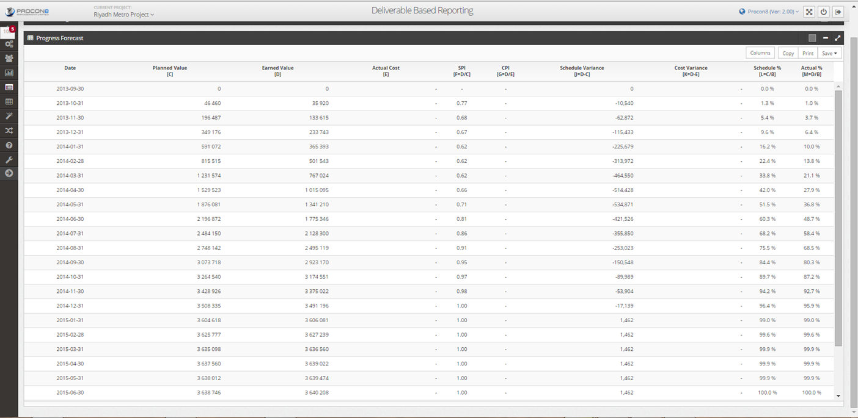
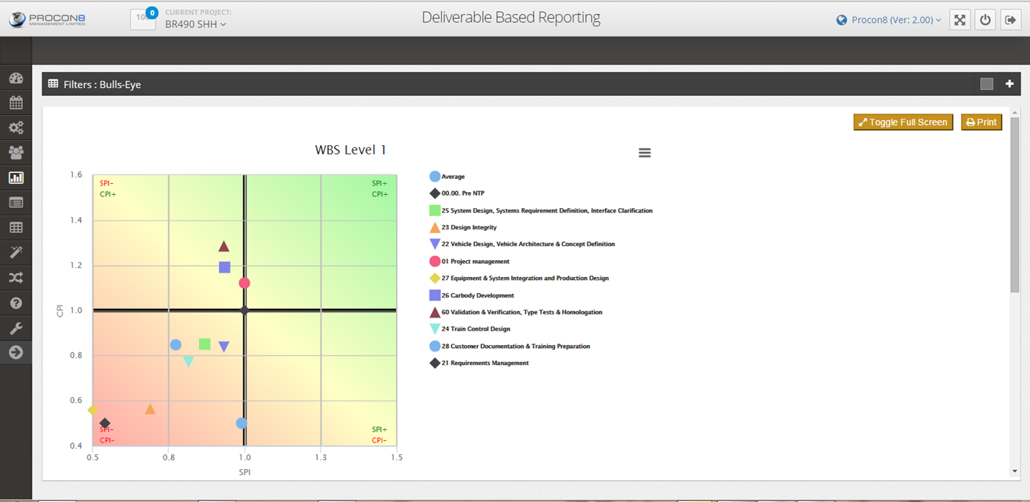
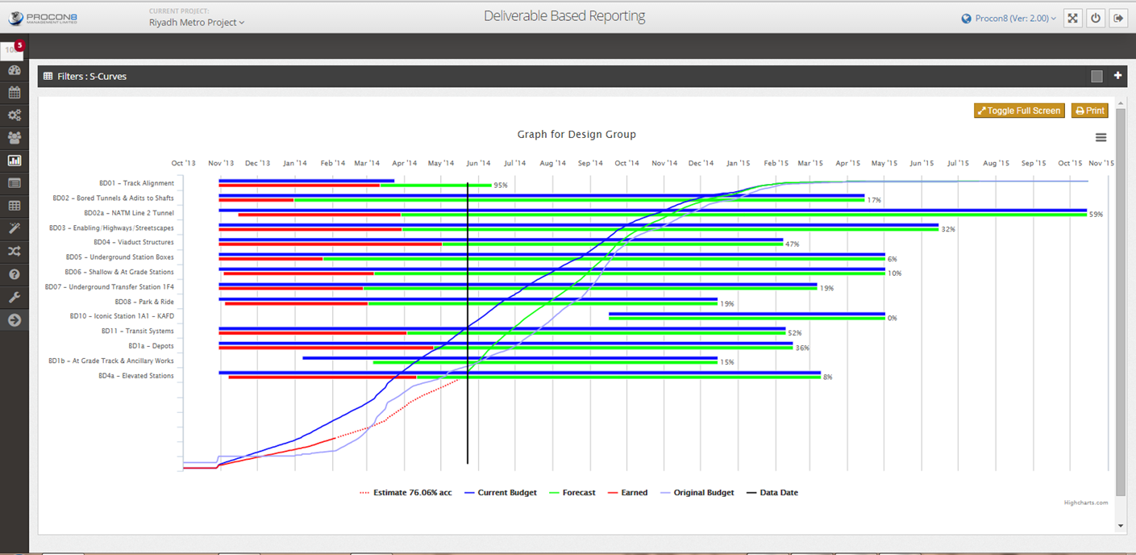
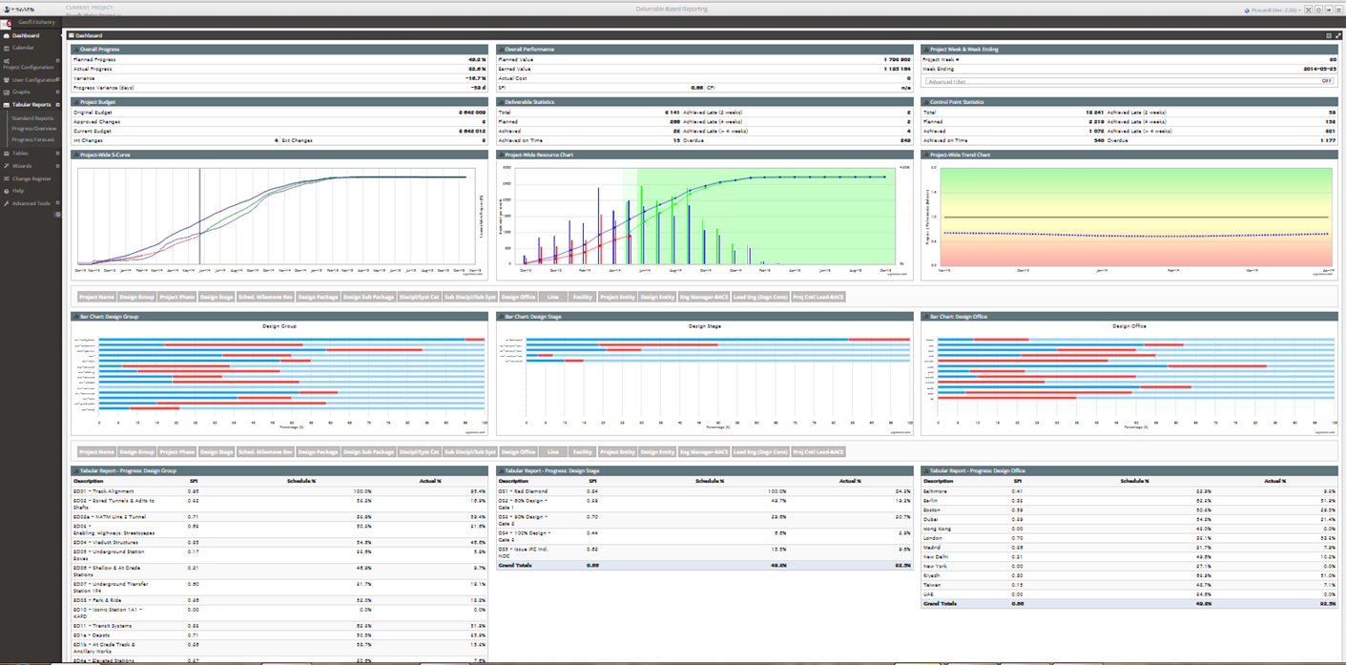
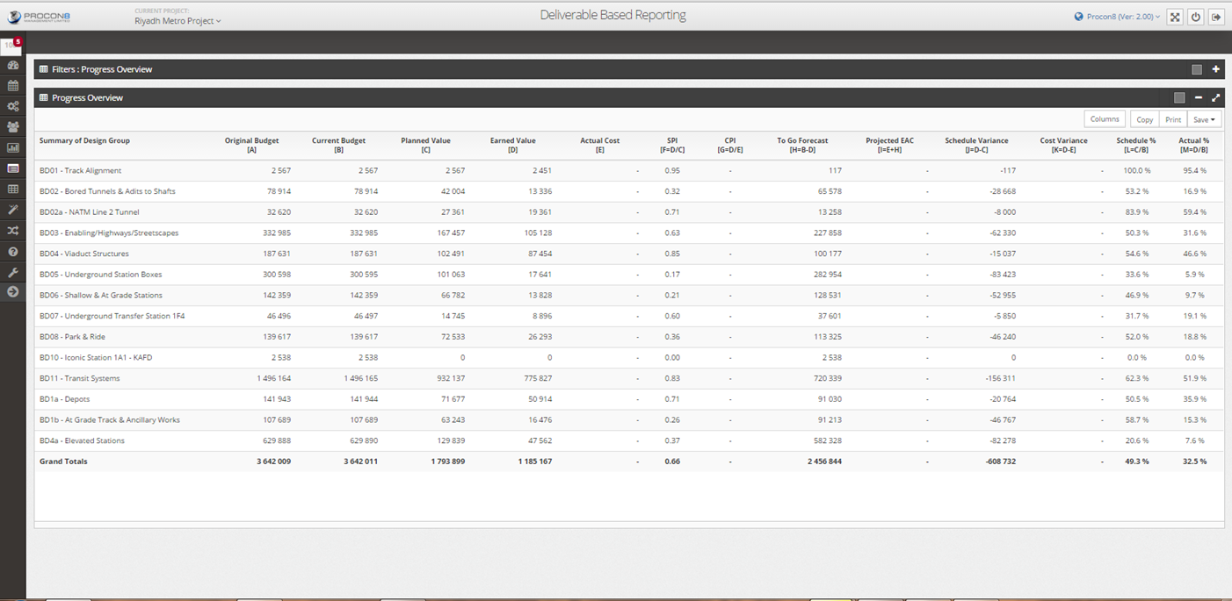
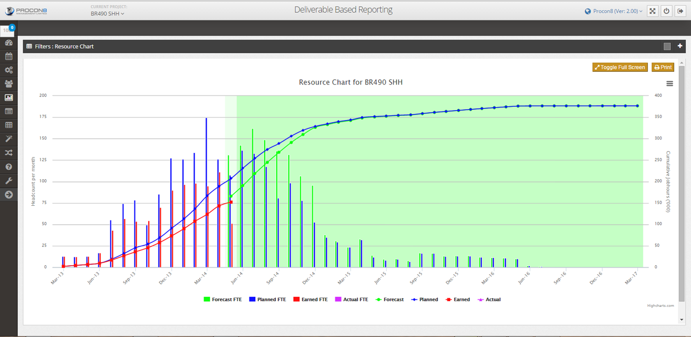
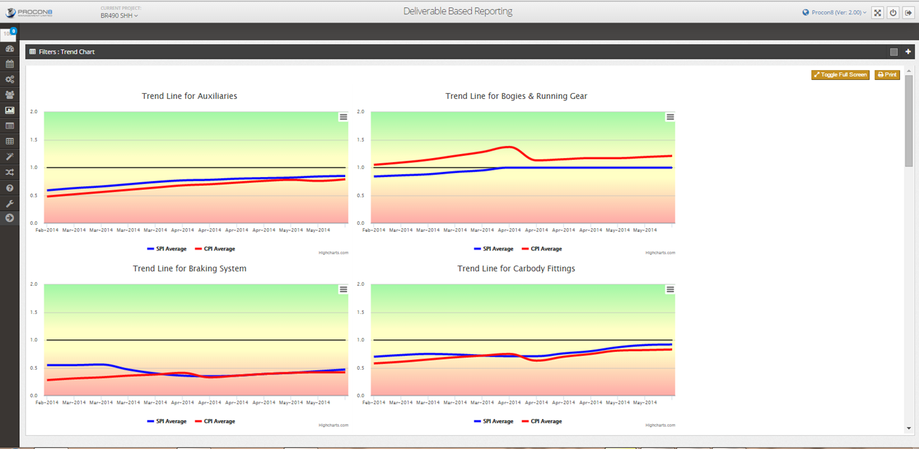

Project Management with the Lights On

Slide 3
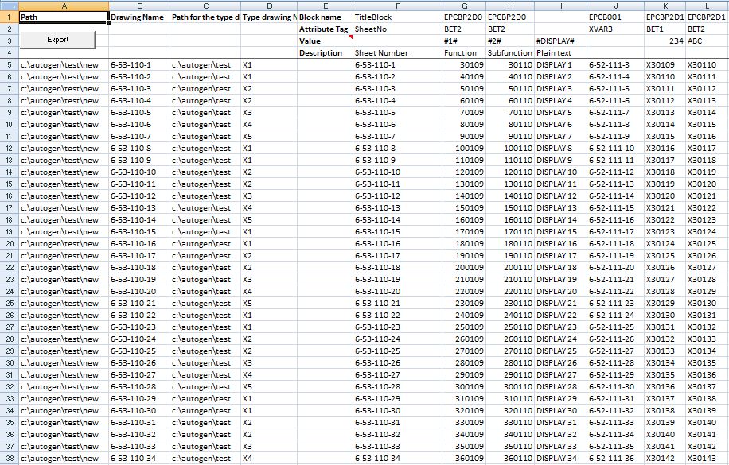
Deliverable Based Approach
  There are usually significant deliverables that need to be produced
  Deliverables may be contractual (customer) or internal requirements
  These may consist of purchase orders, sub contract formation logs, drawings, specifications, reports, procedures, test results etc.
  Volume and complexity make it difficult to determine meaningful interdependencies
  CPM is not the most effective methodology for managing the progress and performance of these deliverables
  Deliverables are tracked at a lower level than the CPM schedules in numerous spreadsheets
  Spreadsheets tend to:
      have limited version control
      are susceptible to constant change
      do not promote a disciplined approach to progress and performance monitoring

Slide 4

DBR Methodology
  Based on the principles of Earned Value Methodology (EVM)
  Progress/performance of deliverables in all project phases
  Schedule Progress Index (SPI) and Cost Performance Index (CPI)
  Structured database that promotes discipline, structure and rigor
  Effective performance measurement and feedback tools for projects
  Clear and objective
  Patterns/trends in the past are accepted as good indicators of the future
  Enables projects to integrate the management of scope, time and cost

Slide 5
The Software Answers the Following Questions:
  Is the project ahead or behind schedule?
  How efficiently is the project using time?
  When is the project likely to be completed?
  Is the project currently over or under budget?
  How efficiently are resources being used?
  What is the likely cost of the remaining work?
  By how much will the project be over or under budget at the end?
  Where are problems occurring (pinpointing)?

Slide 6
DBR Benefits
  Applicable across all industries, sectors and projects
  Significantly reduces the amount of subjectivity
  Promotes structure and discipline
  Information is web based (allows users to log in remotely)
  Easy to read reports (standardised formats - universal indicators)
  Administration requires a lower skill level compared to a Project Planner
  Facilitates effective resource planning
  Trends are visible within a couple of reporting periods
  Allows project managers to “target” specific problem areas
  Easy to install, configure and customize

Slide 7
DBR Features.
  “Interactive” Dashboard
  Calendar (Meetings, Events, Risks, Actions)
  User access restrictions
  Comprehensive and “Intelligent” Help Menu
  Change Control functionality
  Integrated Actions and Risk Register
  Theme Selection (client customization)
  Budget Reconciliation
  Bug logging / feature requests
  Powerful tabular and graphic reporting (pivot effect)
  Data integrity checking through Tables
  Wizards for up/downloading unlimited records
  Status is based on forecasting dates NOT guessing percent complete

