Slide 1

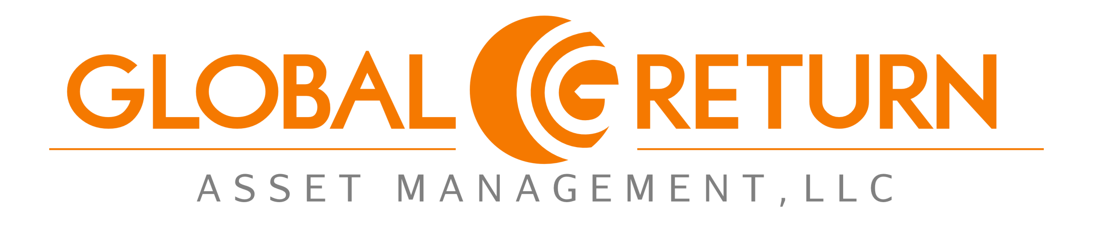

Slide 2


Logos
Main Logo
Floater-Logo

Slide 3
disclaimer
This presentation and its contents are a confidential communication. The information contained herein is proprietary and belongs solely to GLOBAL RETURN Asset Management, LLC. GLOBAL RETURN Asset Management, LLC (hereinafter referred to as the “Management Company”) is a limited liability company incorporated in the state of New York and governed by the laws of New York. No reproduction or distribution of this information, in whole or in part, is permissible without prior written consent of the Management Company.
This presentation has been prepared solely for informational purposes and does not offer investment advice. This presentation does not recommend the purchase or sale of a limited partnership interest, shares, securities or units. If any offer to purchase a limited partnership interest, shares, securities or units into the Management Company is made, it shall be pursuant to a definitive Private Placement Memorandum prepared by, or on behalf of, the Management Company and shall supersede the information contained herein in its entirety. Any decision to invest should be made only after said investor has consulted with appropriate licensed investment, tax, accounting and legal advisors and the advisors collectively deem an investment is suitable for said investor.
It is possible that an investment lose money. Investing is speculative in nature and performance results can be volatile. Past performance is not indicative of future performance. Many factors affect investment results; including but not limited to, changes in the market, economy, political environment or financial developments.
Under no circumstance does the content of this presentation represent a recommendation to buy or sell a limited partnership interest, shares, securities or units.

Slide 4
Table of contents
Investment Highlights
Investment Strategy Overview
Investment Strategy Process
Investment Strategy Analysis
Service Providers

Slide 5
Executive Summary
Strategy | Long-only value investing with multiple hedging strategies.
Objective | To compound our principle using superior risk management while providing liquidity and full transparency to our clients.
Investment Approach | Research driven fundamental analysis at the quantitative and qualitative levels.
Alignment of Interest | Company owned with over 90% of Founder’s net worth invested in the same strategy.

Slide 6
Performance track record

Slide 7
Peer ranking
NOTE: You can include this on the previous slide if there’s room or if it looks okay. Other

Slide 8
Our philosophy
We are long-term investors who buy deeply valued securities in companies we want to own. We are contrarian in nature and seek opportunities with strong cash flow, inexpensive assets and multiple competitive advantages.
We are thematic at the macro-level and use a bottom-up, research-intensive evaluation process at the sector and security level. This process includes analyzing securities at the quantitative and qualitative levels.
Risk is a significant focus that often keeps us inactive and sitting with cash. The securities we purchase are the ones remaining after risk-analysis.
Our size per position varies for many reasons and is used as a form of risk management.

Slide 9
strategy: investment universe
To purchase domestic and foreign securities that offer superior risk-adjusted returns. We are thematic at the macro-level and use a bottom-up, research-intensive evaluation process at the sector and security level.
Of significant importance to us is evaluating opportunities at both the quantitative and qualitative levels. Once a security has been selected for investment, a risk-budget is assigned to it based on possible outcomes and the potential risk/reward ratio.
Long-biased small, mid and large cap domestic and foreign securities.
Hold 20-35 positions from several months to many years.
All dividends are used to purchase additional securities.

Slide 10
Strategy: Portfolio Profile
Asset
Universe
Three Strategies – One Portfolio
  Core Value
  Value + Catalyst
  Alternative Value
Global Markets
Small, Mid and Large cap
Stocks, Options, Warrants

Slide 11
Portfolio Profile: 3 Strategies – 1 portfolio
Core Value (65-70% of portfolio)
  Securities that will generate long-term appreciation and compound growth; focused on secular growth.
  Growth in free cash flow, assets and book value, intrinsic value
Value + Catalyst (25-30% of portfolio)
  Underappreciated securities with short-term challenges or that possess growth drivers for near-term price appreciation
Alternative Value (5-10% of portfolio)
  Rarely available opportunities that offer significant risk-adjusted returns; includes, warrants, options, preferred stock. Will keep cash available.

Slide 12
Strategy: Target Allocation
- Underappreciated Growth opportunities
Warrants
Options

Slide 13
Strategy: investment Research
Macro
Fundamentals
Develop
Themes
Research
Data
Identify
Sectors
Screen for
Stocks
Develop Sector Portfolios
Establish Investing Plan
Execute and
Repeat

Slide 14
strategy: Security Analysis
Analysis includes:
  75 quantitative ratios
  50 qualitative indicators
  Dividend Discount Model
  Graham Number
  Financial Statements
  Discounted Cash Flow
  Sum of the parts evaluation
  Common size peer comparison
  Meet with Company Management

Slide 15
Buy & sell criteria

Slide 16
Risk management

Slide 17
Investment process = risk management
Investment Process | Risk Management

Slide 18
WHY INVEST NOW?

Slide 19
Why global return
Our historical returns are the best in the industry. These returns are even more impressive when considering how much Cash we maintain.
Risk is our most important consideration when investing. Our goal is to never have an annual decline greater than 12% or more than our benchmark.
Our Founder keeps over 95% of his liquid net worth in this strategy.
Our strategy enables us to compound wealth over the long-term and meanwhile generate gains in shorter-term horizons.
We can access global markets which significantly broadens our opportunity set.

Slide 20
Service providers
Prime Broker, commitments from:
  Lazard Capital
  ConvergEx (a subsidiary of BNY Mellon)
  Concept Capital
Fund Administration
  Opus Fund Services
  SS&C Technologies
Legal Advisor
  KleinbergKaplan
Independent Auditor
  Anchin, Block & Anchin

Slide 21
Biography
Elliot Trexler is the Founder and Chief Investment Officer of GLOBAL RETURN Asset Management where he focuses on investment analysis and portfolio management. Prior to founding Global Return, Elliot was a successful equities trader for three years at T3 Capital Management where he focused on catalyst-driven investment opportunities.

Slide 22
Not for distribution
Elliot Trexler
etrexler@globalreturnam.com
D (917) 633-4195
M (317) 519-6625
www.globalreturnam.com

