Slide 1


Slide 2
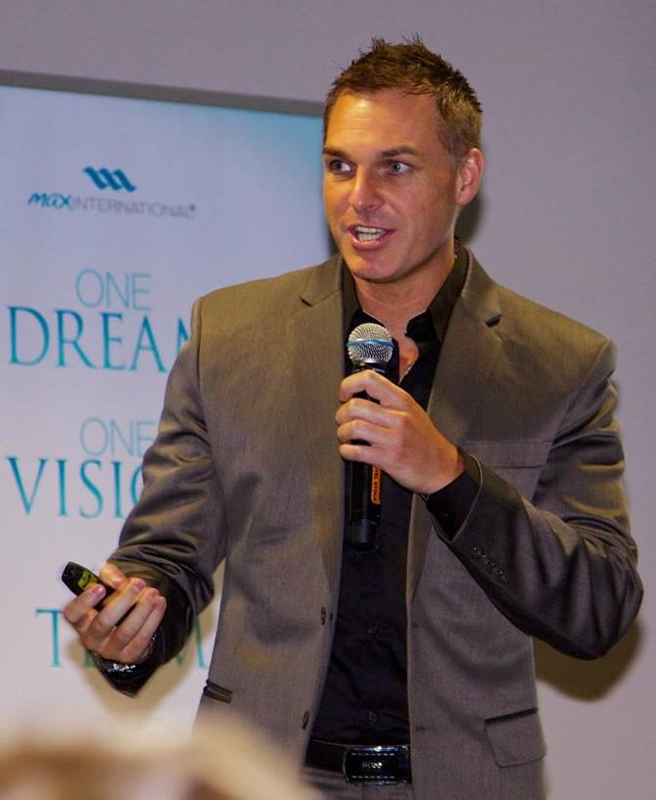
Business Evaluation
Make more money
Have more time
Grow as a person
Help other people
Marcus Schubert

Slide 3
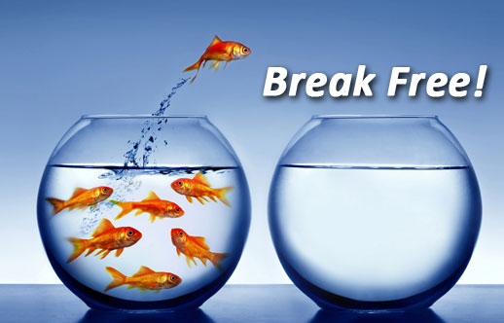
There are two types of people
TIME
&
MONEY

Slide 4
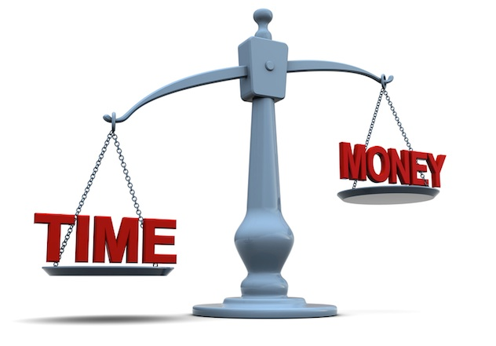
Most people are trading

Slide 5

Because of that, their relationships are suffering

Slide 6

Their health is suffering

Slide 7

Their kids are walking home alone

Slide 8
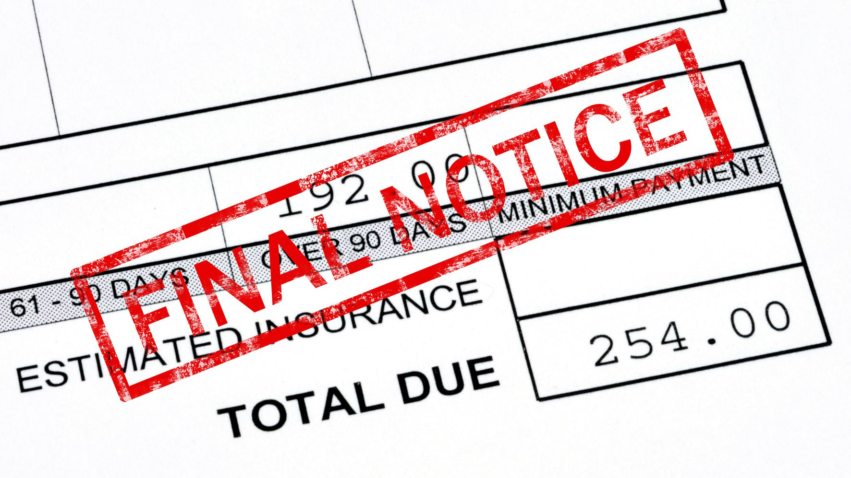
Their bills are piling up

Slide 9
So let me ask you a question
Do the work once
Get paid over & over again
Make money while you’re sleeping
Per sale
Per client
Per hour
Per week
Per year
Paid once
Start again from zero
Notes:
Are you getting paid per hour, day, week, month or year?
Maybe you’re getting paid per sale or service provided?
Basically if you don’t work, you don’t get paid right?
That’s the problem & that’s why it’s almost impossible to have a decent income AND free time…

Slide 10
“85% of all millionaires are self made”
Became a CEO
Built a Real Estate portfolio
Became a Professional Athlete
Become an Actor, Entertainer or Inventor
99% built a business
Not just any business, a BIG BUSINESS
*“The Millionaire Next Door” by Thomas Stanley & William Danko

Slide 11

So what are your options?
Work more hours
Start a business
Get a second job

Slide 12

What type of business?

Slide 13

Conventional Business Model
Conventional Biz Model – you develop everything yourself. 80% of these businesses fail in the first 5yrs*
Franchising – 95% succeed. You develop nothing. You get the systems, product, branding & training
*Bloomberg
80%

Slide 14

But most people cant afford it
And you still have no time…

Slide 15

What if there was…
Notes:
What if there was a BETTER WAY
What if you could start a business with no loans, no risk and, and the more successful you became, the more TIME you had to enjoy it.
A business that included professional systems, training, branding, insurance, international offices, staff, a legal team, product registrations, patents, clinical studies, product distributions.
And the best part is, what if you could start this business without interfering with what you are currently doing and made a difference to thousands or peoples lives?

Slide 16

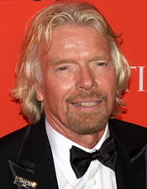
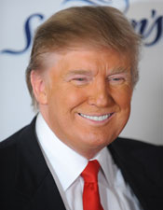
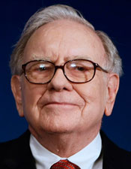
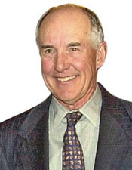
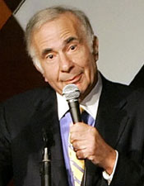
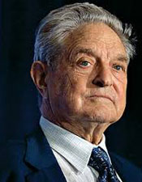
What do these 4 men have in common?
#1. The’re all BILLIONAIRES
#2. There all invested Network Marketing companies
Richard Branson
Donald Trump
Warren Buffet
William Stiritz
Carl Ichan
George Soros

Slide 17
Network Marketing

Slide 18

Don’t get stuck in the past..

Slide 19


Don’t get stuck in the past…
Why drive?
When you can fly…

Slide 20


Why carry your bags…
When you can wheel it…

Slide 21
#1 Network Marketing opportunity in the world today….

Slide 22


Slide 23
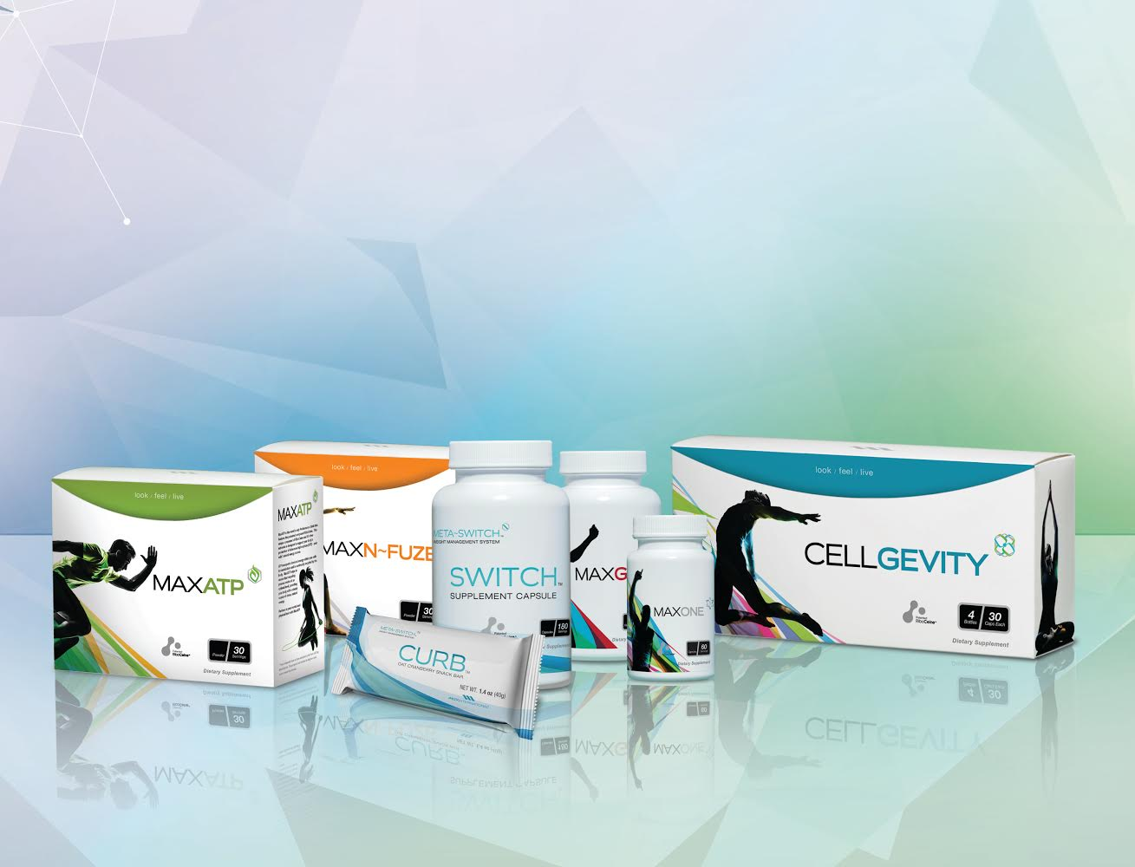
Max International
We offer breakthrough products, that are safe, natural and backed by science.
We are capitalising on 4 of the largest growth trends in the world today

Slide 24

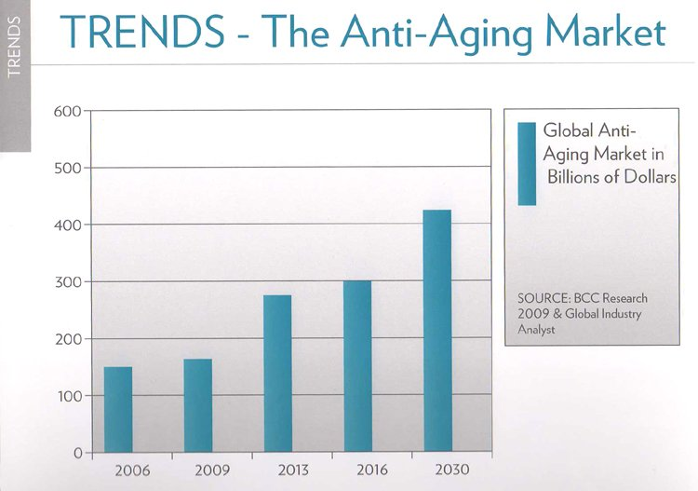
#1. Health & Anti-aging Trend
Fuelled by over a BILLION baby boomers, born 1946-1964
Every 8 seconds someone turns 50 and guess what they are spending their money on?

Slide 25
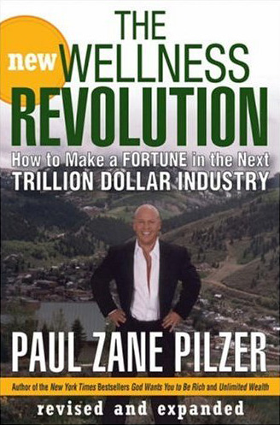
Anti-aging!
$300 Billion in sales in the next 3yrs
Everybody wants to look better, everyone wants to feel better and everybody wants to be healthy.

Slide 26
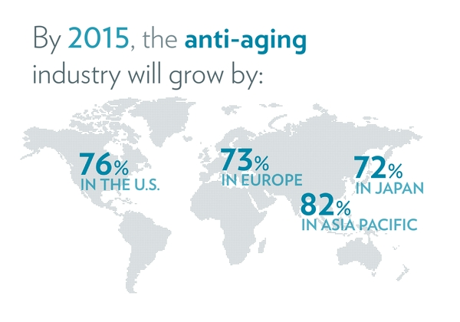
*BCC Research Group & Global Industry Analyst

Slide 27
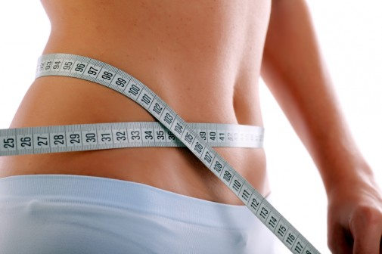
#2. Weight loss trend
The World Health Organization estimates over a BILLION adults globally are overweight
In 1992 the FDA estimated Americans spent $30 BILLION on weight loss
Today Marketdata Enterprises says $60 BILLION in North America

Slide 28
Aussie Stats?? Real time statistics

Slide 29

#3. The home business trend
Since you started watching this presentation 200-300 people just like you, have started a home-based business.
That’s 300,000 people a week
Most people want more time, most people want more money and guess what the best part is?

Slide 30
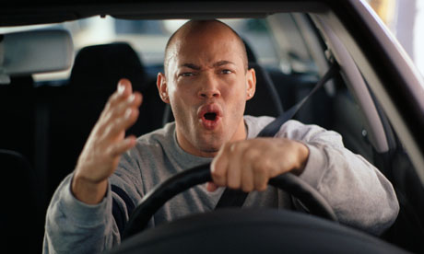
No Traffic!

Slide 31
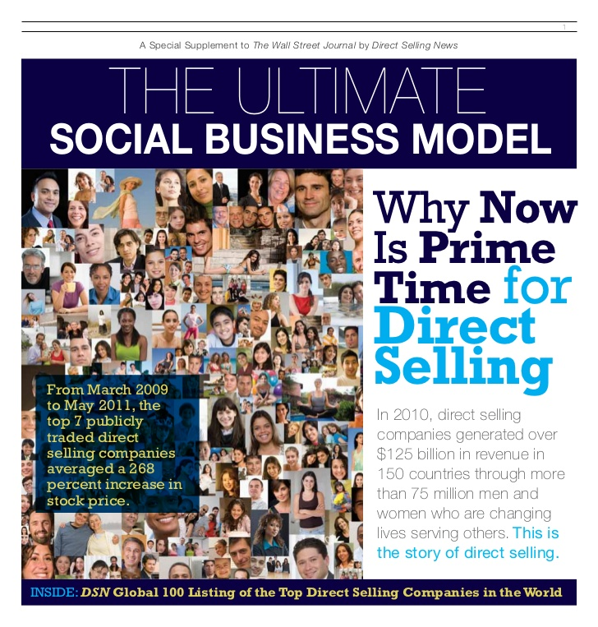
Wall Street Journal

Slide 32
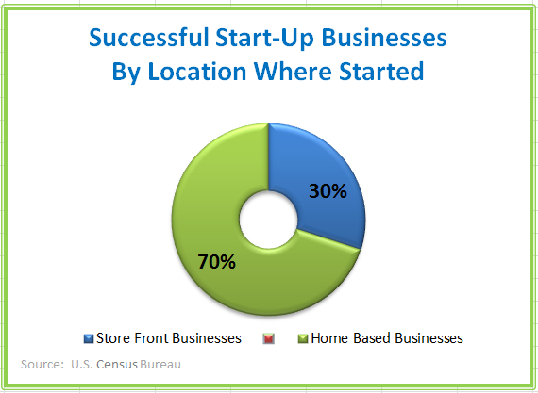
More than double your success rate!

Slide 33





#4. Internet & relationship trend
78% of people surveyed said they trusted a peer recommendation vs 14% trust an advertisement

Slide 34
What if…..

Slide 36

8 products into ONE SINGLE product
Inflammation
Energy
Recovery
Immune
ONE PRODUCT
Anti-Oxidant
Sleep
Mood
Detox

Slide 37

We have it and it’s exclusive to Max
Developed by a world renowned scientist
It has 20 peer reviewed studies
38 patents & patents pending
It empowers every cell in the body to create the most powerful antioxidant known to man….. Glutathione

Slide 38
Google it…
WOW

Slide 39
What if you also had…

Slide 40
An anti-aging breakthrough
That was clinically proven & showed results in just 60 seconds…

Slide 41
A weight loss product
Scientifically proven to safely & powerfully activated your metabolism
Without raising your heart rate or blood pressure
Required no change to diet or exercise
Without starving yourself, or replacing meals with a shake!

Slide 42
Well.. we have those too!

Slide 43
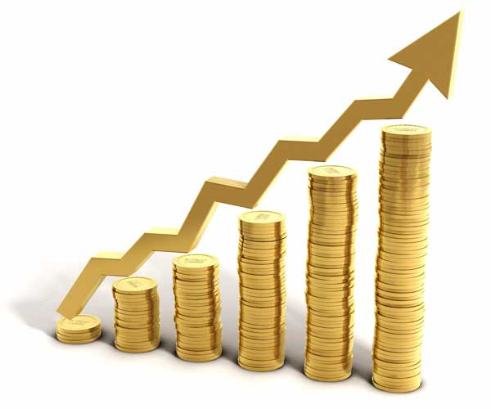
Lucrative Compensation
Earn a 25% commission your customer orders generated from all over the world
Earn up to $480,000 / yr by building 2 teams
Earn up to 50% matching bonuses, on each person you personally introduce
That’s up to $240,000 / yr per person that you introduce to Max & there’s no limit

Slide 44


PRIME 5
BUSINESS BUILDING STRATEGY

Slide 45

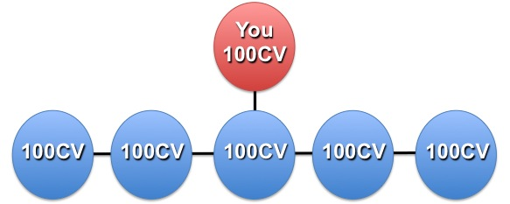
Step #1. | Enrol with Max for $70 (US$49)
Step #2. | Set up a 2 product auto-ship $200 (US$138)
Step #3. | Find 5 people to do the same thing

Slide 46
The Power Of Duplicating Prime 5
5 People (500cv)
5
25
125
625
3125
15,625
Total 19,530
Each person does a little bit of work, but the results compound over time

Slide 47
Building Strategy & Income Rewards
Month | New People | USD* | AUD* | Max Rank
Month 1 | 5 | $200 | $240 | $240 residual*
Month 2 | 25 | $700 | $840 | Associate
Month 3 | 125 | $3,143 | $3,771 | Silver
Month 4 | 625 | $9,666 | $11,600 | Platinum
Month 5 | 3215 | $39,219 | $47,063 | Double Diamond
Total | 19,520 | $52,928 | $63,513
*We have assumed in these projections that each person would have also found 5 customers
*Figures are an example only of what could be achieved. Income shown is calculated on AutoShip Prime Bonus, Binary Team Bonus & 1st Level MCB’s, Max Living Bonus, Global Bonus Pool @ $50 / share & 5 PC’s on 1 Box Loyalty

Slide 48
It’s powerful but super simple
Step 1. Decide who you want to help
Step 2. Send them a video like this
Step 3. Connect them to your business partner

Slide 49
It’s time to fly...
4 major growth trends
- Health & anti-aging
- Weight loss
- Home business
- Internet & relationships
Help yourself while helping others
It’s simple, you can do it & we’re here to help you

Slide 50
So by now your probably thinking…
What do I do next?
How do I get started?
Great questions.
The person who invited you to see this presentation can help you with everything you need.

