Slide 1

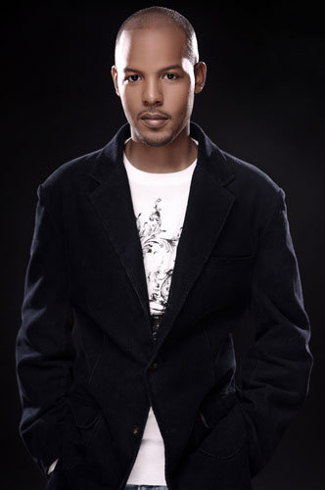
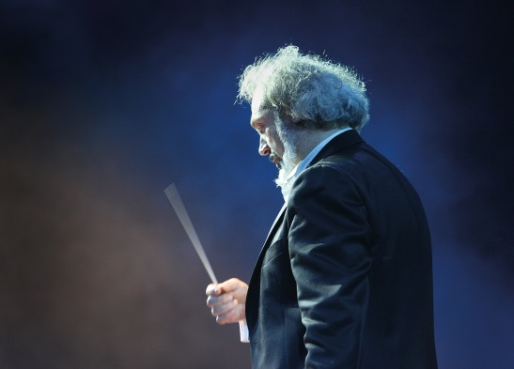
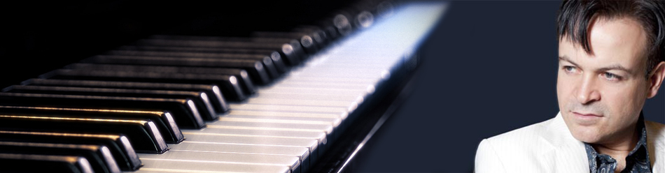



2015 International Fall Gospel Music Tour
“Open Heaven”
Diego Basso
Special Guest Conductor
Venice, Italy
Antonio Ciacca,
Pianist & Composer
Professor, The Juilliard School NYC
Nate Brown
Award Winning Choral Director

Slide 2


“Open Heaven”
2015 Fall International Gospel Music Tour
“Book Today”
•
TOUR INCLUDES:
Orchestra Collaboration
Sheet Music Provided
• Rhythms Section Provided
• 6-9 Vocalist Provided or Choral Collaboration
• Choral Director, Nate Brown
• Guest Orchestra Director From Venice, Italy “Diego Basso”, (1-3 Songs)
Pianist & Julliard Professor, Antonio Ciacca (1 -2 songs)
1- 2 hours of music available
www.gentlegiantmusicministries.com

