Slide 1
RAW Beverage Co.
Cane Water Design Brief

Slide 2
Status
Formed October 2014
Single skew – cane water + kumquat
National Food Laboratory testing in progress for shelf life, pathogens and FDA approval
Distribution and production slated for early Q2 2015

Slide 3
The Brand
We are called RAW for two reasons…
We are all about pure, raw, natural goodness. The reason raw cane water is so healthy is because of all of the life-giving nutrients contained in it. It's an ideal thirst quencher and cooling drink, It keeps the body hydrated.
Secondly we have a RAW attitude. We want to lead an exciting health revolution that transforms what people eat and drink so this new thinking takes the world by storm.

Slide 4
The Challenge
Cane water is raw sugar cane juice. Perception is that all sugar is the same – bad for you and behind obesity.
The product separates and looks unappealing (green) in the bottle.
Served over ice it is refreshing and delicious. Chilled it is good, but sweet, un-chilled it’s sickly sweet.

Slide 5
#1 Sugar Cane Juice
FACT: Raw sugarcane juice is just as healthful as any other freshly pressed juice, and is in fact something of a Super Hero among plant foods.

Slide 6
#1 Sugar Cane Juice
FACT: As a member of the grass family, it has a high potency equivalent to wheatgrass juice. Sugarcane juice contains only about fifteen percent total sugar content, all of which is in a raw unrefined form. The rest of the juice consists of water brimming calcium, chromium, cobalt, copper, magnesium, manganese, phosphorous, potassium and zinc. It also contains iron and vitamins A, C, B1, B2, B3, B5, and B6, plus a high concentration of phytonutrients, antioxidants, proteins, soluble fiber and other health supportive compounds.

Slide 7
#1 Sugar Cane Juice
FACT: Working synergistically, these nutrients provide a supremely health-promoting food which has been studied for its role in fighting cancer, stabilizing blood sugar levels in diabetics, assisting in weight loss, reducing fevers, clearing the kidneys, preventing tooth decay, and a host of other health benefits.

Slide 8
#1 Sugar Cane Juice
For full list of benefits see http://www.processedfreeamerica.org/resources/health-news/535-raw-sugarcane-juicenatures-perfect-wonder-food
Nutritional label can be found at http://www.sugarcaneisland.com/.

Slide 9
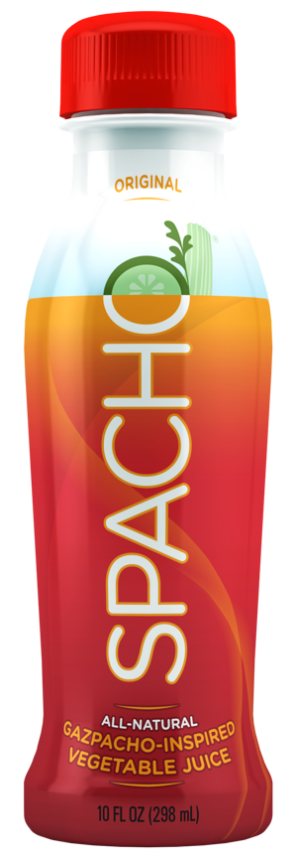
#2 Product Separation
The label needs to be a full wrap.
Once shaken and poured it looks fine – almost clear water like.

Slide 10
#3 Taste
Ice lessens the sweetness and heightens the refreshment.
Repurchase will be maximized by consumers drinking over ice.

Slide 11
Mandatory Package Communication
Health Benefits/Refute negative sugar perceptions.
Label full bottle wrap.
Best drunk over ice.

Slide 12
Design Guidance
Logo and Labeling for 16oz square sided white plastic bottle.
Front panel – logo
Back panel – nutritional label
Side panels – health benefits/nutrients AND best drunk chilled/over ice

Slide 13
Design Guidance
We are a modern brand.
Best exemplified by what we are NOT…
  Mom and Pop
  Calm ,passive, neutral, hippy, bandwagon
Adjectives: Lively, punchy, take no prisoners, mass market, cool (pun intended), modern, youthful, fresh, healthy, and raw (ROAR).

Slide 14
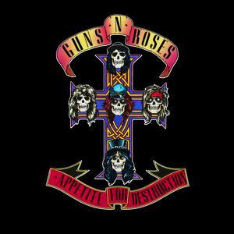

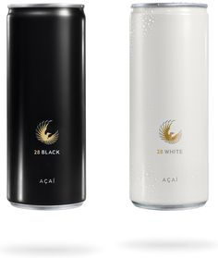
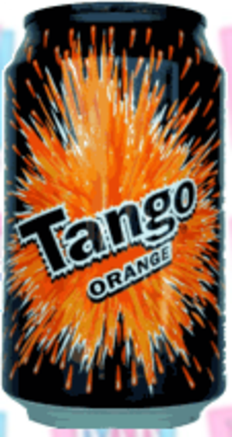


Creative Fodder

