Slide 1
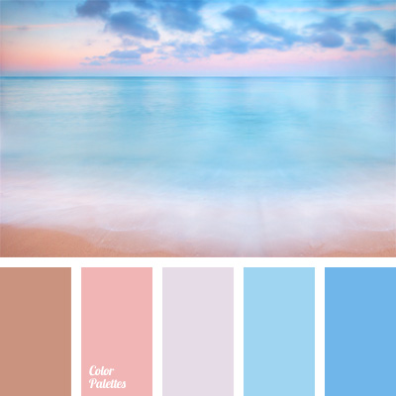
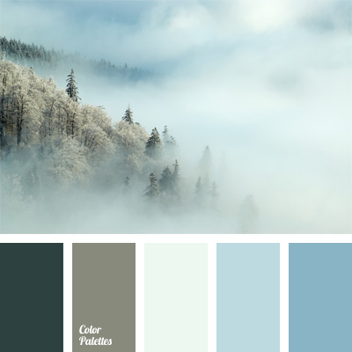
Colour pallet
Option 1
Option 2 (preferred)

Slide 2


Logo sample preferences
I’ve flipped this one upside-down as I like the concept of the
top of the logo being calm, with the movement
underneath – as goes the saying ‘Stillwater runs deep’.
It would say Stillwater on one side with Interiors on the other and SW in the middle.
I don’t like the big black box around the logo, but I like the antique looking
flowing lines, and I seem to be keen on designs that feature initialling motif.

Slide 3



I also liked the look of these as an alternative.

