Slide 1
United States Sports Academy
International Sports Diploma
Mark Chay
Executive Director

Slide 2
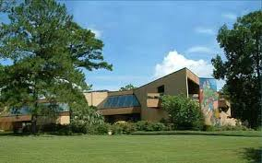
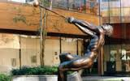
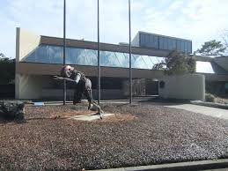

Introduction to USSA
America’s Sports University
  ISD, B.S.S., M.S.S., Ed.D. in Sport Management
Regionally Accredited by the SACSCC
Graduated students from over 112 countries
Distinguished Alumni include Lynn Wheeler, Mike Vollmer

Slide 3
USSA in Singapore
First introduced and conducted by the Singapore Sports Council in 1985
In 2003 ISA became the administrators for the USSA International Sports Diploma
ISA’s flagship programme
Over 523 alumni students in Singapore working in sports-related or management-related jobs

Slide 4
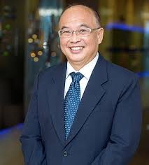
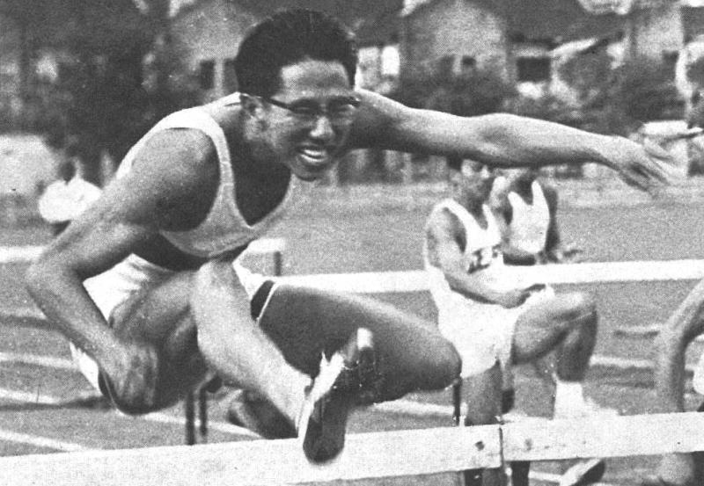
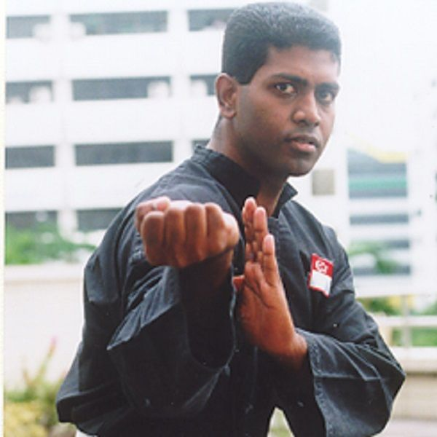
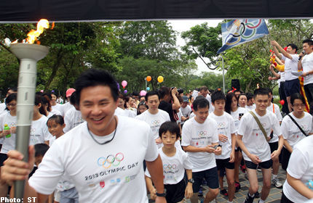
Distinguished Alumni
Ret. Brig. Gen. Prof. Lionel Lee
PPA, MBBS, MSS, MPH, FAMS
Dr. Tan Eng Yoon
Olympian, (Ex) President Olympians Singapore
Sheik Alauddin
World Champion,
Sportsman of the Year
Mark Chay
Olympian
Asst. Gen. Sec. Olympians Singapore
Member, SNOC Athlete’s Commission
Board Member, AOOA
Member, Chinese Heritage Foundation
CdM, 2014 Youth Olympic Games
Director, Inspire Singapore
Executive Director, ISA

Slide 5
USSA Programmes
USSA International Diploma in Sports Management
USSA International Diploma in Sports Coaching
USSA International Diploma in Sports and Exercise Science (Sports Fitness)

Slide 6
ISD Sports Management
1.
Sports Administration
2.
Sports Facilities and Events Management
3.
Sports Marketing
Core
4.
Sports Business and Personnel Management
5.
Sports Public Relations
6.
Sports Fundraising
7.
Structure & Function of Sports
8.
Olympic Sports Culture
9.
Leadership Principles of Sports
Electives
Mentorship

Slide 7
ISD Sports Coaching
1.
Sports Administration
2.
Sports Facilities and Events Management
3.
Sports Coaching Methodology
Core
4.
Sports Psychology
5.
Sports Medicine
6.
Sports Strength & Conditioning
7.
Sports Marketing
8.
Sports Nutrition
9.
Human Anatomy & Physiology
Electives
Mentorship

Slide 8
ISD Sports and Exercise Science (Sports Fitness)
1.
Sports Administration
2.
Sports Coaching Methodology
3.
Sports Psychology
Core
4.
Sports Strength & Conditioning
5.
Personal Training
6.
Sports Nutrition
7.
Sports Marketing
8.
Human Anatomy & Physiology
9.
Sports Performance Enhancement
Electives
Mentorship

Slide 9
Structure: Full-Time
Module length is 4 weeks with minimum of 40 instructional hours per module
Classes are weekdays (Monday – Friday)
  3 ½ hours of classes per day
Examination-based qualification
  50 MCQ, Open book
Mentorship after successful completion of core and elective modules
Attainment of Diploma after successful completion of modules and mentorship

Slide 10
Structure: Part-Time
Module length is 6 weeks with minimum of 40 instructional hours per module
Classes are weekdays (Tuesday and Thursday)
  4 hours of classes per day
Examination-based qualification
  50 MCQ, Open book
Mentorship after successful completion of core and elective modules
Attainment of Diploma after successful completion of modules and mentorship

Slide 11
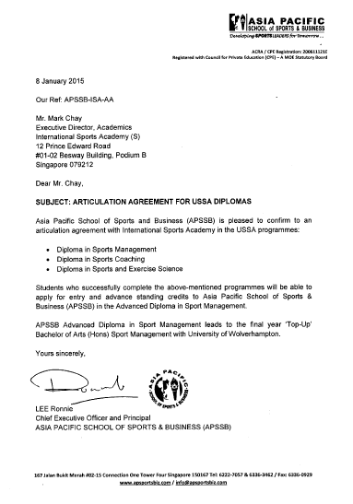
Articulation
Partnership with the Asia Pacific School of Sports and Business
All USSA Diplomas apply and attain advanced standing in the Advanced Diploma in Sports Management course

Slide 12
ISA (USSA) – APSSB Partnership
USSA ISD
12mths
APSSB Advanced Diploma Sports Management
8mths
University of Wolverhampton B.A. (Hons) Sports Management
12mth
Sheffield Hallam University
M.Sc. Sports Business Management
12mth

Slide 13
Non-Refundable Fees
Enrolment Fee | $160.50
Course Fee | $9,416.00
Course Material Fee | $214.00
Examination Fee (internal) | $107.00
Examination Fee (external) | $1,712.00
Total | $11,449.00
*Instalment Payment of 6 instalments every 2 months
*Each instalment is $1,908.00
*Up to 95% WDA Funding

Slide 14
Our Commitment
ISA is committed to ensuring that all its educational products and services meet or exceed our students’ requirements.
Our philosophy is one of continual improvement emphasizing quality at the core in all that we do.

Slide 15
Contact
Mark Chay
Executive Director
International Sports Academy
E : mark_chay@isa.edu.sg
ussa@isa.edu.sg
T : 8222 0615/ 6423 0668
A : 12 Prince Edward Road,
Bestway Building Podium B, #01-02
Singapore 079212

Slide 16
Thank you

