Slide 1
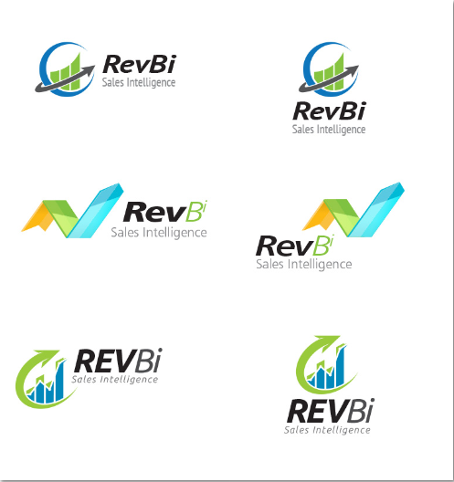
Initial Design Concepts
We like the color pallete and elegance for group 2.
None are simple enough with the right iconography

Slide 2
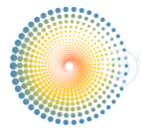

Our 2nd iteration
Icon 1: The wormhole was interesting b/c of the relationships between physics and analytics, plus the correlation with speed.
Icon 2: A more simple image depicting a blackhole emissions. Same justification as icon 1.
Neither are simple or iconic enough

Slide 3
Divergent Concept
This icon represents a dashboard, but also has dots/nodes to represent analytics
Simple but not effective
`

Slide 4
Divergent Concepts
Connected nodes with a 3 dimensional aspect depending on where you focus your eye.
Nodes – Connecting the dots
Resembles a “crows foot” which is used in data modeling
Arrow similarity for upward growth

Slide 5

Last Concept
Using the concepts of both taglines…
Evolution
Growth
People icons representing both analytics, evolution, growth (bar chart)

