Slide 1

Your CRM starts with Email
Insight your email
Automate Data Collection
Get Big on Data

Slide 2

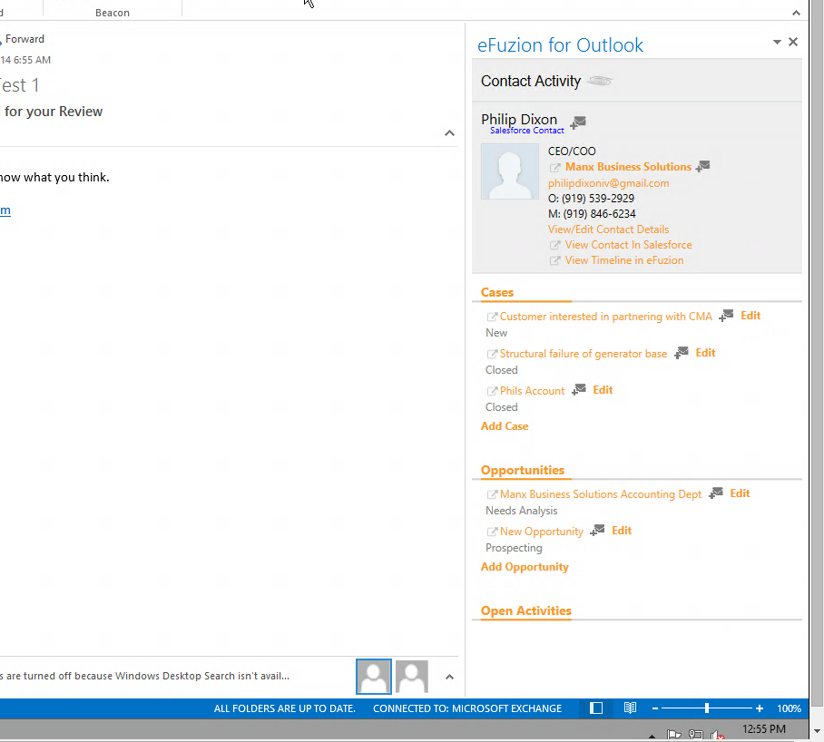

You Live in Outlook, why doesn’t your CRM
Read. Create. Update
Any of your Salesforce Standard Objects
Leads
Accounts
Contacts
Opportunities
Cases
Activities
Read. Create. Update

Slide 3
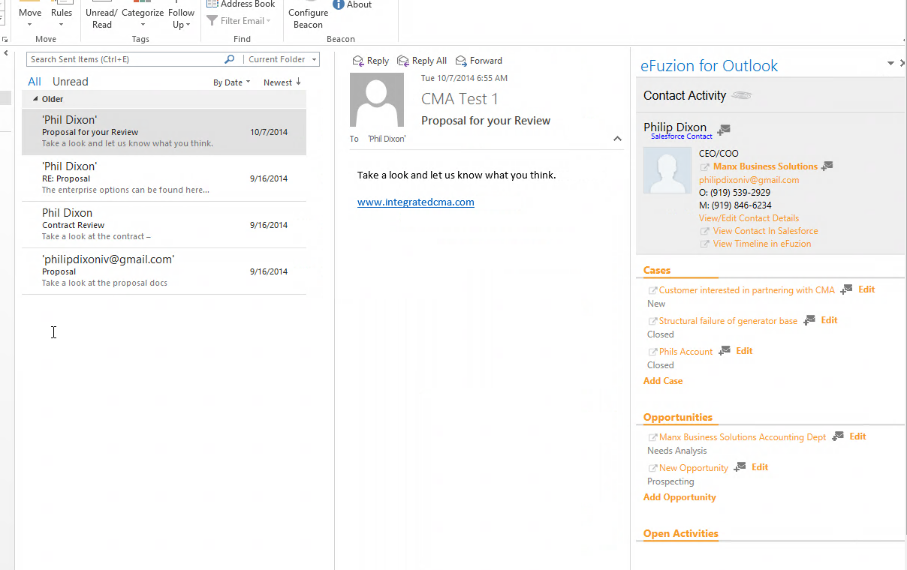
You Live in Outlook, So should your CRM
eFuzion finds the contacts on your email conversation and associates it with CRM contacts

Slide 4
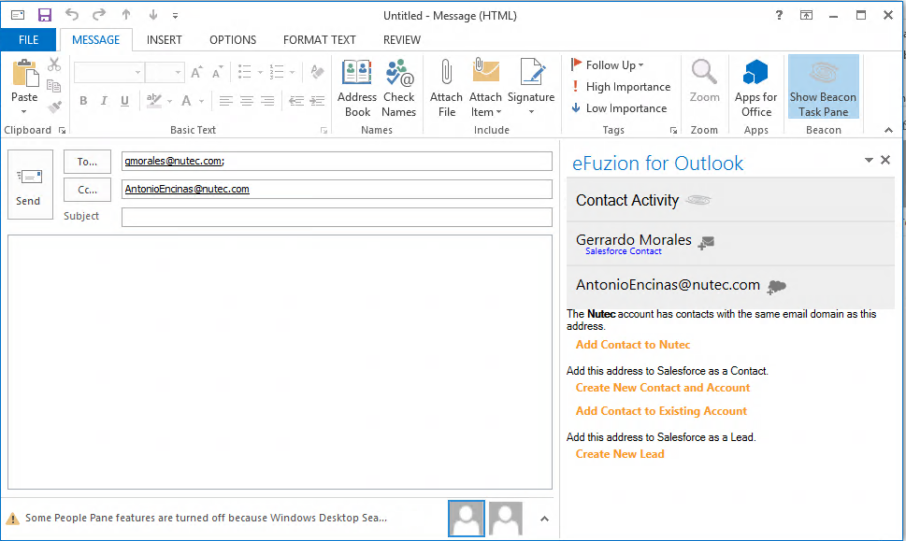
Collect Contacts Easily
Gerrardo is a contact in Salesforce and Antonio is not.
eFuzion recognizes which contacts are not in Salesforce and prompts the user to add them.
eFuzion also recognizes that Antonio should be associated to the Nutec Account and prompts to add the contact to Nutec.

Slide 5
Automate Data Collection
Now Users can create and edit without leaving Outlook.
Click the to file emails. Replies will be automatically captured.

Slide 6
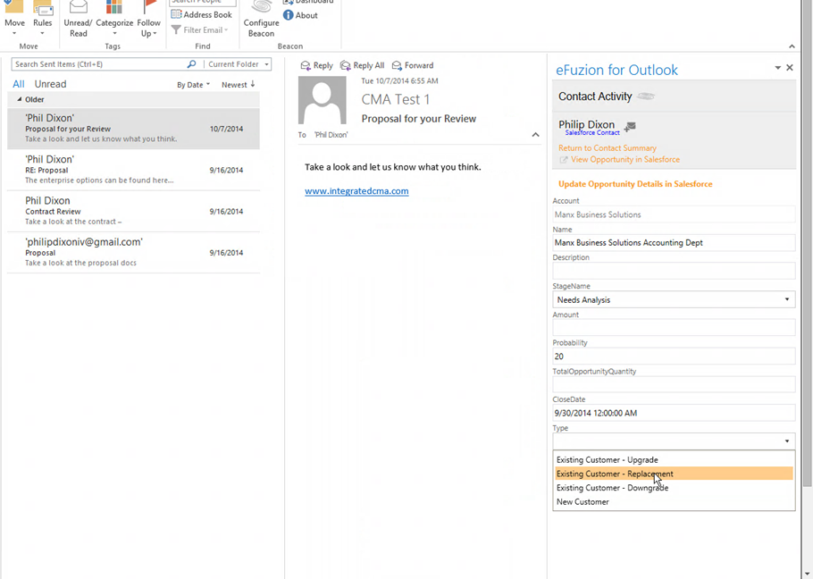
Automate Data collection
Updating an Opportunity from within Outlook

Slide 7
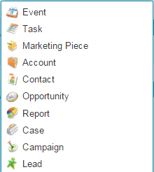


Integrate CRM and/or DM Systems
These usually integrate with Salesforce already!!!
File and track emails inside Salesforce or with a stand alone document management system
Document Management
System

Slide 8
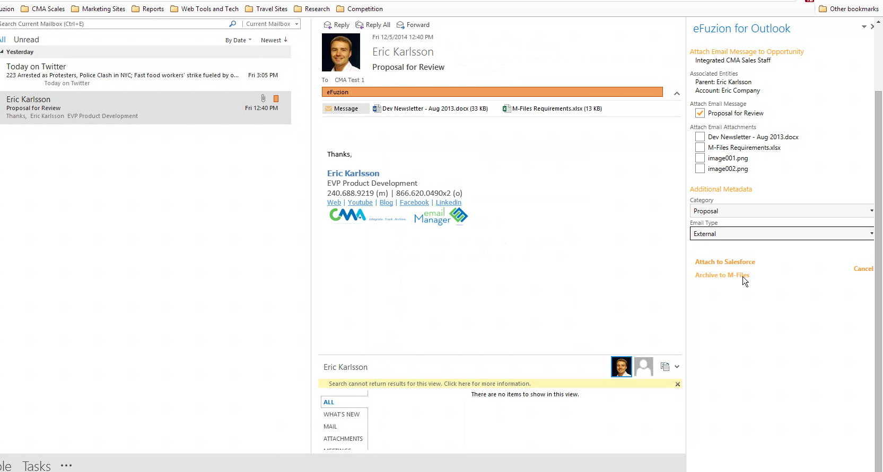
Emails and Attachments
Pick which attachments you want to keep
Easily categorize and associate emails with any Salesforce object
Or store the emails and attachments in a separate document management system.
Emails will be uploaded with the corresponding opportunity, Account/customer, and project related data

Slide 9
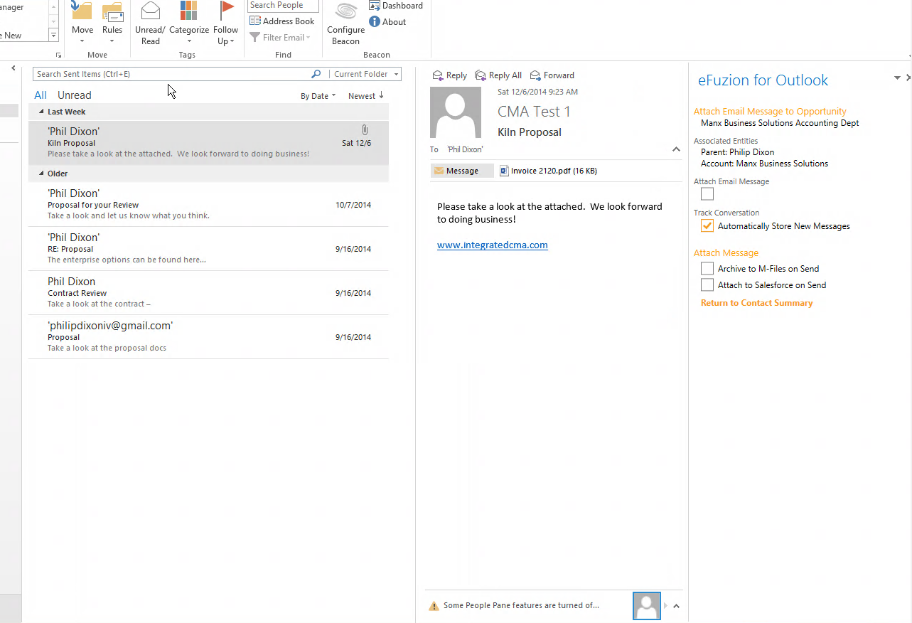
Let efuzion Capture Email Replies for you
Automatically File Replies!!!

Slide 10
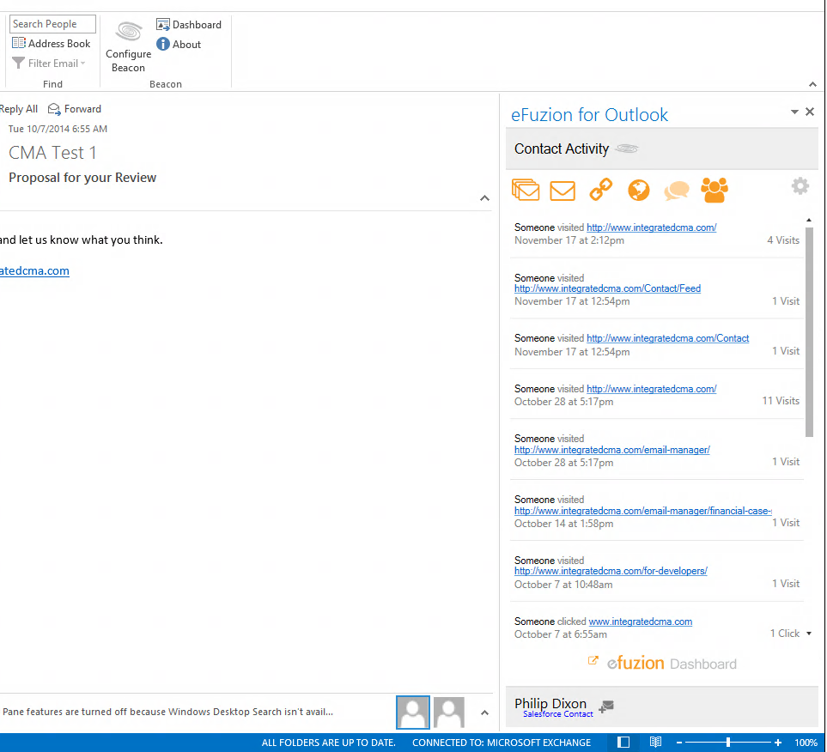
Understand your prospects and Engage them at the right time
eFuzion Tracks
Opens
Link Clicks
Website Visits
Opens. Clicks. Website Visits

Slide 11
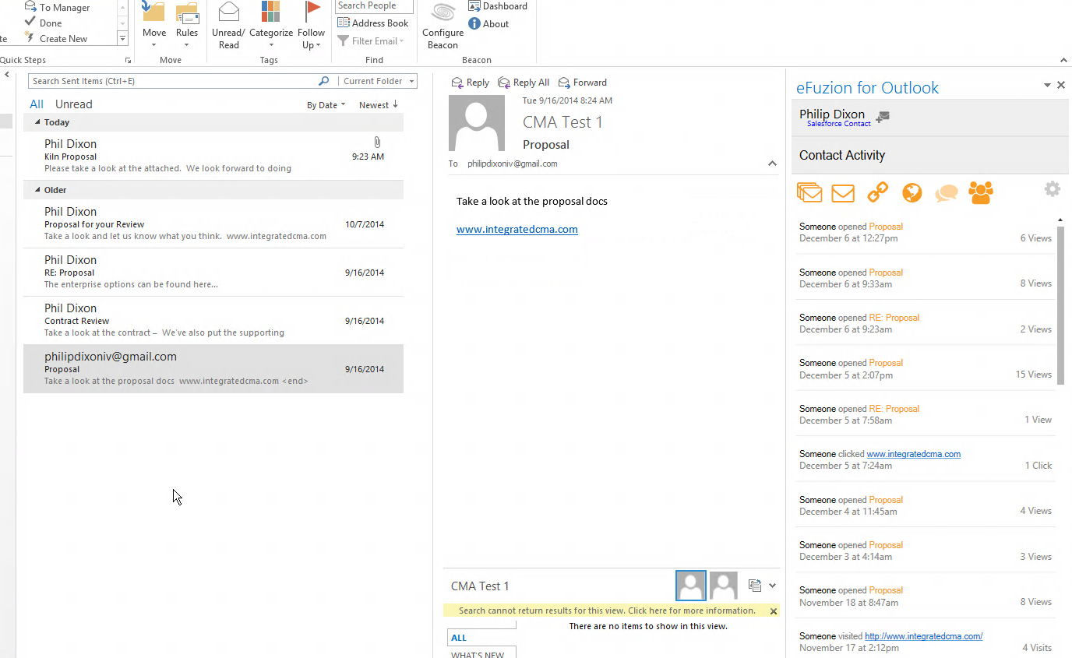
Insight your email
eFuzion grabs contact activities and puts them back in the related email conversation.
Opens
Clicks
Website Visits
eFuzion captures digital behavior to help your sales reps and project members understand and engage customers.

Slide 12

Create | Update
Tracking | Filing
Get Big on Data

Slide 13
Free!!!
Outlook and Salesforce Integration

Slide 14

Get big on data
Website
CRM
Customer Support
Email marketing
Accounting
Integrate Data from multiple sources and grow your business intelligently

Slide 15


Get Big On Data
The app helps you update and clean your CRM data
Integration Connects your data sources
Efuzion produces automation and analytics

Slide 16







Get Big On Data
Out of the Box
Comes with the App
Enterprise Analytics
Any App

Slide 17
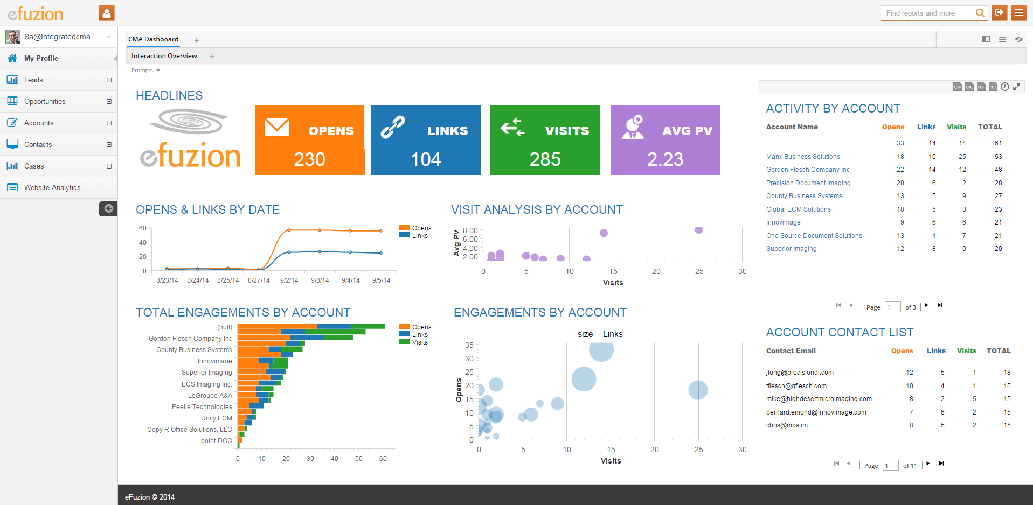
eFuzion includes powerful Business Intelligence and analytics.
Include Any other Data
  Accounting/ERP
  Marketing Automation
  Service/Support Desk
  Web Applications
  Inventory
  Supply Chain
Dashboards, analytics and reports for all your data. Out of the Box, all Salesforce, Website, and Email Tracking data is brought into an automated data warehouse. Pivot, drill down, and drill across multiple data sources with an intuitive interface.

Slide 18
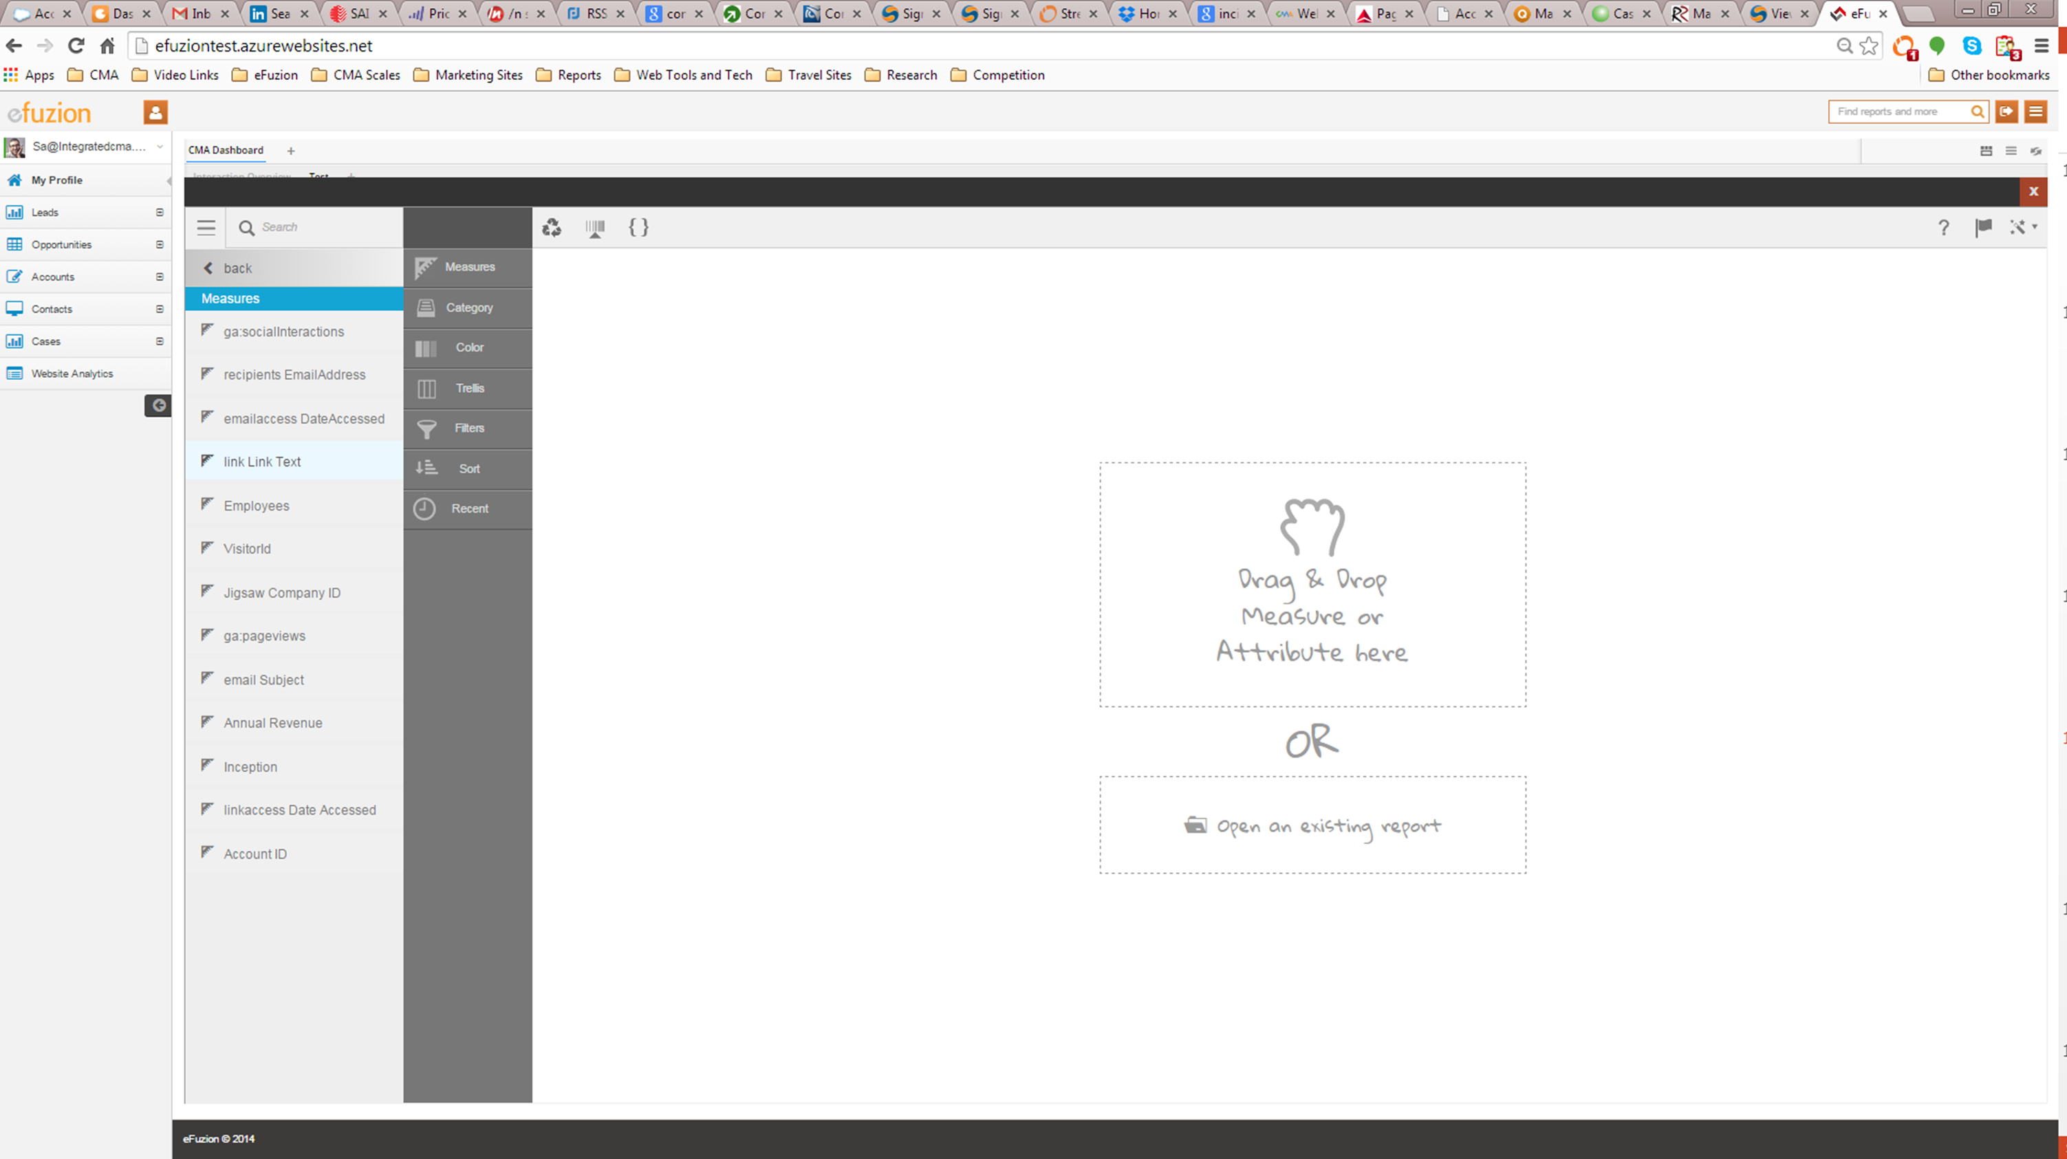
Discover with Drag and Drop Interface

Slide 19
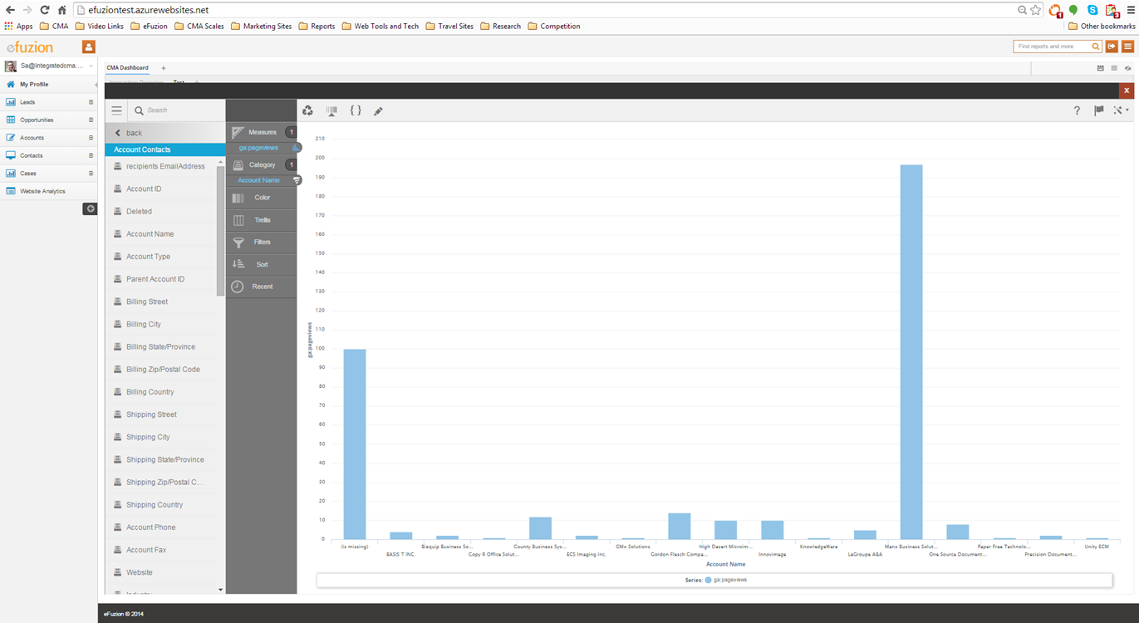
Add Measures and Attributes
Filter – Sort - Trellis

Slide 20
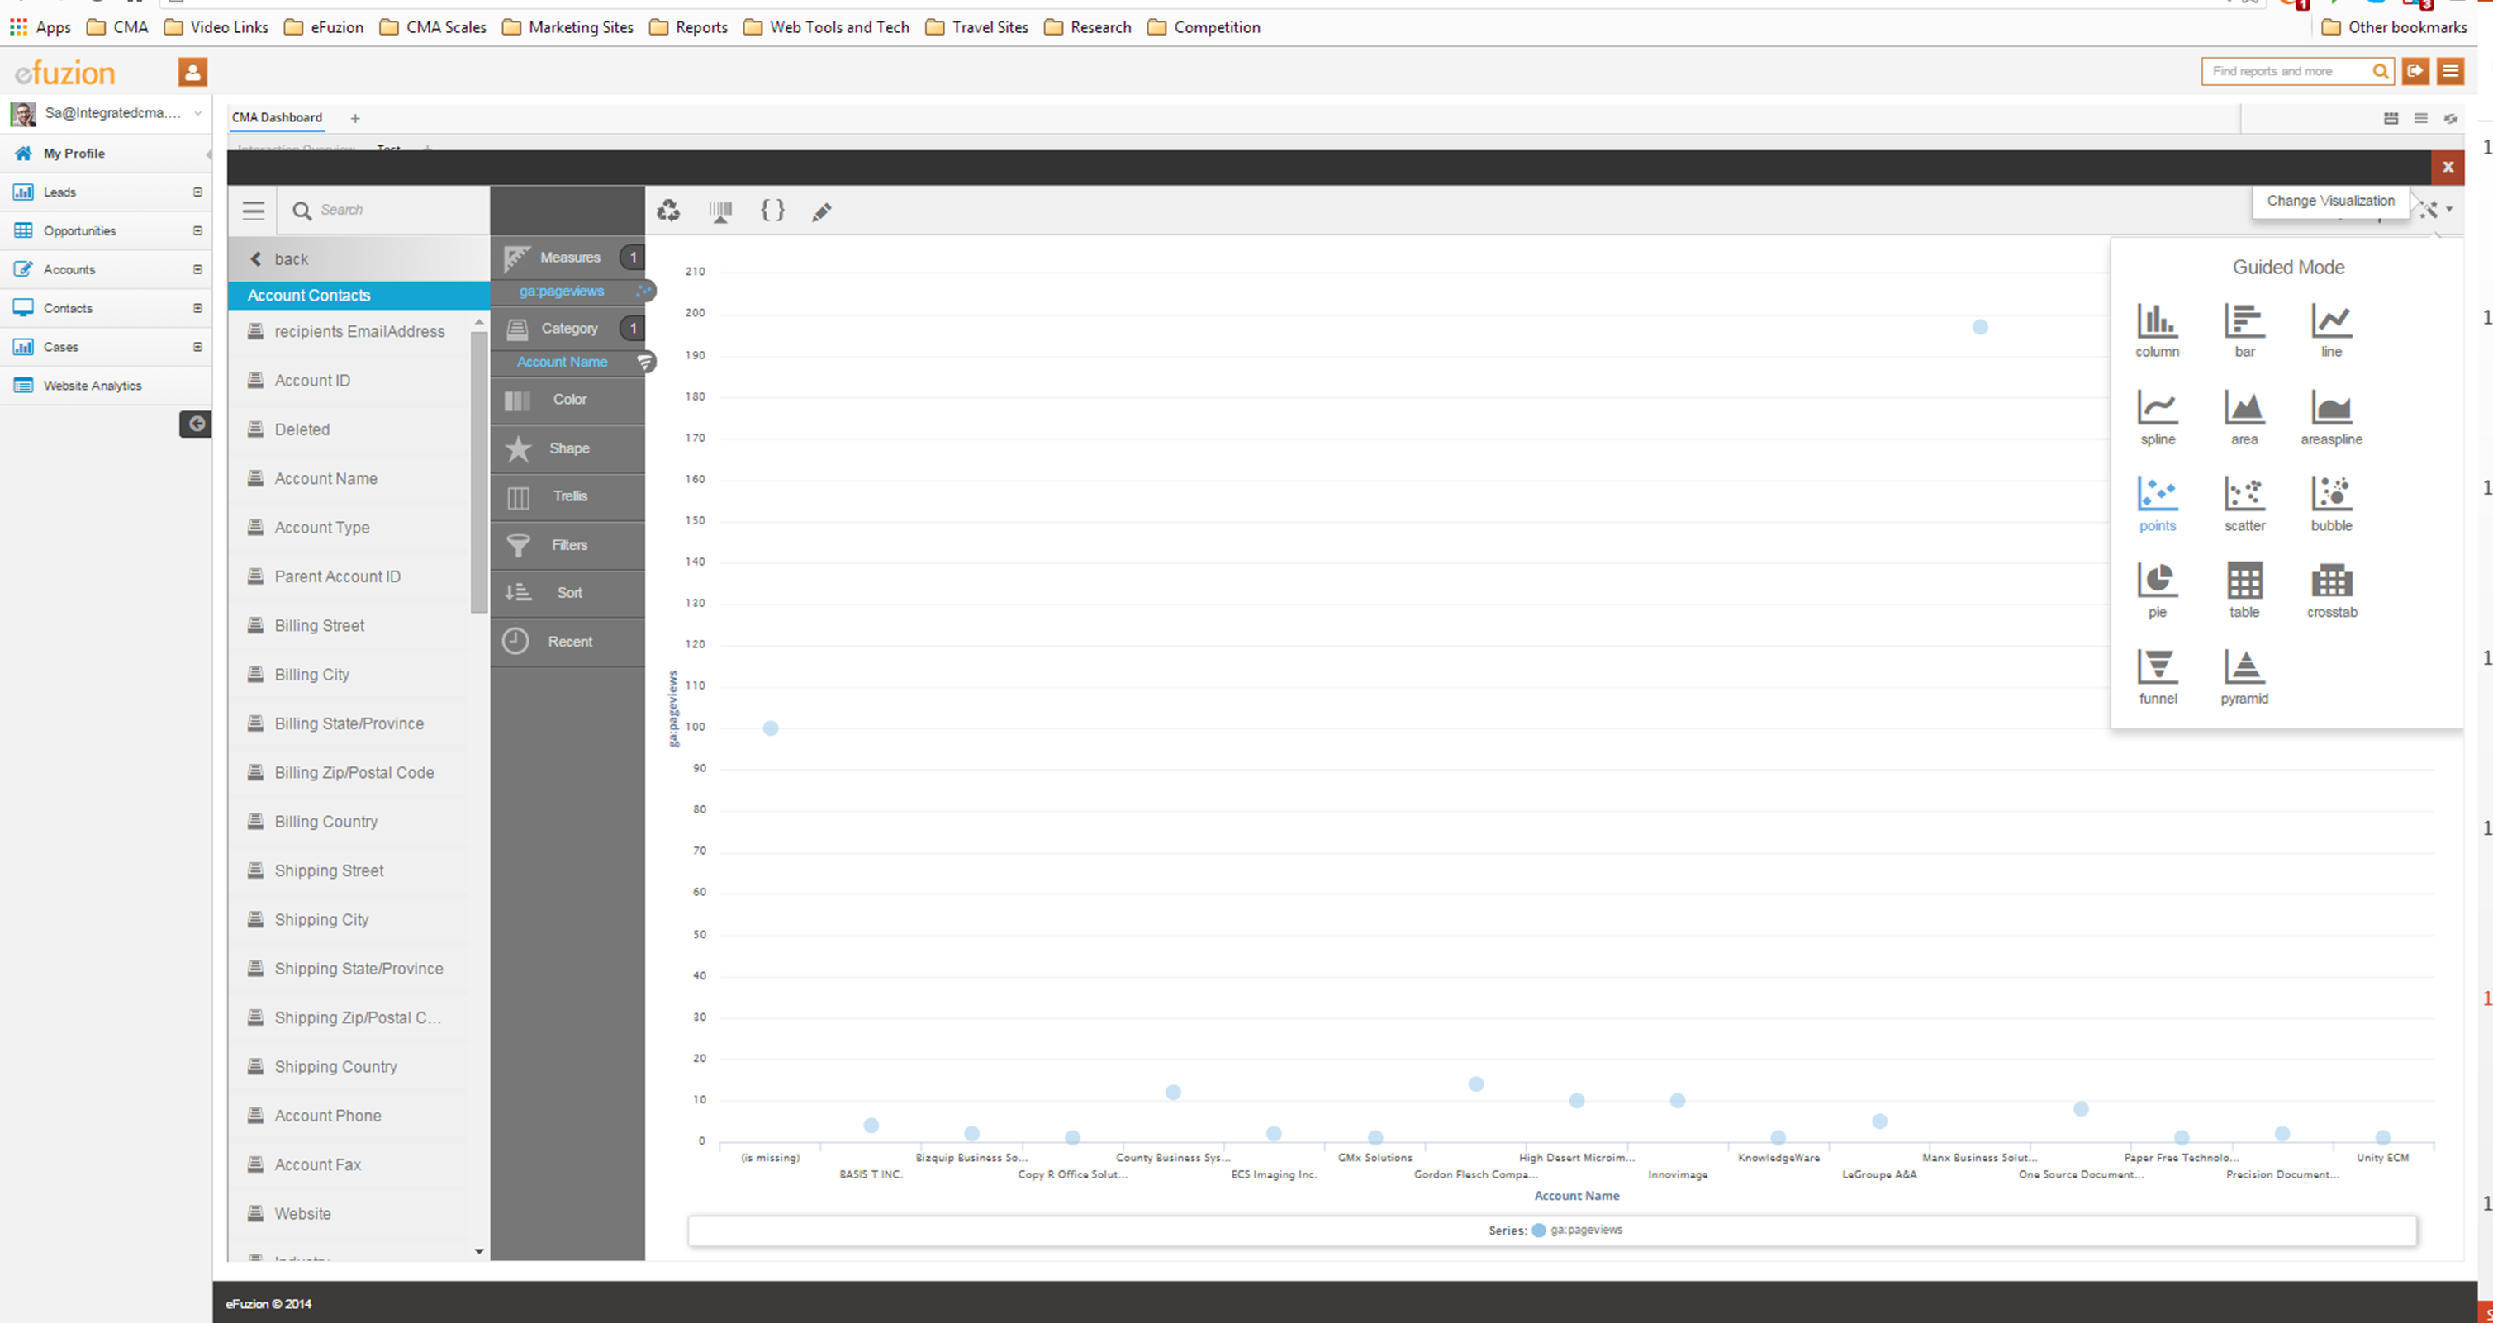
Easily Change and save your Chart Types to generate new dashboards
Share it and Collaborate on the data

Slide 21


Integration and Automation
Converge Data from multiple sources to paint the picture
Efuzion automatically refreshes and snapshots your data
Discover with Visualization – No DBA’s or Data analysts required

Slide 22
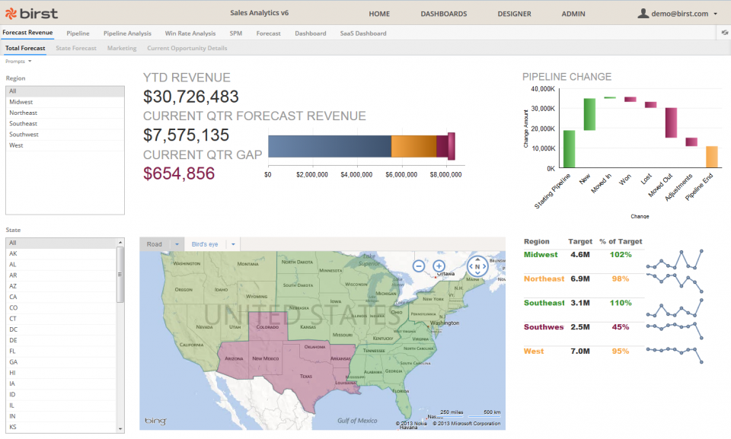
Sales Pipeline Analysis

Slide 23
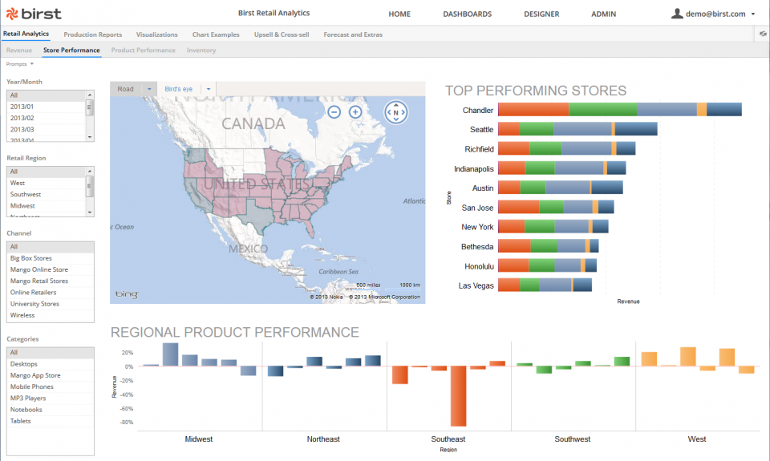
Distribution Performance

Slide 24
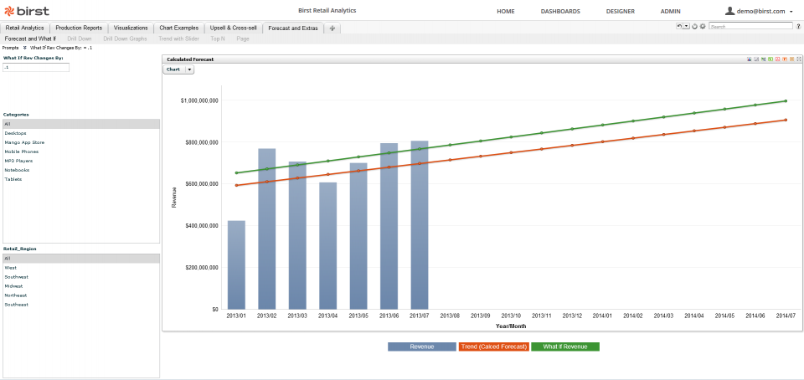
What-If Analysis

Slide 25
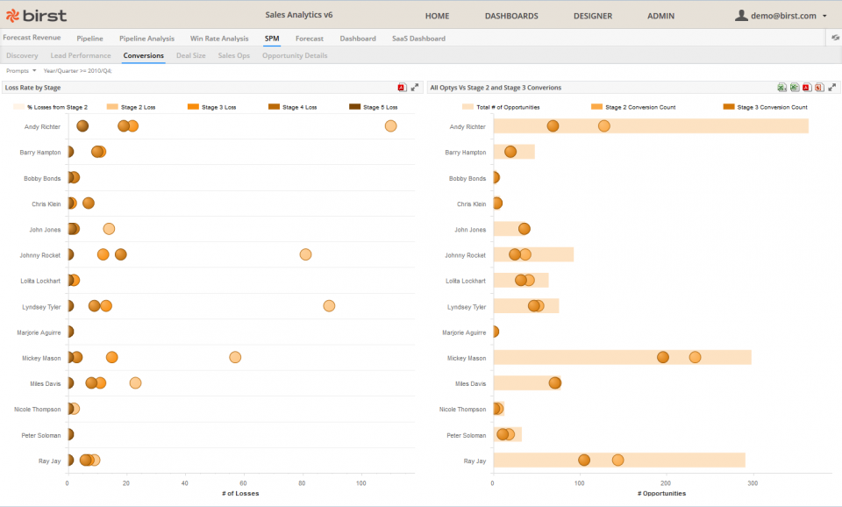
Win Rate analysis

Slide 26
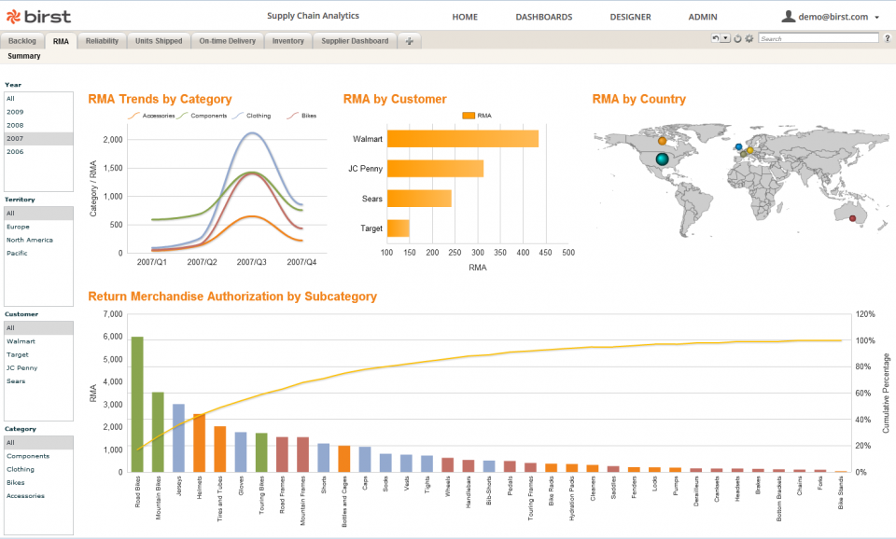
Product Return Analysis

Slide 27
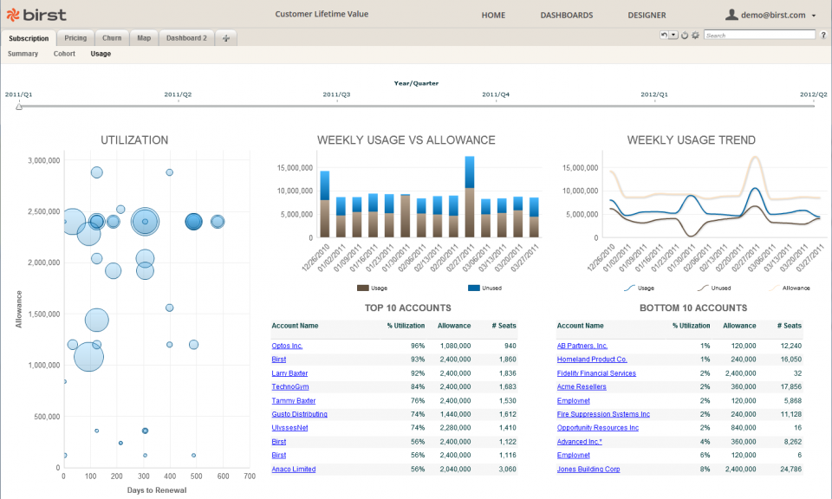
Customer Lifetime Value

Slide 28
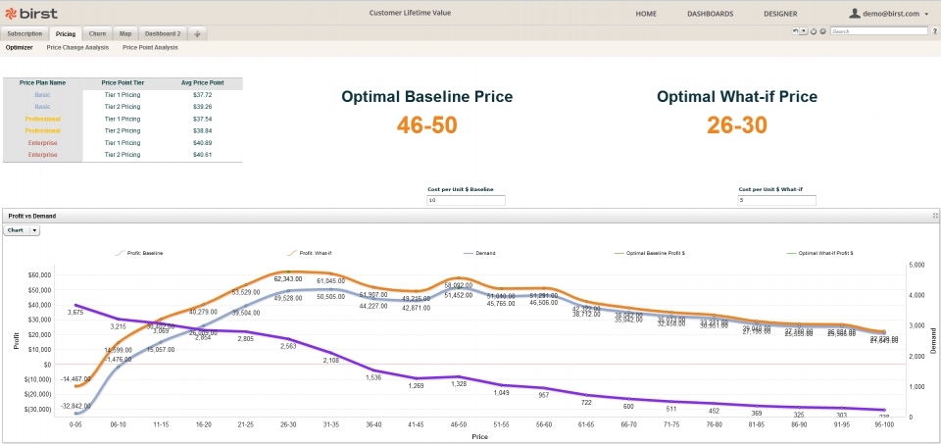
Price Optimization

Slide 29
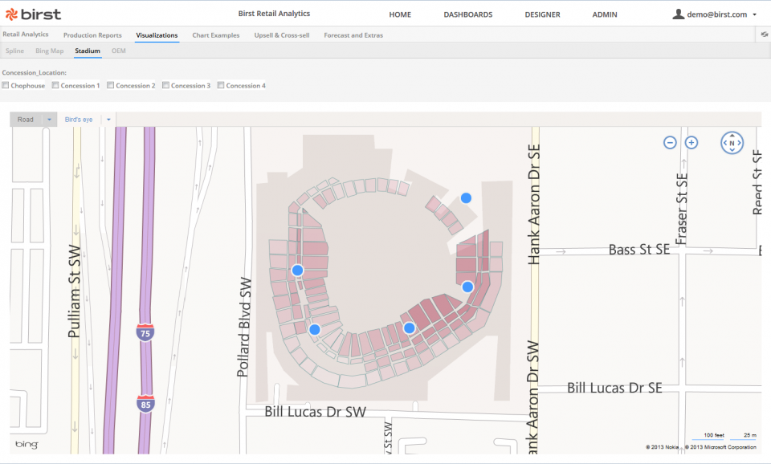
Location Analytics

Slide 30
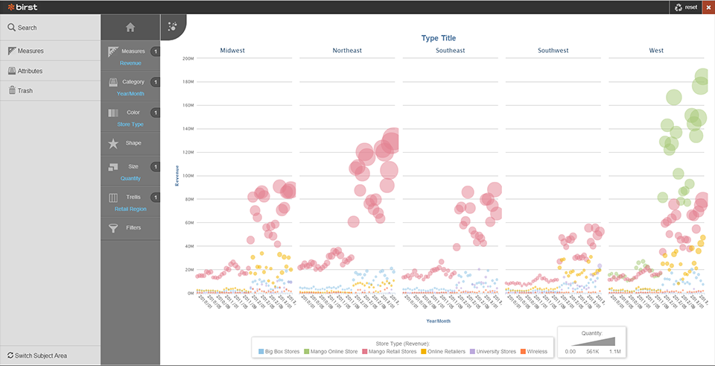
Regional Sales Analytics
Trellis your categories

Slide 31
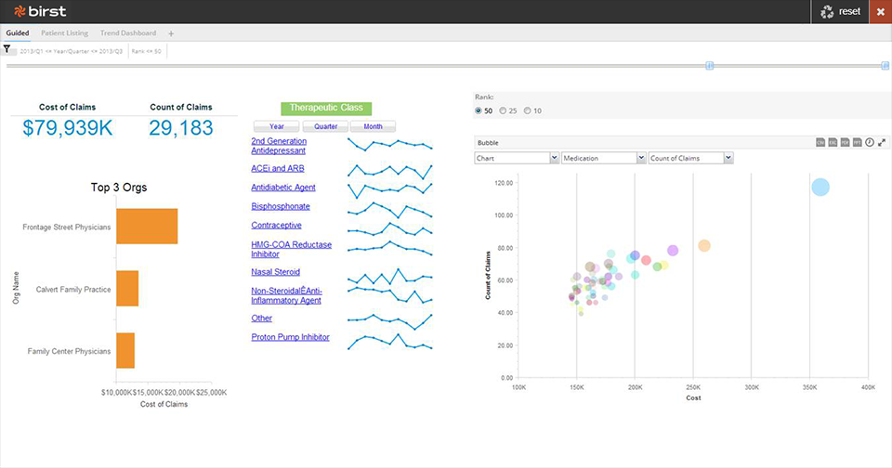
Distribution Analytics

Slide 32
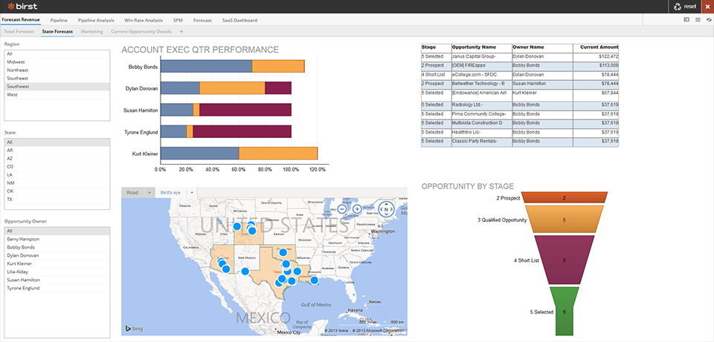
Regional Sales Performance
Opportunity Execution

Slide 33
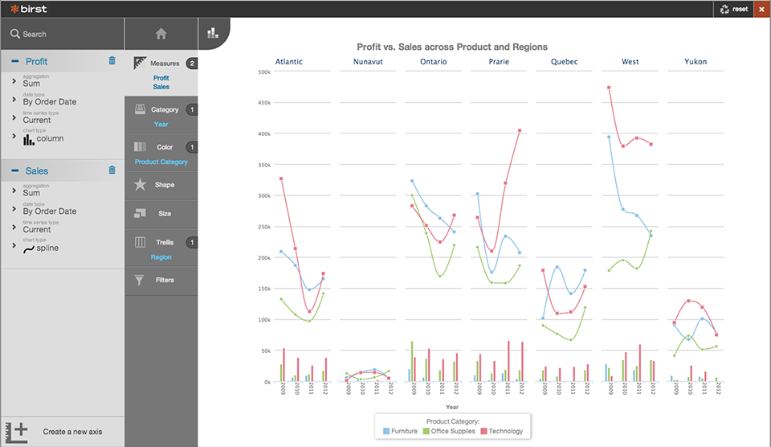
Product Analysis by Region

Slide 34
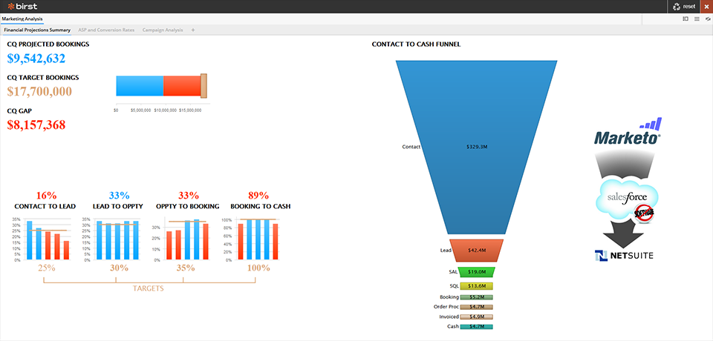
Lead to Cash Analysis

Slide 35
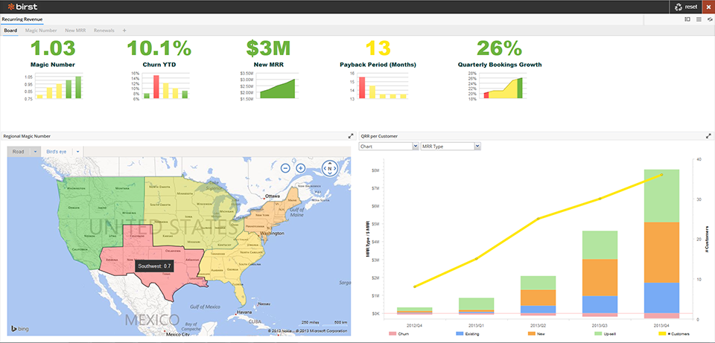
Recurring Revenue and Customer Acquisition
By Region

Slide 36
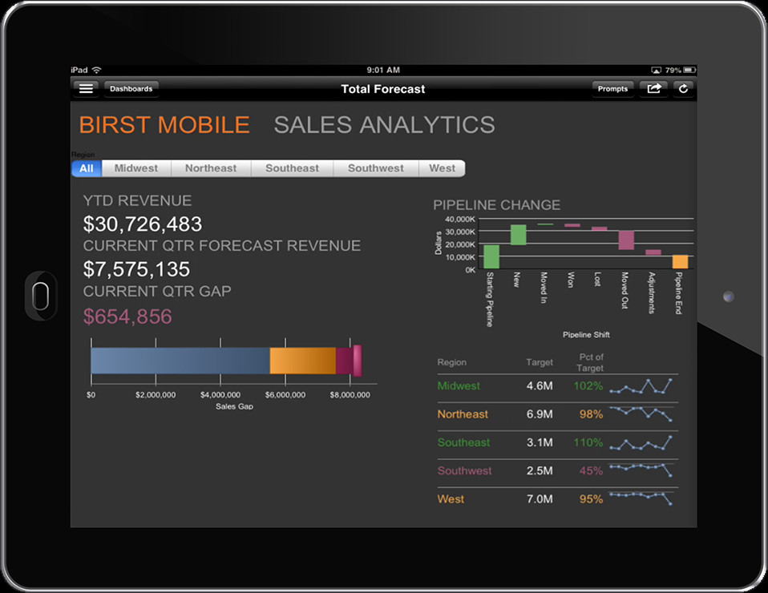
Mobile Analytics

Slide 37
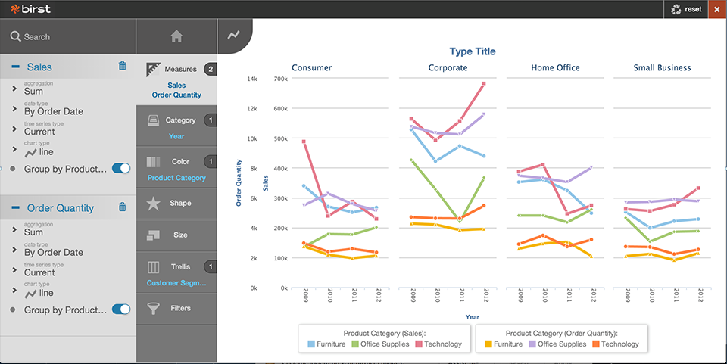
Market Segment Identification

Slide 38
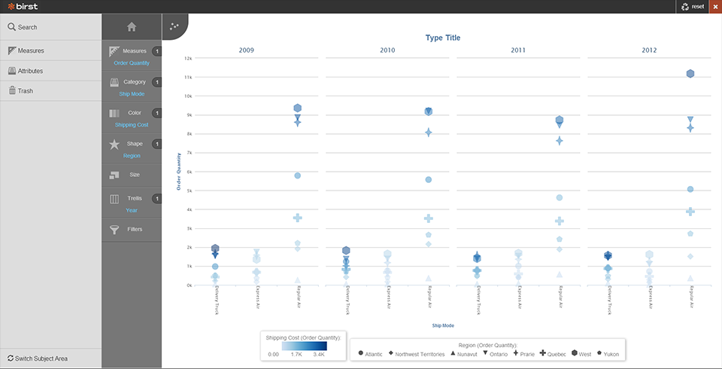
Shipping Cost Comparison by Region

Slide 39
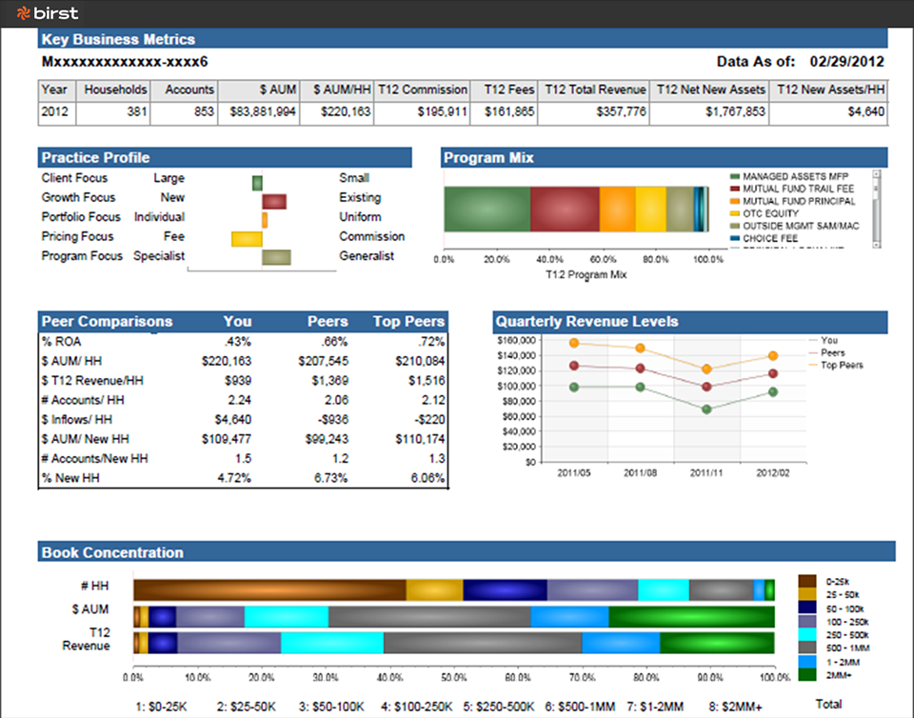
Peer Client Statistics

Slide 40
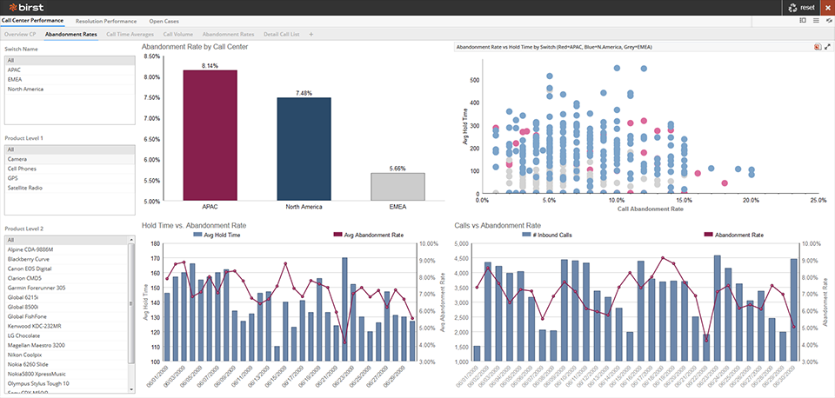
Call Center Performance

Slide 41
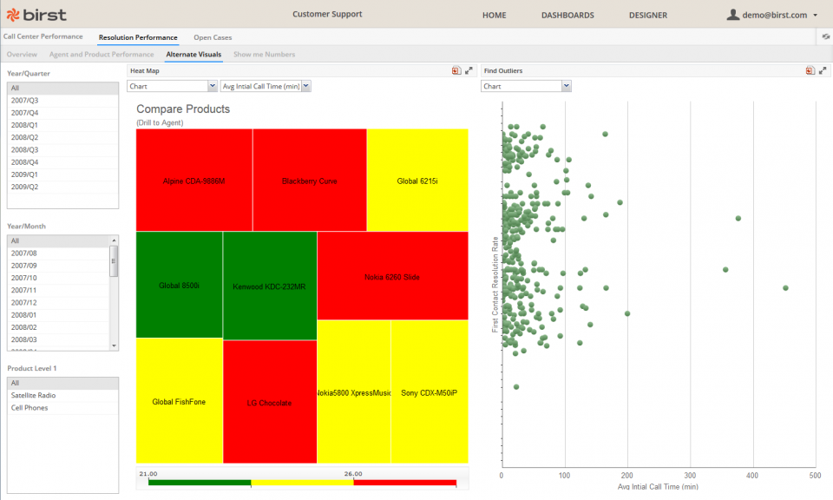
Call Resolution Analysis

Slide 42
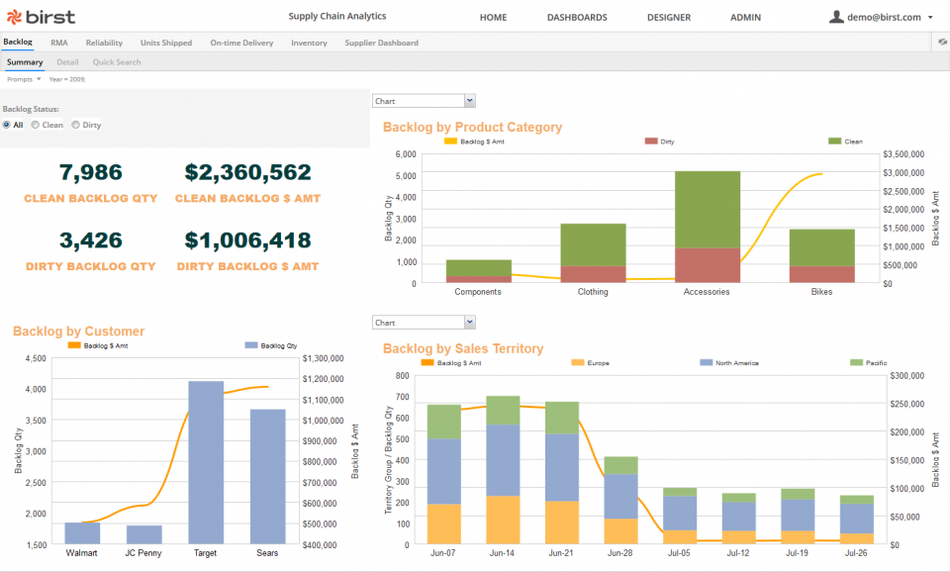
Backlog analysis

Slide 43
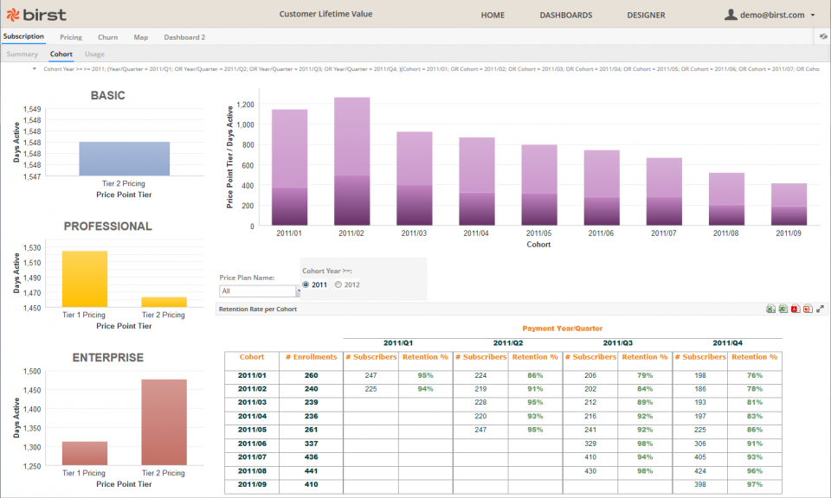
Cohort Analysis and Churn

Slide 44
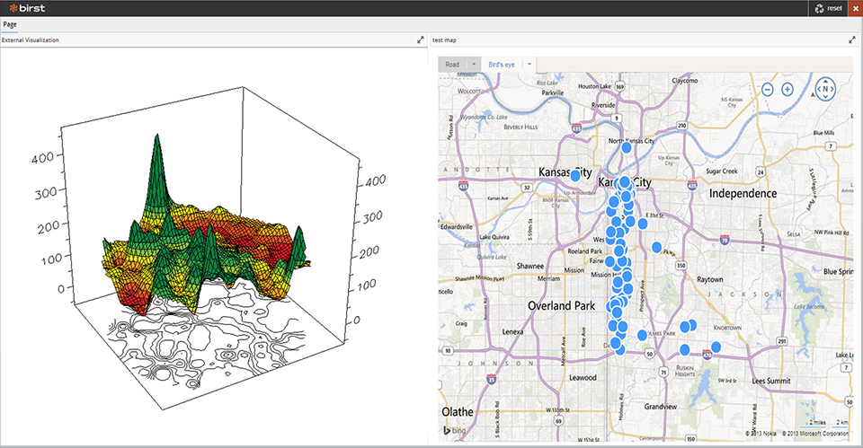
Property Damage by area

