Slide 1

KNOWING YOUR BACKYARD
October 14, 2010

Slide 2
Agenda
7:30 Breakfast
8:00 – 8:20 Welcome, Keynote rant (Ken and Eric)
8:20 – 8:40 Financials (Greg and John)
8:40 – 9:05 Production Accounting (Glen)
9:05 – 9:20 Marketing (Huw)
9:20 – 9:40 Other software and predictions (Barry and Scott)
9:40 – 10:00 Questions, discussion

Slide 3
The Keynote Rant…

Slide 4
Things that either receive too much attention or not enough…
IS Management
  Outsourcing
  Personal Organization
  Project Management Office (PMO)
  Enterprise Application Architecture
Methodologies
  Change Management
  Leaning of Business Processes
  Best Practices (What is that anyway?)
Business Processes
  Supply Chain Management (SCM)
  Enterprise Resource Planning (ERP)

Slide 5

Financial Accounting
Greg Kautz & John Haslett

Slide 6
Financial Accounting - Trends
Current options look very familiar:
  P2ES Qbyte FM
  SAP
  Oracle
  CGI
  JV Nexus
Nothing has emerged to “force” companies to consider new options – most have adopted a policy of “if it ain’t broken, don’t fix it”
Where companies do change, the driver is frequently a need for more sophisticated procurement, asset management or global delivery capability
IFRS has not proven to be a differentiator
Consequently, we’re not seeing any large new investment by vendors in Financials

Slide 7
P2ES Qbyte FM
Qbyte FM user count is over 130
Almost all new users are smaller and adopting the ASP model
Core functionality and technology has not changed
New features include technical currency, master file maintenance wizard and reversal engine for system-generated vouchers
P2 is focusing on the reporting layer across all their products, with Optix being relevant to FM – product continues to evolve

Slide 8
SAP
SAP remains the 800 lb. gorilla among ERP’s, with no apparent threats
The company has made several acquisitions in its quest to be “much more than just an ERP”
BusinessObjects Portfolio is promoted to manage performance, collaboration, risk and compliance
SAP strongly prefers a role on the implementation team, to provide QA and help offset perceived weaknesses of system integrators
22 new SAP implementations in Calgary since 2003 (all industries)
“Industry Value Network”, comprising SAP, industry reps, technology and integration partners, provides industry input to product directions
Stated differentiators include Performance Management, Data Accessibility, optimized processes in Logistics and Marketing
Stressing evolution from On Premise -> On Demand -> On Device

Slide 9
Oracle
After some uncertainty, JDE EnterpriseOne has emerged as the lead horse for asset-intensive industries, including oil and gas
eBusiness Suite has not been visible
No significant developments in offerings to oil and gas industry
Some industry-specific solutions are delivered by partnerships in the U.S., but not in Canada
Oracle is currently reactive in the E&P space – will consider RFP’s
Oracle frequently gets visibility in companies through PeopleSoft HR, Hyperion or Primavera but has not converted many of these customers to an Oracle financial solution

Slide 10
CGI
Clear focus for CGI is on PAS
Envision:
  Compliance with IFRS standard
  Moved away from ORACLE forms
Wolfpac:
  No product development
  Some new clients, usually as a result of familiarity with product

Slide 11
Others
JV Nexus:
  Niche player in small/emerging market
  No signs of changes in strategy or new investment
WellPoint:
  Apparently has abandoned Microsoft-based solution

Slide 12
Financial Accounting Vendors
High
Stable
Leaders
P2ES (FM)
SAP
Oracle (EnterpriseOne)
Product Richness & Maturity
(Canada)
CGI (Envision)
JV Nexus
CGI (Wolfpac)
Low
Be Cautious??
Watch For
High
Vision & Ability to Execute
High

Slide 13

Production Accounting
Glen Murphy

Slide 14
Production Accounting - Trends
Still lots of choice in the market:
  CGI/PAS
  P2ES/PRISM
  Quorum/TIPS
  Entero/evPA
  Zedi/PetroNet
  Tietoenator/Energy Components
  Vertex
Alberta royalty changes in oil January 2011
Saskatchewan registry in operation October 2011
Some companies are continuing to build international operations

Slide 15
P2/Qbyte
PRISM at 75+ installations
On-going redevelopment of PRISM – Tango project
New product Metrix completion planned for Oct 2011. First customer signed (from Triangle)
New architecture & development environment, keeping full PRISM functionality
Migrate from PRISM 2010-17

Slide 16
CGI (PAS & Triangle)
PAS in production at Husky, Devon, Talisman and EnCana plus Penn West and Cenovus
Customers happy with Sustainment Board.
6 ASP clients
Ready for AB royalty & SK registry changes
Considering US functionality
Pricing was a barrier to additional mid-tier customers. New pricing model in place
Triangle decreasing customer base (first customer lost to Metrix)

Slide 17
Quorum (TIPS)
Strong in the midstream niche
Recently added another recent midstream company
Integrated with their FDC (PGAS)
Have implemented E & P companies
Strength in ability to do complex gas plant allocations

Slide 18
Entero (evPA)
Successful midstream implementations
Large E & P implementation integrated with FDC cancelled due to merger
Recently successful with another midstream customer
Company is very busy
Some service issues

Slide 19
PetroNet Zedi
PetroNet leadership (Raj Abbi) is back and company is now in separate offices to allow focus on customers
Still owned by Zedi
Financial backing and integration with FDC
Two large clients (>5,000 wells). Want to move more into mid-tier
Strong reporting
Ready for AB royalty changes

Slide 20
Other PA Solutions
Vertex – stable but small customer base. Effect of main client gas property sale?
Tietoenator (Energy Components) – slowly growing local base. Worldwide presence

Slide 21
Production Accounting Vendors
High
Stable
Leaders
P2ES (PRISM)
Product Richness & Maturity
(Canada)
CGI (Triangle)
CGI (PAS)
Vertex
Zedi
(PetroNet)
Tietoenator (EC)
Quorum
(TIPS)
P2ES (METRIX)
Entero (evPA)
Low
Be Cautious??
Watch For
High
Vision & Ability to Execute
High

Slide 22

Marketing
Huw Gibson

Slide 23
Marketing - Trends
A lot of activity, particularly oil
Increasing number of services – ICE, Shorcan, NetEnergy, NGX/NTP, PetroTranz
More on-line brokering means simpler pricing
Lots of vendors but no easy choice
New vendors – Solarc, TriplePoint, Quorum
Companies marketing oil doubled in 5 years to 60, means more liquidity
Large percentage have budgets and are looking to replace existing systems or spreadsheets
More production due to oil sands and unconventional

Slide 24
What’s Happening
Egistix
EBO/Egistix (gas & oil marketing) company and product are maturing
Emphasizing Egistix Open as gateway to applications
Loss of two major accounts, gained one
Solarc
Won first major Canadian oil & gas client from Egistix
First install had rough patches
Actively pursuing other clients

Slide 25
What’s Happening
Allegro
Allegro shrinking office, loss of a major client and a smaller client
Internal management issues
TriplePoint
Won a major account from Allegro
Acquired Softmar in January for vessels
No previous oil & gas Canadian installs
Moving from pure trading to include physical

Slide 26
What’s Happening
WellPoint
One sale announced of Energy Broker
Still saddled with financial issues
Their other EB customer has closed its doors
Extended support for OMS
Focusing on oil rather than gas & liquids
Quorum
Existing gas and liquids applications in US
Looking for partner to add oil in Canada and US

Slide 27
What’s Happening
PetroTranz
Not a marketing software vendor but a data exchange service
245 operators now using COTS for electronic Form A’s. 95% of oil operators
Have signed one midsize facility operator and are being evaluated by a large prospect
Strategy for automating Form B, Form C, NOS and reporting calendar in 2011

Slide 28
Oil, Gas & Liquids Marketing Vendors
High
Stable
Leaders
Allegro
Egistix/EBO
Product Richness & Maturity
(Canada)
WellPoint (OMS, EB)
Entero (Enterovision)
Solarc (RightAngle)
Encompass
TriplePoint
Quorum (QGM, QLM, QOM)
Low
Be Cautious??
Watch For
High
Vision & Ability to Execute
High

Slide 29
A quick glimpse at other areas…
Scott Aitken & Barry Henderson

Slide 30

Economics and Planning
Main Players:
Peep, Capacity Planner, Enterprise Planner – Schlumberger (Merak)
Value Navigator – Energy Navigator
Hyperion Planning – Oracle
Outlooksoft – SAP
Government/Finance – Palantir
Manage - 3ESI
Mosaic - Entero
Happenings:
Line is blurring between where economics tools and planning tools start and stop.

Slide 31

Well Lifecycle
Main Players:
Wellview/Siteview - Peloton
Wellcore – P2
Generwell – micotan
OpenWells - Halliburton/Landmark
Happenings:
Wellcore – 2 new sales in US in the last couple years. Being re-developed in .NET (6~8 months)
Movement from just capturing data through the well life cycle to planning & executing a program. Project based vs. well based.
Trend is towards the merge of drill planning and engineering functionality.

Slide 32

Land
Main Players:
P2 - QBLM
CS - CS Explore
CGI – Landman
Divestco - Landrite
Happenings:
Watch for continued interest in cloud based exchanges looking at providing services for Lease Contracts, DOI information and others

Slide 33

Asset Management
Some Players:
A. Best of Breed:
  Maximo – IBM, EAM-Infor, Avantis-Invensys, MMS³²/NS/PM-Cendec, DAXEAM-Wellpoint
B. ERP:
  SAP, Oracle, Microsoft
  SAP Business One (integrated add-in like Field-Vu) and Microsoft Dynamics GP (integrated with add-in like Wennsoft)
Happenings:
Organizations invested in ERP are starting to push harder to perform this function within their solution. “We paid for it so let’s use it”. This area and Supply Chain are becoming part of what is expected from an ERP

Slide 34

Field Data Capture
Some Players:
PVR/GFR/CNS - CGI
Zedi
Avocet Capture (Fieldview) /Avocet Volume Manager (Quorum) – Schlumberger
Energy Components (“the SAP of FDC”)
Prodview - Peloton
Critical Controls
PGAS – Quorum
Entero (scope?)
Happenings:
Vendors looking at blurring the lines between FDC-PA.
More client companies starting to question the wisdom of FDC, given growing capabilities of SCADA and SCADA historians.
PVR/GFR/CNS targeted for a re-write starting in the next year with plans to consolidate all into one product.

Slide 35

Shining a light on the future …
Lumina’s fearless predictions for 2011!

Slide 36

Barry’s Masterpiece

Slide 37
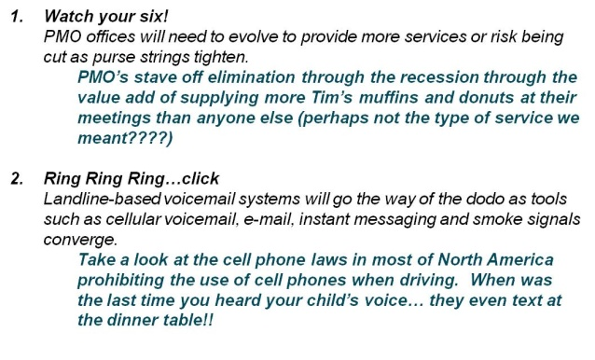
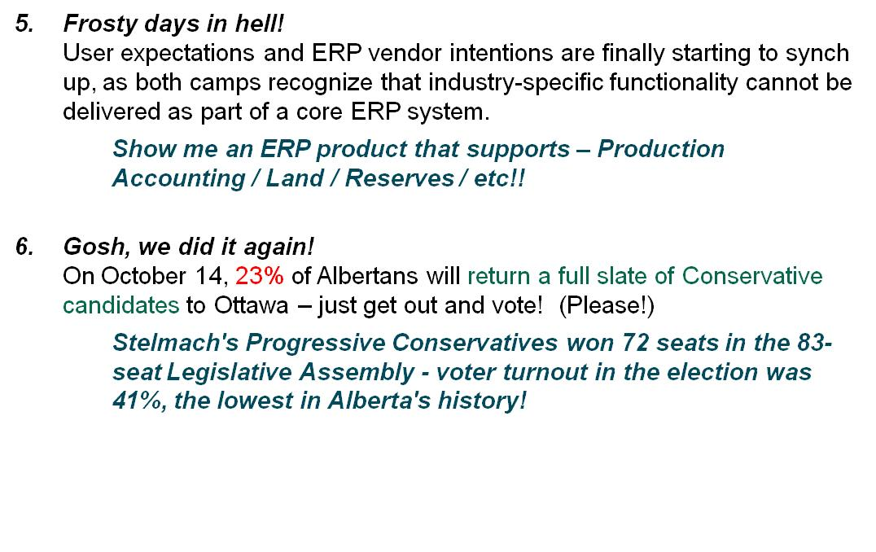
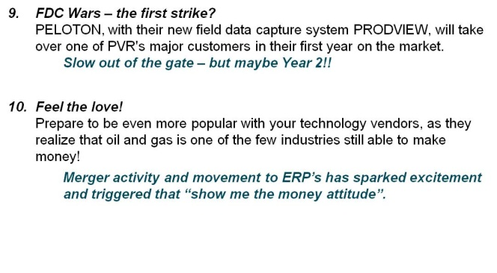


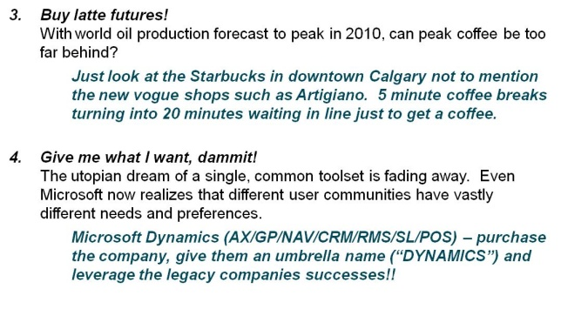
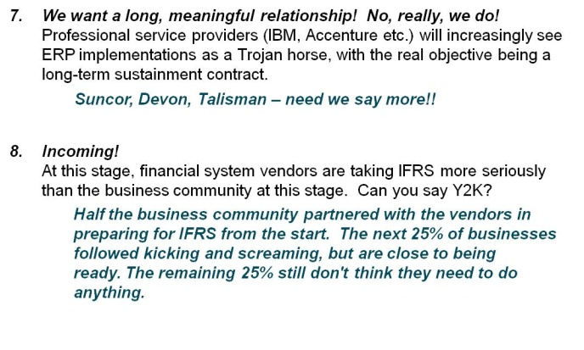
And as for the future…
Our 2009 Score -
An AWESOME 94.9873459403%

Slide 38
2011 Predictions
PRICE! PERFORMANCE! PARANOIA! PANIC! – WE OUTSOURCE BECAUSE??
Application-related service and support outsourcing will continue to fail without measures of success. No one is willing to stand up and say, “Well, that works now.”
MY APP/DATA IS WHERE??
We will see an accelerated development and use of cloud-based apps due to bad and expensive support (in-house or outsourced). Expect to see companies moving to externally-hosted apps and trying out new cloud-based relational databases (e.g. SQL Azure).
CRUDE BUT TRUE
There will be at least one new crude oil marketing system on the street next year.

Slide 39
2011 Predictions (contd.)
IT’S A GAS
There will be new products available to handle the calculation of greenhouse gases. Soon, accounting for greenhouse gas will be worth more than accounting for natural gas.
AH, EEERRPP.
With multiple companies implementing or upgrading ERP systems, $200/hr + consulting rates for implementation resources will be the norm.
DEAC-TIVATE
The big boys in the consulting world will have delivered plans that they can’t execute - changes are afoot, look for local talent to save the day.

Slide 40
2011 Predictions (contd.)
OIL & WATER
With BP's debacle in the Gulf and the oilsands' recent promotion to Hollywood tabloid status, look for more pressure to manage the corresponding increased costs as well as new systems/corporate memory to better support a PR battle.
IT AIN’T HEAVY, IT’S OUR FUTURE
The road may be long, but look for the anti-Heavy Oil activists lose clout as the value of energy reserves outweighs environmental concerns.

Slide 41
2011 Predictions
MERGE WITH CAUTION
The pace of M&A will slow and we will see a rise in the number of midsize companies through organic growth as the trusts convert and the portfolio rationalization of the big guys settles down.
BLACK-CRACK!
Companies tire of battling device desires beyond the boring Blackberry and users that connect with other devices anyway. Those less progressive have the digital security guy send out a last-gasp email about the dreadful consequences - which he sends from his Android device! Progressives switch to Smartphone allowances and tell users to buy their own.

Slide 42
That’s it!
Questions and discussion

