Slide 1
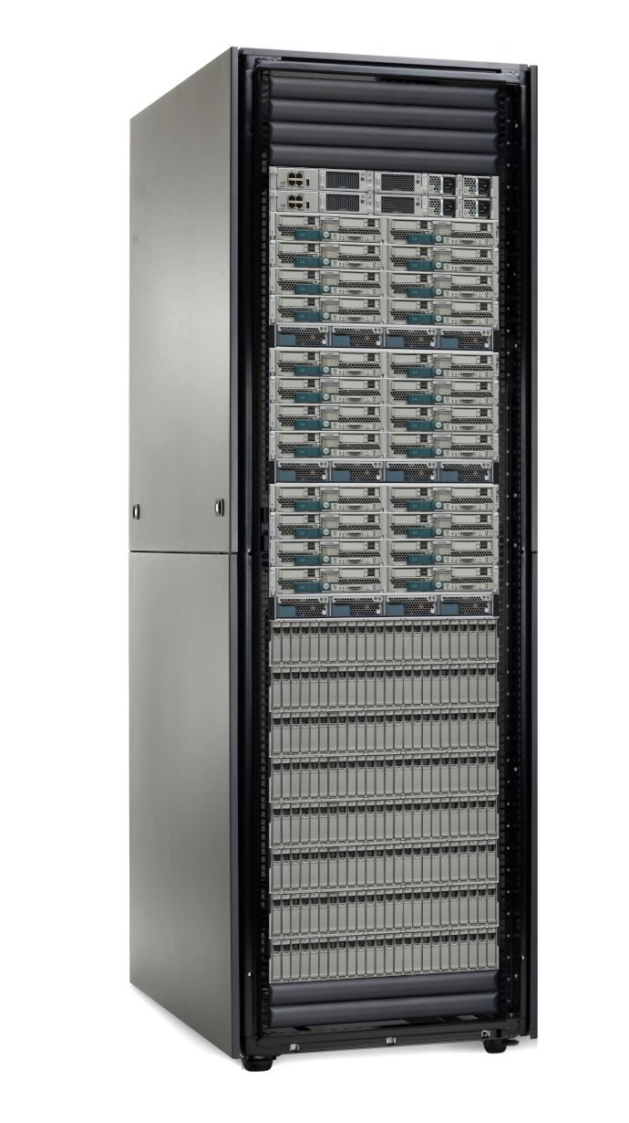
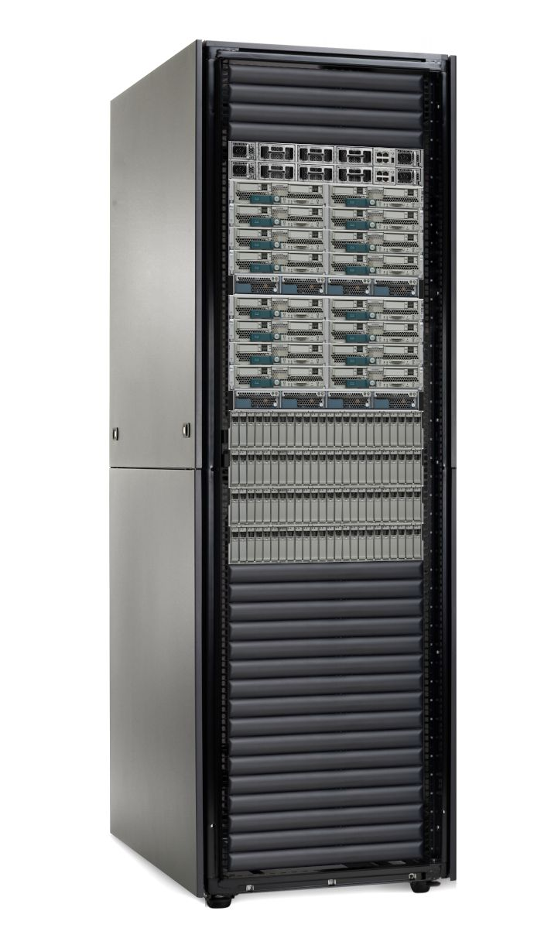

Initial Graphic thoughts
Nuvula Public Cloud
Cloud Bursting
Hybrid Integration
AGFA GiantClouds
Amazon, Google, Facebook, Azure
Private Cloud
Nuvula1
Hybrid Integration

Slide 2
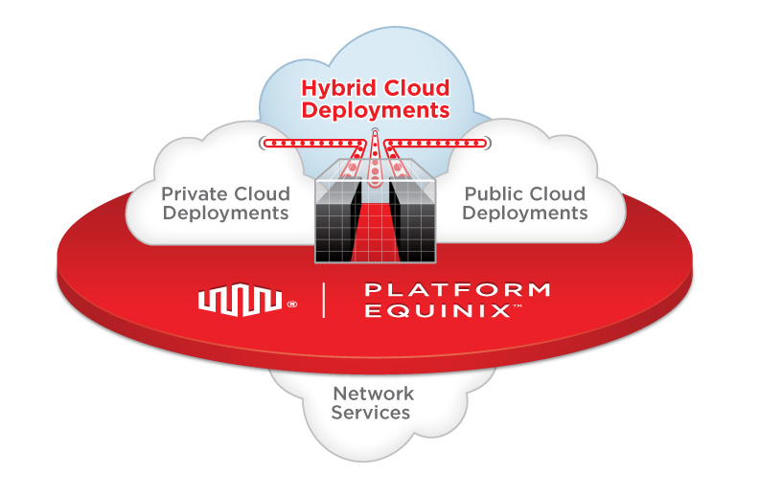
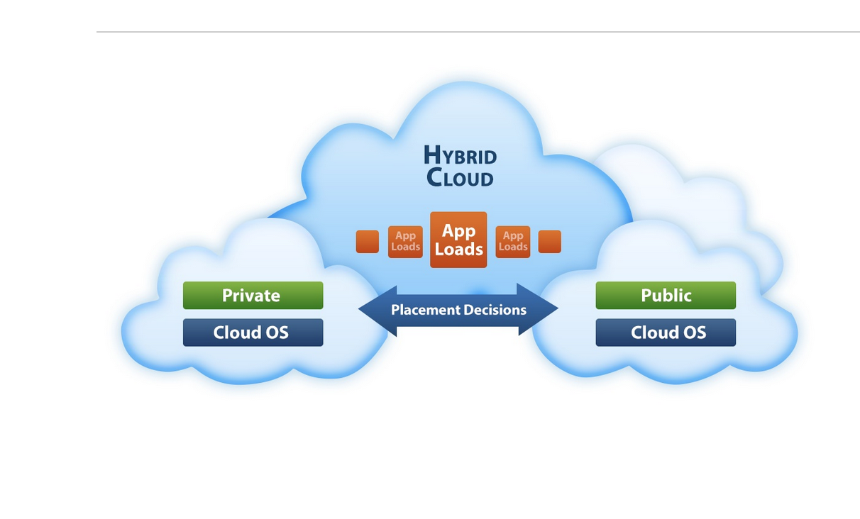
Examples
link

Slide 3
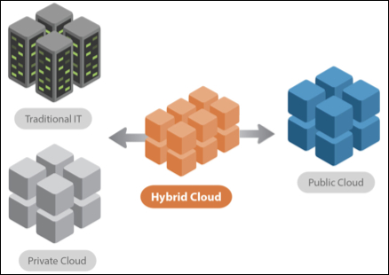
More examples
Pictures of racks: Link

Slide 5

Company Logo

Slide 6
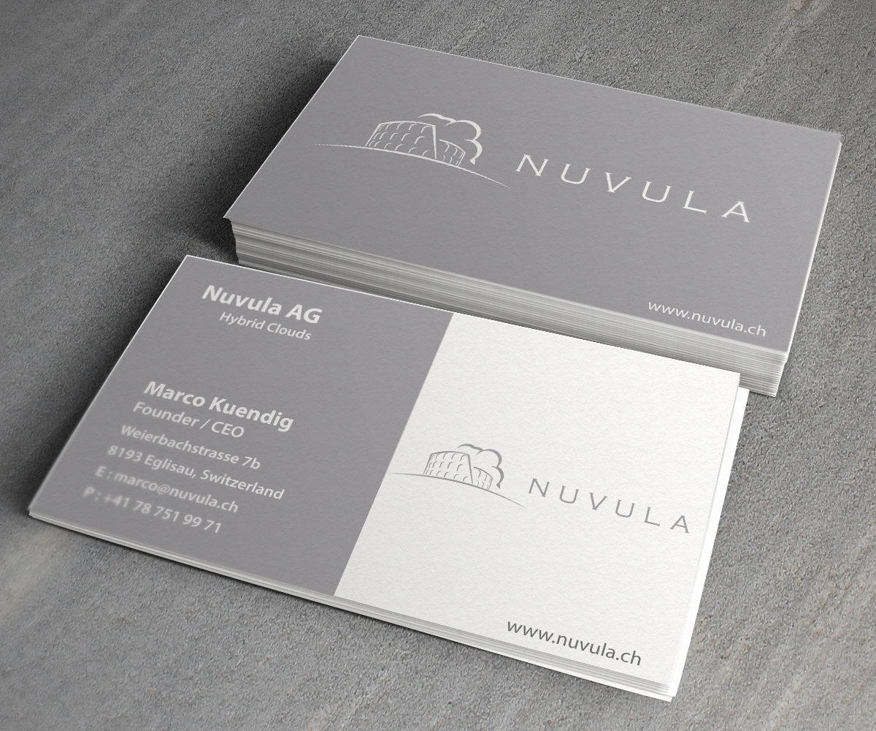
Current Business Cards

