Slide 1
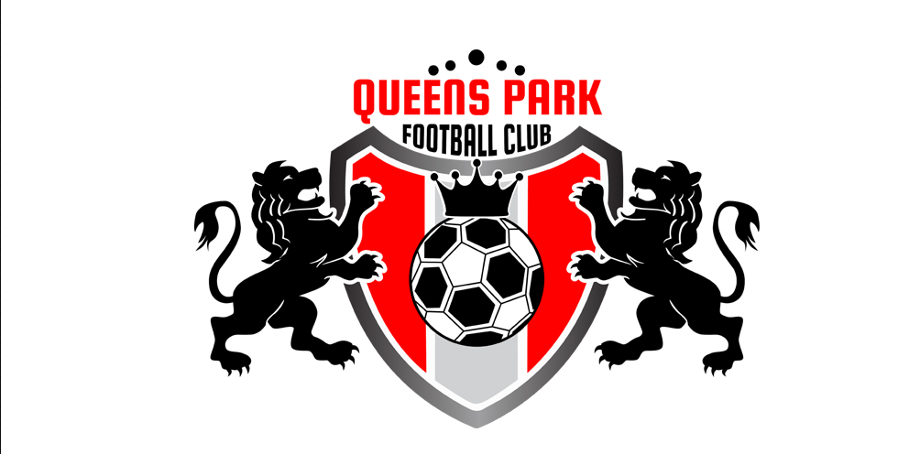
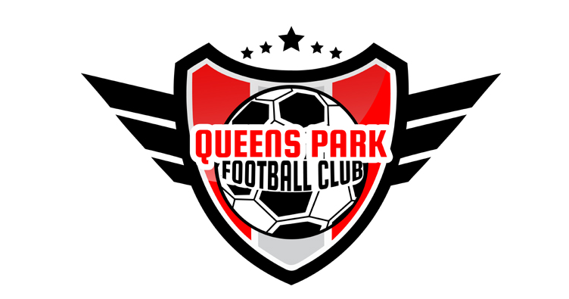

Remove insert Lions – same as other version
Insert Crown – remove stars
Insert JUNIORS into design
Insert JUNIORS into design
Give all colours of all elements metallic look as per Arsenal logo and this other design

