Slide 1
ICOM: Nightlife
Beta Design

Slide 2
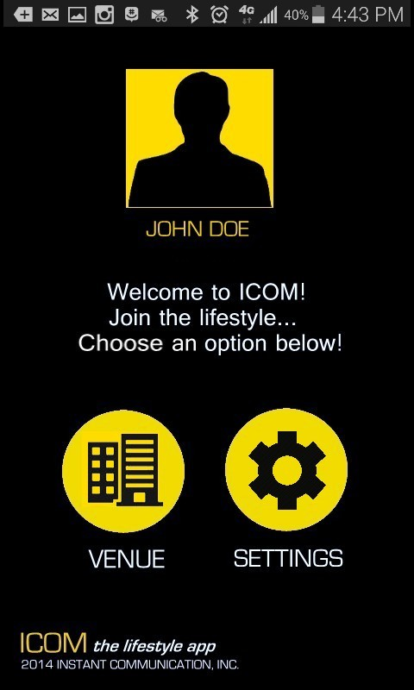
User’s first page will consist of signing into/ creating a user profile or finding the venue they are currently in.

Slide 3
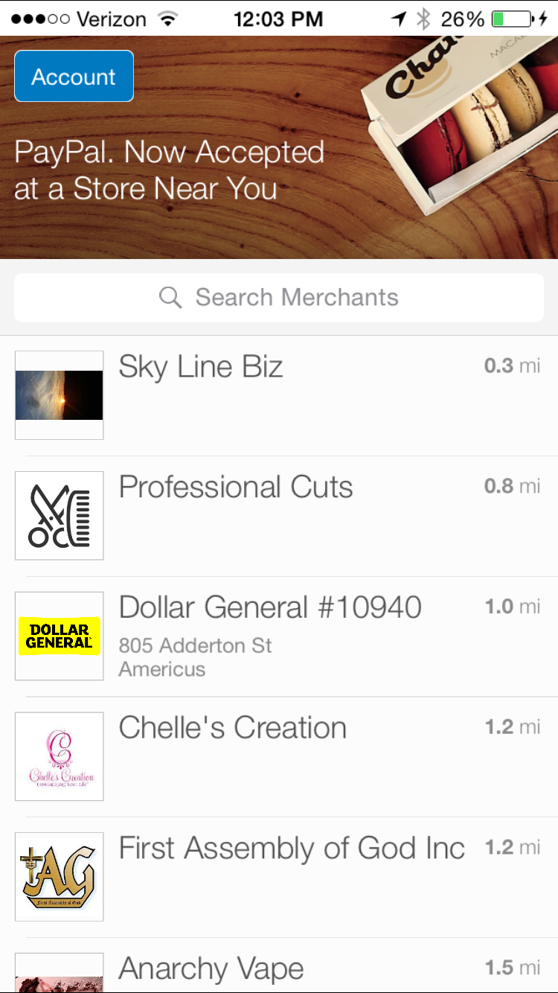
We would like an expansion slide when viewing venues that we operate in, similar to paypal.

Slide 4
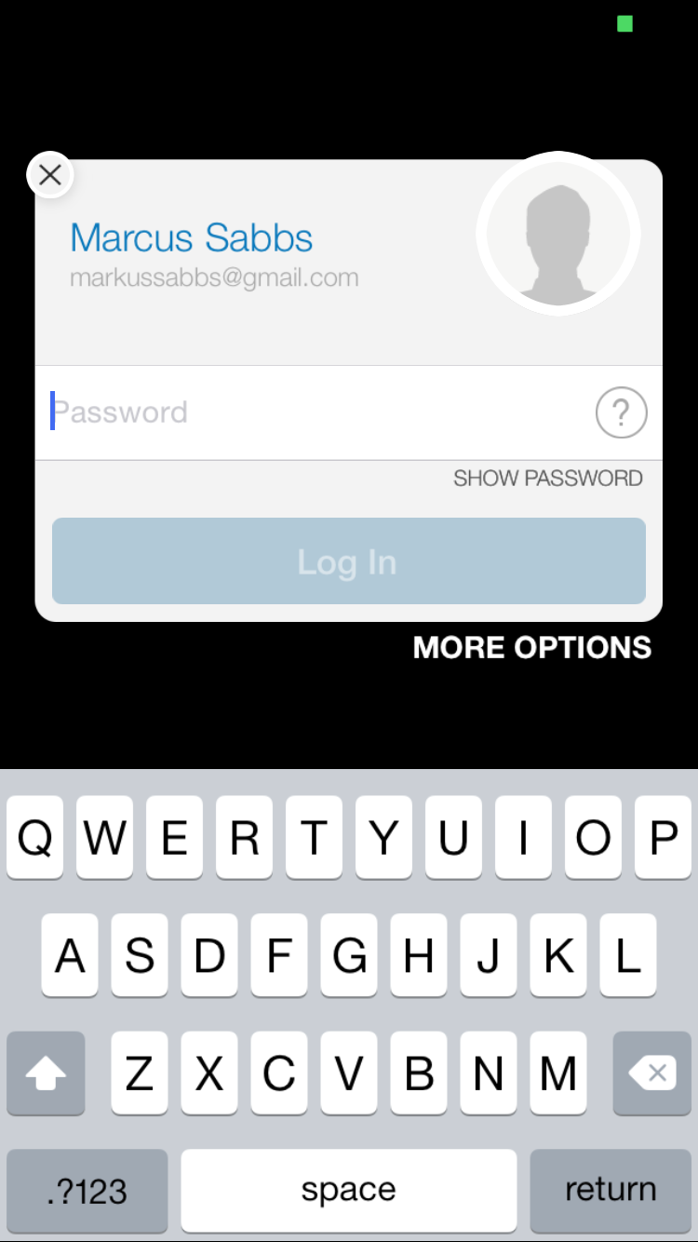
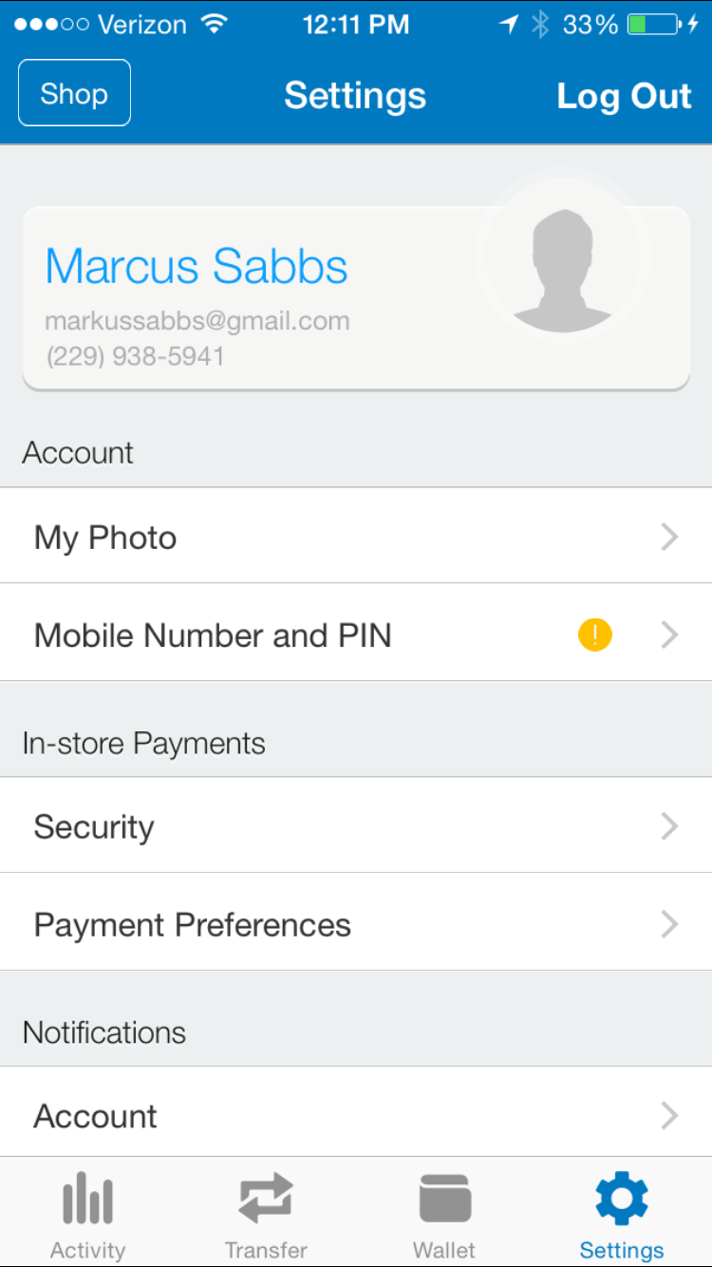
Users logging into their profile should have options similar to these.

Slide 5
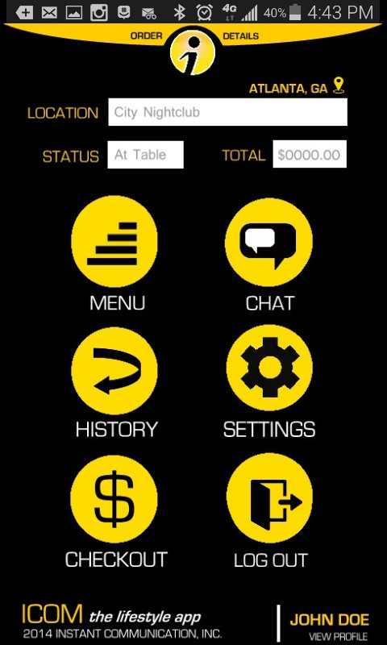
Once users are logged in, they will be directed to this “Homepage”
API used: Quickblox (insert custom content)

Slide 6
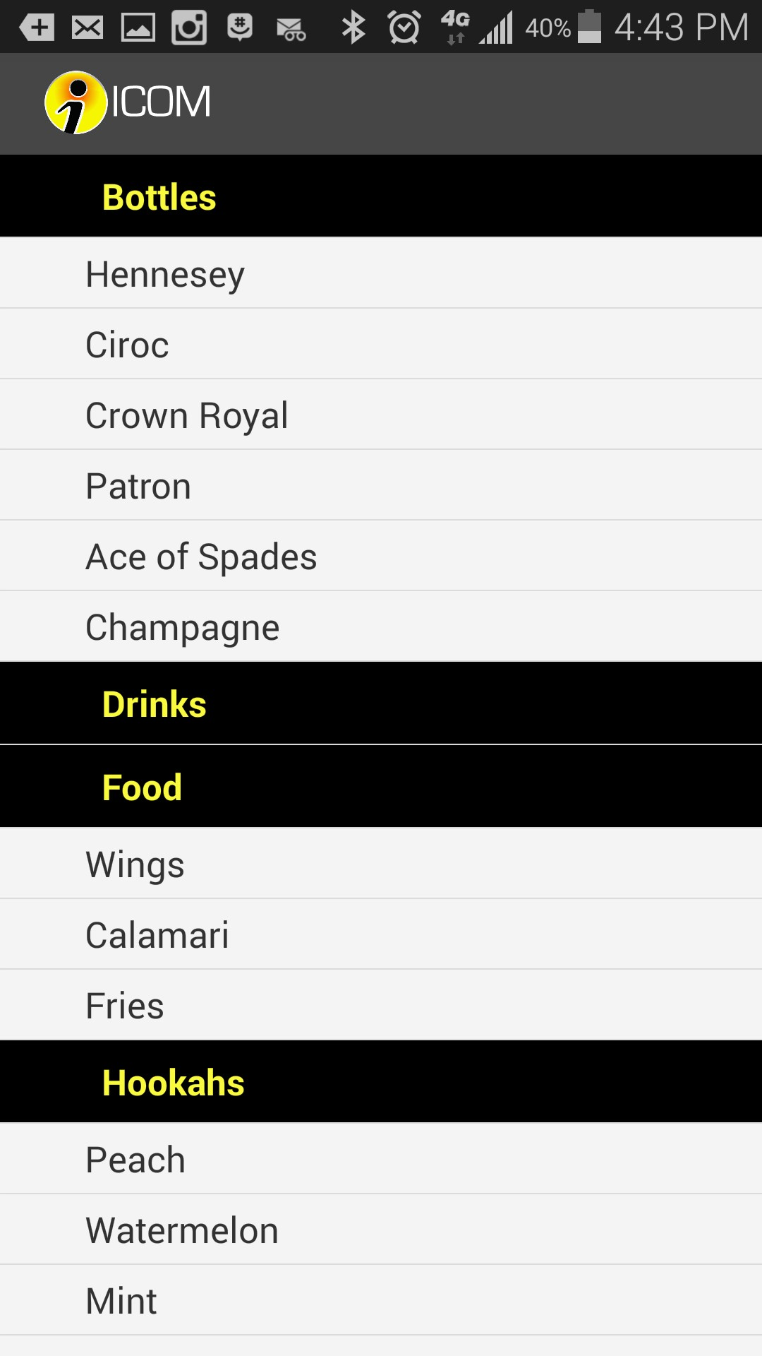
Users will have the ability to access custom menus, tailored specifically for venues in service
API used: Quickblox (insert custom content)

Slide 7
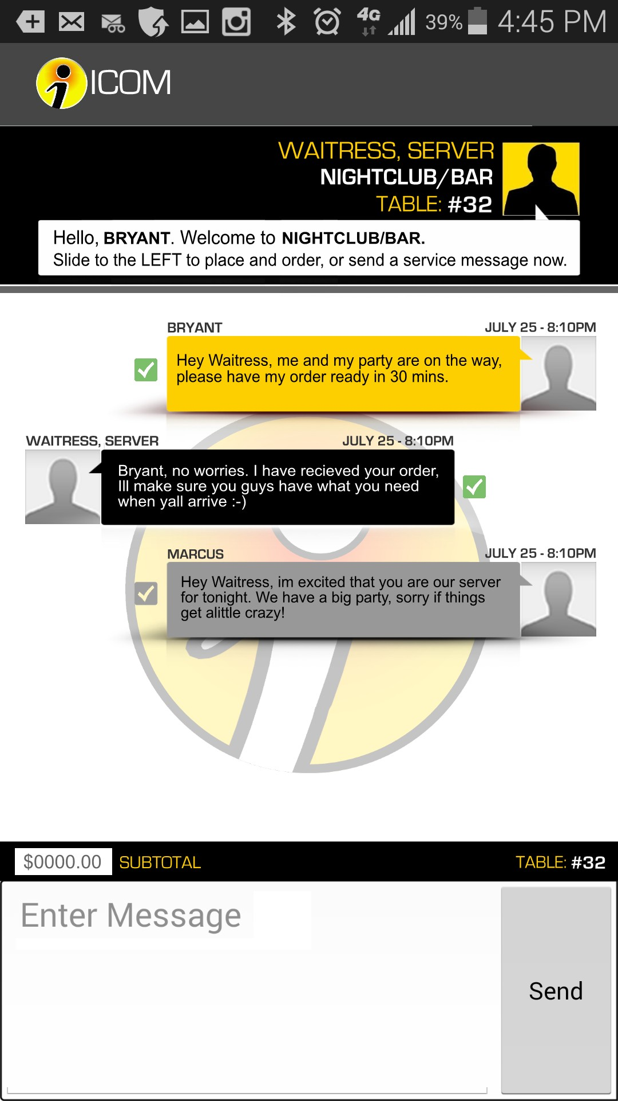
Users will be directly connected to an exclusive chat that will allow them to communicate with their server for the night. As soon as the customer leaves, hosts will have the ability to remove customers from the chat while simultaneously expiring the access code.
API used: Quickblox (insert custom content)

Slide 8
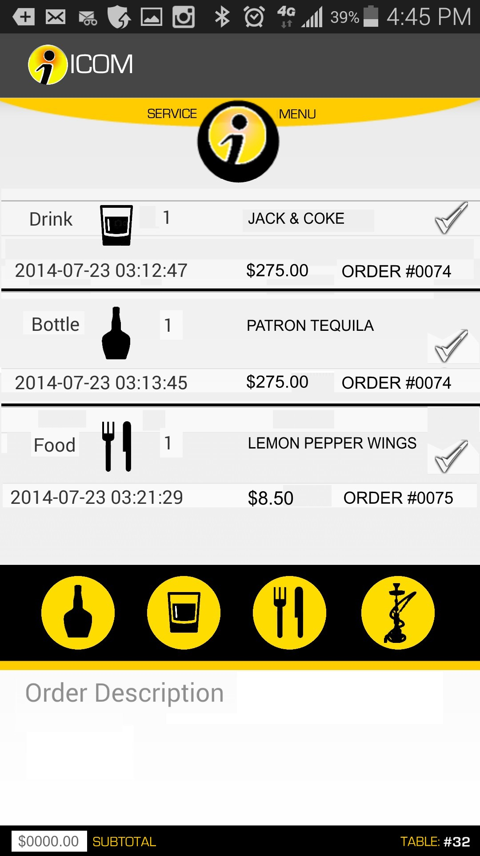
As users place orders they will be able to see their “running tab”
API used: Quickblox (insert custom content)

Slide 9
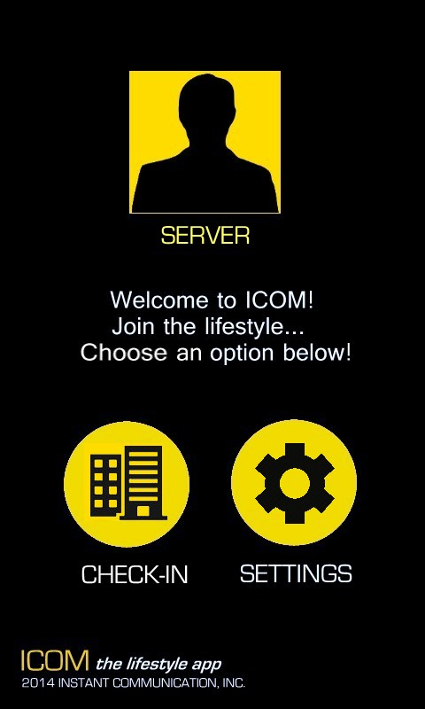
Servers first page will consist of signing into/ creating a user profile. Their profile should be able to store the following information:
Email
Employer
API used: Quickblox

Slide 10
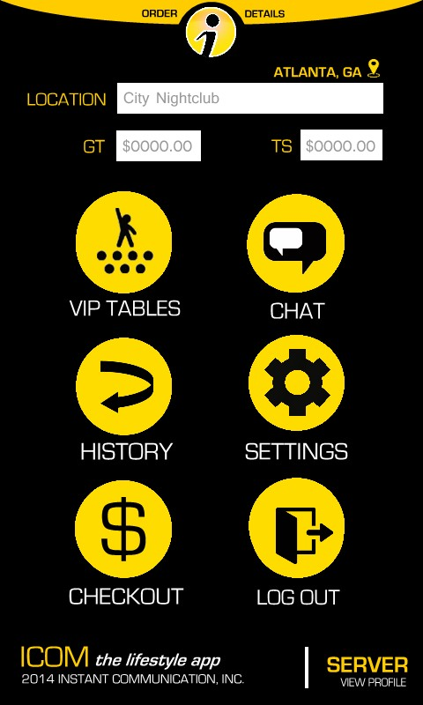
Once servers are logged in, they will be directed to this “Homepage”
API used: Quickblox (insert custom content)

Slide 11
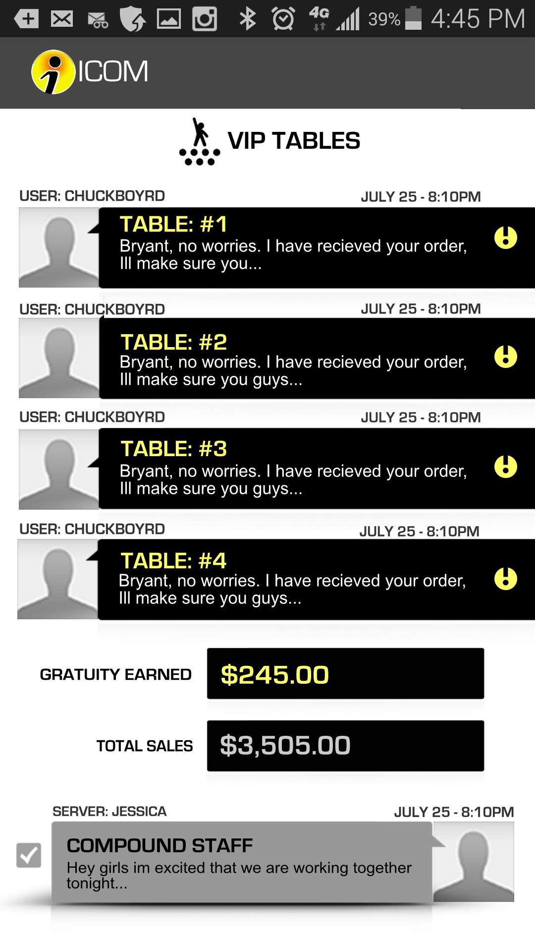
Servers will have access to serveral chats (similar to group me) so that they can communicate with users for the night. As soon as the customer leaves, hosts will have the ability to remove customers from the chat while simultaneously expiring the access code.
API used: Quickblox (insert custom content)

Slide 12
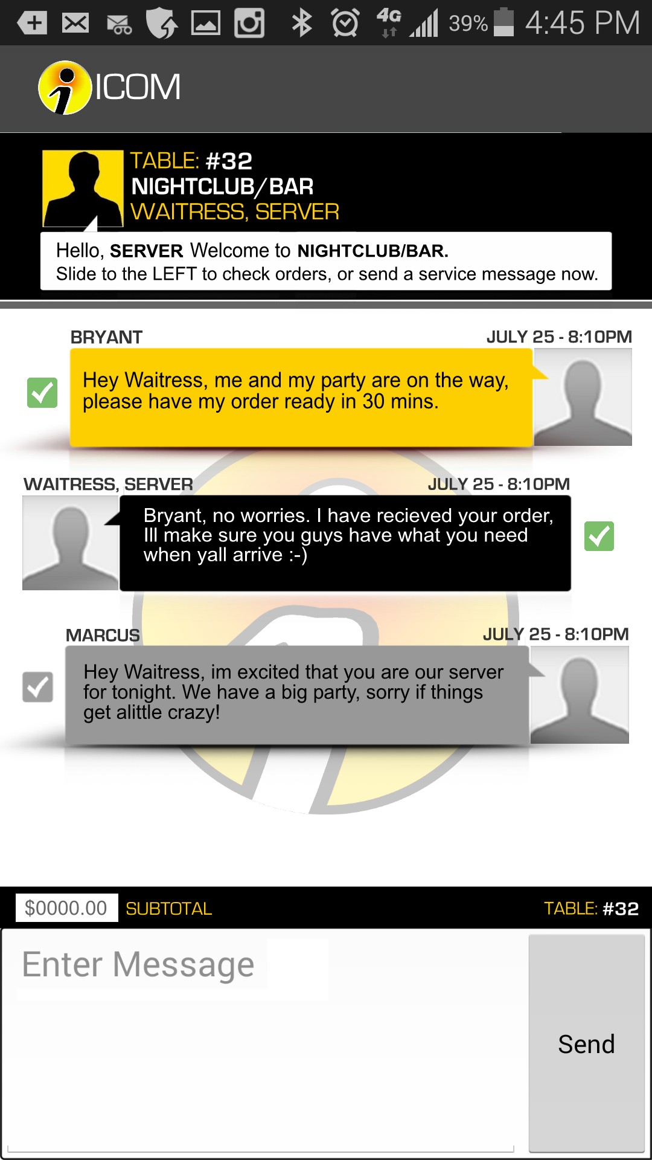
Server chat continued.
API used: Quickblox (insert custom content)

Slide 13


Beta Design logos

