Slide 1



Smart.
Fast.
Thorough.
Dossier,
January 2013
Notes:
Was hab ich davon => Highlight Customer Benefit

Slide 2
“Fundamental analysis as easy, fast and individual as it should be.”

Slide 3


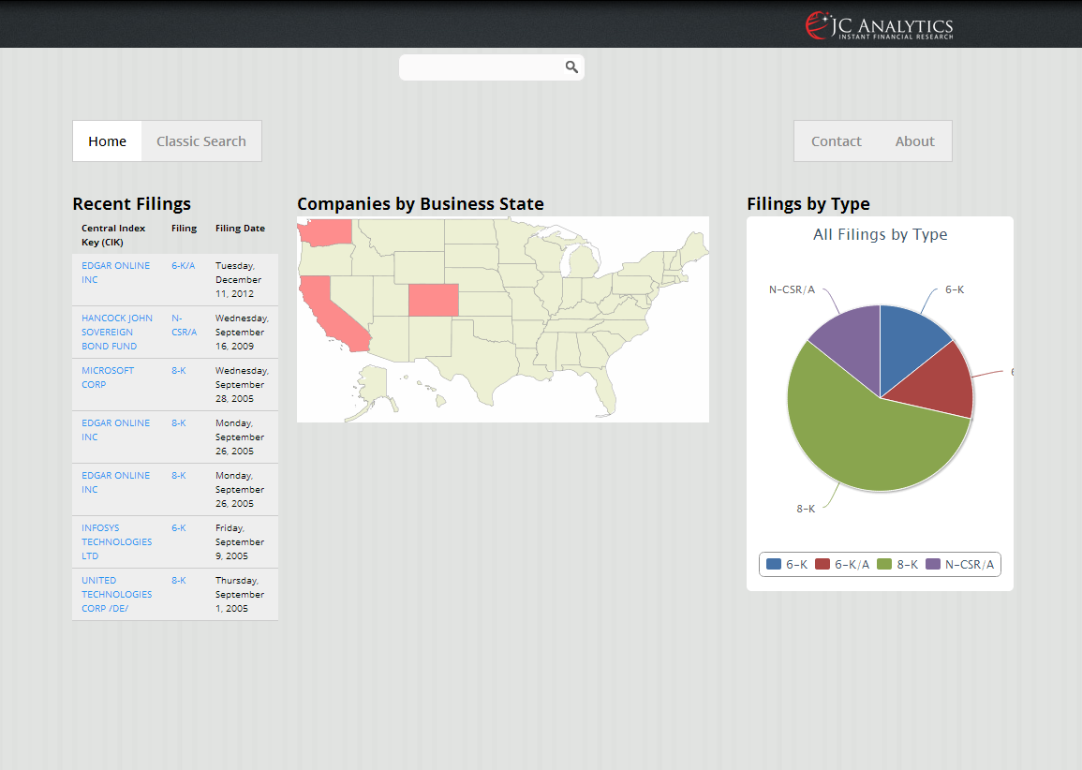
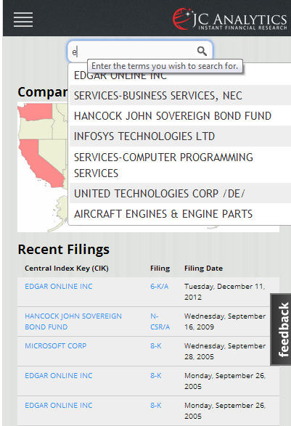

Slide 4
In a Nutshell
We provide fast, easy and intuitive access to financial fundamentals with our cloud-based research suite leveraging companies electronic disclosures.
Innovation:
Big Data:
Infrastructure Business:
Fat Tail:
Global Movement: Electronic disclosures are

Slide 5


Logos

Slide 6
Current Colors:
Blue: R: 49, G: 57, B: 174, A: 255
Red: R: 221, G: 42, B: 43, A: 255

Slide 7

Company & Contacts
Thomas Bömoser, CFA
Founder & CEO
+49 157 31 65 08 07
thomas.boemoser@jc-analytics.com
JC Analytics GmbH
Technologie- und Innovationszentrum (TIZ)
Robert-Bosch-Straße 7
D-64293 Darmstadt
www.jc-analytics.com
info@jc-analytics.com

