Slide 1
Facilitating investment in Canada
Sept 09, 2014

Slide 2
Table of Content
目录
About Invest Canada Alliance
投资加拿大协会简介
Our FDI Attraction Strategy
我们的招商策略
Investment Promotions Partnerships
协会招商平台
Services for Chinese Companies
招商落地服务
Industry Focused Business Parks
产业园区的建设
Open Discussion
开放讨论

Slide 3
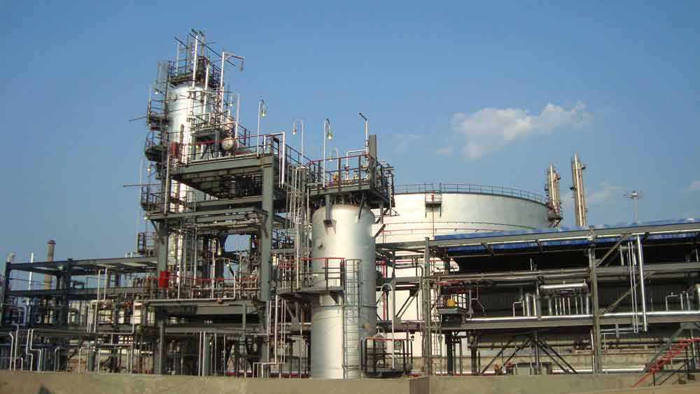

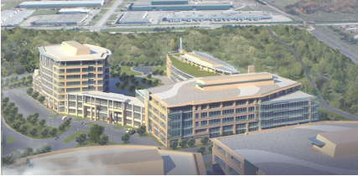
About Invest Canada Alliance
关于投资加拿大协会
Not for profit organization
非盈利组织
Mission
宗旨
  Working with all three levels of Canadian governments and Chinese investment promotion agencies to attract Chinese FDI to Ontario, Canada
  与联邦政府、安省及市级政府深入合作，配合安大略省政府及中国海外投资促进机构，吸引中国企业来安大略省投资。
  Provide tailor-made full range services to Chinese companies
  为中国企业提供量身定制的全方位的一条龙落地服务

Slide 4
Opportunity
机遇
China is going through an economic shift
中国经济正在转型
China’s outflow FDI has increased to $90.17 billion in 2013 from $0.98 billion in 2002
中国对外投资从2002年9亿8千万美金增长至2013年900亿2千万
China government is actively encouraging companies to “Go out”
中国政府鼓励中国公司“走出去”
More and more Chinese companies can compete in North American market
越来越多的中国企业有实力到北美投资
  Leaders in their perspective industry in China, even in the world
  很多有意向的公司在中国业内领先，甚至在全球领先
  Technology focuses, not labour intensive
  科技含量高，附加值高
  Have excellent financial strength
  有经济实力

Slide 5


Challenges for Chinese Companies
中国企业投资加拿大的挑战
  Challenges for these companies in the early stage
  这些公司前期面临的挑战
    How big is the market in North America?
    北美到底有没有市场？
    How does it affect my cost structure by setting up operations in Ontario?
    在安省建厂公司的产生什么样的影响？
    What about financing?
    融资怎么办?
    Even though the opportunity is here, how do I follow it up with 13 hours time difference?
    即使有机会，但有13个小时的时差，在北美没团队来跟踪项目?

Slide 6
The Unique approach by ICA
ICA独特的招商模式
Market
市场
Operation运作
Finance 财务
ICA
Platform
ICA平台
Business Parks
产业园区
Notes:
以协会为平台，整合中加两国政府与社会资源，促进并加速中加两国投资合作
以协会为核心，为中国投资企业提供量身定制的一条龙落地服务

Slide 7
Approach One: Building strategic Partnerships
特色一：架构针对中国的招商平台

Slide 8
Building the Partnerships
平台的建设
Invest Canada Alliance
投资加拿大协会
Chinese Governments
中国政府部门及招商机构
Canadian Governments
加拿大政府及招商机构
Chinese Businesses
中国企业
Chinese Business Parks
中国园区开发商
Canadian Businesses
加拿大企业
Canadian Business Parks
加拿大园区开发商

Slide 9
Partnership: Chinese and Canadian Governments
平台：中加政府与政府对接
Invest Canada Alliance
投资加拿大协会平台
Canadian Government Agencies
加拿大政府部门及组织
FedDev Ontario
加拿大联邦安省经济发展部
Ontario Ministry of Economics Development
安省经济发展厅
Chinese Government Agencies
中国政府部门及组织
Chinese Ministry of Commerce
中国商务部
Chinese Provincial Governments
中国省政府
Chinese Municipal Governments
中国市政府
ICA Partnership Municipalities
投资加拿大协会合作市政府
Economics Development Agencies and Associations
其他经济发展协会及机构
Industry Associations
行业协会

Slide 10
Partnership: Chinese and Canadian Businesses
平台：中加企业与企业机构对接
Invest Canada Alliance
投资加拿大协会平台
Canadian Businesses
加拿大企业
Chinese Businesses
中国企业
Looking for investments
需要投资
Looking for Chinese market
发展中国市场
Looking for new markets
寻求新市场
Looking for good projects
寻找项目
Looking for local partners
需求合作伙伴
Chinese Financial Institutions
中国金融机构
Looking for services
需要相关商业服务
Looking for partners
需求合作伙伴
Service Provider
提供服务

Slide 11
Partnerships:
平台：中加园区开发商与园区开发商对接
Invest Canada Alliance
投资加拿大协会平台
Canadian Business Park Developers
加拿大园区开发商
Chinese Business Park Developers
中国园区开发商
在中国的招商资源
Chinese Business Development Resources
增强在中国招商力度
Strong Presence in China
加拿大本地开发经验
Canadian local experience and expertise
为园区吸引本地企业
Canadian and global businesses to come to the business parks

Slide 12
Approach Two: Offer Tailor made services for Chinese businesses
特色二：为中国企业量身定制一条龙落地服务

Slide 13

Services: Market
落地服务：市场
Seeking a concrete opportunity
for companies that are looking to
invest in Ontario
为有意向的企业提供具体项目
Market Study
市场调查
Cost Structure Verification
成本结构验证
Canadian Business Model
Development
加拿大商业模式开发
Business Plan
商业计划
Feasibility Study
可行性研究报告

Slide 14
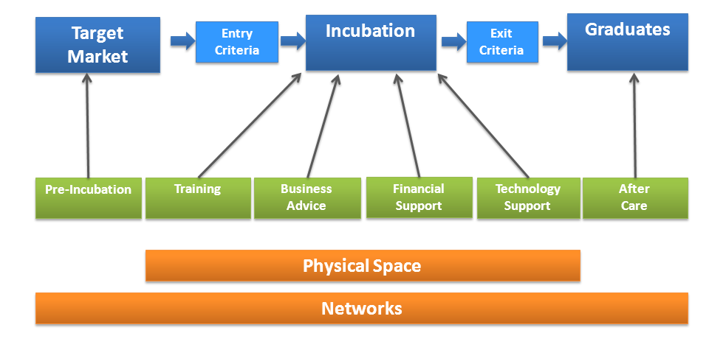
Services: Incubator
落地服务: 企业孵化器
Provide service as Chinese companies’ initial project manager
作为中资企业前期的项目经理，提供前期运营服务
  In the process of establish
  an incubator
  协会正在筹建孵化中心
  Site selection
  在安大略省的选址
  Assist in applying for grants
  申请政府拨款/贷款
  Government Relations
  协调政府关系
  Assist to build a Canadian team
  协助组建本地团队
  Provide office space for companies at the early stage
  为企业提供前期办公场所

Slide 15

Services: Financing
落地服务: 融资
Chinese Companies’ Actual Investment
中国企业投资
10% -- 30%
Canadian Government Grants/Loans
加拿大政府拨款/贷款
0% -- 10%
Debt Financing by Chinese Institutions
通过中国金融机构贷款
70%
Canadian local funds
加拿大本地产业基金
0% -- 10%

Slide 16
ICA Business Development Centre
投资加拿大协会招商中心
Receive Chinese Delegation and Promote Investment in Canada
接待中国访问团宣传加拿大的投资优势
Incubator for Chinese company investing in Canada
中国企业孵化器
Promote Partnered Chinese provincial/municipal governments
与中国省市政府合作介绍当地投资机会
Provide Professional Business Services at a Central Location
提供专业性的落地服务

Slide 17

Toronto Centre
多伦多中心正在筹备当中

Slide 18

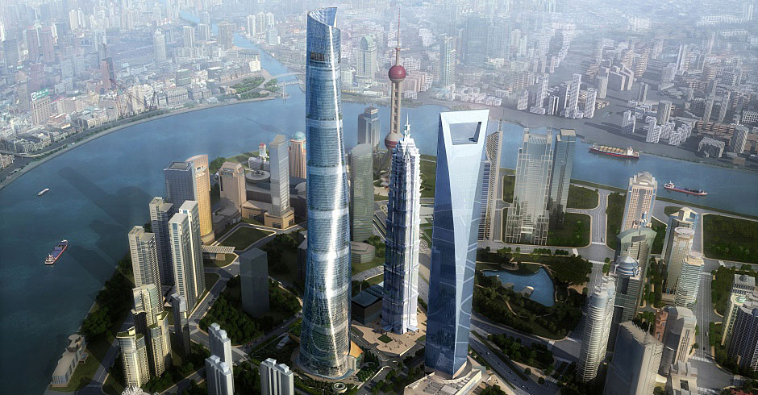
Business Development Centre in China
中国招商中心
We have a plan to set up a business development centre in China as well.
我们也有计划在中国建设招商中心
If there is an opportunity, we hope to establish the centre with an agency
如果有机会我们也希望和中国的机构合作建立

Slide 19
Approach Three: Building Industry focused Business Parks
特色三： 建立以产业为主题的工业园区

Slide 20
Industries Focused Business Parks
打造主题产业园区
Advanced Manufacturing
先进制造业
Medical & Life Science
医药和生命科学领域
Green Technologies
绿色环保业
Information & Communications Technologies
信息技术业
Financial Services
金融服务业

Slide 21
Importance of a business park
园区对招商的意义
Utilizing Chinese businesses as anchors, attracts companies from Canada and around the world to build an industry cluster
以吸引中国企业投资为龙头，同时吸引加拿大及世界各地相关企业入驻产业园。
Targeted FDI promotion
有针对性招商
  These industries have big markets in North America
  招商企业在北美有市场、有优势
  Provide in-depth industry focused business services
  提供深入的业内资讯服务
A concrete project moving forward
作为具体项目进行推进

Slide 22
Importance of a business park
园区对招商的意义
Bringing in private partners in FDI attraction efforts
整合社会资源，投入招商工作
  Chinese and Canadian Business Parks Developers
  加拿本地开发商、中国开发商
  Chinese and Canadian Industry Associations
  加拿大与中国的行业协会

Slide 23
Business Park Operation Model
园区的运作模式
Chinese and Canadian Government Agency Set Policy for the Business Park
加两国政府牵头
Joint developed by Chinese and Canadian Businesses
中加两国开发商联合开发产业园，及配套设施
ICA will be responsible for FDI attraction
投资加拿大协会发展厅负责招商
ICA working with Ontario Ministry of Economic Development and local economic development partners to provide services
协会与安省及市政府招商机构提供落地服务
Our partnership financial institution will provide financing support
由协会合作的金融公司提供资金支持

Slide 24
Peterborough Industrial park
彼得堡工业园
Pilot Project led by The City of Peterborough
与彼得堡市政府的试点项目
The City of Peterborough provide industrial land for the industrial park
由市城府提供园区前期工业用地
Local developer: Bromont Group
本地开发商：博茂集团
Chinese developer: Jingmei Group
中国开发商：京煤集团
Financing support: China Development Bank
融资支持：中国国家开发银行
Status: Bromont Group and Jingmei Group is doing due diligence on each other
项目进展：博茂与京煤集团在做彼此的尽职调查

Slide 25
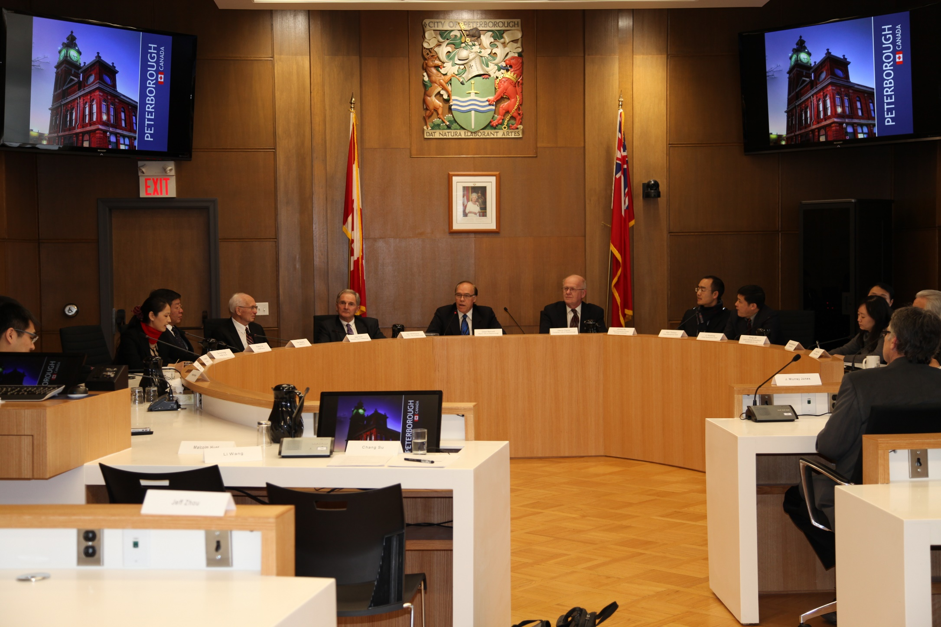
Peterborough Industrial park
彼得堡工业园
Beijing Jingmei Group working with the City of Peterborough and local developer Bromont Group
北京京煤集团与彼得堡市政府及当地开发商博茂集团洽谈合作

Slide 26


Our Success in 2013
2013年成绩
Two companies have formally signed agreements with Invest Canada Alliance
与投资加拿大协会正式签约有两家企业
  A Life Science Company
  生物科技公司
    $40 million investment
    4千万加币投资
    Create 50 jobs in Canada
    在加拿大创造创造50个就业
  A Green Technology Company
  绿色节能企业
    Phase I: $20 million investment
    第一期投资2千万
    Total investment: $100 million
    总投资：一亿加币投资
    Create over 100 jobs
    在加拿大创造100个就业

Slide 27
Projects in Progress
正在进展的项目
Curtain wall
玻璃幕墙公司
Steel Structure
钢结构公司
Industrial Tape
工业胶带公司
Data Centre + Financial Service Information Technology
数据中心及金融信息产业综合性开发
Research and Development centre for a cellphone manufacturer
手机公司研发中心及未来生产基地

Slide 28
Contact us:
416-699-2288
info@investcanada.org

