Slide 1


Slide 2
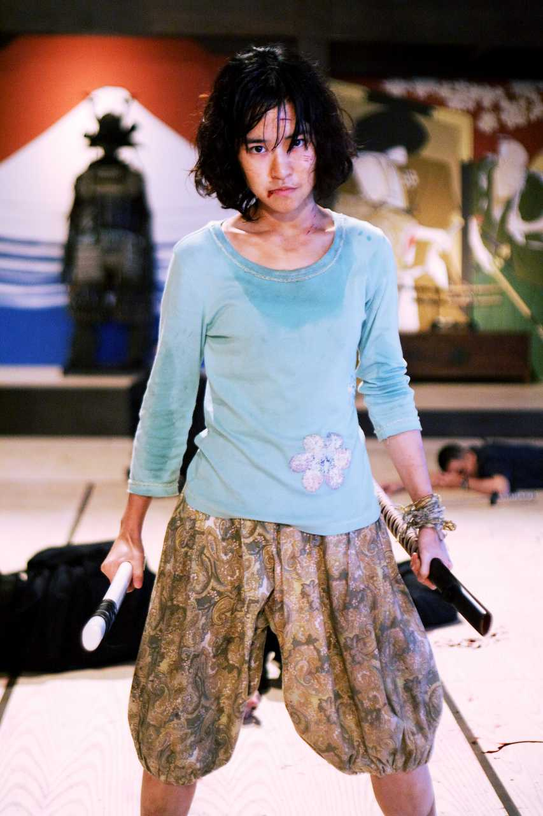
Whirlwind’s Daughter
A widow’s act of vengeance brings the wrath of both the Triad and the police down upon her and her loved ones.

Slide 3
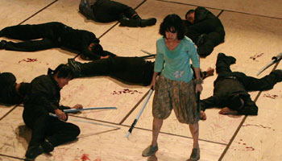
Vengeance is Sweet…
Typically revenge movies end with the successful act of vengeance

Slide 4
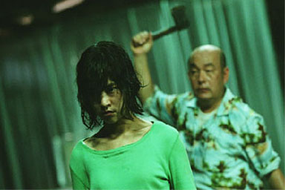
…Until It’s Not
Revenge isn’t the end of the story, it’s just the beginning.

Slide 5


Visceral Action
No wire fighting. Just visceral punches that the audience can feel.

Slide 6
Key Characters

Slide 7



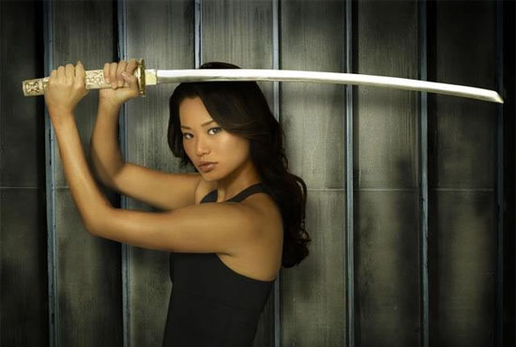


Kim Chang
Brooding, obsessed and deadly
Maggie Q
Jamie Chung
Charlene Choi

Slide 8
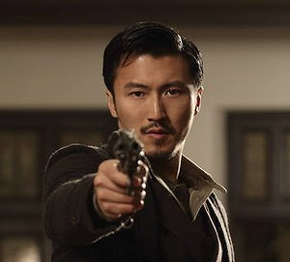

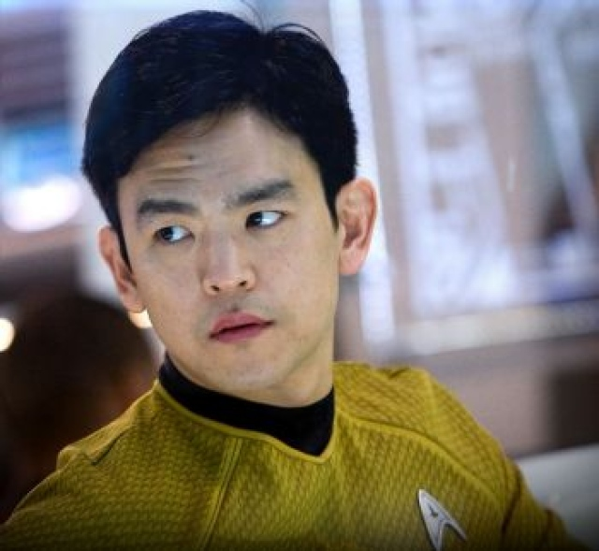
Roger Leung
Earnest, trustworthy, a rule-follower
Nicholas Tse
Steven Yeun
John Cho

Slide 9
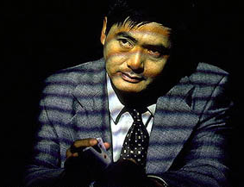
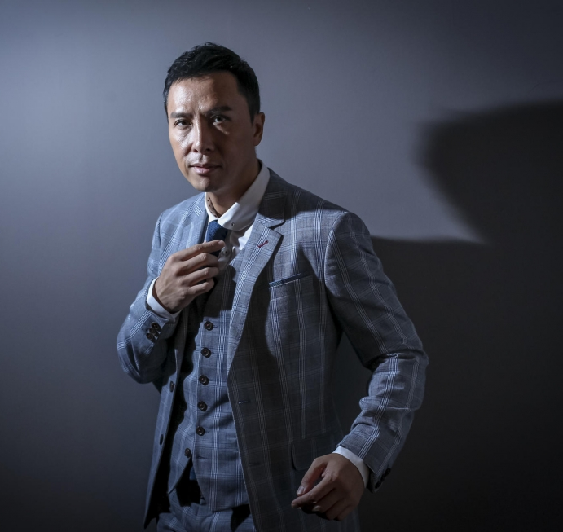
Paul Li
Intelligent, ruthless, and charming
Yun-Fat Chow
Donnie Yen

Slide 10
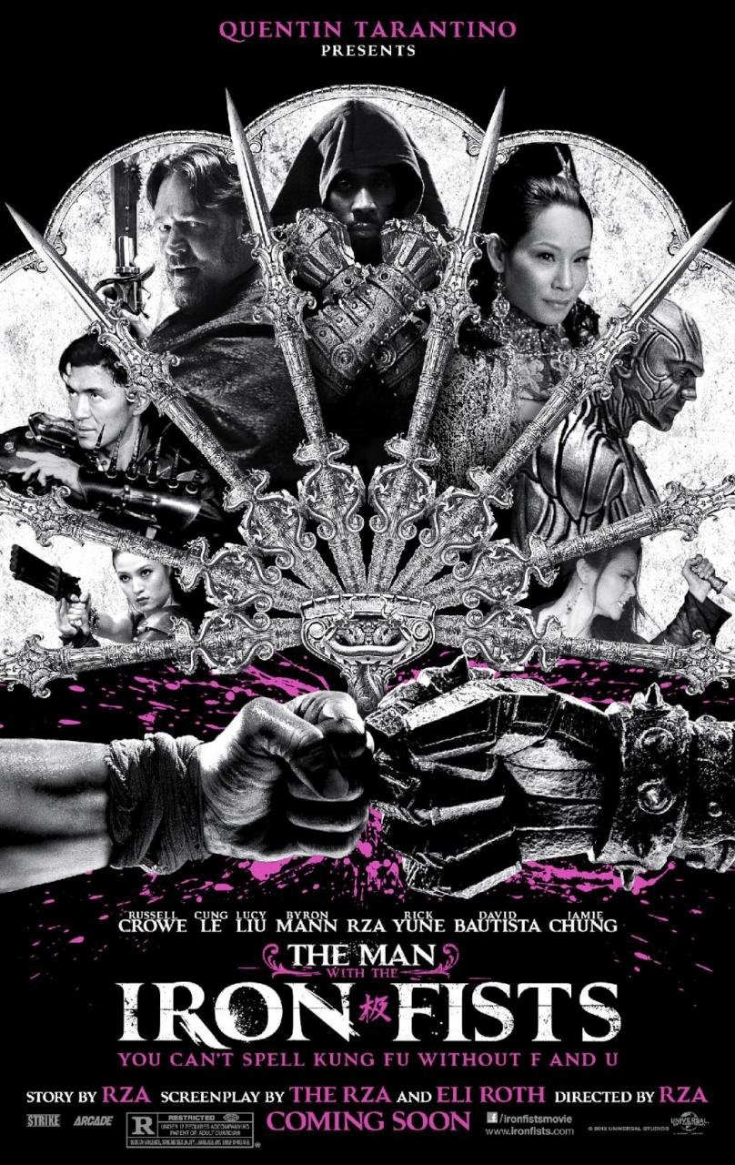
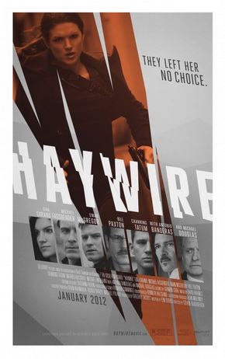

The Business Side
Martial arts films have a solid fan base internationally. And female-led thrillers have a proven track record.
The Man With The Iron Fists (2012)
Estimated budget (incl P&A): $15M
International box office: $22M
Domestic DVD/Blu-ray: $11.5M
Haywire (2012)
Estimated budget: $23M
International box office: $34.5M
Domestic DVD/Blu-ray: $9.5M
Tai Chi Zero (2012)
Estimated budget: $12M
International box office: $25M

Slide 11
Mediabiz
Mediabiz was founded in 2000 by Karine Martin.
It has two distinct but complementary units: Production and Financing.
Its access to reliable sources of capital means it can accelerate execution of projects for the international market.
Financial Division
Mediabiz has raised two funds: Mediabiz Capital and Mediabiz Investment.
Mediabiz Capital supports Mediabiz’ production division and its strategic partners by providing:
Gap financing
Bridge financing
Presales financing
Government tax credit and subsidies financing
As added value to Mediabiz Capital’s debt product, Mediabiz Investment is an equity fund which will co-invest on a pro-rata participation basis with other equity investors on a project.

Slide 12
Mediamax
Mediabiz’ award-winning production division, founded in 2009 with support from a billion dollar pension fund.
Our model:
Experienced development team
Experienced production team
Leverage our substantial and stable access to capital and our long-standing relationships with international sales agents, distributors and broadcasters.
Recent productions:
Midnight Sun (feature) – Producer, Mediamax (Montreal)/H.D Productions SRL (Italy), $17M
Outcast (feature) - Producer, Mediamax (Montreal)/Yunnan Film Group (China)/22h22 (France), $25M
Maïna (feature) - Producer, Mediamax (Montreal)/Productions Thalie (Québec)/Nuit Blanche (Montreal), $9.5M
Speedracer (animated series) - Executive Producer, Mediabiz International/Mediamax (Montreal)/Toonz (Singapore), $6.9M
Magic Beyond Words (TV movie) - Producer, Mediamax (Montreal)/Lifetime (USA), $3.8M US
The Moth Diaries (feature) - Producer, Mediamax (Montreal)/Samson (Ireland), $12M

Slide 13
State of the Project
We have a draft that has been through multiple revisions
• Still room to make changes to better meet the needs of the Chinese market.
• Fast pace of turnaround. By our estimate 3 months to complete a polish and another 6 months to complete packaging.
• Development will be financed through Mediamax’ operating budget, using existing staff already in place.

