Slide 1
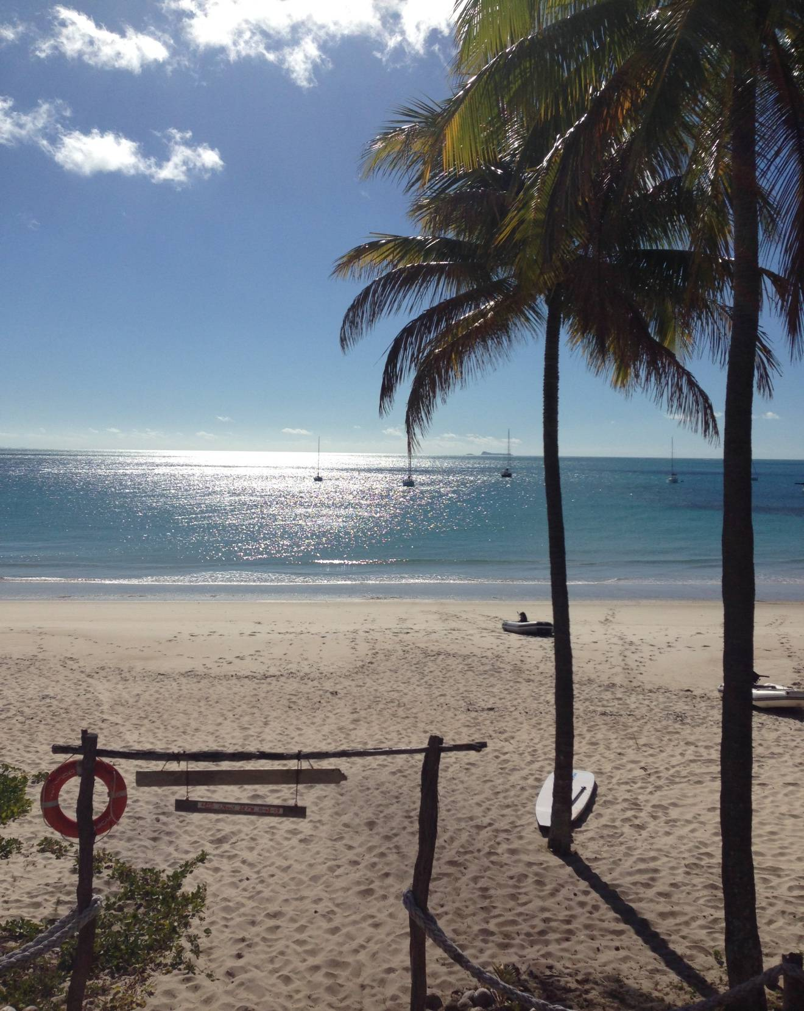
JOIN US
FOR SUNSHINE,SAILING
AND SNORKELLING ON THE
GREAT
BARRIER
REEF!

