Slide 1
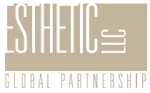

Slide 2
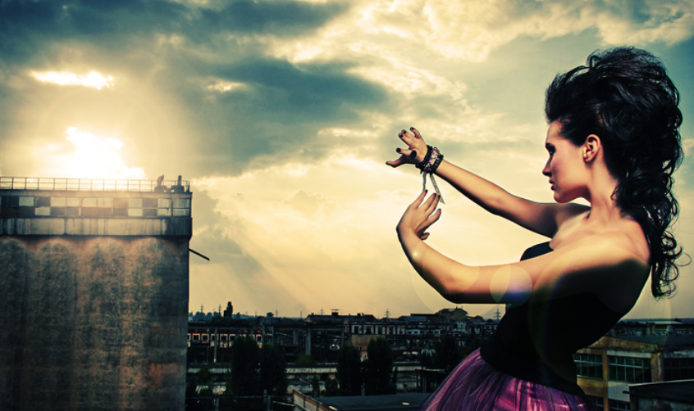
Esthetic [es-thet-ik] : a principle of taste or style adopted by a particular person, group, or culture

Slide 3
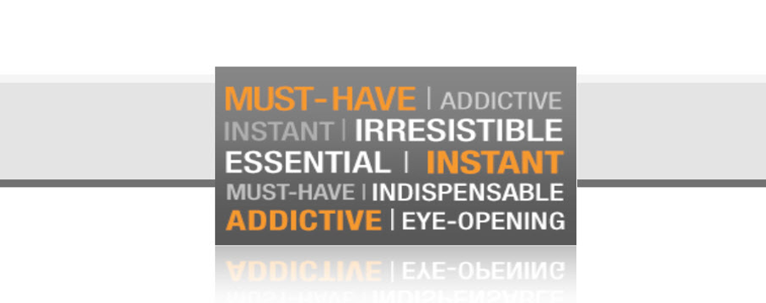

Slide 4
Esthetic ignites profitable product solutions and powerful brand equity from Trends specific to you and your customer.
We distill direction from catwalks, and translate it into bespoke, executional factory production line lingo.
We are agents of Consumer Trend Alchemy, and the Secret Weapon in your Brand Development arsenal.
Trend Forecasting, Look Book Creation, Private Label Brand Design, Product Development, Consumer Profiling.

Slide 5
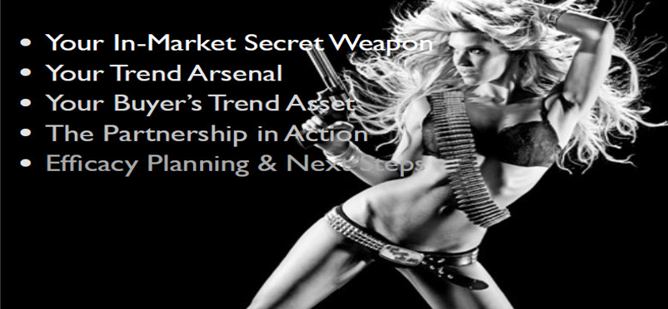

Slide 6
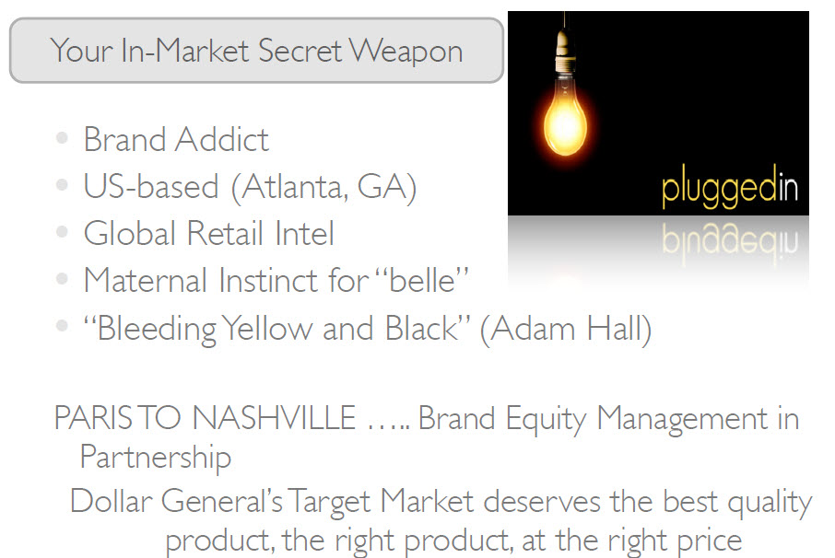
(read on)

Slide 7
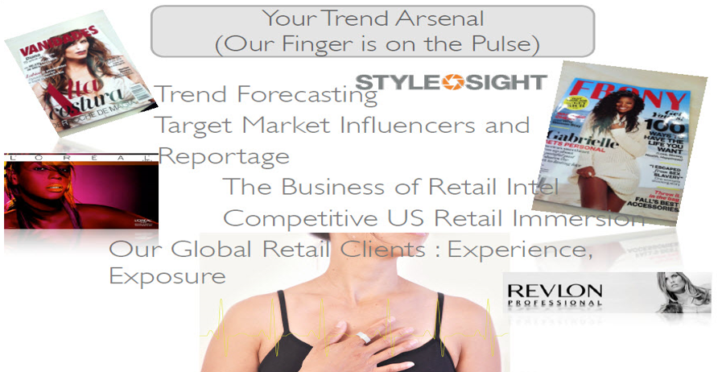


Slide 8
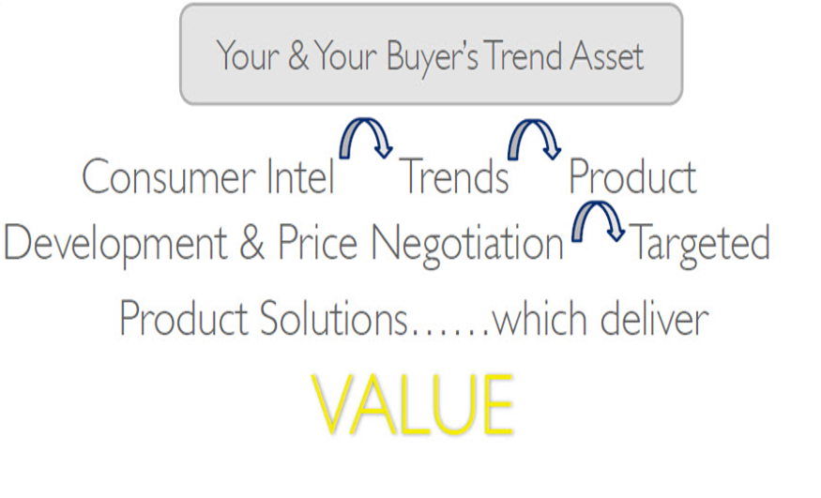

Slide 9
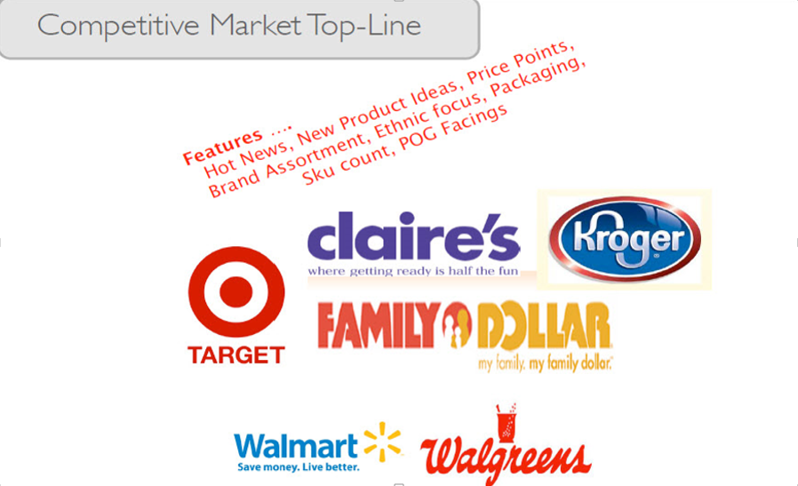

Slide 10
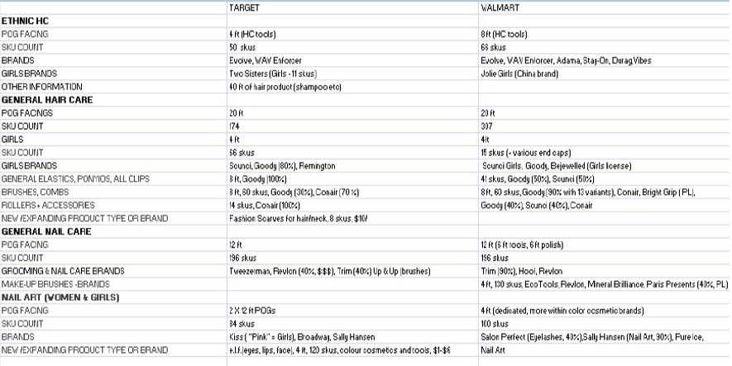
intel is king

Slide 11
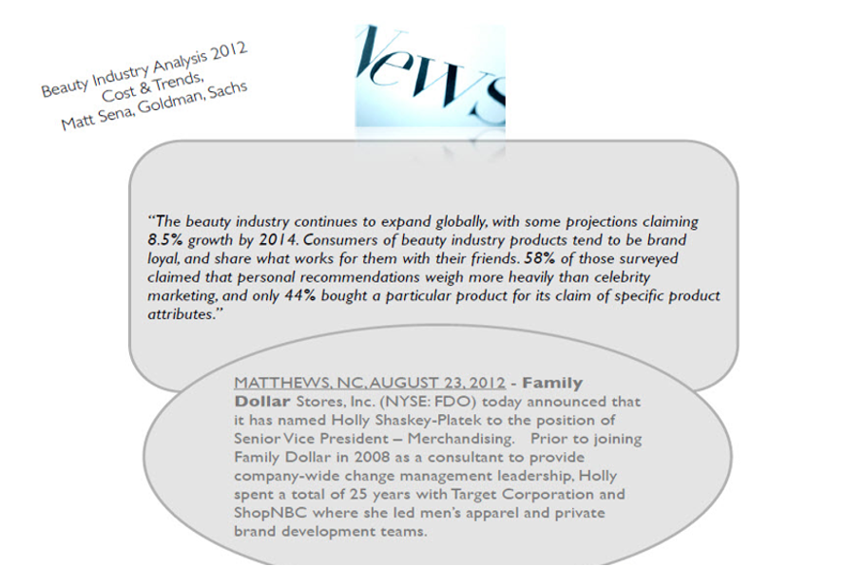

Slide 12
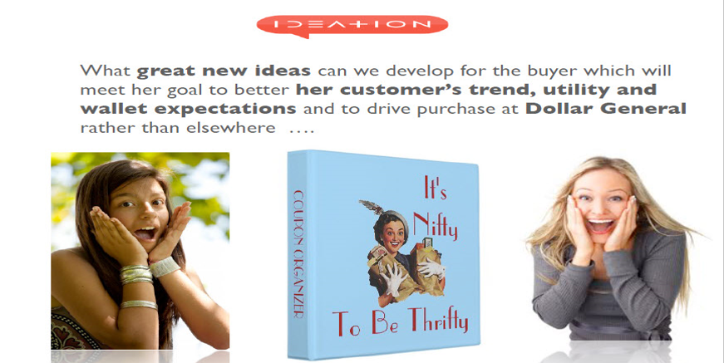

Slide 13
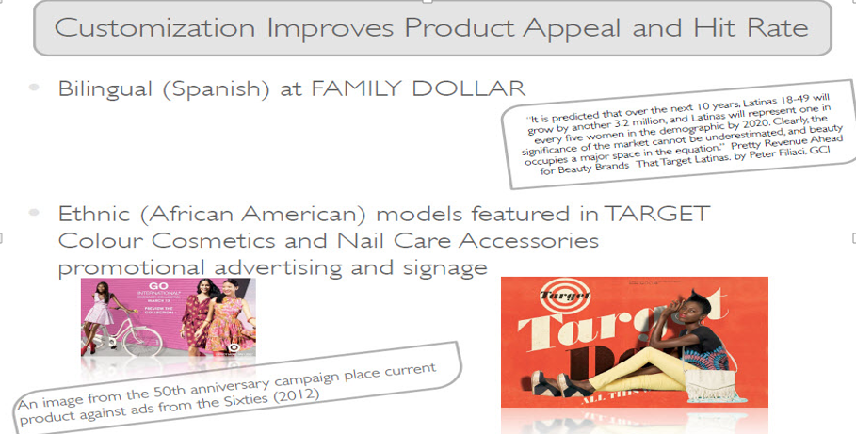

Slide 14
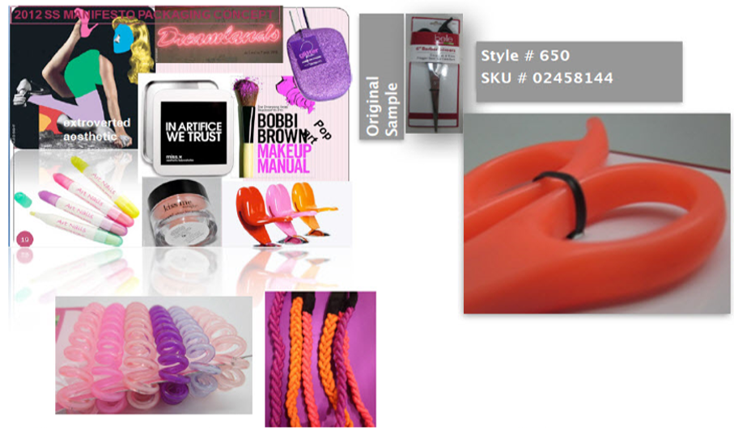
trends evolve into UPC codes

Slide 15
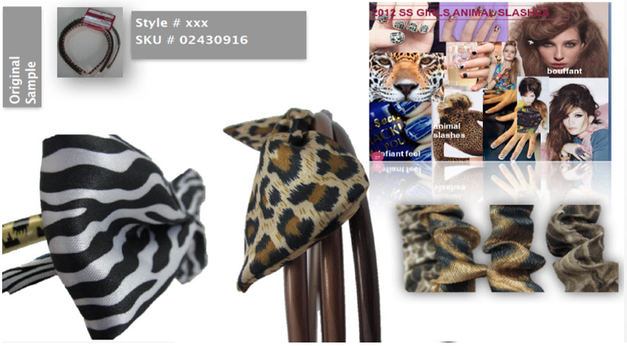
trends evolve into UPC codes

Slide 16
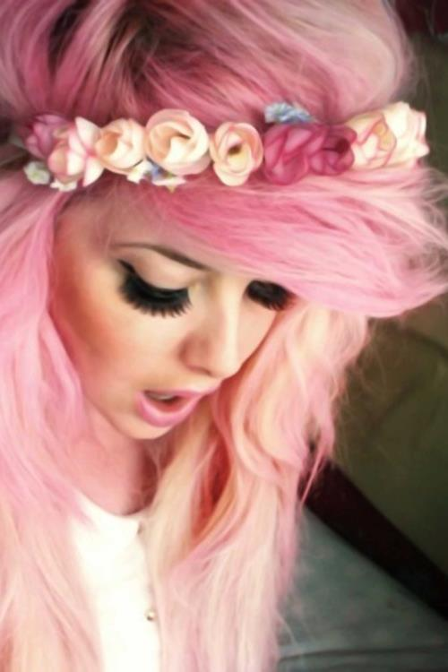

a story
about a brand
belle
born 2007
came of age 2012
all grown up 2014

Slide 17
the challenge
We were asked design the Private Label brand packaging for Dollar General’s belle hair care & nail care for women/girls & to manage the category.
This would :
Give Dollar General shoppers as much VALUE as possible
Improve the ‘shop-ability’ of the stores
Attain more share of wallet to Dollar General by redirecting traffic from grocery stores, drugstores and big box retailers (Wal-Mart)
Deliver an invigoration of brand equity to the Dollar General brand families

Slide 18
specifics from the buyer
Reduce the number of sizes of packaging to 3 sizes, and in so doing bring more consistency to the planogram by having less ‘card’ size
Revamp the design/color of the belle packaging
Visually unify all sections
Keep Pink (or some variation thereof) for young girls
Make the women’s accessories look more contemporary

Slide 19
brand message
  Quality beauty - tools & accessories at a great value price to give a woman a fashionable look for any occasion
  belle is empowering to women & girls – it offers an opportunity to afford good quality, fashionable, accessories which help her feel the best she can feel…
  Buy belle products – because you’re worth it.

Slide 20
brand positioning
  belle will create a powerful alternative purchase to national brands with a hot, fresh look/feel at a lower price
  This Private Label brand provides a better margin to Dollar General and lower retail costs for the consumer (as compared to national brands)
  A fashionable brand which offers a ‘high perceived value’ look at a value price

Slide 21
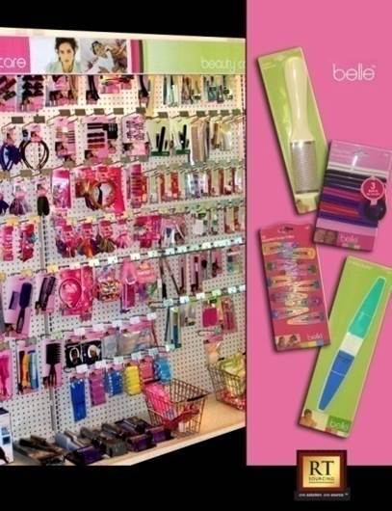
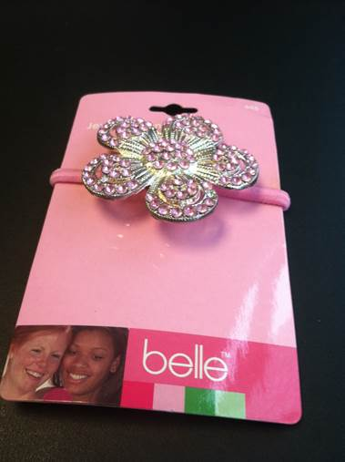
belle · the history · 2007

Slide 22
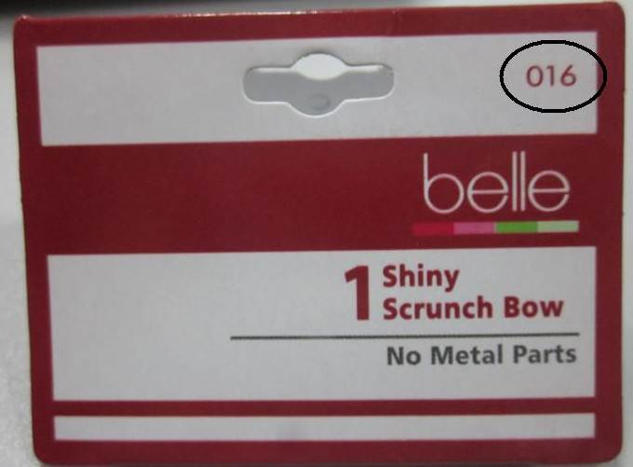
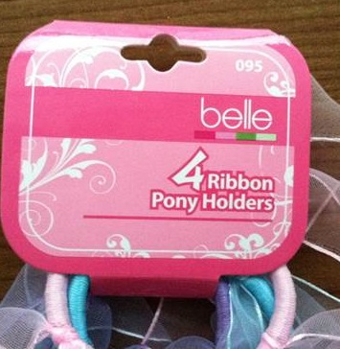
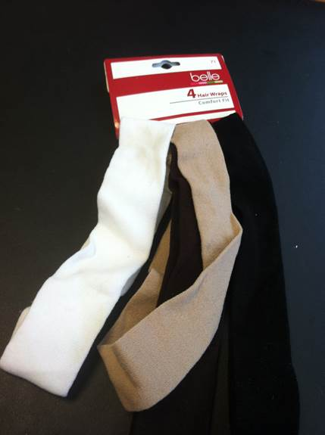
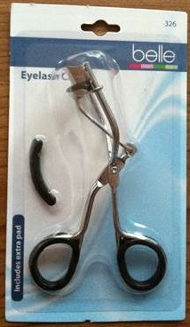
belle · 2013 · confusion on the shelf
·

Slide 23
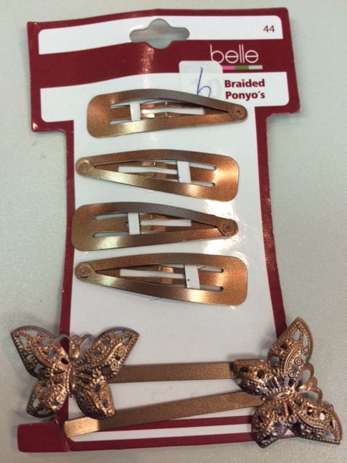
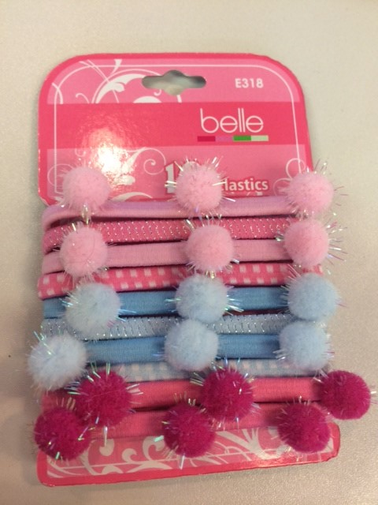
`
anarchy required

Slide 24
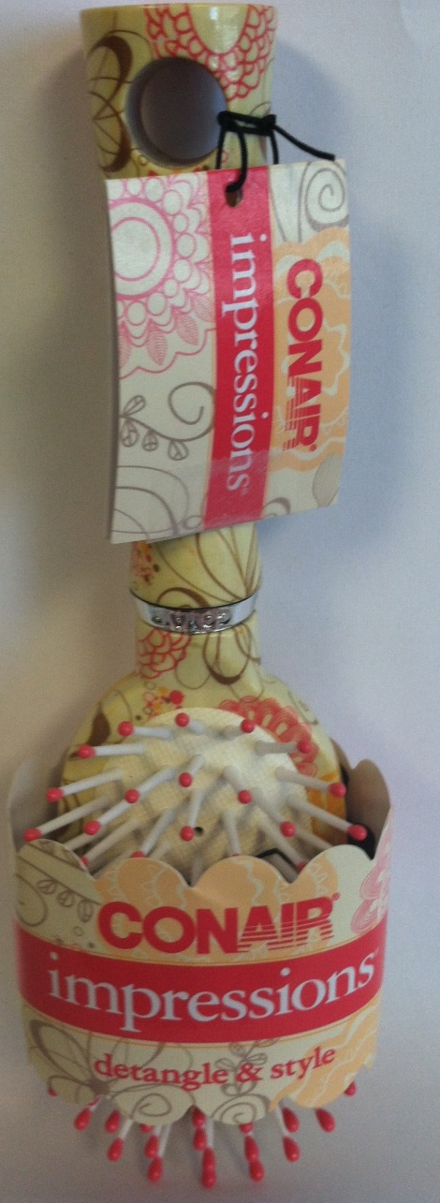
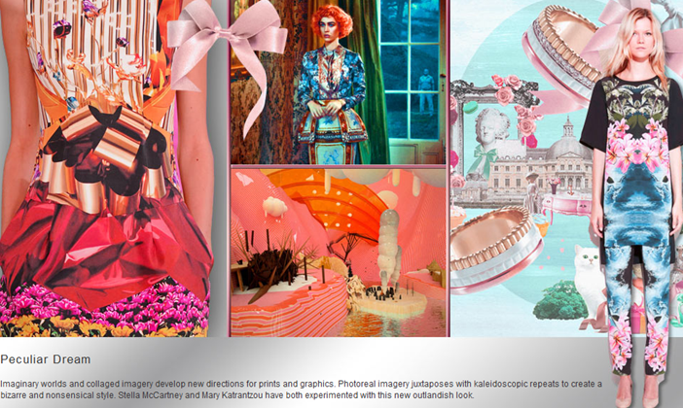
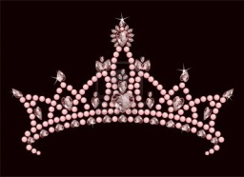
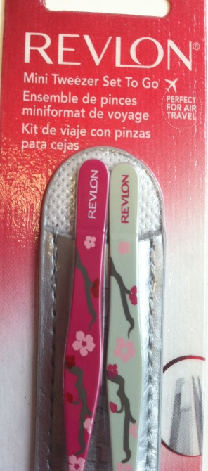
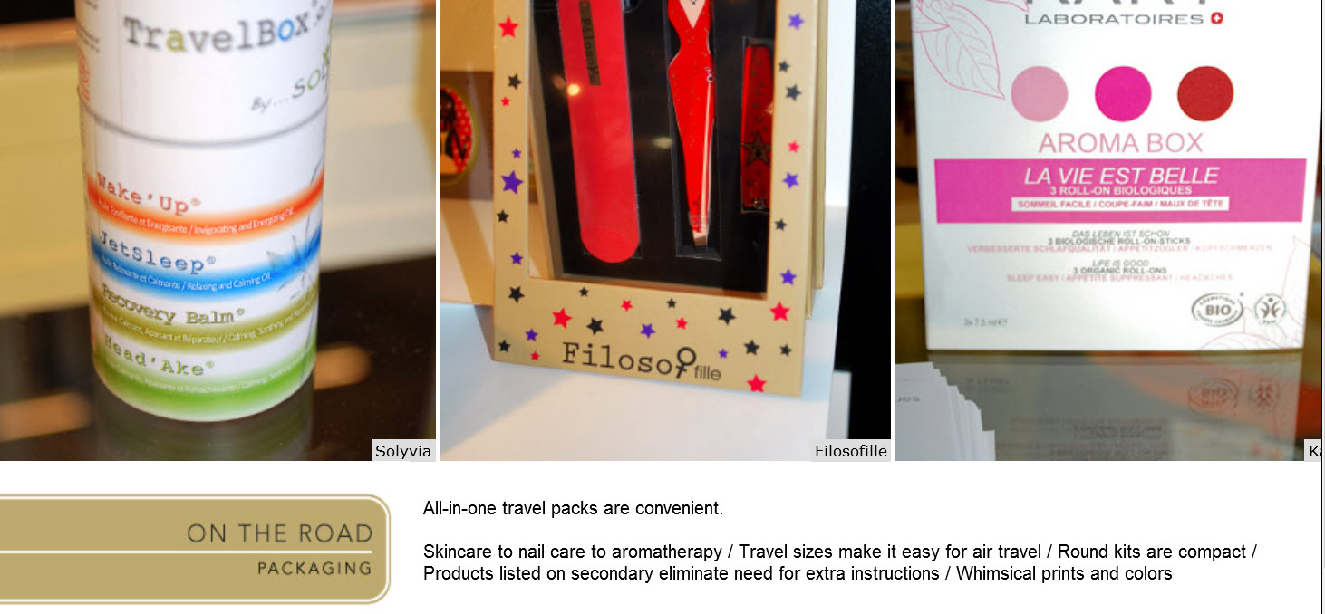
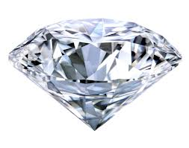
concept # 1 “feminine florals” - inspired by
Beauty Beyond Paris, 2013 Packaging Trends

Slide 25
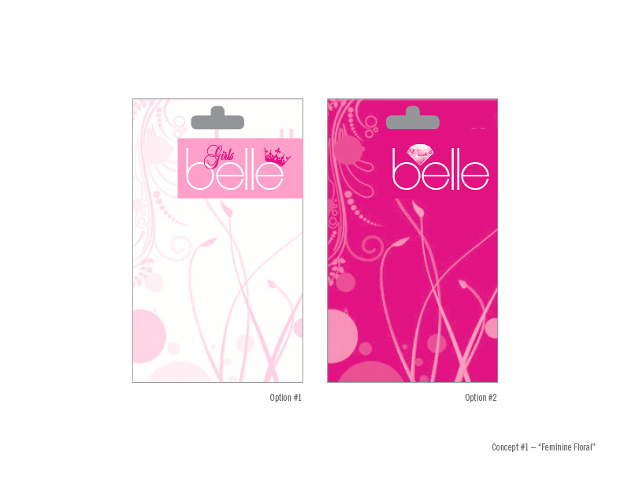

Slide 26
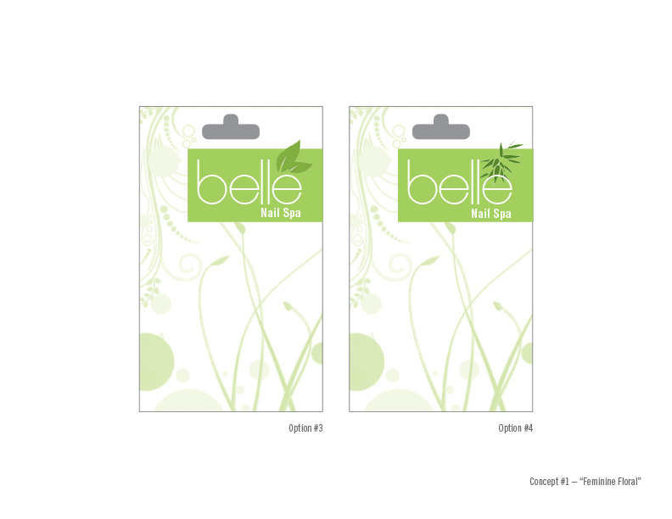

Slide 27
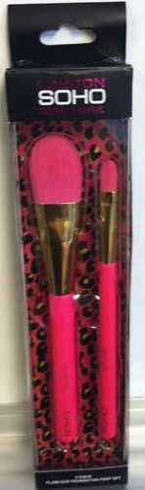
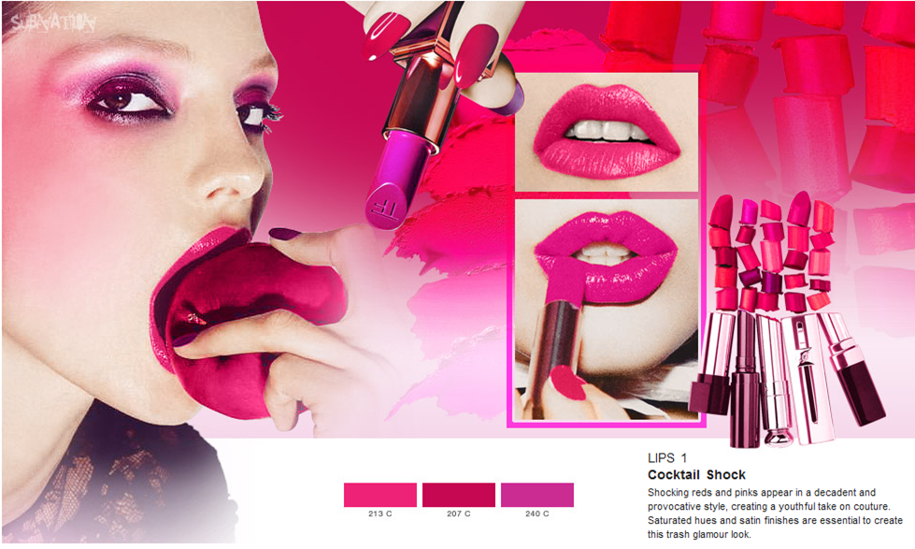
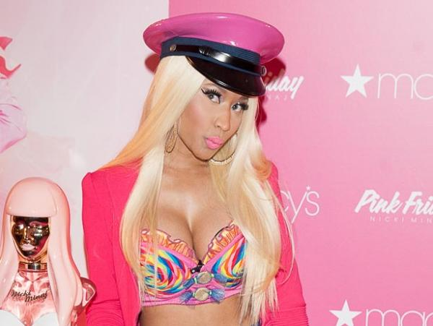
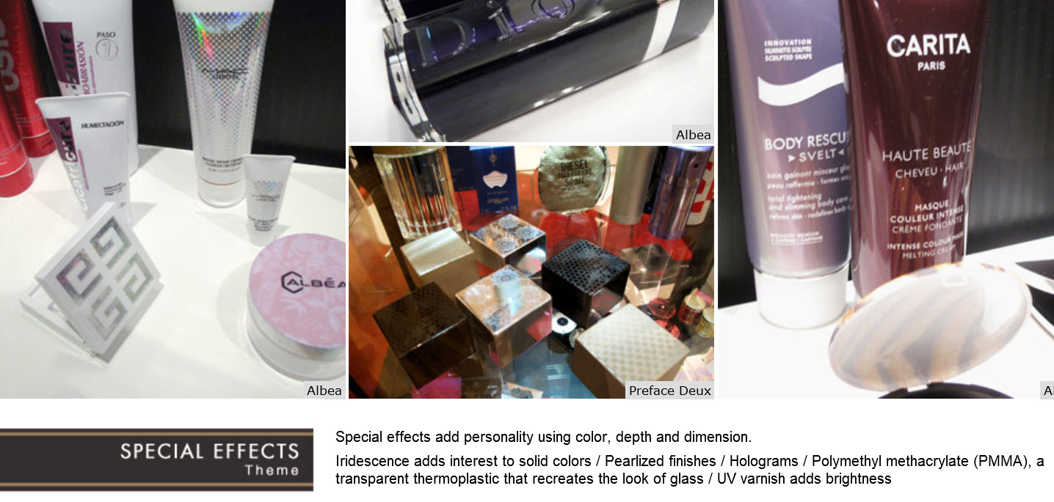
concept # 2 “Club belle” - inspired by
LuxePack, New York 2013 Packaging Trends

Slide 28
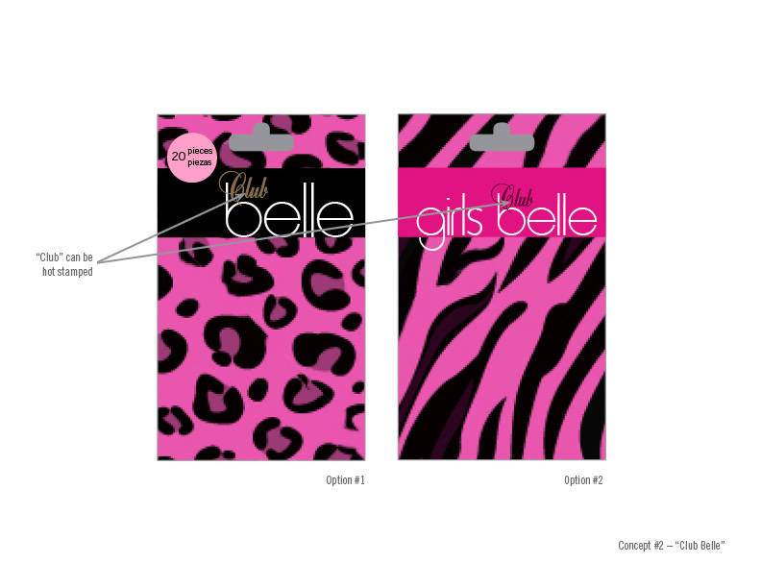

Slide 29
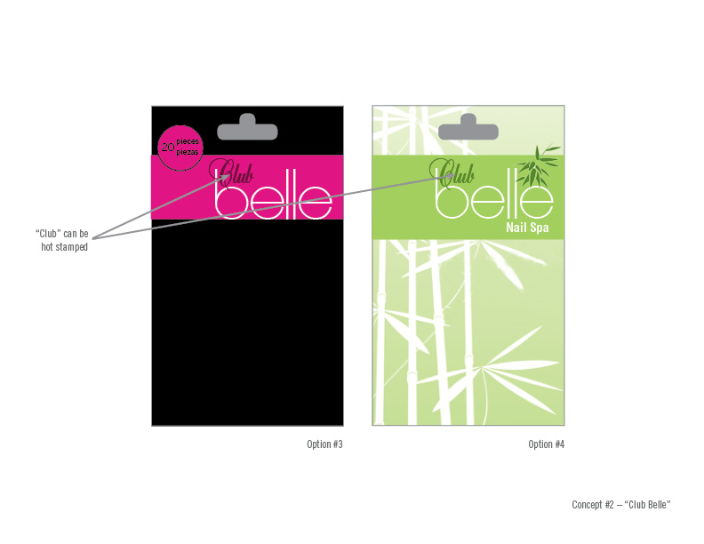

Slide 30
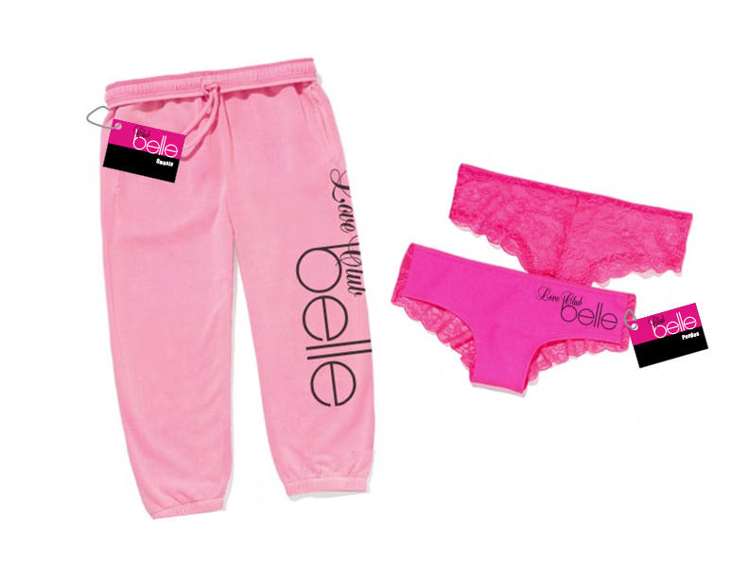
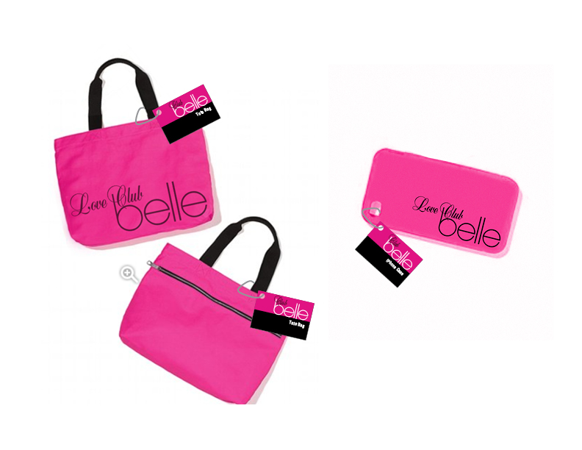
the world of belle … introducing the Club belle line

Slide 31
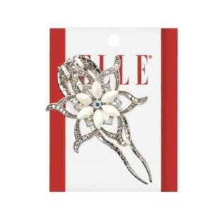
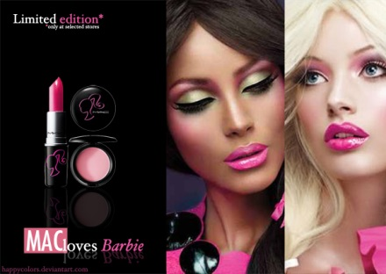
concept # 3 “Elle” - inspired by

Slide 32
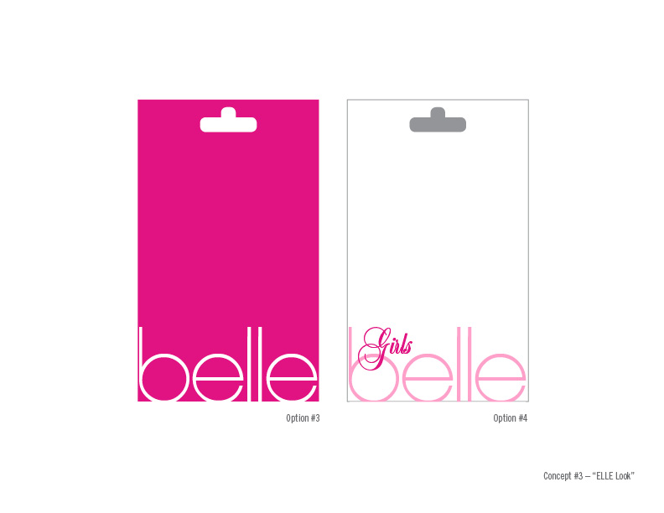

Slide 33
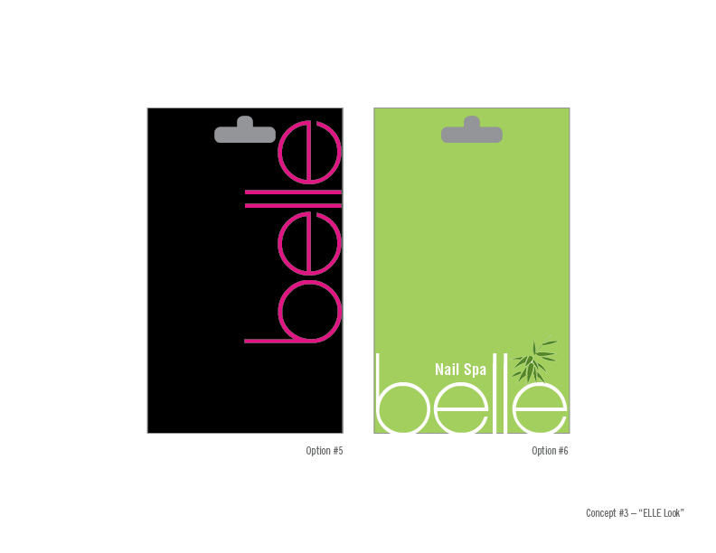

Slide 34
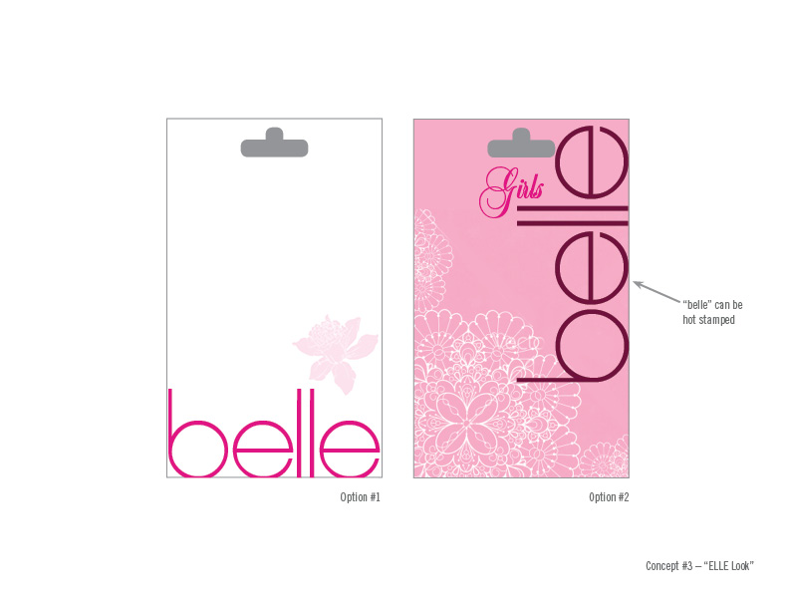

Slide 35
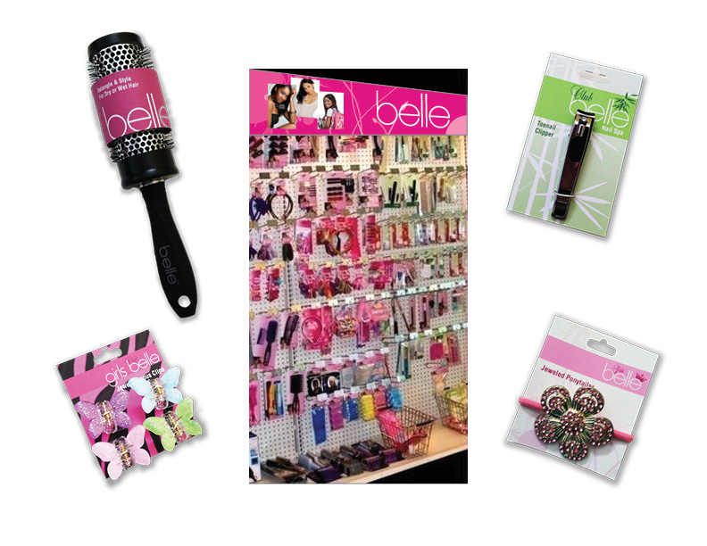

Slide 36
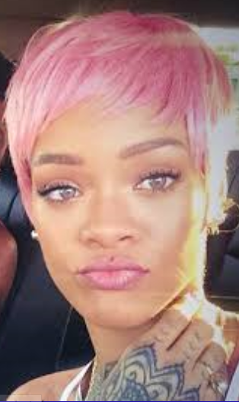
belle
2014
all grown up

Slide 37
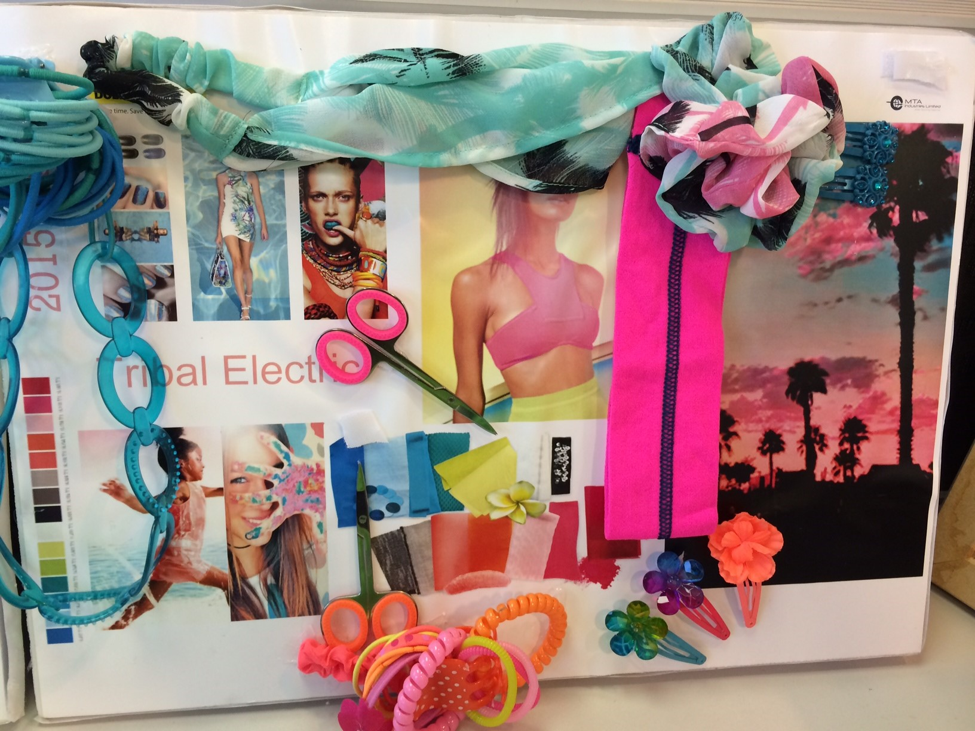

Slide 38
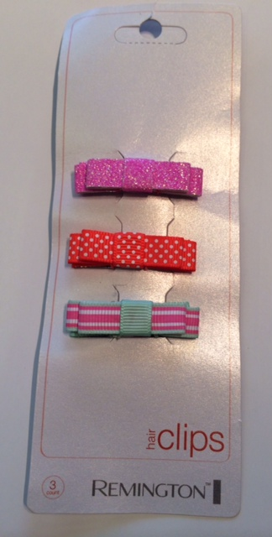
Direction 1
another new look campaign inspired by existing
belle & Remington

Slide 39
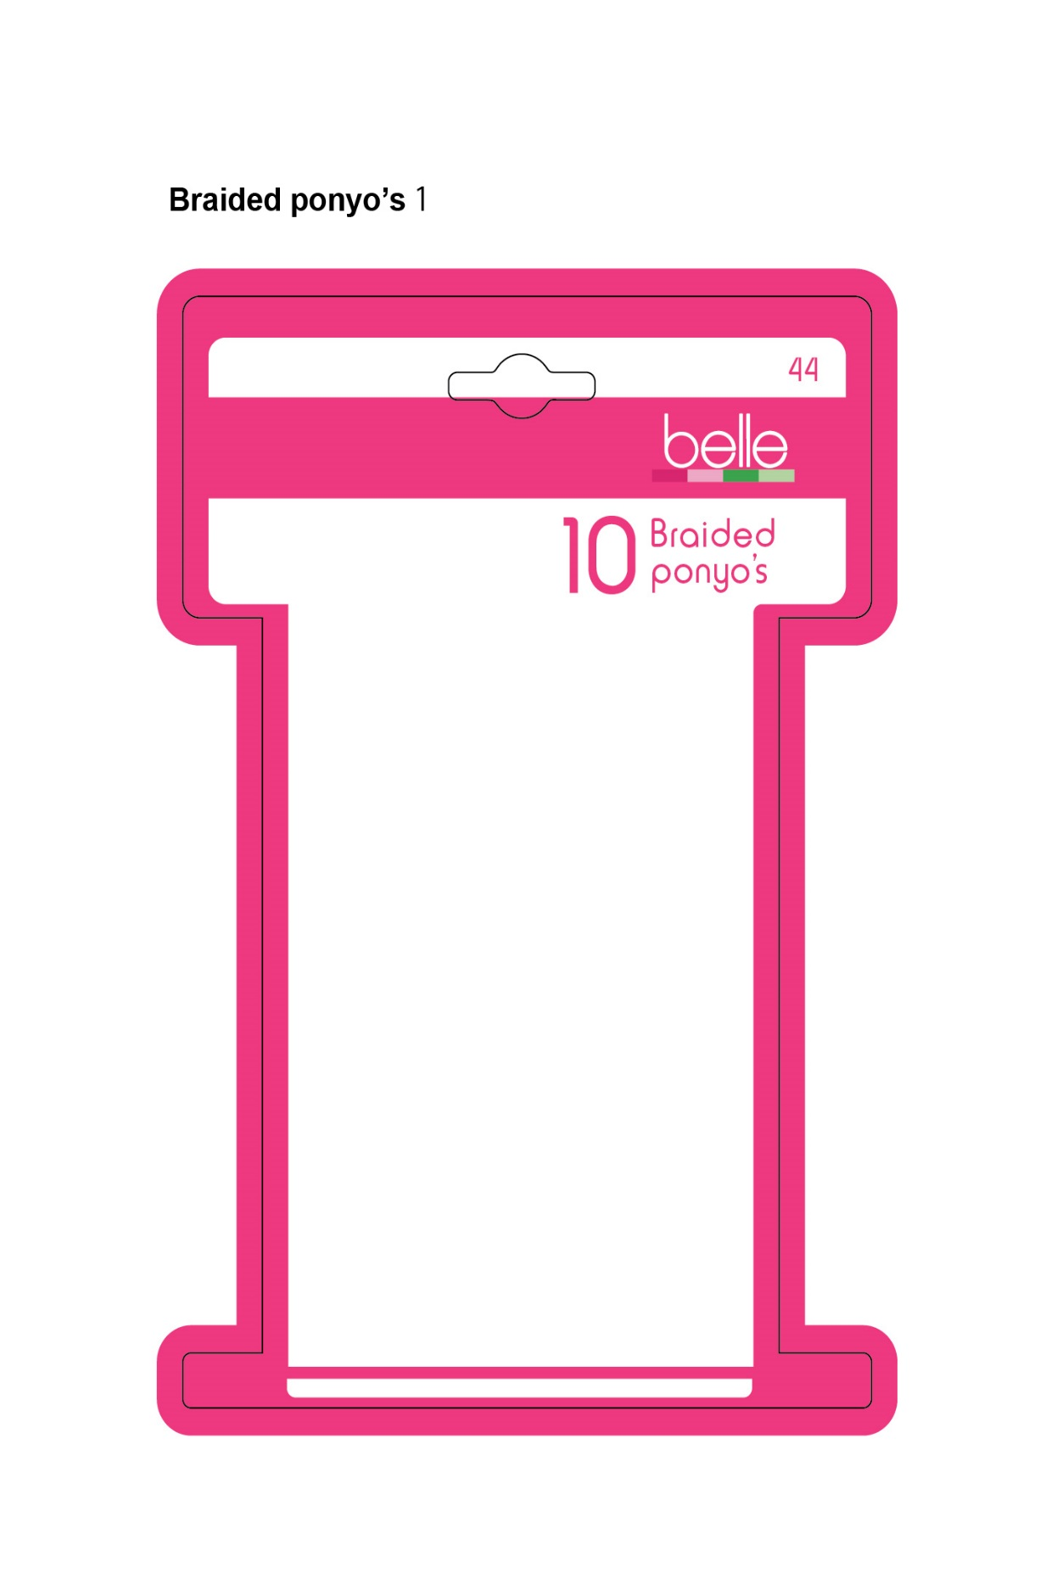
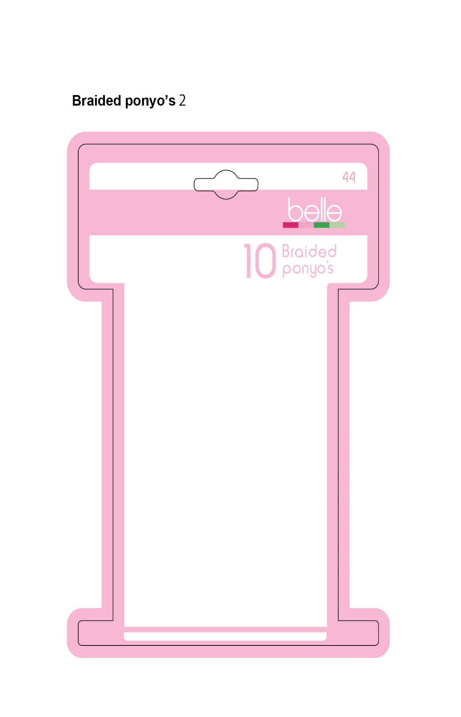

Slide 40


Direction 2
inspired by Accessorize Angels, Claire’s Club &
Cosmoprof 2014, Bologna

Slide 41


Slide 42


Direction 3
inspired by Accessorize & Claire’s

Slide 43


Slide 44

Direction 4
inspired by Accessorize

Slide 45



Slide 46


Direction 5
inspired by Target & Primark

Slide 47


Slide 48

Direction 6
inspired by Giannini

Slide 49


Slide 50

Direction 7
inspired by Scűnci & belle girls

Slide 51


Slide 52

2015 will look like ……

Slide 53
WOW…. what now
brought an average of 75 IMU points to a US$ 15 billion US dollar store’s highly profitable Private Label program
there are over 140 hard working, profit-generating skus, refreshed twice a year
cool esthetic market driver trends relevant to the audience are integrated into brand refreshment and replenishment plan seasonally, spring/summer and autumn/winter
product development with merchandisers and factories handled with 95% on-time shipping rate through trusted partners
value and product quality has been maintained and IMU increased despite retailers squeezing suppliers like lemons for improved FOB pricing
client chased down and recruited original product and brand development team and begged to be rescued from Li & Fung in an attempt to resurrect the brand equity in 2012
periodic logo refreshment is done to maintain the brand impact as consumer tastes evolve & purses shrink or expand
retailer expanded its Private Label penetration strategy with significantly improved performance by the own brand …so…..
it dropped Goody, a major national brand and has significantly reduced Connair/Scunci on shelf to make way for more of its more profitable Private Label baby….“belle”

Slide 54
Private Label Outpaces Overall Sales
The company’s gross profit as a percentage of sales increased 34 basis points. “As part of our ongoing efforts to increase our gross margin rate, we added more than 200 private brand items in 2012 and continue to expand other private and proprietary brands in consumables,” said Richard Dreiling, CEO, Dollar General.
11,500+ stores in 40 US states

Slide 55
“Above all, you want to create something you are proud of….” – Richard Branson
Since no person will make a great business who wants to do it all himself or get all the credit.
Chose the right partner.
Read more at http://www.brainyquote.com/quotes/topics/topic_business3.html#bxpxjr1r2AktXVP1.99

