Slide 1
End user experience

Slide 2
Home page
Total raised for charity:
Venue login
List my venue
Find a venue
Subscribe
Find out about deals and venues
Your name:
Email:
Date of event
Date
Calendar selector
Location:
Enter a State, Suburb or postcode
Venue capacity:
Enter the number of people
Venue use:
Select from the list
Keyword search:
Type a keyword you want to search for
+ Advanced Search
Search
My recent searches
1) Venue a
2) Venue b
3) Venue c

Slide 3
Advanced search options shown
Total raised for charity:
Venue login
List my venue
Find a venue
Subscribe
Find out about deals and venues
Your name:
Email:
Date of event
Date
Calendar selector
Location:
Enter a State, Suburb or postcode
Venue capacity:
Enter the number of people
Venue use:
Select from the list
Keyword search:
Type a keyword you want to search for
Venue Type:
Select from the list (eg winery. regional)
Venue size:
Select from the list
Ceiling height:
Select from the list
Venue Door width:
Select from the list
Venue requirements (tick all that apply):
Accessible toilets, childrens toilets, kitchen, dance floor, gardens, lecturn…
Facilities
Entertainment:
Band, dj, …
Search
Decorations:
Seat covers, table cloths, table decorations
Staff:
Waiters, mc, security
Food / drink:
Main meals, finger food, beverage packages,
Transportation
Taxi, bus, train, car, tram,
Parking spaces
Select from the list
Customer rating
Select from the list
Donation stars
Select from the list

Slide 4
Search results page
Total raised for charity:
Venue login
List my venue
Sort by:
Rating
Distance
Price
Availability
Map View
Results
Refine Search:
+ Venue Type
+ Venue Size
+ Ceiling Height
+ Venue entry door width
+ Resource type
+ Audio visual requirements
+ Entertainment
+ Facilities
+ Decorations
+ Transportation options
+ Staff
+ Parking spaces
+ Packages available –
+ Customer rating
+ Donation partner
Photo
Name:
Suburb: State: Size: Capacity:
Short description:
Facility icons: Verified icon
Rating: Donation Stars:
Price from:
Date Available icon: Yes / no / tentative
Special offer:
More info
Enquire now
Photo
Name:
Suburb: State: Size: Capacity:
Short description:
Facility icons: Verified icon
Rating: Donation Stars:
Price from:
Date Available icon: Yes / no / tentative
Special offer:
More info
Enquire now

Slide 5
Detailed listing page
General
Facilities and resources
Important information
Photos
Photo
Name:
Suburb: State: Size: Capacity:
Resource type: eg winery …
Short description:
Facility icons: Verified icon:
Rating: Donation Stars:
Price from:
Date Available icon: Yes / no / tentative
Special offer:
Availability calendar:
View floorplan
View map Get directions
Send to friend Share Print page
Request booking
My recent searches
1) Venue a
2) Venue b
3) Venue c
Subscribe
Find out about deals and venues
Your name:
Email:

Slide 6
Detailed listing page
General
Facilities and resources
Photos
Photo
Resources available:
+ Venue Type
+ Venue Size
+ Ceiling Height
+ Venue entry door width
+ Resource type
+ Audio visual requirements
+ Entertainment
+ Facilities
+ Decorations
+ Transportation options
+ Staff
+ Parking spaces
+ Packages available –
+ Customer rating
Request booking
My recent searches
1) Venue a
2) Venue b
3) Venue c
Subscribe
Find out about deals and venues
Your name:
Email:

Slide 7
My Booking Request
Date of event
Start Date
Start Time
Calendar selector
End Date
End Time
Request recurring booking
Are your dates flexible
Yes / No
Number of guests
Enter the number of people
Venue use:
Select from the list
+ Venue requirements (tick all that apply):
Leave blank items that do not apply
 | Item Title | Description | Booking imcrements (drop down list) |  | Cost per increment | Plus Cost per head | Minimum available | Maximum available | Image
+ Facilities list |  |  | Number | increment |  |  |  |  |  | Add extra facilities
+ Entertainment list |  |  |  |  |  |  |  |  |  | Add extra Enternainment options
+ Decorations list |  |  |  |  |  |  |  |  |  | Add extra decoration options
+ Staff list |  |  |  |  |  |  |  |  |  | Add extra staff options
+ Food list |  |  |  |  |  |  |  |  |  | Add extra food options
+ Beverage list |  |  |  |  |  |  |  |  |  | Add extra beverage options
+ Other |  |  |  |  |  |  |  |  |  | Add more options
My details
Name
First name, last name
Email:
Enter your email
Postcode:
Post code
Phone number:
Phone number
How did you hear about us?
Tick all that apply
Booking Estimate
Enquire
Book now

Slide 8
Confirmation page
Thank you. Your booking request has been sent. A copy of your booking will be emailed to you in the next few minutes.
A donation will be made to xx charity when your booing is finalised.
If these details are incorrect please make a new booking
Subscribe
Find out about deals and venues
Your name:
Email:

Slide 9
Venue Back end – taking bookings by phone
Booking taken by:
Insert name
Booking enquiry date:( Auto insert)
Calendar selector
Date of event
Start Date
Start Time
End Date
End Time
+ Add recurring booking
Enter the number of attendees
+ Venue requirements (tick all that apply):
Leave blank items that do not apply
 | Item Title | Description | Booking imcrements (drop down list) |  | Cost per increment | Plus Cost per head | Minimum available | Maximum available | Image
+ Facilities list |  |  | Number | increment |  |  |  |  |  | Add extra facilities
+ Entertainment list |  |  |  |  |  |  |  |  |  | Add extra Enternainment options
+ Decorations list |  |  |  |  |  |  |  |  |  | Add extra decoration options
+ Staff list |  |  |  |  |  |  |  |  |  | Add extra staff options
+ Food list |  |  |  |  |  |  |  |  |  | Add extra food options
+ Beverage list |  |  |  |  |  |  |  |  |  | Add extra beverage options
+ Other |  |  |  |  |  |  |  |  |  | Add more options
Customer details
Name
First name, last name
Email:
Enter your email
Address:
Address:
Phone number:
Phone number
How did you hear about us?
Tick all that apply
Venue use:
Select from the list
Notes:
Add notes
Booking Estimate
Tentative booking
Book now

Slide 10
Venue User – Admin Tab
Total raised for charity:
Venue login
List my venue
Venue Email:
Venue phone number:
Banking details:
These details will be used to allow customers to pay booking fees into your bank account.
Account name:
BSB:
Account Number:
Venue Manager’s details
These details will be used to notify you of new bookings and will not be visible to customers
Manager’s mobile:
Manager’s email:
How do you want to be notified of new bookings: SMS, Email,
+ Add another venue manager’s details
Venue admin details
Privacy policy
Enter details
Terms and conditions
Enter details
Public liability insurance
Upload pdf or jpegs of covernote
Next
ABN
Upload pdf or jpegs of covernote
Bond per booking
$
Non Refundable Deposit %
%

Slide 11
Venue User – Venue Tab
Total raised for charity:
Venue login
List my venue
Venue Name:
Location:
Address, state, suburb, postcode
Venue capacity:
Min
Max
Venue use:
Tick all that apply
Venue Type:
Select from the list (eg winery. regional)
Venue Description:
Description
Upload venue images
Upload jpegs
Getting There
Transportation
Taxi, bus, train, car, tram,
description
+
Venue Parking spaces
Venue Accommodation Available:
Yes / no
Next

Slide 12
Venue User –Venue
Total raised for charity:
Venue login
List my venue
Venue Options
Leave blank items that do not apply
 | Item Title | Description | Charged by: (drop down list) |  | Cost per | Set Minimum available | Set Maximum available | Upload image
Facilities | Select from drop down |  |  | Minute |  |  |  |  | Add extra facilities
Entertainment | Select from drop down |  |  | Hour |  |  |  |  | Add extra Enternainment options
Decorations |  |  |  | Day |  |  |  |  | Add extra decoration options
Staff | Select from drop down |  |  | Week |  |  |  |  | Add extra staff options
Food Package |  |  |  | Month |  |  |  |  | Add extra food options
Beverage Package |  |  |  | Per item |  |  |  |  | Add extra beverage options
Other |  |  |  | Per head |  |  |  |  | Add more options
Next

Slide 13
Venue User – Room / Resource
Add your resources and rooms for hire here
Room / resource name:
Capacity:
Min
Max
Venue Description:
Description
Upload images
Upload jpegs
Room Specifications
Upload floorplan
Upload pdf or jpegs
Venue size:
m (w) x m (l)
Ceiling height:
cm (h)
Venue Door width:
cm(w) x cm (h)
+ Add another room or resource

Slide 14
Venue User – Calendar setup
Total raised for charity:
Venue login
List my venue
Venue name:
Enter venue / resource name
Date range
Leave blank items that do not apply
Day | Open | Closed | Minimum hire time | Maximum hire time | Minimum duration between bookings | Cost per(drop down list) |  | Cost per | Plus Flat venue fee | Plus Cost per head
Monday |  |  |  |  |  | Number | Units
Tuesday |  |  |  |  |  |  | Minute
Wednesday |  |  |  |  |  |  | Hour
Thursday |  |  |  |  |  |  | Day
Friday |  |  |  |  |  |  | Week
Saturday |  |  |  |  |  |  | Month
Sunday
Add date range
Next

Slide 15
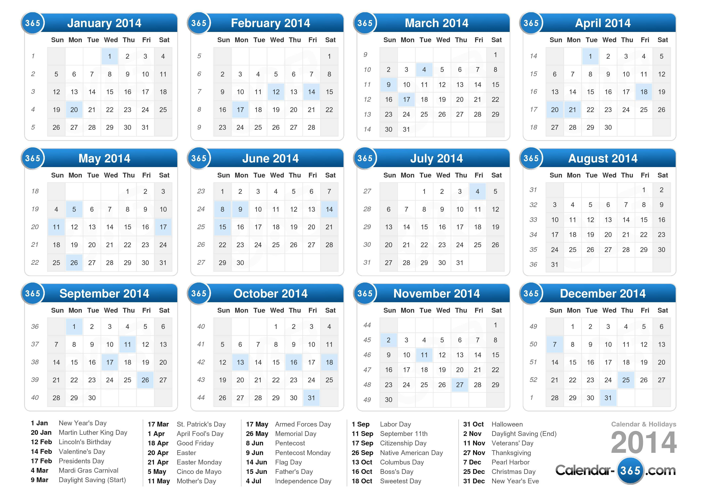
Venue User – Calendar
Total raised for charity:
Venue login
List my venue
Room name:
Selct from list
View: Day / week / Month / Year
Click on a day to add a booking
Next

Slide 16
Venue Back end – taking bookings by phone
Booking taken by:
Insert name
Booking enquiry date:( Auto insert)
Calendar selector
Date of event
Start Date
Start Time
End Date
End Time
+ Add recurring booking
Enter the number of attendees
+ Venue requirements (tick all that apply):
Leave blank items that do not apply
 | Item Title | Description | Booking imcrements (drop down list) |  | Cost per increment | Plus Cost per head | Minimum available | Maximum available | Image
+ Facilities list |  |  | Number | increment |  |  |  |  |  | Add extra facilities
+ Entertainment list |  |  |  |  |  |  |  |  |  | Add extra Enternainment options
+ Decorations list |  |  |  |  |  |  |  |  |  | Add extra decoration options
+ Staff list |  |  |  |  |  |  |  |  |  | Add extra staff options
+ Food list |  |  |  |  |  |  |  |  |  | Add extra food options
+ Beverage list |  |  |  |  |  |  |  |  |  | Add extra beverage options
+ Other |  |  |  |  |  |  |  |  |  | Add more options
Customer details
Name
First name, last name
Email:
Enter your email
Address:
Address:
Phone number:
Phone number
How did you hear about us?
Tick all that apply
Venue use:
Select from the list
Notes:
Add notes
Booking Estimate
Tentative booking
Book now

Slide 17
Head admin backend
Able to see all loaded venues and their account type status
Able to delete, suspend, review all accounts
Ability to upgrade / downgrade accounts
Able to email all venues – eg, put venues into mailing lists by account type, usage – eg, email them when they get their 10th booking, email when they get a booking to see how it went.
Able to email all users – eg, see how their booking went.
Able to sms venues and users
view calendar – edit calendar
Block out times

