Slide 1
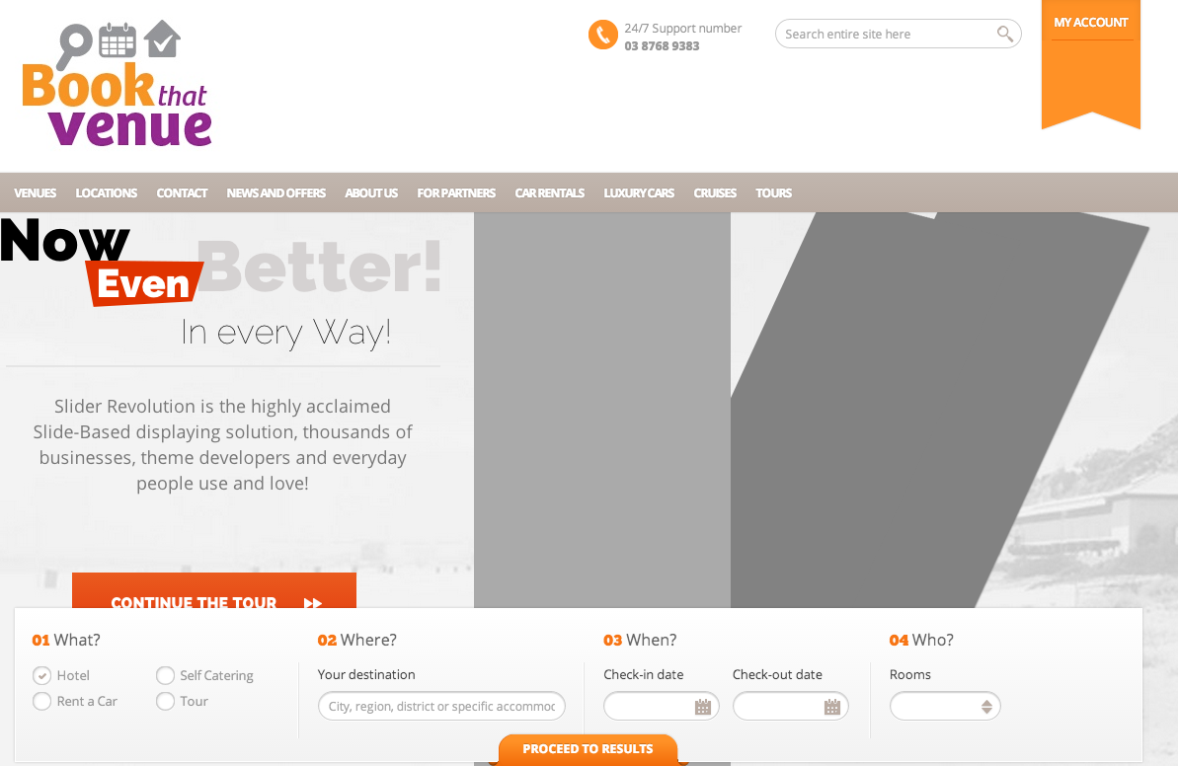


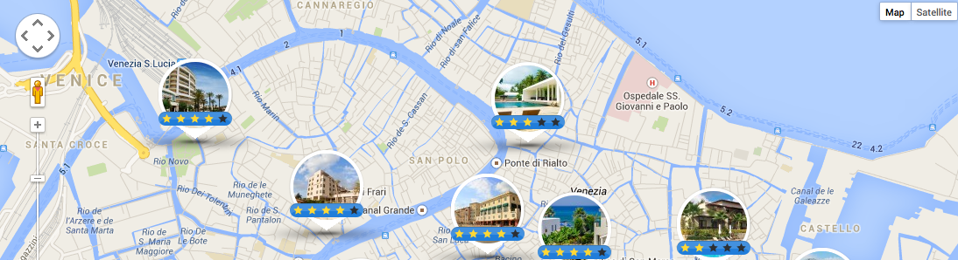

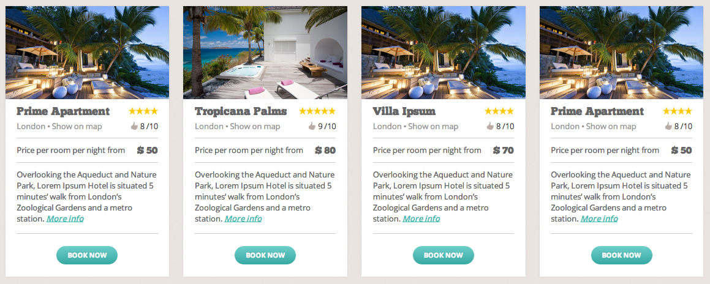
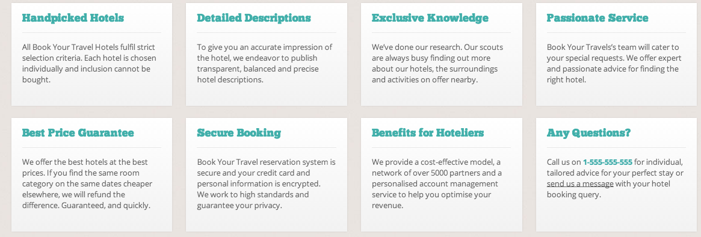
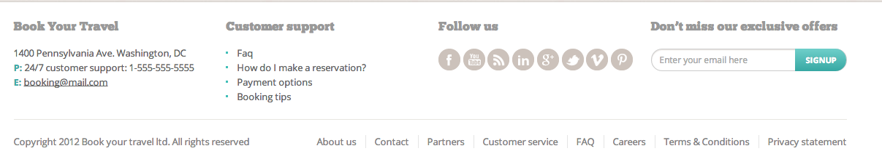
Venue Booking
Home Venues News & Offers Inspiration Contact FAQs
Search
Top Venues
Why should you book your venue through Redsteps
Redsteps Bookings
5 Venables Crt Berwick VIC
P: 03 8796 9383
E: info@bookings.redsteps.com.au
Copyright Redsteps
Notes:
I would like to get a cleaner appearance.
I found this design and quite like it. I have added a map function on the top which I think is a nice feature so people can search near where they live. Can you please edit this design to have it suit your icons and colours and fonts. I like how it feels clean, crisp and has a little depth created by the buttons, search fields and the search box.
Might need to review colours used – I am going to use redsteps as the brand – I think it is more different and will stand out as a concept better than book that venue, I have finance set up for it eg banking.
Note – for the main menu the headings would be – Home Venues News & Offers Inspiration Services Contact FAQs
Under What – Have the types of venues
Where – postcode / suburb
When – Change to date
Who – Change to number of quests?

Slide 2
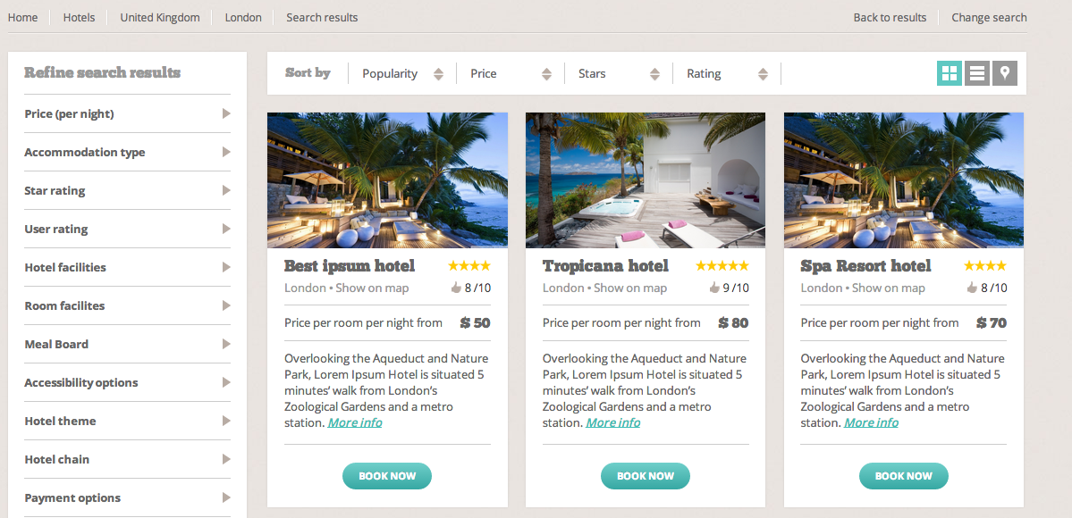
Home Venues News & Offers Inspiration Contact FAQs
Notes:
This would be the search results page – it shows the relevant searched hotels and a refine your search results on the side.
Refine by: Location, Price, Venue Type, Star rating, User Rating, Facilities, Resources, Food and Beverage, Venue Size, Capacity, Payment options,
Show for each venue: Image, Title, Suburb (show on map), rating icon, stars icon, price per head from, venue price from, max capacity icon and number, short description, Verified symbol, Special offer highlight symbol, Available symbol, More info, Add to shortlist, Enquire now, Book Now.
Probably set to show 10 venues per page..then have the buttons at the bottom
Ability to show in a grid as is, in a list or via the map.

Slide 3
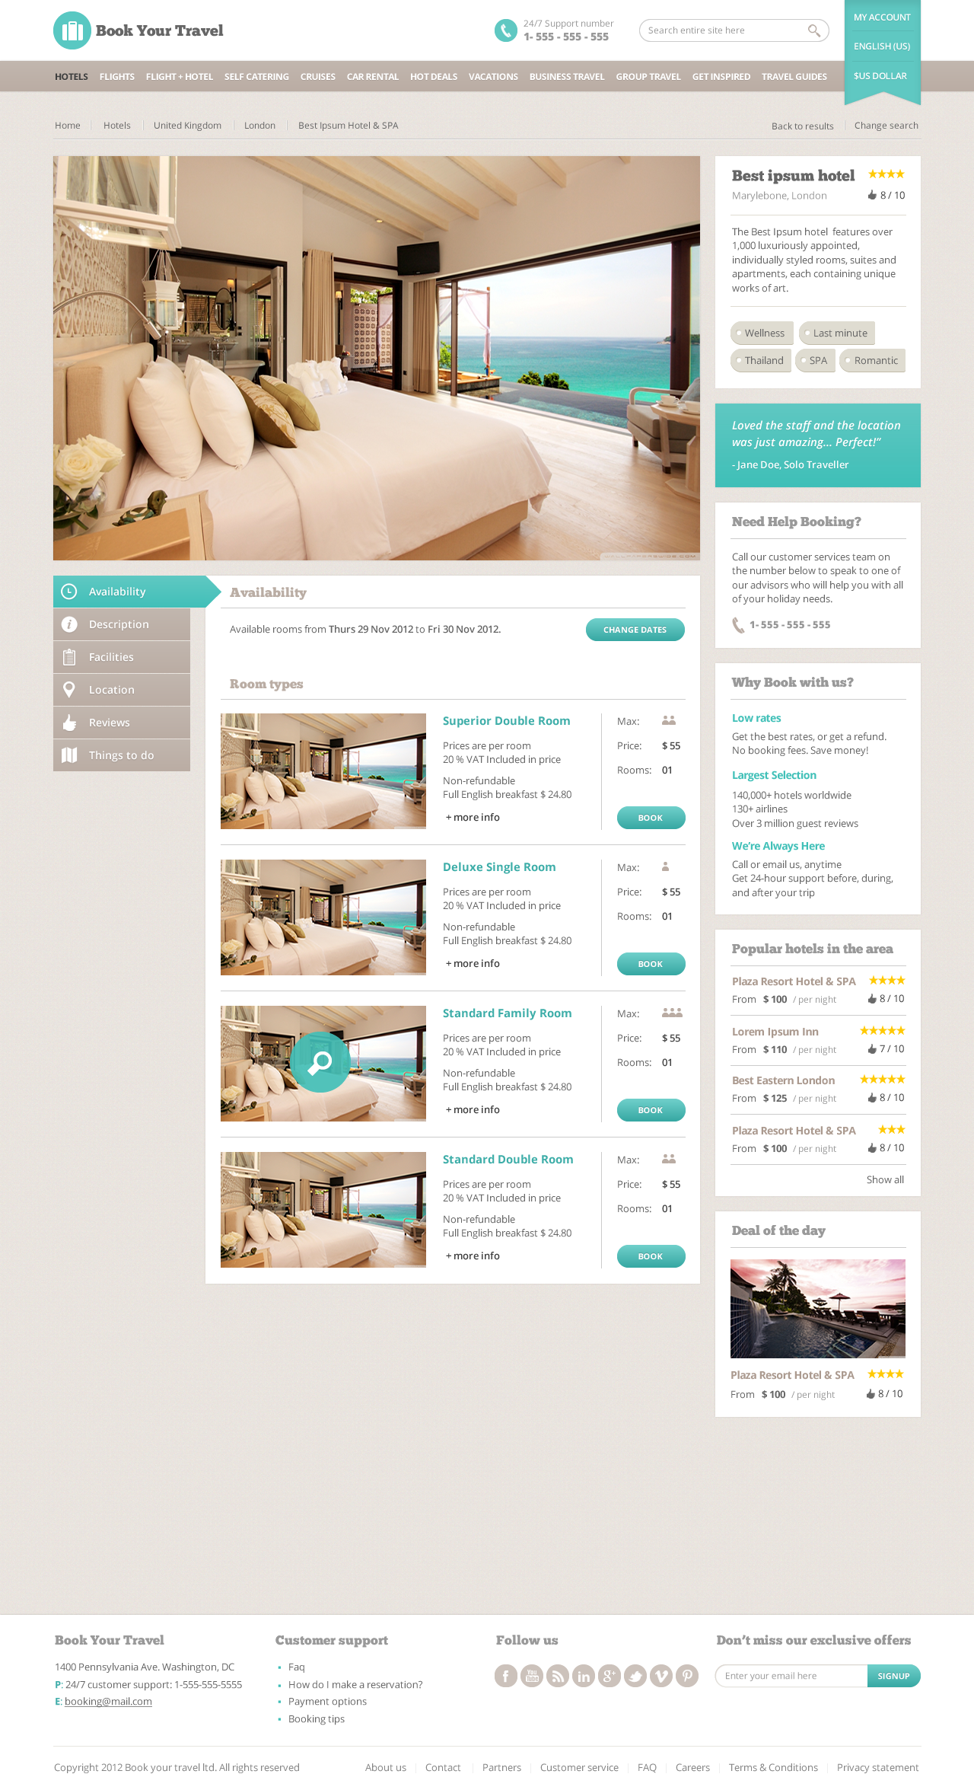
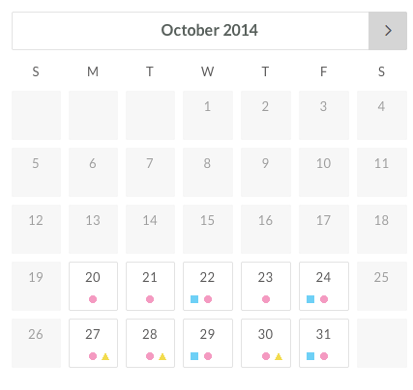
Home Venues News & Offers Inspiration Contact FAQs
Venue Title
Notes:
Love this – for a detailed venue layout. - visit this site for ideas: http://themeforest.net/theme_previews/3813953-book-your-travel-online-booking-html-template?index=7&url_name=book-your-travel-online-booking-html-template or here: http://themeforest.net/item/book-your-travel-online-booking-wordpress-theme/full_screen_preview/5632266
Probably want all the content that is shown here except – remove ‘things to do’ from side panel on the left.
Make the room title above the image or in a more prominent location on the left side of the page
Availability section – add in a calendar that can be searched by clicking the date or viewed to see when is available.
Change why book with us to – why book with Redsteps

Slide 4
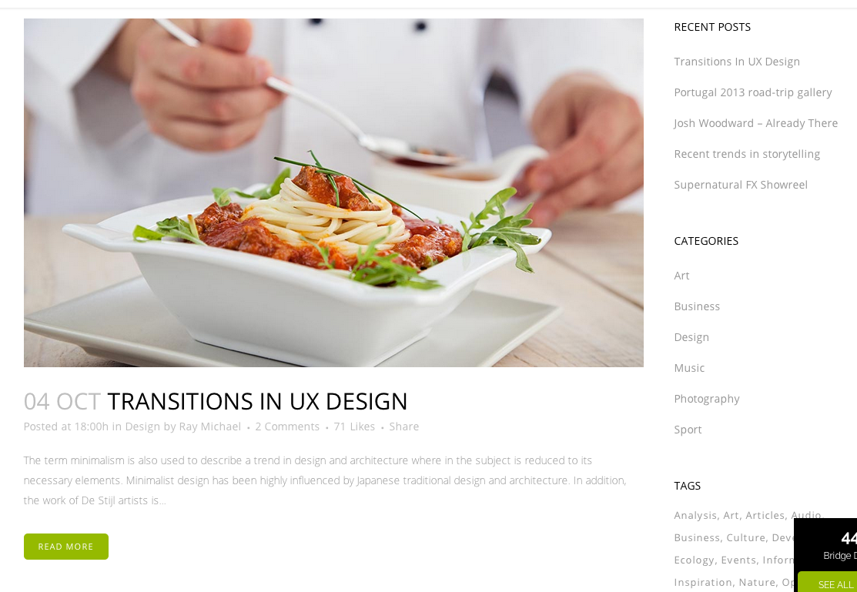
Home Venues News & Offers Inspiration Contact FAQs
Venue Title
Notes:
Side panel template

Slide 5
Home Venues News & Offers Inspiration Contact FAQs
Venue Title
Notes:
Love this – for a detailed venue layout. - visit this site for ideas: http://themeforest.net/theme_previews/3813953-book-your-travel-online-booking-html-template?index=7&url_name=book-your-travel-online-booking-html-template or here: http://themeforest.net/item/book-your-travel-online-booking-wordpress-theme/full_screen_preview/5632266
Probably want all the content that is shown here except – remove ‘things to do’ from side panel on the left.
Make the room title above the image or in a more prominent location on the left side of the page
Availability section – add in a calendar that can be searched by clicking the date or viewed to see when is available.
Change why book with us to – why book with Redsteps

Slide 6
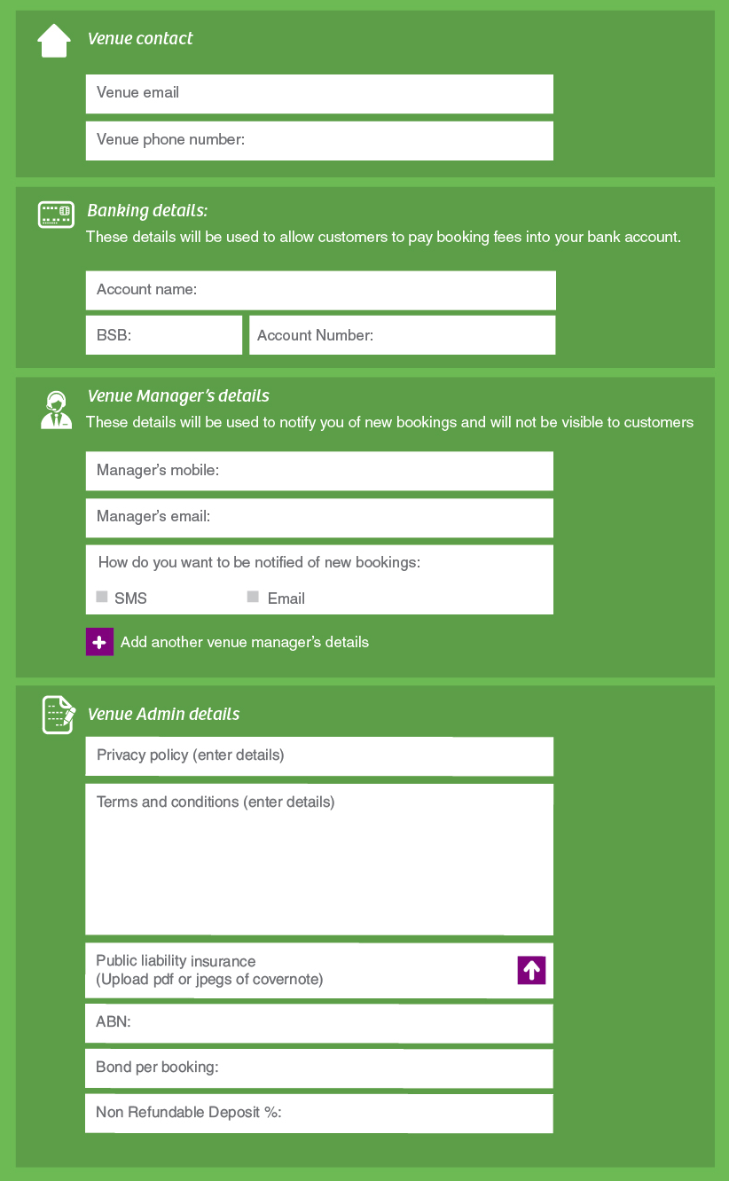






Admin tab to have all this like this
Admin
Notes:
Same content but move the top menu to the side

Slide 7
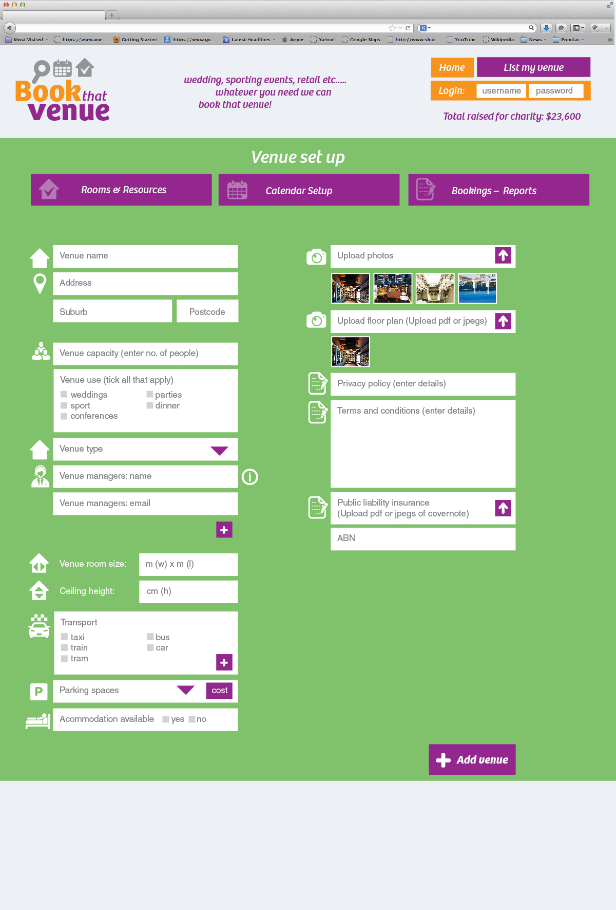
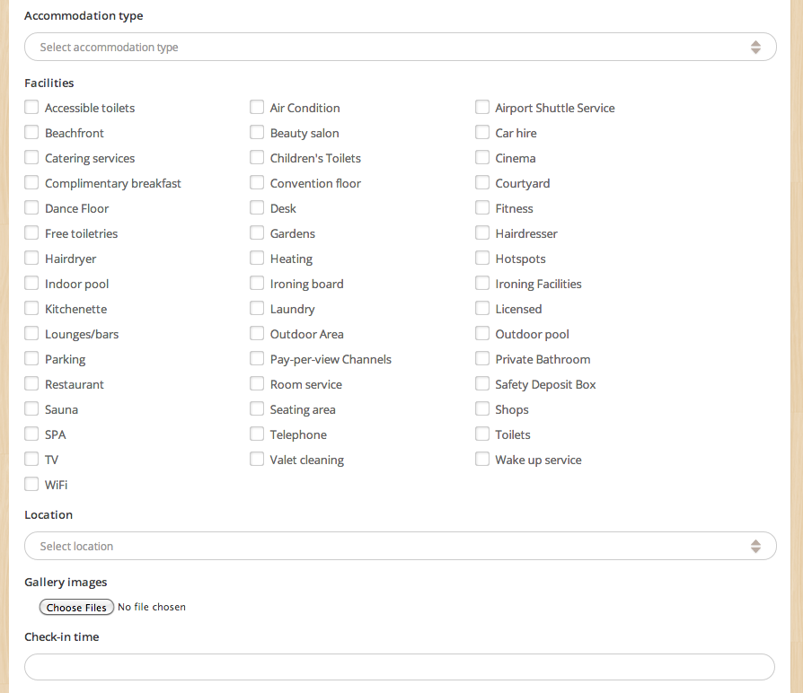
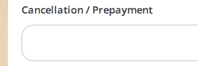

Venue
Featured image
Venue managers phone
Notes:
Side tabs to replicate the top tabs in your design: / Admin / Venues / Rooms & Resources / Calendar / Availability settings / Bookings / Reports
I think for the venue owner page I would like something like this so it is a little clearer how to manage for them. Have the ability to create an accommodation venue / room here with all the facilities on one page.
Include all the fields already shown in your design. Change images to have one as ‘featured image’ and another as gallery images.
Add Cancellation / prepayment policy
Add Facilities here.

Slide 8
Room / Resources
Room name
Featured image
Capacity
Room use
Room managers name (select from a drop down list that is created under venues)
Notes:
Side tabs to replicate the top tabs in your design: / Admin / Venues / Rooms & Resources / Calendar / Availability settings / Bookings / Reports
I think for the venue owner page I would like something like this so it is a little clearer how to manage for them. Have the ability to create an accommodation venue / room here with all the facilities on one page.
Include all the fields already shown in your design. Change images to have one as ‘featured image’ and another as gallery images.
Add Cancellation / prepayment policy
Add Facilities here.

Slide 9
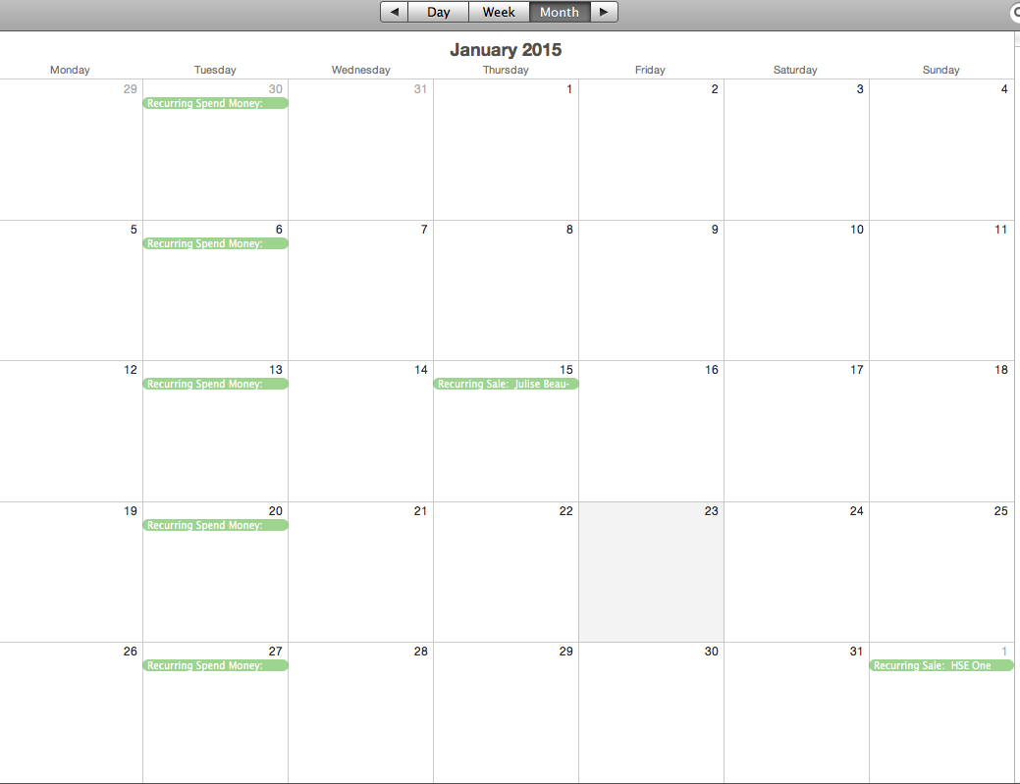
Add new Booking
Calendar
Search bookings _________

Slide 10
Add new Booking
Bookings
Search bookings _________
All Pending Completed Filter by…(all fields)
ID Staff Customer Start date End Date Resource/Room Food No. Guests Beverage Total Action
Casey Joe Blog 4/1/14 4/1/14 Room 1 - 50 Premium $1000 - pending Edit Cancel View
Casey Joe Blog 4/1/14 4/1/14 Room 1 - 50 Premium $1000 - pending Edit Cancel View
Casey Joe Blog 4/1/14 4/1/14 Room 1 - 50 Premium $1000 – paid Edit Cancel View
Casey Joe Blog 4/1/14 4/1/14 Room 1 - 100 Premium $1000 – paid Edit Cancel View
Casey Joe Blog 4/1/14 4/1/14 Room 1 - 50 Premium $1000 - pending Edit Cancel View
Casey Joe Blog 4/1/14 4/1/14 Room 1 - 50 Premium $1000 - pending Edit Cancel View

Slide 11
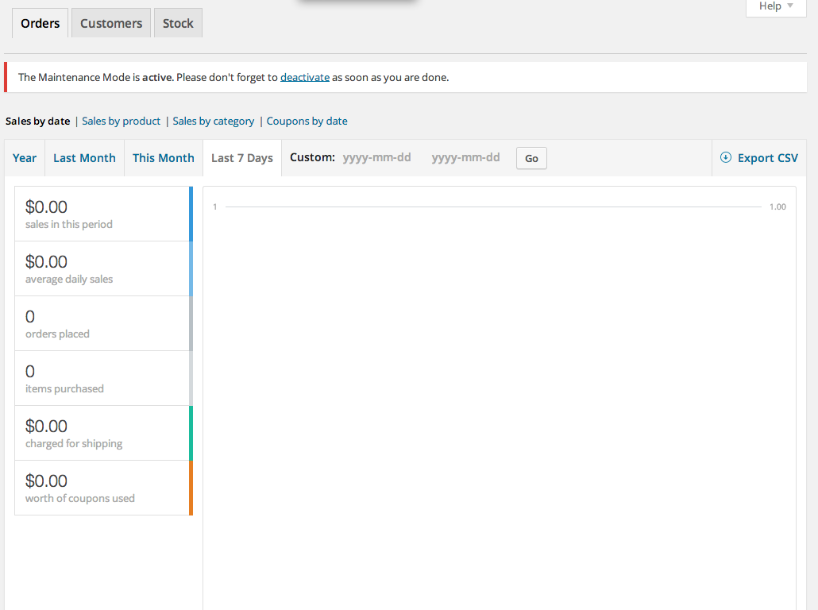
Reports

