Slide 1










MyHealthDash
Raya Guruswamy | Kartik Muktinutalapati | Francisco Solves | Kamini Umashankar

Slide 2








Food Logging Today
Notes:
You’re juggling work, a family, a baby (babies), a spouse
What you eat becomes an afterthought
Having to stop and eat (let alone cook) becomes an annoyance

Slide 3

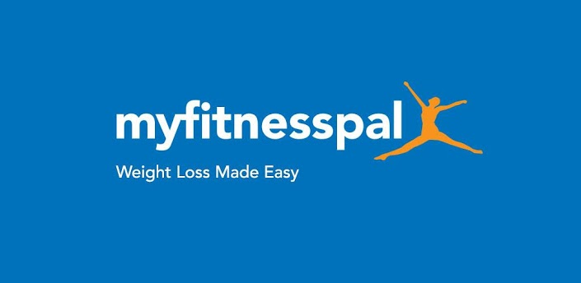


Current Offerings
Notes:
4
Product based data entry ..Makes it a chore
Start with enthusiasm and zeal. Then forget, get behind, catching up, it’s another course in itself

Slide 4
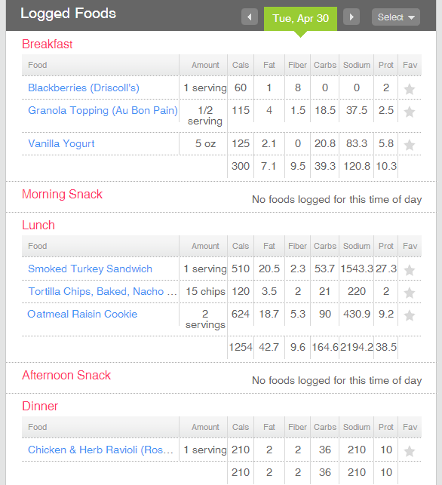
State of the Art
Nutrients
Manual entry
Logging multiple times per day
Recommended allowances
What to avoid?
Incentives to eat better
What to do with the information?
Fitbit.com
Notes:
Allowances – how much of what
Avoid – Based on my preferences, allergies, personal beliefs
Incentives – Cookie for fruit?
Info – So what?

Slide 5


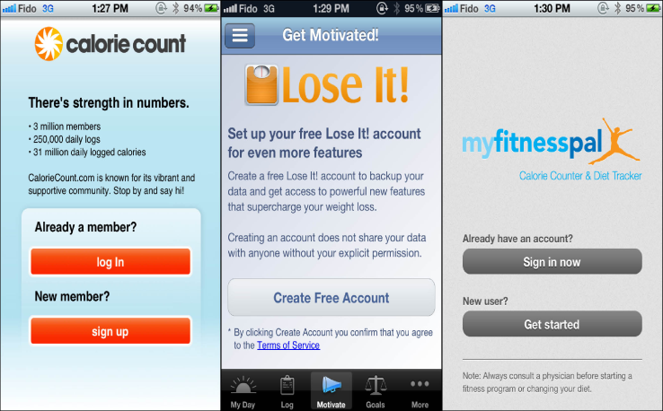




Need
$$+$$
$$=$$
Notes:
Logging burn-out

Slide 6

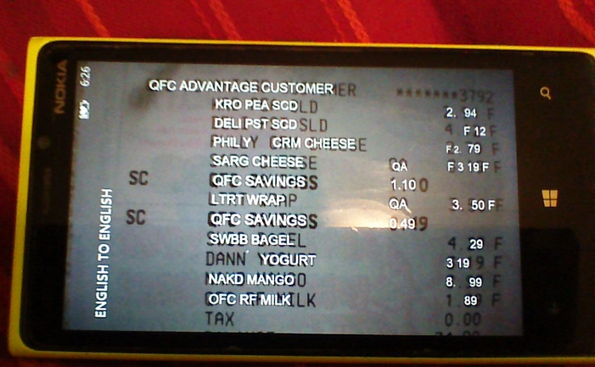
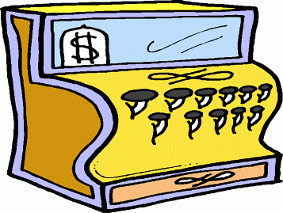
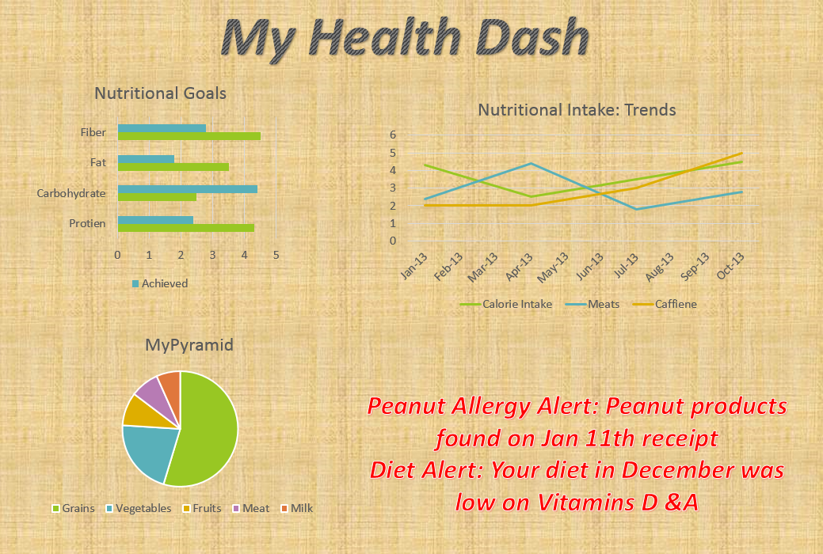
Our Offering
Match Products &
Extract Nutrition Data
Personalized Coaching
You need additional protein this month
You were short on green vegetables previous week
Your baby might be allergic to the contents of XYZ product

Slide 7



Target Market?
  13.6 million of college students are considered to be low on Potassium, Calcium and Vitamin D
  15 million US citizens estimated to have food allergies
70% of US adults are either overweight or obese

Slide 8












Marketing
What How Why

Slide 9

Business Model
Freemium Revenue Model
  First 3 months - FREE
  Month 3 onwards - $4.99/month
Advertising
  Healthy food vendors
  Diet products
Licensing and Acquisition
  Retail outlets
  Competition
Notes:
Competition is only making money on subscription models
Free for first two months
$4.50/Month -> Pay as you go
$39.99/Year -> Bundled Rate
Trends in Calorie consumption
Personalized Profiles/Preferences

Slide 10

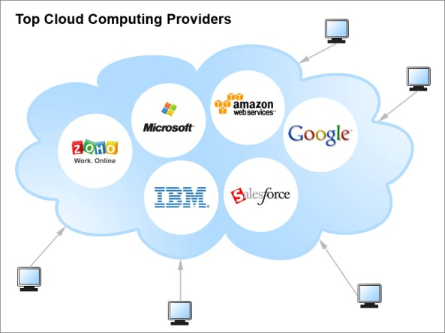
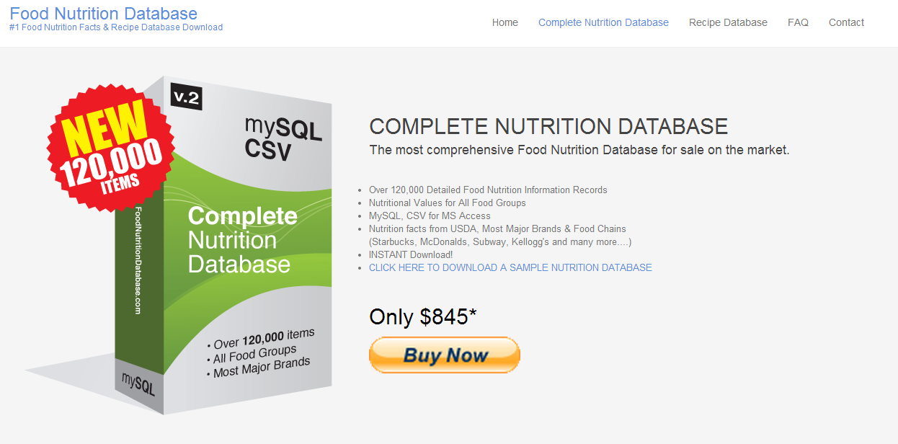
Make vs Buy: Technology Procurement
Cloud Servicies
Text Recognition
Nutritional DataBase

Slide 11
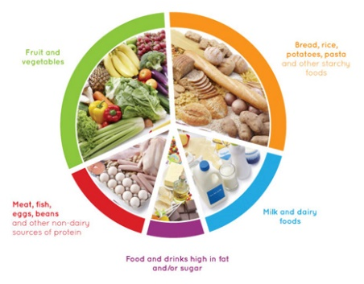
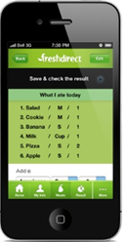

Make vs Buy: In-House Development
Intelligence
KRO PEA SCD = Kroger's Pea Salad=
User Interface
Integration

Slide 12
Consulting
Marketing
Engineering
Operational Timeline
BUILDING BLOCKS
Text Recognition, Nutrition Database
Cloud Servicies
BETA VERSION
Basic User App
MyHealthDash Website
Social Marketing
FEEDBACK
Demo
Monitor Feedback
Improvements
Blogs
Phase#1
Technology
Phase#2
Start-Up
Phase#3
Consolidation
April 2014
July 2014
October 2014

Slide 13
Incurred Costs
$145K (2014) $166K (2015)
$75K (2014) $198K (2015)
$10K (Q1 2014)

Slide 14
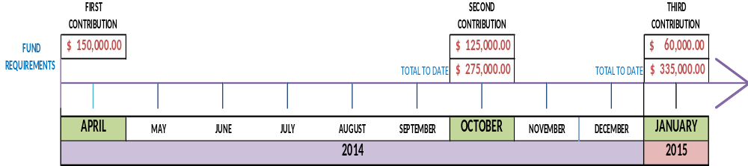
Projected Investment Timeline
Phase 1
Software development
Phase 2
Software development
Phase 3
Software development
Procurement
Consulting: Nutrition & Marketing
Consulting: Nutrition & Marketing
Maintenance
Consulting: Nutrition & Marketing

Slide 15
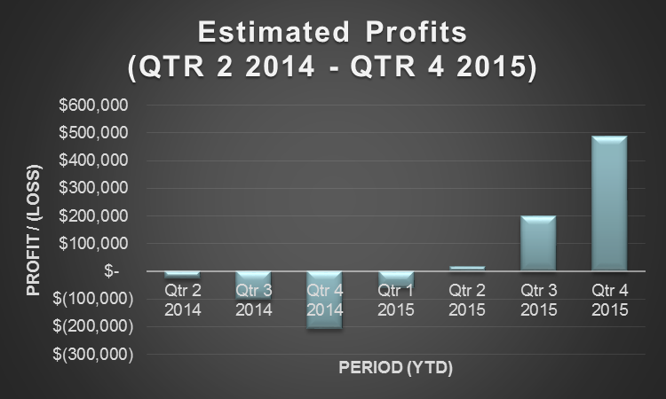
Profitability Analysis
Assumptions
3000 new users per month
40% retention
Excluded advertising revenue
Positive income earned – Year 2
Break even – Year 3 (for $400K investment)

Slide 16
Risks
Consumers
User fatigue
Priced too high
Individual vs. Family
Privacy
Compliance
Public Perception
Threat of Entry & Competitors
Existing players
Food retailers
Substitutes & Complements
Professionals
Dieticians, Trainers
Self-help plans
Suppliers
Retailers
Receipt bar codes
Customers
Scanning receipts

Slide 17
Mitigations
Consumers
Tie-ups
Go lower for mass adoption
Profiles and intelligence
Consumers
User Fatigue
Priced too high
Individual vs. Family
Threat of Entry & Competitors
Patent in-house IP
Tie-ups with retailers
Privacy
Transparent Policy
Security driven engineering
Substitutes & Complements
Hire nutrition experts & public faces
Suppliers
Multiple data input mechanisms
Long-term ‘lazy customer’ plan

Slide 18








Entrepreneurial Team
Marketing: Raya Guruswamy
  Business Development, Promotions
Technology: Kartik Muktinutalapati
  Software, Computer Science, Machine learning
Project Mgmt.: Francisco Solves
  Project Control, Operations
Finance: Kamini Umashankar
  Financial Control & Reporting

Slide 19

Thank You!

Slide 20
Appendix

Slide 21
Marketing
 | What | How | Why
Blogs | Create nutritional blog, including opt-in email lists. Features health related topics such as celebrity healthy living | Contains links to several relevant nutritional, health and lifestyle information | Build up user-base or community during testing phase
SEO | Users are steered to MyHealthDash | Point users to MyHealthDash or when looking up details on competitors | Encourage users to switch and capitalize on competitors that are experiencing slow growth and/or poor sales
PR | Appeal to students, diet-restricted individuals and weight-loss strivers | Partner with major grocery stores, sports apparel retailers and employer insurance programs | Draw in users not actively searching for web-based solution for nutrition management
Social Media | User-interaction and announcement platform | Establish presence on major social media applications (Facebook, Twitter) | Provide information for new-users and obtain feedback from users

Slide 22

MyHealthDash
Allergy Alert: Peanut products found on Jan 11th receipt
Diet Alert: Your diet in December was low on Vitamins D &A
Advice: Protein rich dishes are more satisfying than carbs or fats

Slide 23
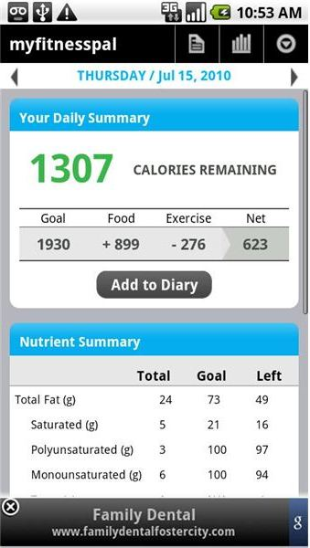
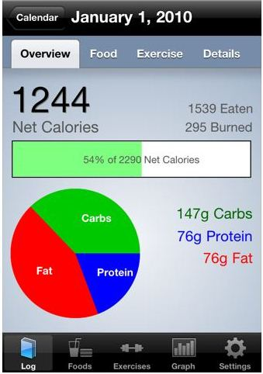
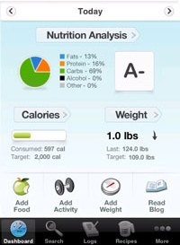
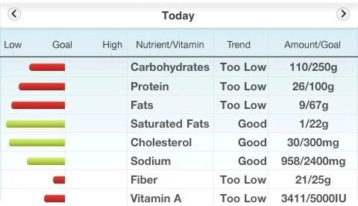
Personalized Dash Board- Examples
Myfitnesspal
Carb Manager
Calorie Count
Lifewithlyn

Slide 24





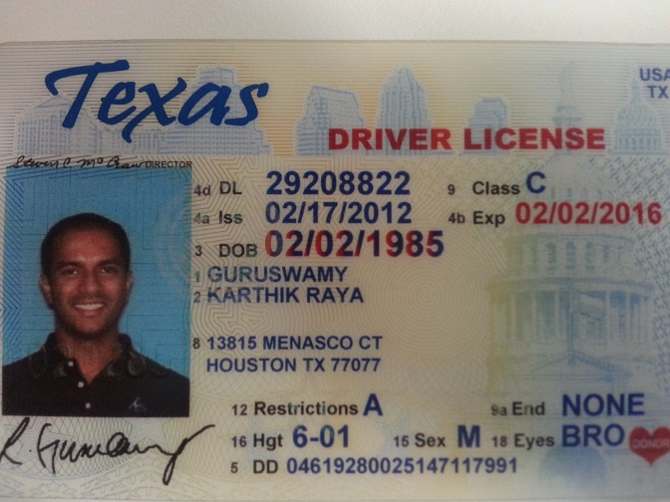

First Market - Austin
Notes:
Why Austin: Strong VC sector, talented workforce, home to major corporations (inc Whole Foods and Gold’s Gym), low taxes, proximity to team-members and team members having a connection (paco regional office of OHL, kartik large MS presence). Most nutrition aware town.

Slide 25
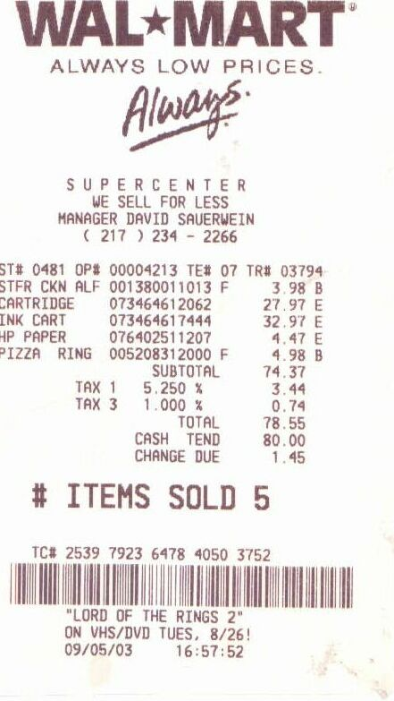
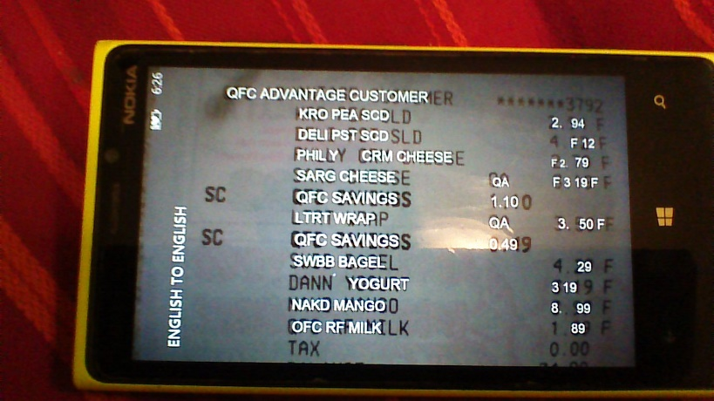

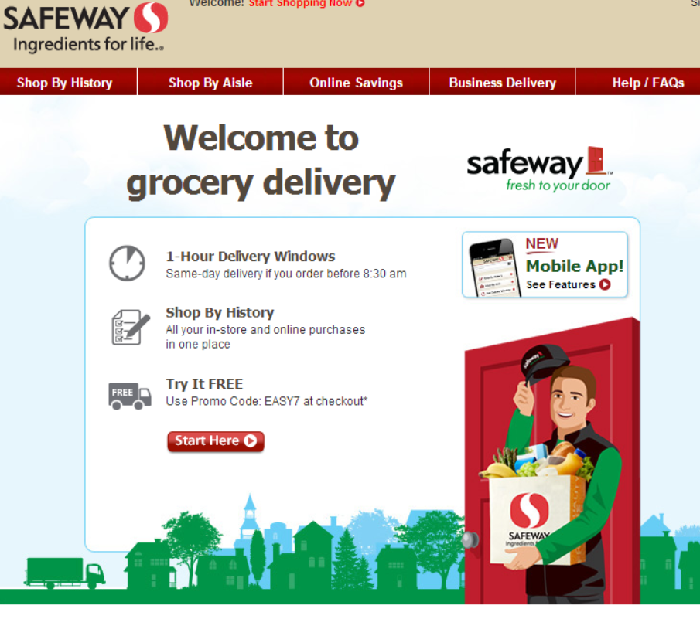
Data Input Mechanisms
OCR
Bar Codes
Digital Receipts

Slide 26
Barcode Input Scenario
Product Nutrition DB
Personal Nutrition Data
Goals
History
Nutrition Info
Intelligence
Walmart Receipt Repository
Itemized Product List

Slide 27
Barcode Input Scenario
Product Nutrition DB
Personal Nutrition Data
Goals
History
Nutrition Info
Intelligence
Walmart Receipt Repository
Itemized Product List

Slide 28
Financials
Initial Investment : $400,000
Expenditure: $400,000/year app.
Assumed Retention: 40%
Revenue: $4.99 / month subscription; advertising revenue excluded from estimate.
1,000 New Customers/Month
Positive Net Income: Year 3
Break Even: Year 4
3,000 New Customers/Month
Positive Net Income: Year 2
Break Even: Year 3
7,000 New Customers/Month
Positive Net Income: Year 2
Break Even: Year 2
Actual Case
Probable Case
Optimal Case
Notes:
Fitness Pal launched in 2005
New customers / Month -> 1.5 million
Calorie counter 10 million installs
Mint, found it was acquired in 2009 , 1 million users

Slide 29
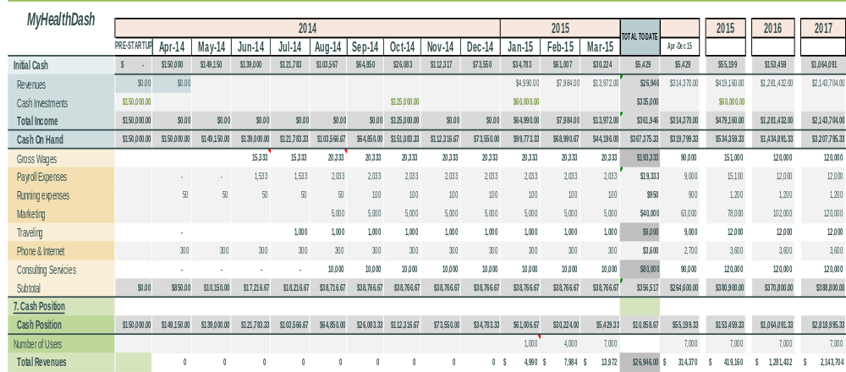
Projected Cash Flow

Slide 30
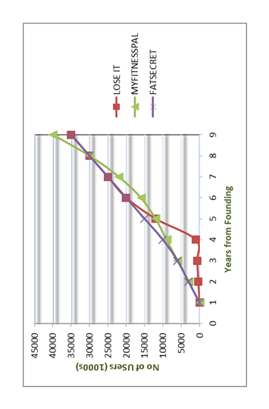
Competitor Growth History

Slide 31
Extensions or Pivots
Automatic computation of carbon footprint
License receipt-to-nutrition technology to
  Grocery stores
  Restaurants
  Hospitals
  Schools
  Retirement communities
Open up to Asian market

Slide 32
Sources
http://www.clipartoday.com/_thumbs/034/1/spc971110clm_tnb.png
http://www.mpplocums.co.uk/LocumNews/wp-content/uploads/2013/01/dash-diet.jpg
http://www.fitbie.com/sites/default/files/opener-best-and-worst-packaged-breakfast-foods-ss.jpg
http://www.executiveofficespace.net/news/wp-content/uploads/2011/02/Officeman.jpg
http://www.thecorneroffice.co/wp-content/uploads/2011/12/personal-assistant.jpg
http://www.feirox.com/rivu/2013/04/myfitnesspal.jpg
www.loseit.com
http://caloriecount.about.com/
http://www.mpplocums.co.uk/LocumNews/wp-content/uploads/2013/01/dash-diet.jpg
http://mindmillion.com/images/money/01-large-cartoon-cash.gif#cash%20clipart
https://fresh.amazon.com
http://shop.safeway.com/ecom/home
http://cdn3.tnwcdn.com/wp-content/blogs.dir/1/files/2013/05/scan.png
http://www.marketdataenterprises.com/pressreleases/Diet%20Market%202012%20Forecasts.pdf
http://img.bhs4.com/a4/f/a4f6209053880aa7470fd14c76144a3873c534dc_large.jpg
http://img.photobucket.com/albums/v69/MomtoKennedy/NutritionAnalysis.jpg
http://img.bhs4.com/f3/3/f33aa3d122eaeac738272711c89ac26431b84b39_large.jpg
http://www.product-reviews.net/wp-content/uploads/Calorie-count-screenshot.jpg
http://www.sfgate.com/business/article/More-turning-to-smart-phone-apps-for-diet-help-2375031.php

