Slide 1

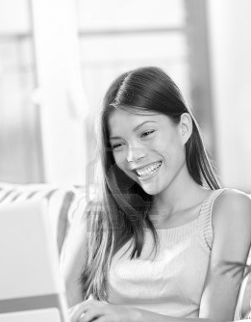
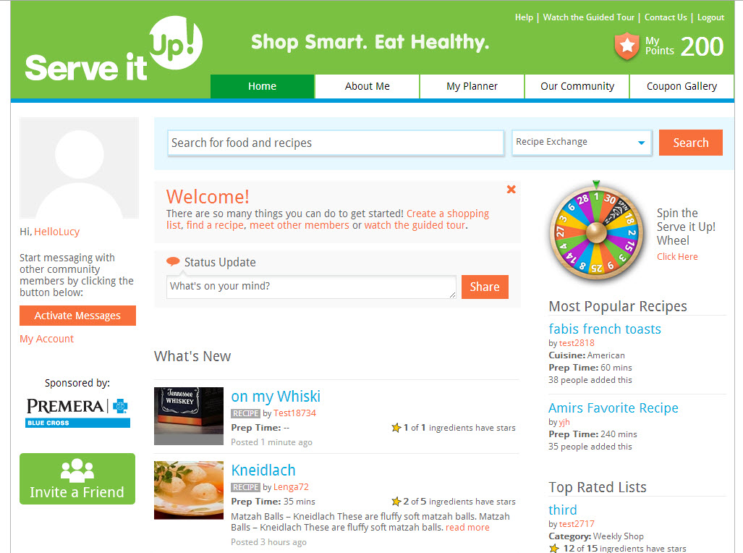

Healthy Customer Portals
See what a patient-centric approach can do to drive patient engagement, acquisition, and improved outcomes
Wellness Layers has built several of the most engaging online and mobile health and wellness destinations in the world, some growing to multi-million member communities. For each client, we strategically customize our Platform and embed our proven three-layered approach to engagement:
Provide your patients with the same care and personalization via online and mobile that you do in your hospitals and clinics. Enable your patients to manage their own health and wellness, connect with others and their care teams, and receive personalized, up-to-date information with calls to action.
Flexible & Market Ready
HIPAA compliant & satisfies meaningful use
EMR, PHR & HRA agnostic
Flexible to integrate with devices, biometric tests, databases, ecommerce systems, etc.
Up-to-date Technology
Built in Microsoft’s latest .NET
Responsive design and Web 2.0 with ‘smart’ planners, memory, drag and drop and optimization for ease of use
Contact us to schedule a demo: 212-595-5170
Flexible Branded Engagement Solutions
www.wellnesslayers.com Schedule a demo: 212-595-5170 or info@wellnesslayers.com

Slide 2
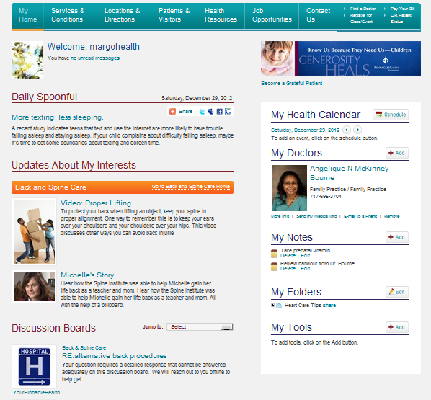
Healthy Customer Portals
See what a patient-centric approach can do to drive patient engagement, acquisition, and improved outcomes
Wellness Layers has built several of the most engaging online and mobile health and wellness destinations in the world, some growing to multi-million member communities. For each client, we strategically customize our Platform and embed our proven three-layered approach to engagement:
Provide your patients with the same care and personalization via online and mobile that you do in your hospitals and clinics. Enable your patients to manage their own health and wellness, connect with others and their care teams, and receive personalized, up-to-date information with calls to action.
Flexible & Market Ready
HIPAA compliant & satisfies meaningful use
EMR, PHR & HRA agnostic
Flexible to integrate with devices, biometric tests, databases, ecommerce systems, etc.
Up-to-date Technology
Built in Microsoft’s latest .NET
Responsive design and Web 2.0 with ‘smart’ planners, memory, drag and drop and optimization for ease of use
Contact us to schedule a demo: 212-595-5170
www.wellnesslayers.com Schedule a demo: 212-595-5170 or info@wellnesslayers.com

Slide 3

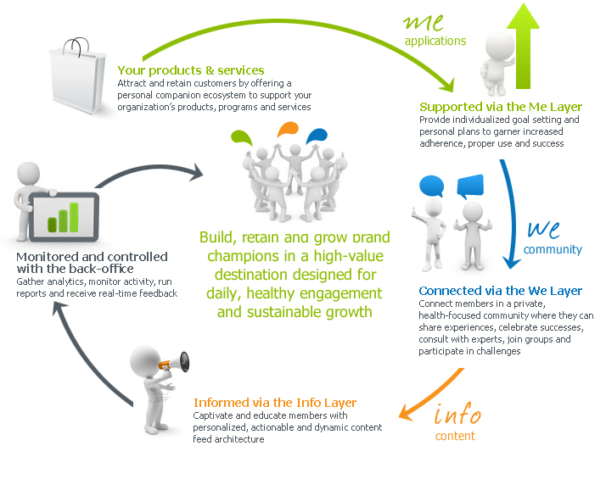








A Proven Approach to Sustained Engagement & Growth
Winner of 3 eHealthcare
Leadership Awards
Wellness Layers has built several of the most engaging online and mobile health and wellness destinations in the world, some growing to multi-million member communities. For each client, we strategically customize our Platform and embed our proven three-layered approach to engagement:
Healthy Customer Portals
me
we
info
Recent Clients
Wellness Layers Advantages
Expertise & best practices across health & wellness
Complete functionality with quick launch
Tried and true platform with 15 years of development expertise
Lower implementation cost
Evergreen, long term investment in future innovation
www.wellnesslayers.com Schedule a demo: 212-595-5170 or info@wellnesslayers.com

