Slide 1


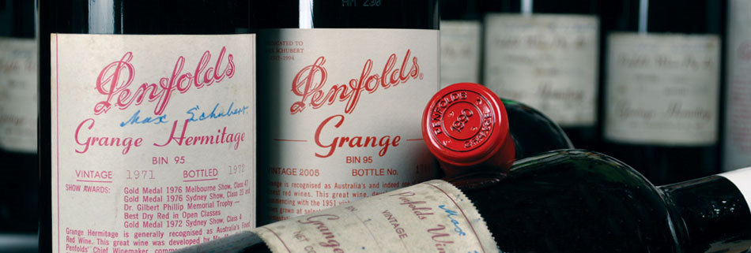

WIN A BOTTLE OF FINE RED WINE
Home Loans
Car & Vehicle Loans
Commercial Property
Business Loans
Equipment Finance
SMSF Loans
HOW MANY BALLS ARE IN THE JAR?
Finance Brokers
Terms & Conditions - Only 1 entry permitted per delegate. Closest correct answer wins. Winner selected at sole discretion of Healthy Loans Gold Coast (the promoter)
www.healthyloans.com.au

