Slide 1

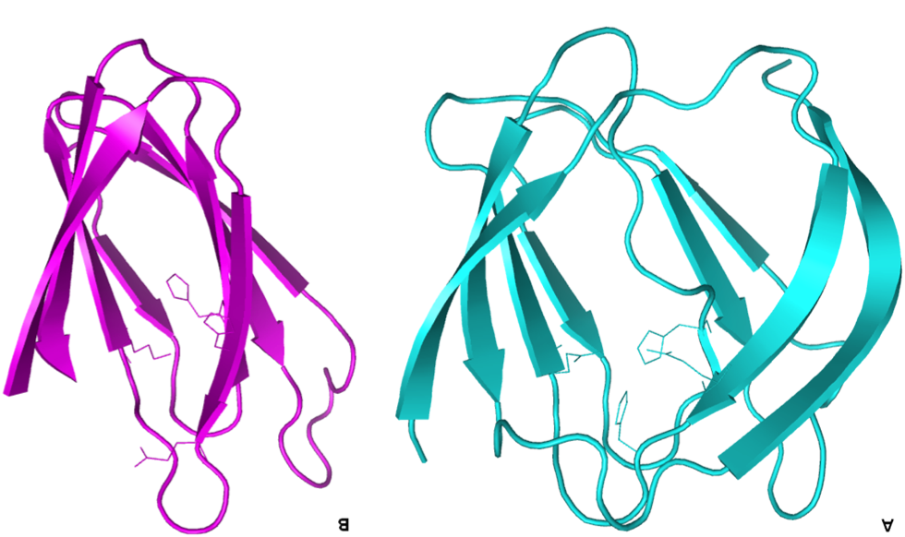
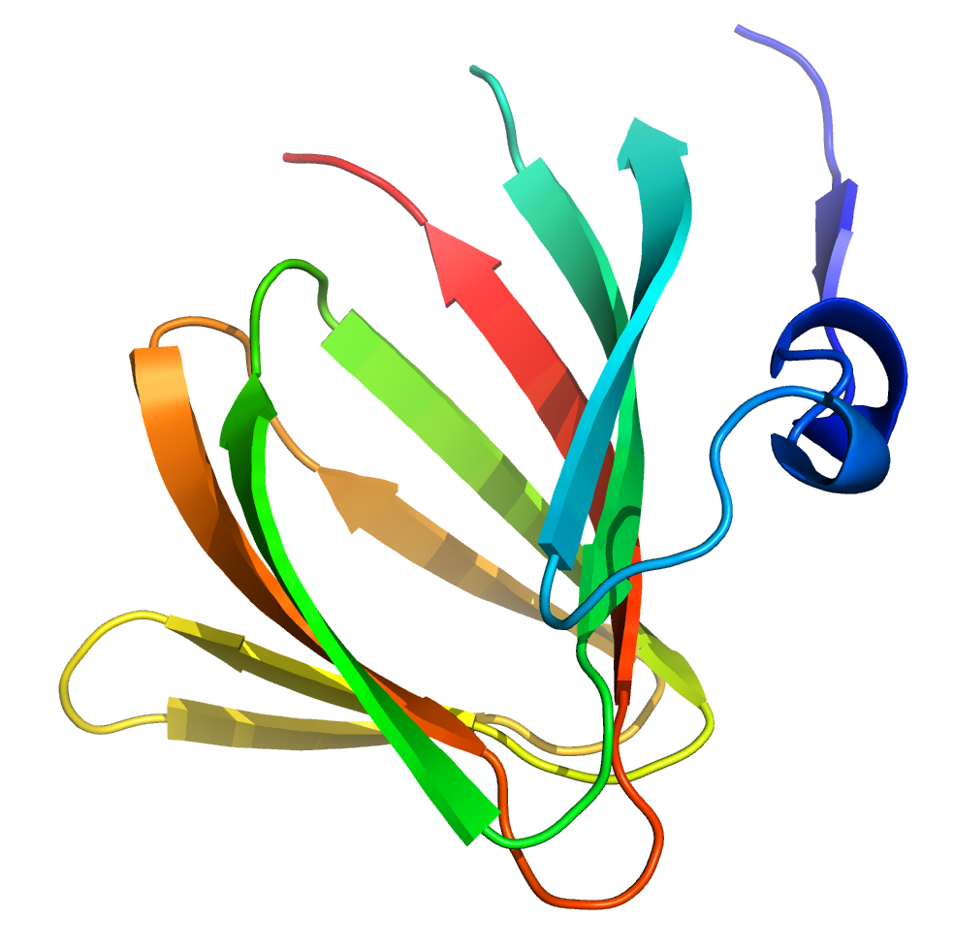
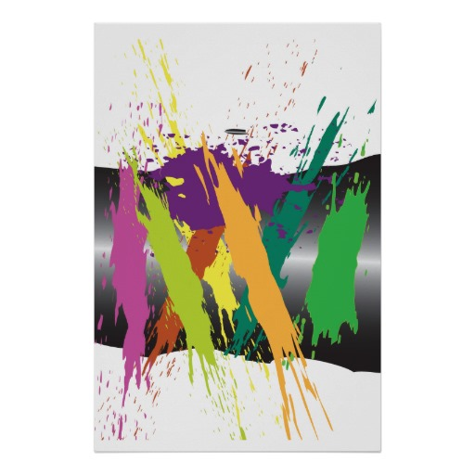
We would like the blue to green colors (maximum of 3 colors total) in the DSM logo.
Also, how the colors overlap to create a different shade of color is a nice touch.
We would like to see the logo be an abstract rendering of a protein structure. To the left are (3) examples of abstract renderings of protein structures so called beta-barrels (they can remind you of a barrel). Please omit (remove) the arrow-head shape at the ends and the narrow connecting strings from the final logo.
We like the abstract nature of the image to the left (1), though it still resembles a beta-barrel.
Note: We are looking for a logo which would accompany our company name: Captozyme. Thus, Captozyme letters (non serif) would be in one of the colors of the logo.

