Slide 1
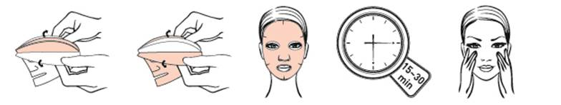
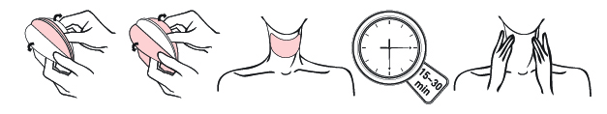
1st set of drawings :
We want to present how to use a mask in two parts. For this we would like something similar :
1
2
3
4
7 min
1st drawing
1 remove the two parts on the right and left of the mask
2nd drawing
Apply the face part and the neck part
3rd drawing
Wait 7 minutes
4th drawing
Gently massage face & neck to let (one hand on face one hand on neck

Slide 2
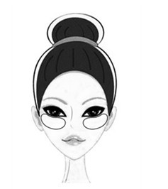
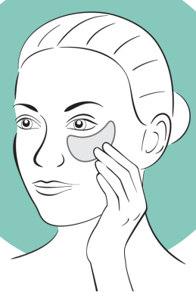
2nd set of drawings :
We want to present how to use an eye patch. For this we would like something similar drawing than before and change the 2nd one:
1
3
7 min
or
1st drawing
Same as previous 1
2nd drawing
Apply under the eyes
We need two patches on the drawing
3rd drawing
Wait 7 minutes
Same as 3
4th drawing
Gently massage face & neck to let (one hand on face one hand on neck

Slide 3
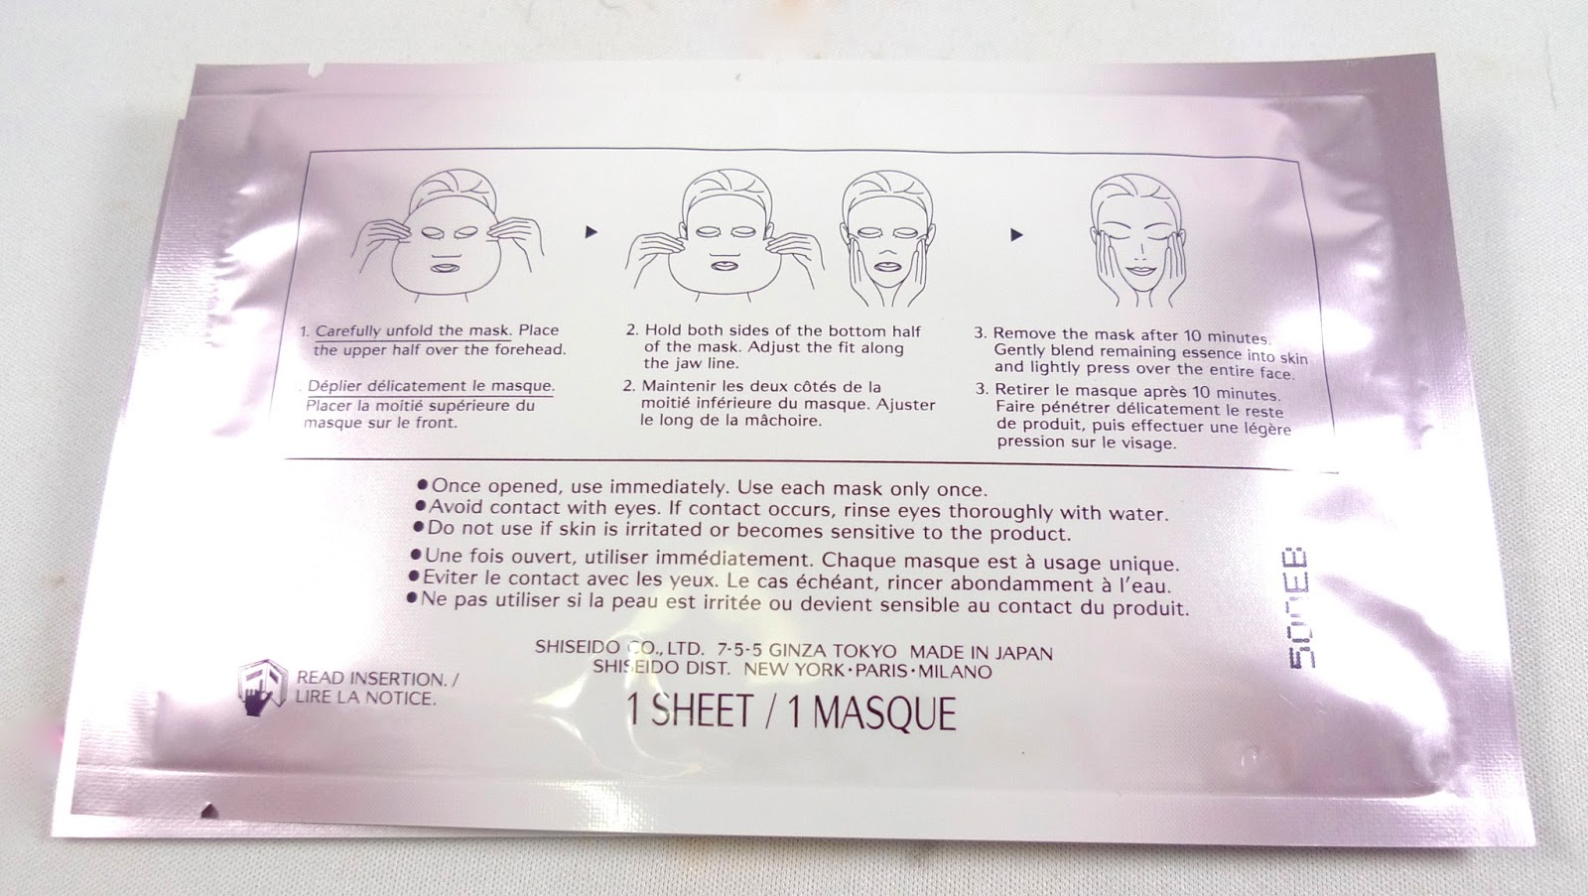
Few examples on packagings

Slide 4
