Slide 1
Drill Cuttings Waste Management
We minimize the environmental footprint of drilling operation
ZERO DISCHARGE

Slide 2
Technology to serve Environment
Company slogan is ZERO DISCHARGE.
We work in deploying the latest technology “ USA & Europe” in the field of drill cutting recycle and economically managing the footprint.
With the ramp up in oil demands and the increase in oil prices , operators are extending their operations into new geographical areas “ government regulations and eco-sounds” created the need to a specialty services and products that should go parallel or even ahead.
UAE , double rig activities in two years “ especially offshore & Man Made islands”.

Slide 3
Business concept
Help our client identify the risks and hazards associated with their operations.
Assist and create economically effective customized solution to reduce the environmental impact “ chemical and /or physical”.
While designing the proper solution we look at all operation aspects and assure integrating our process & solution into the daily operation , simply we work simultaneous before the problem created.
Daily measure of our efforts will be communicated to the clients in terms of economics and operation efficiency.

Slide 4
Omar Saeed Alamri
Chairman
Islam Taha
Director
Business Acquesation
Ahmed Hussieny
Director
Operations
Office Manager
Finance & Accounting
Operation Manager
Marketing Manager

Slide 5
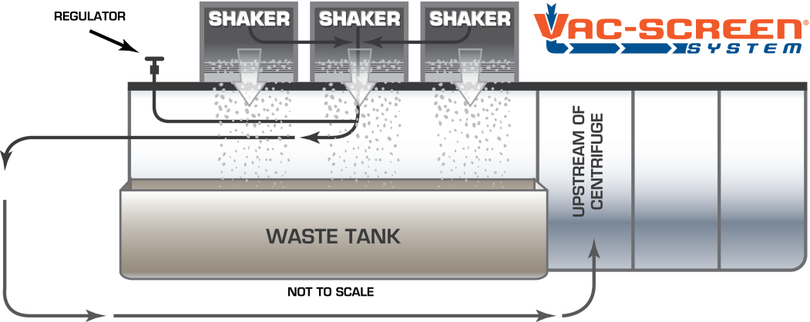
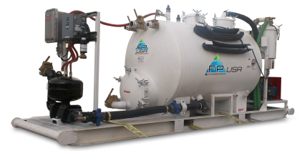
Vacuum Pump “ Separation on Fly”

Slide 6
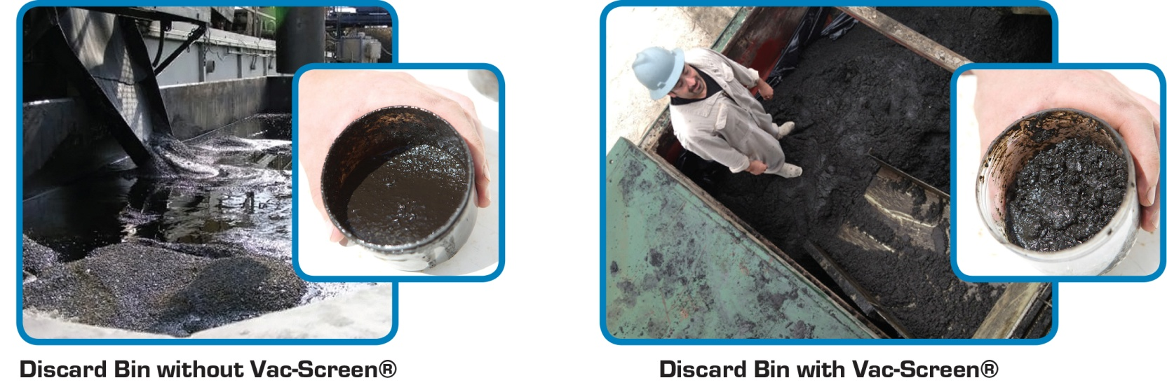
Strength & Benefits
Recover drilling fluids , up to 120,000 USD savings per day in intense operations.
Dried cutting can be re-injected immediately “ no need for transport and further treatment ”.

Slide 7
Customer List “ UAE”
ADNOC.
ADCO.
ADMA.
ZADCO.
ADOC_Japan.
AL-HOSN , OXY
Wintershall.
KNOC.
Schlumberger
Halliburton.
Baker Hughes Inteq
Petrochem.
Weatherford.
Masdar City.

Slide 8
Customer List GCC
ARAMCO.
PDO.
OXY_OMAN.
BP_OMAN.
OMAN OIL.
CCED_OMAN.
KOC _ Kuwait.
TAQA.
KE , Kuwait Energy.
WAFRA.
Petro-Msila.
OMV_YEMEN

Slide 9
SWOT analysis
Strength Vast multinational experience in the field of drilling operations and Upstream activity. Existing network with services provider and suppliers both internal and external. Ability to customize economically sounds and efficient solutions to our clients. Local sourcing and in country value. | Opportunity New technology which is already proven in USA and Europe. Ramp up in Drilling activity. UAE , GCC trends to minimize the environmental impact in all aspects of the industry and specific to Oil and GAS. Specific to MM islands and ZERO discharge.
Weakness Market entry and customer education on Waste Management awareness. Operation integration and process compliance with learning curve approach. | Threats Delay in Fund , may raise concern with US supplier. Delay in startup may make the market available to other supplier. Admin work and visa regulations .

Slide 10
Performa Invoice
Item | Daily Charge “ AED” | Days | Total
Operating Unit | 2800 | 180 | 504,000
Stand By Unit | 1700 | 180 | 306,000
Senior Operator | 2600 | 180 | 468,000
Junior Operator | 1700 | 180 | 306,000
Others | Spars and Transportation |  | 200,00
 |  |  | 1,784,000

