Slide 1
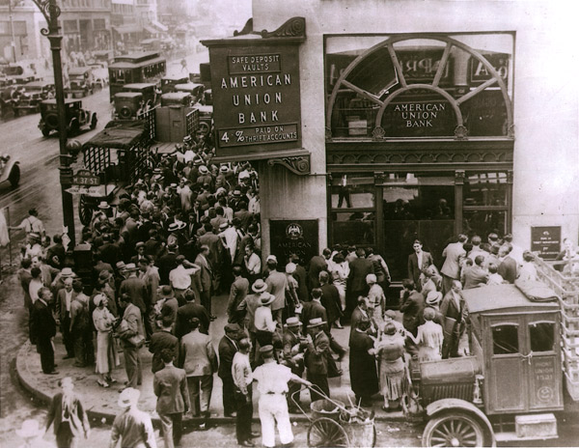

The Beginning of the End for Banks and
The End of the Beginning for Financial Technology
The Dinosaurs
&
The Evolvers

