Slide 1

Residential Real Estate Investment Proposal
Argentina
Grupo Regam
Los Angeles, October 2014

Slide 2
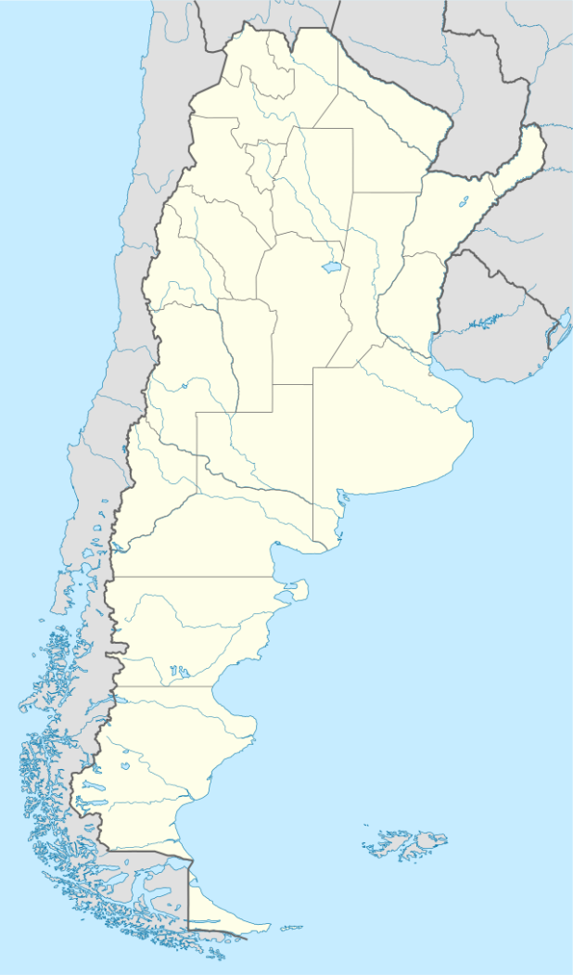


About Grupo Regam
Established in Cordoba in 1967, Grupo Regam is a diversified holding company operating in construction, real estate development and hospitality
Construction
Real Estate Development
Hospitality
Top 13 Construction Company in the country ¹
Diversified portfolio Sq Ft (000s)
Residential 7,384
Commercial/Retail 3,380
Hospitality 834
Corporate 176
Total 11,774
In Argentina’s largest cities
Cordoba 8,715
Buenos Aires 1,290
Mendoza 1,229
Santa Fe 514
Other 24
Domestic and international Clients
Type Sq Ft (000s)
Single Family Residential 18,905
High Rise 651
Total 20,808
In Argentina’s largest cities
Cordoba 20,547
Buenos Aires 261
Founded 1992
First Argentine
owned and operated hospitality chain
Total Hotels 21
Four Star 17
Three Star 4
Opening 2015-2016 3
Cities 18
1- Diario Clarin; Ranking Empresas Constructoras 2013

Slide 3
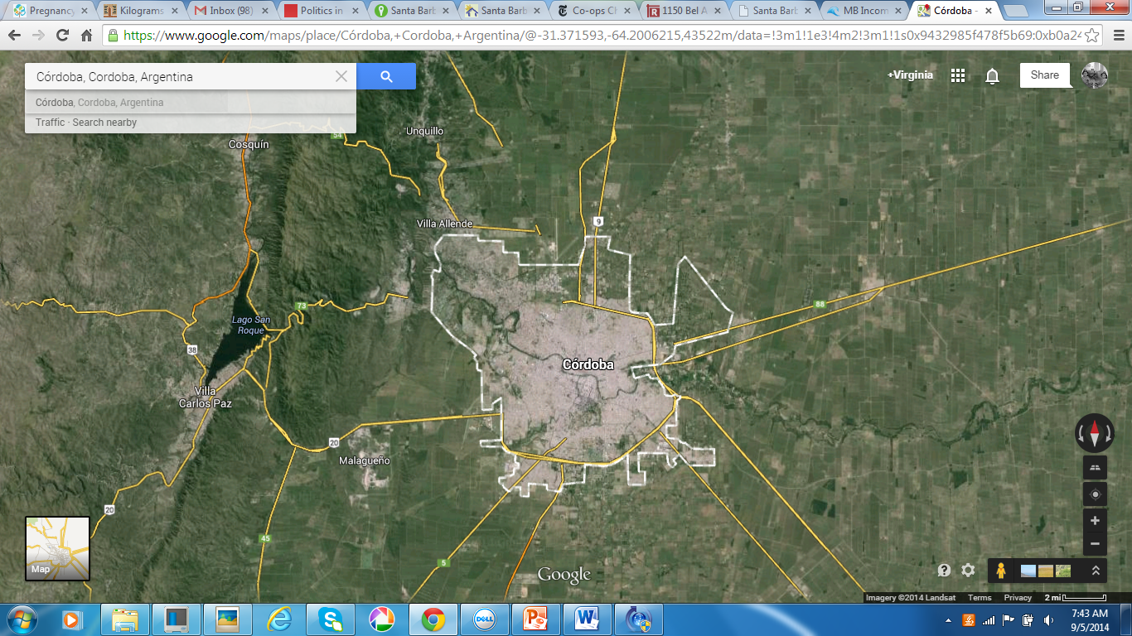








Recently Completed Real Estate Development Projects
Cordoba
Single Family Residential
143 acres
248 Lots
High Rise Condominium
250,048 sq ft
244 Apartments
211 Parking Spaces
High Rise Condominium
387,827 sq ft
364 Apartments
162 Parking Spaces
Mixed Use
Single Family Residential
146 acres
1,030 Lots
Single Family Residential
86 acres
400 Lots
High Rise Condominium
6,000 apartment units
Single Family Residential
59 acres
239 Lots

Slide 4
Residential Real Estate Investment Proposal

Slide 5
Residential Real Estate Development Proposal
Capital Requirement
Available Investment
Timeframe for Capital Deployment
Project Term
Project
Strategy
Expected IRR
Seeking $40M¹ to develop five comparably sized residential real estate projects
Investment Total $50M: Investors $40M | Grupo Regam $10M
2015-2016
18 years
Projects involve the purchase of raw land and the sale of fully developed lots in a mortgage-like financing package.
Offer mortgage financing to middle class households, who have the disposable income but are unable to access credit via the banking system in Argentina
23.5%
1- Unless otherwise specified, the currency used throughout this document is the US dollar

Slide 6
Opportunity lies in mortgage financing
Housing shortage in the argentine middle class is estimated at roughly 1 million households
These households have the income to comfortably afford mortgage payments
Yet mortgage credit is very limited via the banking system in Argentina
Mortgage-like financing is critical to unlocking demand

Slide 7
Middle to upper class housing deficit in Argentina
is estimated at approximately 1 million households
Number of Households with potential need for a home by average household income decile
Income Decile | Households with potential need for a home | Average Household Income (USD)
10 | 259,726 | $ 1,645
9 | 268,473 | $ 1,053
8 | 182,696 | $ 900
7 | 223,970 | $ 800
6 | 179,257 | $ 753
5 | 268,380 | $ 655
4 | 349,582 | $ 540
3 | 353,479 | $ 390
2 | 422,435 | $ 344
1 | 417,275 | $ 200
Total Households with Potential Need for a home | 2,925,273
Total Households | 12,171,675
Households with potential need for a home include:
Renters adjusted to account
for potential buyers only
“Overcrowded” those with 3 or more
Households inhabitants per room
Multiple households where more than
Nucleus one family coexist
Irrecoverable those living in homes of
precarious conditions
934,875 households, roughly 20% of total households in deciles 7 to 10
One in five middle-upper class households have both the means and the likely desire to purchase a home
Source: IERAL Fundacion Mediterranea: Monitor Fiscal Nº 19: Problemas habitacionales e inversión en viviendas sociales en Argentina, 2013

Slide 8
These households have the income required to afford mortgage payments…
Incidence of mortgage payments on household income by income decile
Mortgage payment as a % of household income
27.9%
29.4%
22.9%
25.8%
Income decile
With mortgage-like financing, middle to high income households can afford to purchase their first home with monthly payments below 30% of income
Source: IERAL Fundacion Mediterranea: Monitor Fiscal Nº 19: Problemas habitacionales e inversión en viviendas sociales en Argentina, 2013
* Mortgage payments estimated on a 15 year financing term purchase of lots ranging between 5,000 and 10,000 sq ft in target market areas

Slide 9
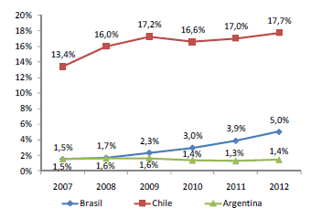
…yet access to mortgage credit is almost non existent in Argentina
Mortgage credit % of GDP
Main causes of limited mortgage financing availability:
Widening gap between salaries and home prices in the past decade
Negative impact of inflation in savings
High risk premium for banks on long term financing
Argentina has one of the lowest mortgage financing rates as % of GDP in Latin America

Slide 10
Financing is critical to unlocking demand
Access to mortgage credit drives growth in number of new home buyers
Financing Term
Interest rate
Tiered Mortgage System
Mortgage Installment Index
Default risk
10 to 15 years
10%
Lower initial installments until site infrastructure is complete and lot is delivered.
Installments double once lot is delivered and for the duration of the financing term.
Financing is offered for both lot purchase and construction.
Installments are adjusted using the Construction Cost Index.
This index correlates with trends in salaries and currency exchange rates over long periods of time.
Property title is transferred only when installments are paid in full. When in default, mortgage is sold to new buyer and payments made are returned to buyer in default.
Site Infrastructure Complete
Lot delivered
$240
30%
Monthly installment:
Installment % of Income:
$ 120
15%
n-2
n-1
n=-1
n=-7
Notes:
What mortgage options do buyers have today? None, 10% LTV, their parents/friends exclusively, etc?
Lower rate until lot is delivered…is this managable for the buyer in addition to their existing rent obligation? How long from lot delivery til they can occupy? How do they finance the build? Can they afford the payment in the interim? The payment reflect a 15 yr ammortizing loan with mixed principle & interest in dollars? Can peso-derived incomes sustain this obligation?

Slide 11
Risks to long term financing in Argentina
Risk
Income growth fails to keep pace with home prices
Currency fluctuation
Economy slowing down following a decade of accelerated growth
Government policies have detered foreign investment
Mitigating factors
Mortgage installments are adjusted using the Construction Cost Index, which over the long term closely correlates with salaries.
Over the long term, currency distortions have corrected to catch up with salaries and construction cost.
-GDP growth projected to increase to 2.83% by 2016 vs a regional 3.47%, following a slow 2015
-Growth could accelerate with investor confidence to exploit shale gas and oil reserves, estimated to be the world's 2nd and 4th largest respectively.
-Strengthening middle class grew from 34% to 53% between 2000-2011¹ By contrast, in Latin America it represents 30% of the population.
Expecting transition to a more market and investor friendly government in upcoming 2015 elections
Affordability
Currency
Economy
Political climate
1- Source: World Bank COUNTRY PARTNERSHIP STRATEGY FOR THE ARGENTINE REPUBLIC FOR THE PERIOD FY15-18 August 7, 2014. Middle class is defined as those with monthly income between $300 and $1,500
Notes:
Bingo!
So middle class now represents half the pop? I’d like to see something on real wages/income and purchasing power.

Slide 12
Affordability Risk: Over the long term, salaries have closely correlated to construction cost trends
The Construction Cost Index is used to adjust mortgage installments over time
Construction Cost Index (CCI) and Average Salaries
1980=100
Average % Annual Growth 1980-2013
84.3
84.4
IERAL Fundacion Mediterranea: Una Propuesta para el Financiamiento de Viviendas para Hogares de Ingresos Medios en Argentina, 2013
CAC: Camara Argentina de la Construccion
Note: The Construction Cost Index published by the Argentina Construction Camara is included for comparison with the official INDEC numbers

Slide 13
Currency Risk: Over the long term, currency distortions tend toward equilibrium with construction cost
Construction Cost Index (CCI) Average Salaries and USD Exchange Rate
1980=100
% Vs 2001
2,058
2,291
1,450
753
IERAL Fundacion Mediterranea: Una Propuesta para el Financiamiento de Viviendas para Hogares de Ingresos Medios en Argentina, 2013
CAC: Camara Argentina de la Construccion
Notes:
I don’t really follow why currency distortions tend toward equilibrium w/ construction costs…its not intuitive to me

Slide 14
Project Proposal

Slide 15
Project Proposal: 5 featured developments
Cordoba
Malagueno
617 Acres
2,569 lots
Highlight provinces
Santa Fe
Alta Gracia
Cordoba
560 Acres
2,120 lots
Buenos Aires
Santa Fe
Rufina
572 Acres
2,450 lots
Goya
531 Acres
2,090 lots
Buenos Aires
Pampa
820 Acres
3,170 lots

Slide 16
Featured Project: Malagueno
ABOUT CORDOBA
Cordoba is the second largest city in Argentina with a population of 1.4M and 478,000 households
The province of Cordoba accounts for 7.6% of Argentina’s GDP and 12.7% of exports
Considered the technological center of Argentina with the highest per capita software university graduates in all of Latin America.
6 major public and private universities, including the National University of Córdoba, the oldest university in Argentina and second-largest in the country.
More than 10 percent of the city’s population are students in colleges or universities, the highest proportion in Latin America and one of the highest in the world

Slide 17
Malagueno project overview
An outline of this project is presented in the following slides as a reference for all five projects, as they share similar characteristics.
Acres: 617
Lots: 2,569
Lot sizes: 4,844 sq ft (60%)
10,764 sq ft (40%)
Completion 24 months: 20%
48 months: 40%
72 months: 40%
Development:
Land subdivision, infrastructure including roads, drainage systems, water, sewerage, and public utilities.
Location:
Western outskirts of Cordoba city
20 min to downtown Cordoba via highway
20 minutes to lake San Roque, popular weekend and vacation destination
Malagueno

Slide 18
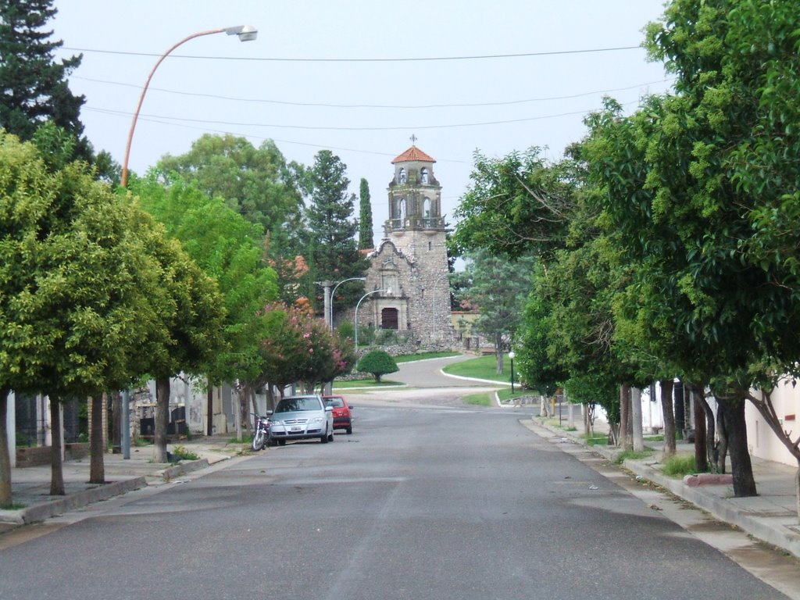
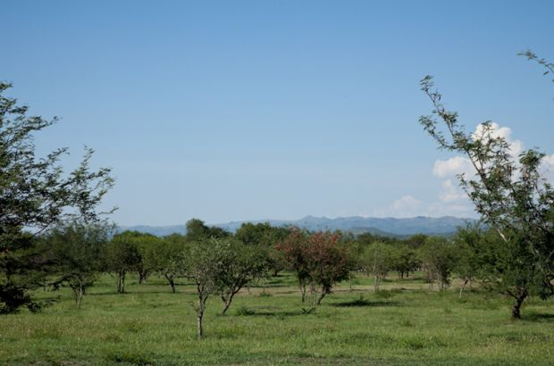
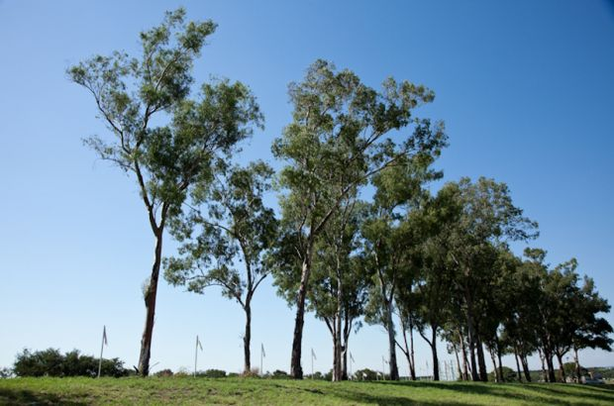
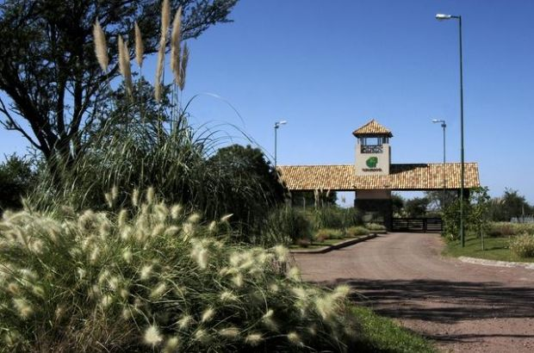
Pictures of Malagueno
Malagueno site

Slide 19
Target Market Segments
Young professionals
Parents of young professionals
Investors
Middle class, college educated professionals including singles, young couples and young families aged 25 to 40
Middle class adults aged 50 to mid 60s who want to help their children buy their first lot of land for the purpose of building their future home.
Local investors with monthly disposable income to invest in real estate as a “safe asset” that allows them to grow their capital over time while generating an additional source of income.

Slide 20
Equity and Returns
Equity and Returns | USD
Equity Required
Sponsor Equity- Invested: 20% | $2,325,969
Investor Equity- Required: 80% | $9,303,874
Total Equity | $11,629,843
Returns
Cash Flow | $54,623,242
IRR | 23.46%
Timeframe | 18 years

Slide 21
Income and Expenses
Income and Expenses | USD
Income | $123,441,943
Land and Infrastructure
Land Cost | $22,832,992
Infrastructure Cost | $20,316,017
Expenses
Marketing | $1,558,442
Sales | $2,918,641
Fees
Construction Management Fees | $3,933,181
Project Management Fees | $10,862,891
Taxes
Commercial and Banking Taxes | $6,396,537

Slide 22
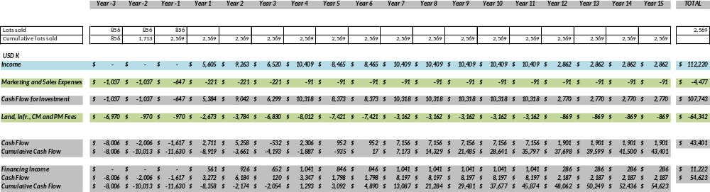
Cash Flow

Slide 23
Team Biographies
Martin Amengual
Martin Amengual is the founder of Grupo Regam. For almost fifty years Mr. Amengual has led the company to become one of the largest construction and real estate development holdings in Argentina. In 1990 he founded Amerian Hoteles, the first fully argentine-owned and operated hotel chain and he has since been instrumental in the company’s growth to over 21 properties in as many years. Mr Amengual has held leadership positions with several institutions including the Argentine Construction Chamber and Fundacion Mediterranea, a think tank. He holds a Civil Engineering degree from the University of Cordoba School of Engineering.
Virginia Moore
Virginia Moore is a Partner and Principal with Corbis Global, an architectural and engineering outsourcing company based in Cordoba, Argentina working with clients in the US, Australia and the Middle East. Ms Moore holds a BA in Business Administration from Universidad Catolica de Cordoba and an MBA from ESADE Barcelona Business School.

Slide 24
Thank you

Slide 25
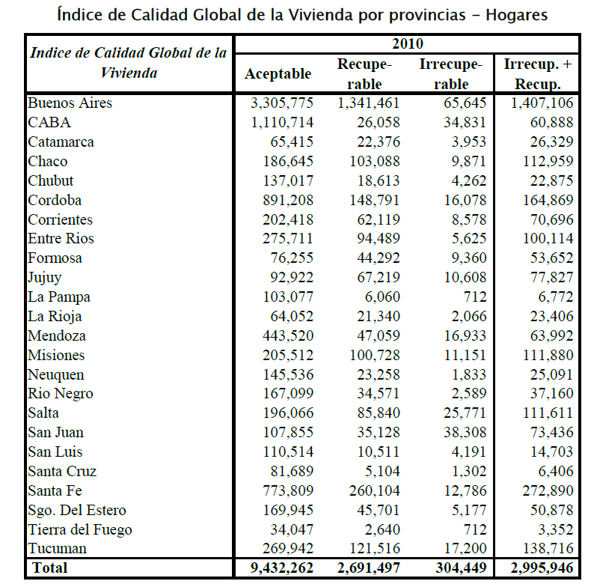
Table A1: Housing quality index by province
IERAL Fundacion Mediterranea: Monitor Fiscal Nº 19: Problemas habitacionales e inversión en viviendas sociales en Argentina, 2011

Slide 26
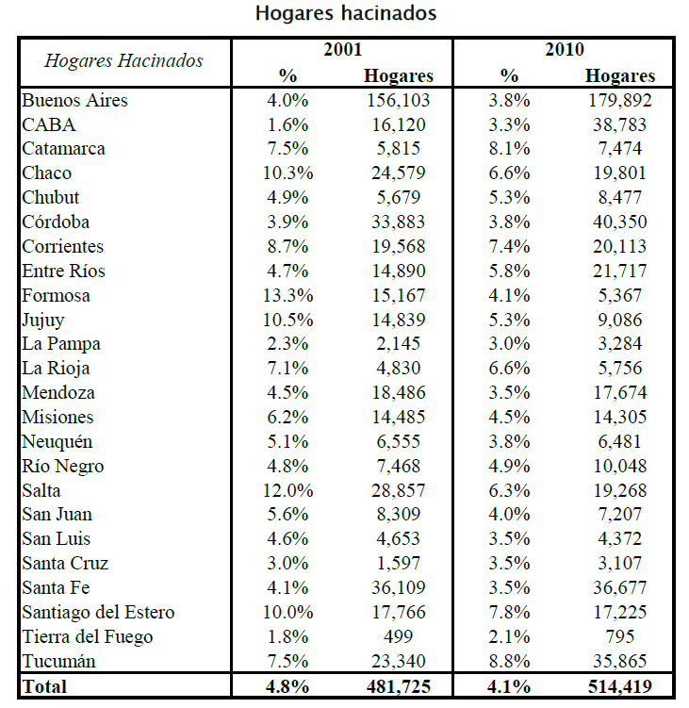
Table A2: “Overcrowded” households by province
IERAL Fundacion Mediterranea: Monitor Fiscal Nº 19: Problemas habitacionales e inversión en viviendas sociales en Argentina, 2011

Slide 27
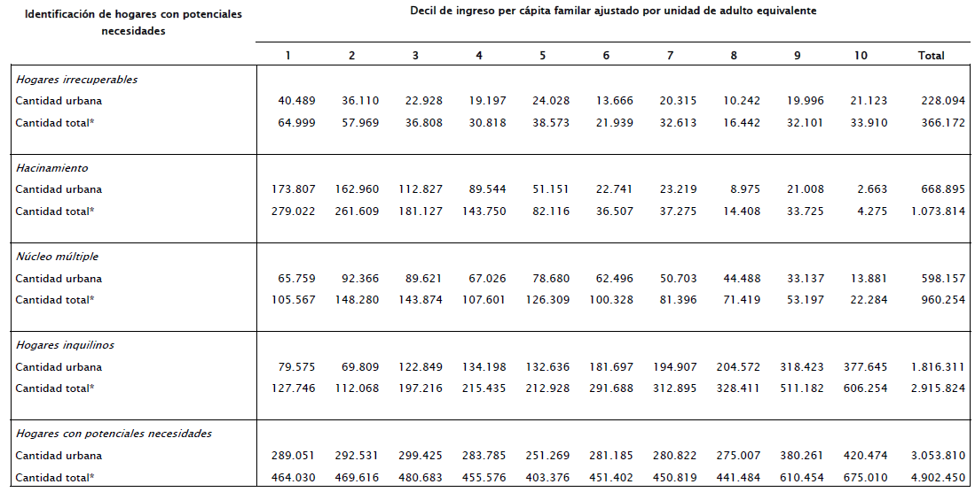
Table A3: Households with potential demand for a home by average household income decile
IERAL Fundacion Mediterranea: Una Propuesta para el Financiamiento de Viviendas para Hogares de Ingresos Medios en Argentina, 2013

Slide 28
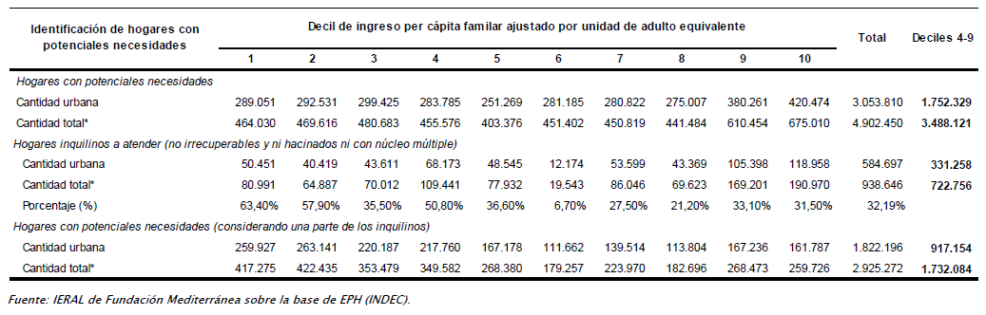
Table A4: Households with potential demand for a home by average household income decile adjusted for renters who are potential buyers
IERAL Fundacion Mediterranea: Una Propuesta para el Financiamiento de Viviendas para Hogares de Ingresos Medios en Argentina, 2013

Slide 29
About Grupo Regam: featured projects
Table 1: Featured projects developed by Grupo Regam in Cordoba city 2004-2014
Development | Type | Size (Sq ft, Acres) | Number of Units | Status | Target Market | Grupo Regam % Share | Sales
1- Torres del Rio | High Rise Condominium | 387,827 sq ft | 364 Apartments 162 Parking Spaces Retail area | Towers 1 and 2 completed. Towers 3 and 4 in development | 30% Aged 50+ High Income 70% Aged 30-50 Mid to High Income | 100 % | Tower 1: 85% Tower 2: 94% Parking Phase 1: 91% Sold
2- Torres del Solar | High Rise Condominium | 250,048 sq ft | 244 Apartments 211 Parking Spaces | Completed | Mid to High Income | 100% | 97% Sold
3- Altos del Chateau | Gated Community | 143 Acres | 248 | Completed | High Income | 50 % | 100% Sold
4- Tejas Dos | Open Community | 59 Acres | 239 | Completed | Mid to High Income | 100 % | 82% Sold
5- Tejas Tres | Gated Community | 86 Acres | 400 | Completed | Mid to High Income | 100 % | 87% Sold
6- Tejas Cuatro | Gated Community | 146 Acres | 1030 | In development | Young families buying their first home | 50 % | 97% Sold
7- Regam Pilay | High Rise Condominium | -- | 6040 | 320 completed 232 in development Land purchased for 940 additional units | 40+ years old purchasing their first home | 50% | 98% Sold

Slide 30
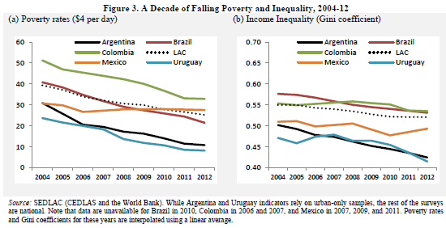
A decade of falling poverty and inequality

Slide 31
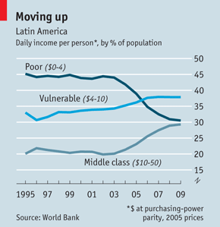
A decade of falling poverty and inequality
Notes:
The bank’s economists nod in the direction of sociology by defining the middle class in terms of economic security. They reckon that for a Latin American household to have no more than a 10% chance of falling back into poverty over a five-year period requires an income of at least $10 per person per day (at purchasing-power parity exchange rates). They define those with an income of over $50 per day—just 2% of Latin Americans—as rich

Slide 32
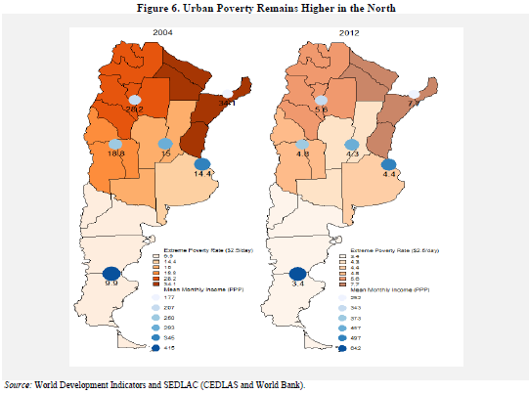
A decade of falling poverty and inequality

Slide 33
Residential real estate macro trends in Argentina
Population 40,117,096¹
12M households
47% are middle class households
Biggest housing deficits are in Buenos Aires, Córdoba, San Juan, Santa Fe and Corrientes
Santa Fe
Cordoba
Buenos Aires
1-Census 2010
2- Includes: homes in irrecoverable condition, overcrowding, multiple nucleus and renters (renters adjusted to account for potential buyers only)
3-IERAL Fundacion Mediterranea: Monitor Fiscal Nº 19: Problemas habitacionales e inversión en viviendas sociales en Argentina, 2013
Notes:
Existe cerca de 3 millones de hogares en viviendas deficitarias según cifras de 2010, de las cuales 2,7 millones son recuperables y 300 mil irrecuperables.
Pero además de las viviendas inadecuadas, el déficit habitacional incluye aquéllas que son necesarias debido a la insuficiencia del número de viviendas. La definición de hacinamiento es útil para aproximar cuantitativamente esta situación. Se podría suponer que los hogares que viven hacinados (más de 3 personas por cuarto) requerirían la construcción de viviendas nuevas o ampliaciones de las existentes. En 2010 había 514 mil hogares hacinados (4,1% del total).
Mortgage credit/GDP Brazil: 4.3% Chile: 17%

Slide 34




Grupo Regam
Established in Cordoba in 1967, Grupo Regam is a diversified holding company operating in construction, real estate development and hospitality
Maybe just replace with following slide
Founded 1967
Construction arm, over 11M sq ft built
Ranked #13 top construction companies ¹
Founded 1992
First 100% argentine owned hotel chain
Operates 21 hotels in 18 cities
Real Estate Development
Real Estate Development Financing
Cementeries
265,000 sq ft retail development
150 retail outlets
Minority Partner
1- Diario Clarin; Ranking Empresas Constructoras 2013
Notes:
Regam…established rather than founded…constructed over 11mm sq ft,

Slide 35

Target Market Characteristics
Marital Status
Education
Age
Tejas Cuatro
Ad Campaign
2012

