Slide 1

Presented to

Slide 2
Why Flameout?
100% Green
Patented Revolutionary Formula
Product Comparisons
Unique Packaging
Safe
Smart
Sales Details & Projections

Slide 3

100% GREEN
27% of shoppers pick green over price.
Flameout is the ONLY 100% Biodegradable and 100% Non-Toxic fire extinguishing foam that is UL listed and certified by both the EPA & U.S. Department of Forestry.
Most Dry Chemical fire extinguishers contain monoammonium phosphate, ammonium sulfate and other chemicals that should be avoided and may require medical attention.

Slide 4
PATENTED FORMULA
48% of shoppers pick technology over tradition.
Flameout's patented formula is the only non toxic formula that STOPS re-ignition and kills grease fires permanently.
Dry Chemical fire extinguishers allow re-ignition.
Flameout prevents re-ignition of
Class A fires (wood, bedding, etc.) and
Class B fires (gasoline, grease, etc.)
Cools burning materials rapidly

Slide 5
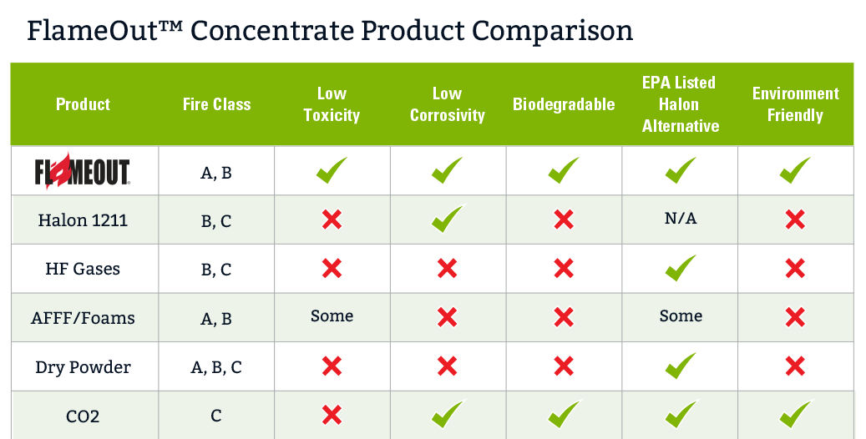

Slide 6
UNIQUE PACKAGING
Easily Draws Customers Attention
Detailed Information Printed on Canister
Eliminates Unnecessary Packaging & Waste
Stands Out From Competition

Slide 7
SAFE
Flameout is the ONLY Non-Corrosive/Non-Toxic fire extinguishing foam available.
Dry Chemical fire extinguishers are toxic and contain corrosive chemicals that can damage electronic equipment such as appliances and computers.
Easy cleanup with water
Family Safe

Slide 8
SMART
Safe to store, handle, and use.
Up to 7’xs more effective than water alone.
Proprietary design allows Flameout to be sprayed at any angle.
Easy cleanup with water.
Cools burning material rapidly.
UL Listed Wetting Agent, US Forestry Service Class A Wildland Foam and an EPA / SNAP approved Halon alternative.

Slide 9
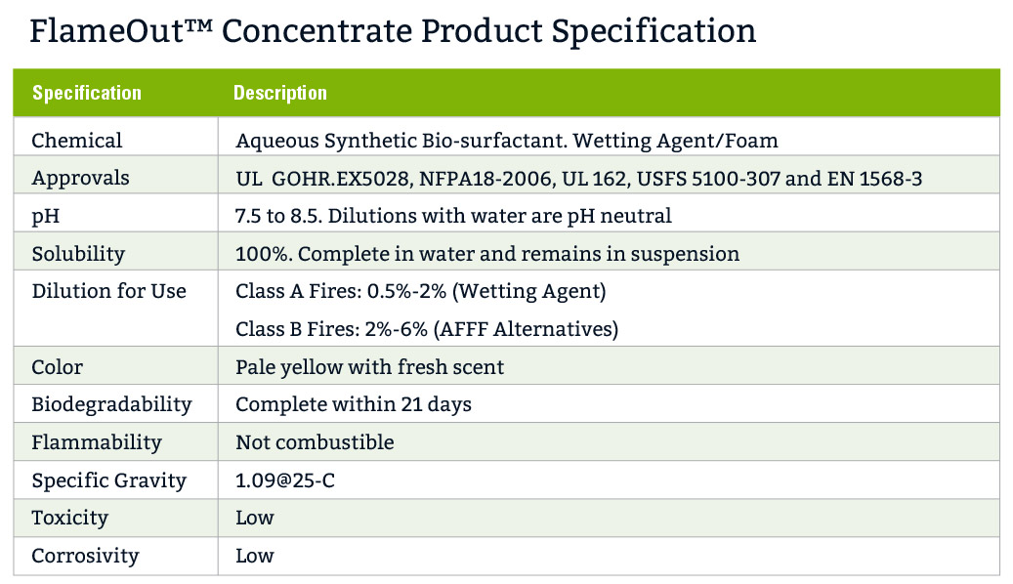

Slide 10
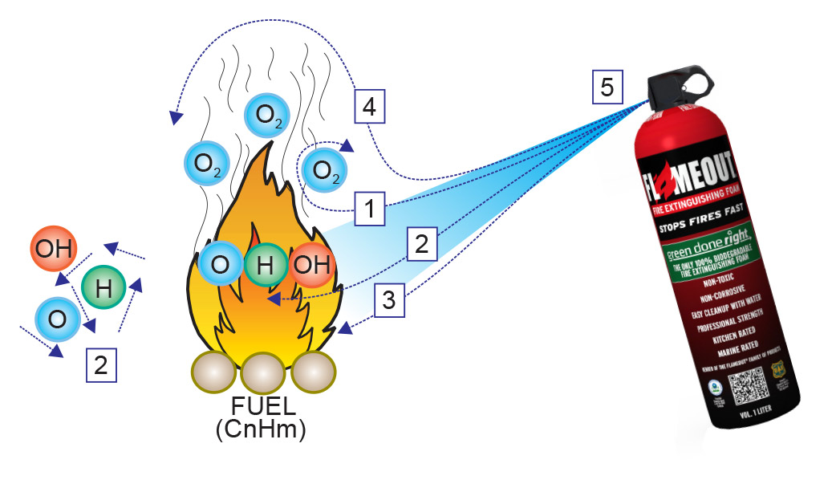
Flameout Breaks the Hydro Carbon String
Causing The Fuel Source to Become Inert

Slide 11
PURCHASES TO DATE
May not need th

Slide 12
PROJECTED SALES – tweak ##
Stores | Monthly Units | Annual Units | Gross Revenue
200 | 8 | 19,200 | $383,424
300 | 8 | 28,800 | $575,136
400 | 8 | 38,400 | $766,848
500 | 8 | 48,000 | $958,560
4233 | 8 | 406,368 | $8,115,169

Slide 13
Financial Metrics
Cost $
Retail $
40% Gross Margin

Slide 14
SUMMARY
FLAMEOUT fits XX commitment to Green.
Innovative design and unique packaging differentiates FLAMEOUT.
FLAMEOUT is a true game changer in fire safety.

