Slide 1
AMIRA & Innovation:
Past, Present & Future
Doug Magoon
8th Biennial Exploration Managers’ Conference March 2010
Yarra Valley
1
Notes:
To add another slide like this one, use duplicate slide under Edit heading.

Slide 2
Presentation Outline
The origin of AMIRA: the first innovation
What is the business of AMIRA?
Development of AMIRA
The benefits of collaboration
Innovations from the past projects
The geoscience portfolio
AMIRA International now
What’s coming
Global vision
Key challenges
Summary
2
Notes:
To add another slide like this one, use duplicate slide under Edit heading.

Slide 3

“Innovation”
OECD Definition*
Product , Process, Marketing & Organisational Innovation
… a good or service that is new or significantly improved. This includes significant improvements in technical specifications, components and materials, incorporated software, user friendliness or other functional characteristics.
… a new or significantly improved production or delivery method. This includes significant changes in techniques, equipment and/or software.
The process of innovation transforms an idea into a new, improved product, process or service. New technology is the visible expression of this.
3
* http://www.oecd.org/document/10/0,3343,en_2649_33723_40898954_1_1_1_1,00.html

Slide 4
The Australian Minerals Industries Research Association Limited
The first innovation
Drivers that led to the formation of A.M.I.R.A in 1959:
The need for a vehicle to look after industry’s interests in the newly formed national processing laboratory: AMDEL
The need for industry support of research in universities and government laboratories
4

Slide 5
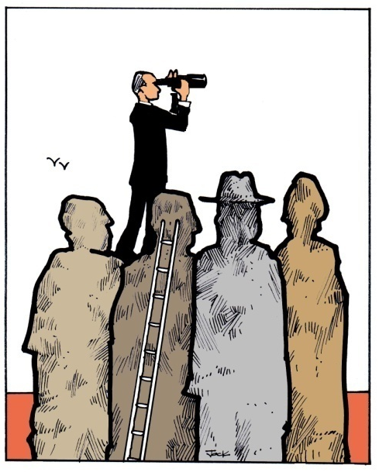
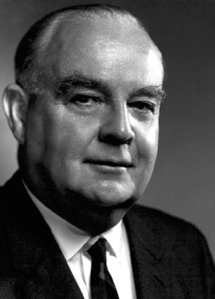
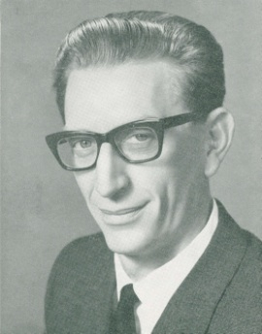
The Birth of A.M.I.R.A.
A.M.IR.A.’s founders had a broader vision for the organisation than just looking after their interests in AMDEL and that was:
“to promote and facilitate in every possible way a research and development service for promoting the development of mineral and associated industries of Australia or elsewhere”
Left to right - Sir Maurice Mawby – Inaugural Chairman of AMIRA 1959-72
Dr J C Nixon – Honorary Executive Officer from 1959 to 1968 and President from 1974 to 1979
5

Slide 6
The Birth of A.M.I.R.A.
Original company members of A.M.I.R.A.:
The Broken Hill Pty Co. Ltd
Colonial Sugar Refining Co. Ltd
Western Mining Corporation Limited
Mount Isa Mines Ltd
Imperial Chemical Industries of Australia and New Zealand
Electrolytic Zinc Co. of Australasia Ltd
Mary Kathleen Uranium Limited
Consolidated Zinc Pty Ltd
Cyanamid Australia Pty Ltd
Associated Pulp and Papers Mills Ltd
6

Slide 7
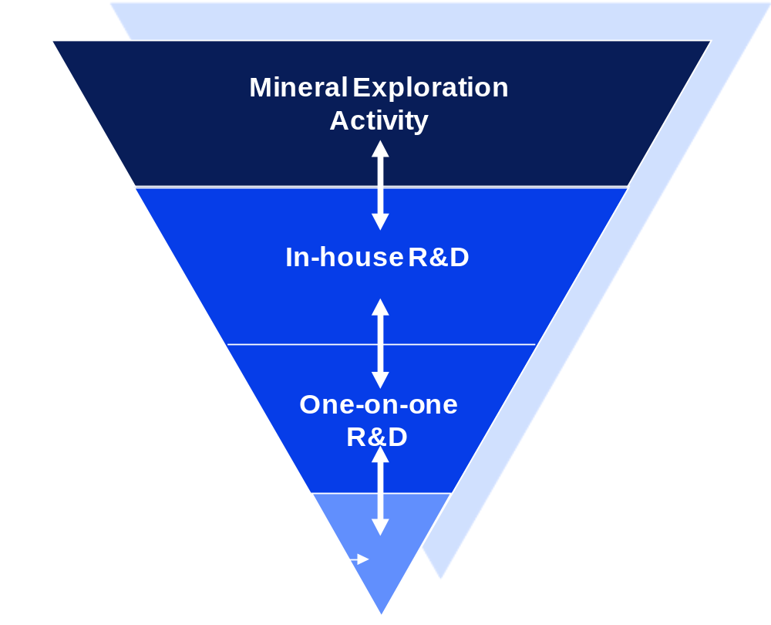
AMIRA’s niche
AMIRA is not in the R&D business
AMIRA is in the business of helping its members create value, R&D is a way of achieving this
7

Slide 8
Benefits of AMIRA Collaborative projects
Project outcomes
that focus on
industry problems /needs
Shared risks
& benefits
Provides
opportunities
for networking
Supports & sustains
local R&D
capacity & infrastructure
  A model for industry collaboration on R&D that individual companies may not have resources to undertake
  Access to significant leverage including supporting government grants
  Foster partnerships between local & international researchers
  High student participation rate in projects
  AMIRA process encourages proactive participation by companies in project identification and design
8

Slide 9



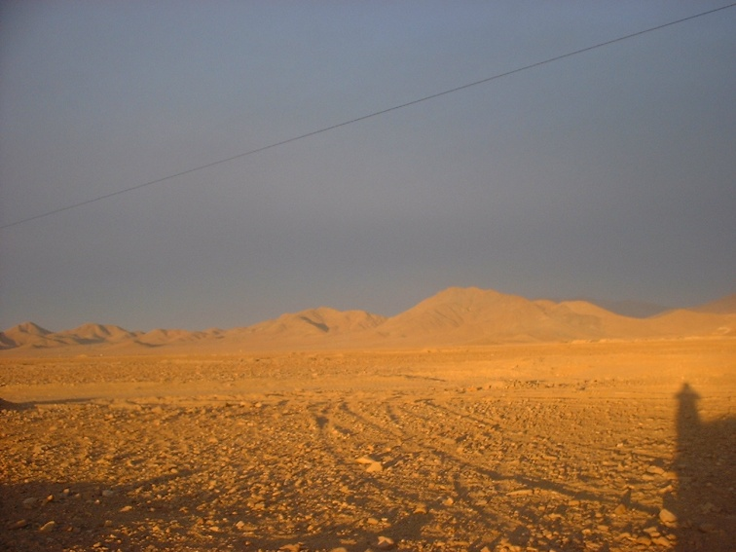
The evolution of AMIRA: exploration research
1950-1960’s
1970-1980s
1980-90’s
1990’s onwards
Granting
Selling
Marketing
Partnering
Global focus but with strong local presence
9

Slide 10
AMIRA’s Research Spend 1990-2009
10

Slide 11
Product & process innovations from AMIRA Projects
Computer assisted
learning
Automated mineralogical
logging of drill core,& chips
Non-toxic
- Heavy liquid
Multiphase meter for oil,
water & gas measurement
Understanding of
Magnetic & radiometric
properties of rocks & ores
Dry-stream
analyser
Thickener
Technology
X-ray fluorescence
spectroscopy
Image
processing
QEMxSEM
Fine particle
flotation
On stream
analysis
Regolith
geochemistry
JK LIFT
Non - destructive
wire rope testing
Sulfide mineral
flotation
JK SimMet &
JK SIM SAND
Solar energy air
conditioning
Remote sensing
In exploration
Mining
geomechanics
Mineral
processing
SIROTEM
PIMA- field portable
spectrometer
Cable bolting
Large axial
flow fans
Coal seam
analyser
Understanding of
Metamorphic
processes
Blasting
optimisation
Pb isotope
ratios technique
EM & IP modeling
&interpretation
Iron ore
classification
Baas Becking
laboratory
11

Slide 12
Geoscience Innovations Examples: I
THE REMOTE SENSING PROJECTS STREAM: 1977- 1996
Acceptance of Thematic Mapper
Remote Sensing Projects
Spectral Instrumentation
13 projects
Industry contribution ~$5.8M
CSIRO contribution ~$5.8M
in 2009$
Understanding of Spectral
Properties
Image Processing applied
to geophysics
Training
12

Slide 13
Geoscience Innovations Examples: II
THE EM/IP PROJECT STREAM: 1977- 1996
SIROTEM Technology
EM/IP Projects
Better Interpretation methods
19 projects
Total Industry contribution ~$7.9M
Hardware development ~$2.3M
Interp. methods & software ~$5.6M
2009$
Improved EM/IP modelling
and interpretation software
Better understanding of the
of the EM method
Training
13

Slide 14
Geoscience Innovations Examples: III
THE REGOLITH / LATERITE PROJECT STREAM: 1987- 1994
Better understanding of the mobility of Au in the regolith
Laterite Geochemistry
Projects
New geochemical
exploration tool
6 projects
Total Industry contribution ~$7.44M
2009$
Contributed to the
discovery of new gold mines
World leading research
capacity
Training
14

Slide 15
Geoscience Innovations Examples: IV
THE YILGARN PROJECT STREAM: 1995- 2007
Major reinterpretation of tectono-stratigraphic framework of Yilgarn Block
Yilgarn Eastern Goldfields
Projects
New regional controls
for Au, Ni, Cu/Pd/Zn
7 projects
Total Industry contribution >$3.6M
2009$
New geochron, geochem,
Isotopic & structural data
Later method application to WAXI project
15

Slide 16
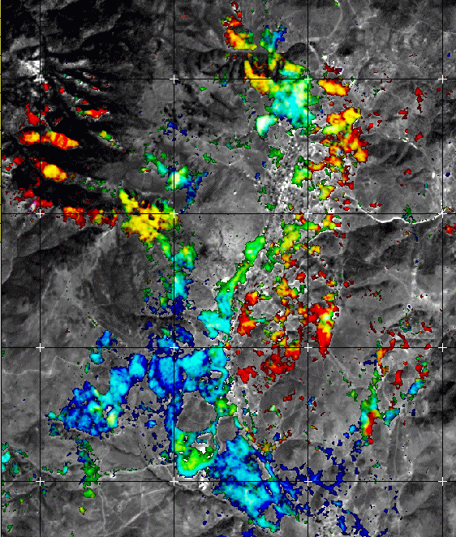
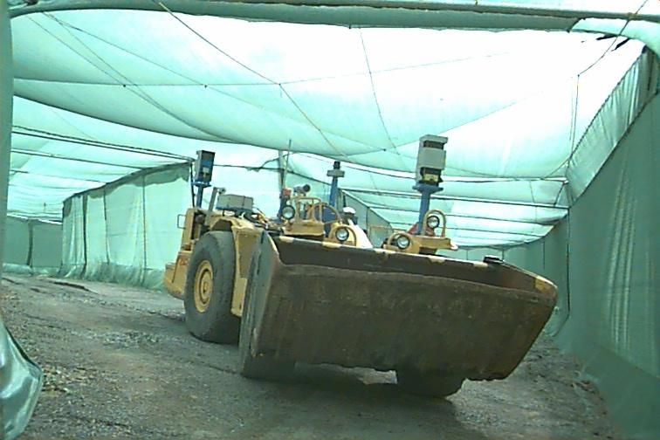
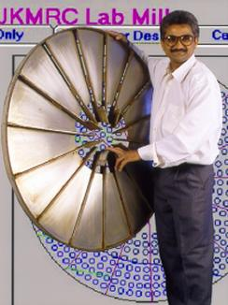
Innovations from AMIRA: a summary
Exploration
    Ground breaking research that has led to routine exploration applications in regolith geochemistry, image processing, mineral mapping, advanced EM modelling, ore deposits models and instrumentation
Mining
    Research in mine planning, geomechanics, blasting,
    equipment optimisation and automation
Mineral mapping: B Hobbs AMIRA Forum 2003
Vastly improved conductivity-depth imaging with layer boundary picking: Jim Macnae EMC 2005
Mineral Processing
    Development of many innovative technologies such as Dry-Stream Analyser for representative sampling & presentation of dry free-flowing material: QEMxSEM an automated quantitative system for the identification of mineral components; JkJetLift pulp lifters for removal of slurry for large grinding mills
    Pushed the envelope in the fundamental understanding of flotation, comminution and thickener technology which have significantly improved operational efficiencies.
LHD negotiating Y junction at artificial mine tunnel
A pilot scale version of JKJetLift which has improved mill throughput in Alcoa mills by 15% and has reduced capital costs
16

Slide 17
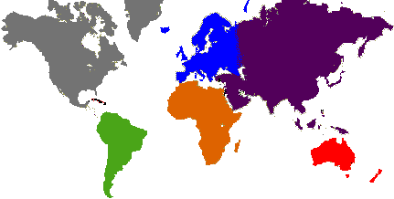
AMIRA: The last 10 years
2000’s ►
USA- 2008
RSA- 2001
CHILE- 2007
Corporatized - AMIRA International Limited
Deepened international links: Offices in 4 continents - subsidiaries in RSA, USA & Chile, with local representation
Increasingly addressing industry problems via multi-disciplinary and multi-institutional projects
Technology transfer a priority
17

Slide 18
AMIRA Geoscience Portfolio: a snapshot from the last 10 years
Regional Framework Studies
  West Africa Exploration Initiative (P934, P934)
  South China Craton (P950)
  Yilgarn (P437, P482, P624, P763, P710)
Technology / Technique Development
  Geophysics (P223F, P407B, P981)
  Geochemistry (P778, P710A, P972)
    Geochemistry in areas of transported cover
    ATR Mineral Chemistry Applied to the Characterization and Exploration of Andean type Cu ± Au Ore deposits
  Geometallurgy (P843, P843A)
Data Compilations & Roadmaps
  Data Metallogenica
  Australian Geoscience Thesis Database (P874)
  Copper Technology Roadmap (P813)
  Drilling Technology Roadmap (P903)
Ore Deposit Model Studies
  Epithermal & Porphyry Deposits (P765A)
  Sediment-hosted Copper Deposits (P872)
  Stress Transfer Modelling of Gold Deposits (P718A)
  Nickel Deposits (P710A, P962)
  Sediment-hosted Gold Deposits (P923)
  Diamond Indicator Minerals (P891)
18

Slide 19
AMIRA Geoscience Portfolio 1990-2009: industry research investment by project type
115 projects
~AU$62.7M in 2009$
19

Slide 20
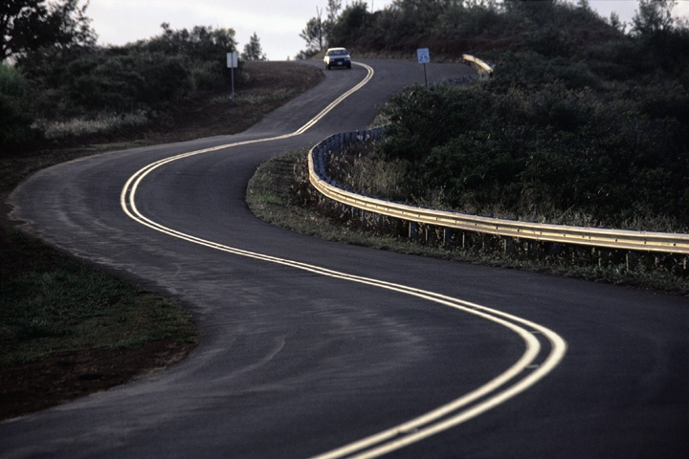
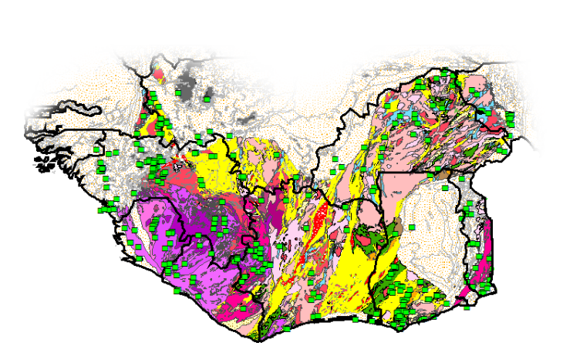
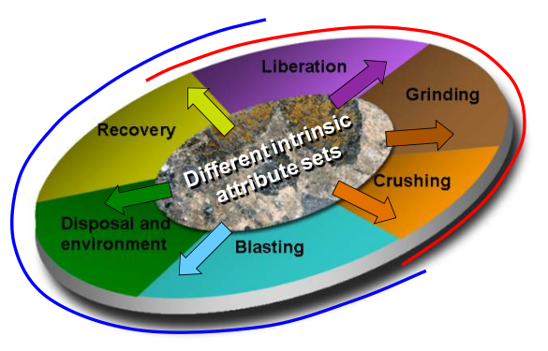
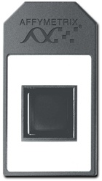
AMIRA continues to help industry
Roadmaps
  Aluminum Technology Roadmap
  Copper Technology Roadmap
  Drilling Technology Roadmap
CRCs
  pmd*CRC
  CSRP
  Deep Exploration Technologies
  cOREx
  New frontiers
  West African Exploration initiative
  Geometallurgy
  Geochemistry in areas of transported overburden
20

Slide 21
AMIRA International in 2010: At a glance
Members: 67 minerals industry explorers, producers and suppliers
Business model: Projects are sourced from multiple regions and then marketed via an international organisation regardless of where the project is developed.
Current portfolio: 34 projects worldwide (as of 30 Dec 09), covering : Geoscience, Mining Engineering, Mineral Processing & Extractive Metallurgy, and Sustainability
  Portfolio value: ~$80M (industry funds) as of 30 Dec 09 with ~$15-20M new projects started each year
  Research collaborators: 221 researchers from some 62 Institutions around the world
  Since its birth AMIRA has ‘managed’ over 1000 projects
21

Slide 22
AMIRA International: At a glance
22
As of 30 June 2009

Slide 23
What is coming at AMIRA?
Mineral processing & extractive metallurgy
Exploration
Mining
Sustainability
P778A - Predictive geochemistry in areas with transported overburden
P1036 - Airborne IP
P765B - Porphyry copper fertility and mineral chemistry
P1031 - Copper-Uranium deposits in central Africa an north Australia
P1029 - Computer aided geological interpretation
P1022 - Rapid inversion of TEM data
P1040 - Data Metallogenica – next generation
P1033 - New tools for underground open stoping
P1034 - Blasting on demand
P1037 - Optimisation of Stope Design and Stope Layout
P987 - ROES
P927 - Shaft compartments
P420D - Optimisation of precious metal leaching and recovery using cyanide
P260F - Influence of process mineralogy & pulp chemistry on flotation of fine & coarse materials
P541C - Increase flotation froth zone recovery
P1027 - CTR/flotation sensor
P780A - Flotation cell hydrodynamics
P931A - Erosion in Multiphase Flow
P1028 - Sustainability of sulphur rich residues
P1003 - Energy efficient liberation and grinding
23

Slide 24

AMIRA’s international vision
Sustainable
Operations
Our aim is to develop sustainable operations with decreased operating costs
Enhanced member links
Deepening relationships with members and ensuring responsiveness to their needs
Global Reach
Global reach into key major mining regions, fulfilling member company requirements through strategic alliances with network of the world’s best researchers through a ‘develop global, serve local’ strategy
Better Service
Delivery
Enhanced service delivery of collaborative research through optimal use of communication technology
24

Slide 25
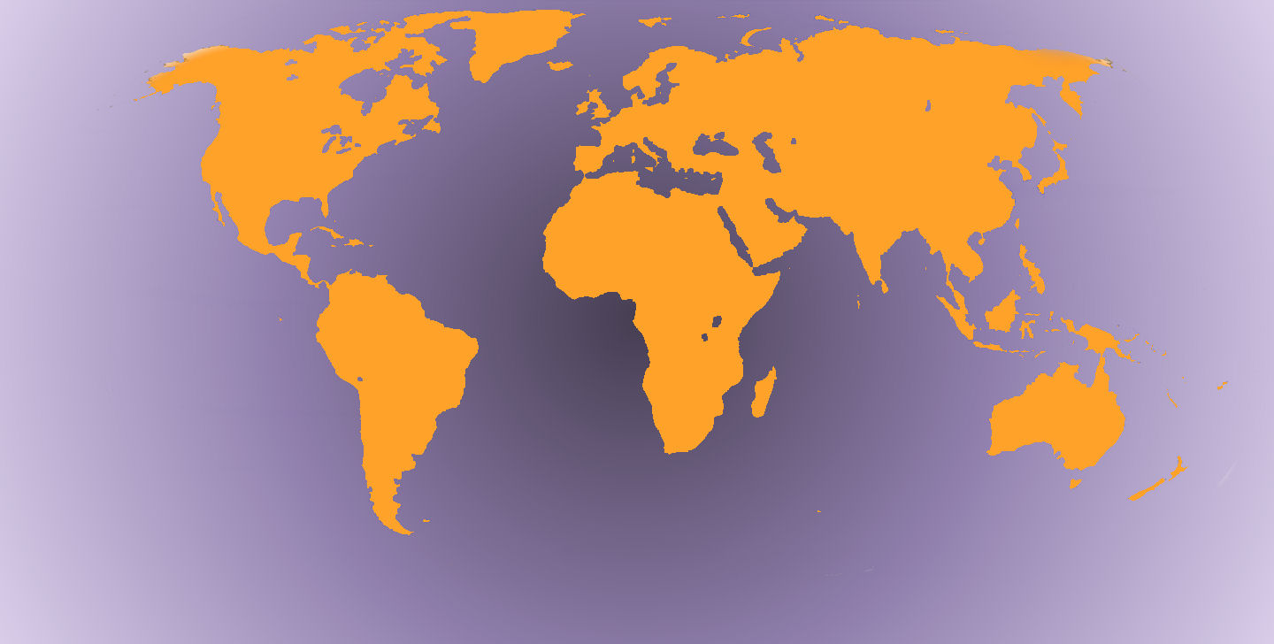
Global Service Delivery
AMIRA Offices
Countries with Research Providers
Countries with Sponsors/Members
25

Slide 26
AMIRA’s Challenges
Operating a global organisation effectively and sustainably, including in non-English speaking markets
Operating sustainably across the minerals value chain: balanced portfolio
Identifying ideas that address industry business needs (pre-competitive, global & local), with fast kill rates for non–compliant ideas
Developing and overseeing complex multi-disciplinary, multi-institutional projects
26

Slide 27
AMIRA’s Challenges
  Delivering to expectations in a distributed world: technology transfer & communications
  Improving strategic dialogue with senior personnel in companies and research institutions
  Considering alternative business models: do some markets require a different approach?
  Develop common understanding of strategy, processes and protocols across all staff
27

Slide 28
AMIRA’s Future
Building Relationships
  Nurturing and developing the global resources industry network for our members and the research community.
  Continue to work with world leading researchers in Australia
  Well positioned to work with the best researchers around the world
  Assist local capacity building in new markets through development of international partnerships with the best of the local researchers
Delivering Value
  Maximise the benefit of our services to all our stakeholders.
Success through People
  Ensuring attraction and retention of energetic talented people.
27
18

Slide 29
In Summary
The AMIRA model of syndicated collaborative R&D has successfully operated for 50 years
AMIRA has had a major influence in the development of a culture of collaboration in the Australian minerals industry
AMIRA has developed over 1000 projects over the years and many have led to innovative technologies that have become standard operating practice with major financial impact
Over recent times the AMIRA International model has been increasingly applied at the global level with the opening up offices in four continents and development of new projects and new research partnerships
29
Notes:
Modified this for November 2005 circumstances
Critical issue for all to understand but has to be repeated is that we are an association of members whose only purpose is to serve the interests of its members; not a separate profit driven company.

Slide 30
In Summary
The AMIRA model fosters win-win partnerships between researchers, industry and government funding agencies
The model also offers an important framework to train people, enhance R&D capacity and support infrastructure at the global & local levels
AMIRA’s support of the exploration sector through innovative projects continues : its continuing global focus ensures that member’s needs can be addressed through global research and/or local partnerships
AMIRA is honoured and proud to be your partner in the advancement of technology
30
Notes:
Modified this for November 2005 circumstances
Critical issue for all to understand but has to be repeated is that we are an association of members whose only purpose is to serve the interests of its members; not a separate profit driven company.

Slide 31
THANK YOU
31

