Slide 1


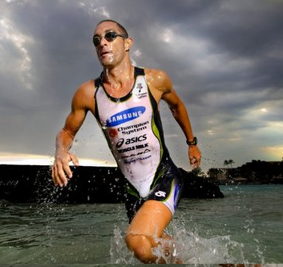




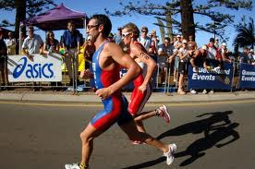
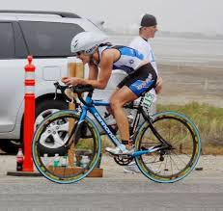
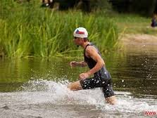
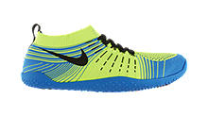
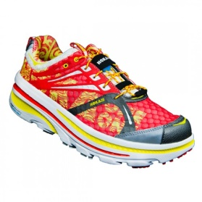
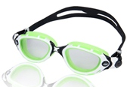
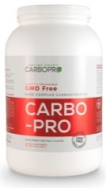





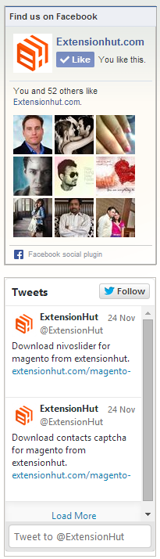


TOM FRANKS
My Athletes Find An Athlete About Athlete IQ
t v Ć ć
X
Athlete Page

 SHOP BY CATEGORY  YOUR CART 
all 
SEARCH

MIKE AUSTIN
San Diego, CA
PRIMARY SPORT: TRIATHLON
EVENTS: SPRINT, FULL IRONMAN
LEVEL: PRO
AGE GROUP: 30-39
TEAM: TRI-SMART TRIATHLON CLUB
BIO: Having changed his focus from short course to Ironman racing, Mike’s first Ironman win came in 2003 at the inaugural Ironman Coeur d’Alene. A follow-up victory came in 2006 on the shores of Tempe Town Lake, as Mike was crowned champion of Ironman Arizona. Notching several top-three Ironman finishes, and three ninth-place finishes at the Hawaii Ironman World Championship (2003, 2007, 2008)….
FULL BIO>
SUBSCRIBE TO MIKE AUSTIN
get updates and special offers
Recommendation Overlay
What Mike Uses (12 Recommended Products)
Product Page




Nike Free Hyperfill
by Nike
$180 $144.97
Hoka One One Kailua Trail
by Hoka One
$180 $144.97
Zoggs Predator Flex R
by Zogs
$180 $144.97
Carbo‑Pro Pure Complex Carbohydrates
by Carbo Pro
$180 $144.97
Recommended by
Recommended by
Recommended by
Recommended by
ADD TO CART
ADD TO CART
ADD TO CART
ADD TO CART
Expand down to see all products
BIO VITALS PERSONAL BESTS UPCOMMING RACES HOW TO ARTICLES
⋅
Mike Austin
 MIKE’S BIO
Looking back, the path I followed to arrive at where I stand today is not that of a typical aspiring athlete. As a child I was moderately active across the various sports offered in school and played a bit of recreational soccer during the summer. As I grew and my interests changed I gravitated towards video games and being with friends as most teenagers do. I took to the seemingly popular sedentary lifestyle, but this was of no concern as I was not interested in exercise or sport.
The cyclical nature of secondary school sports meant that I would spend October ? March training intensively, but would revert back to an almost sedentary lifestyle over the summer months. Initially this did not bother me, but as I progressed through school I needed something to fill this void. In the summer of 2005 a few friends from the swim team had decided that they were going to do a triathlon in the next town over. This piqued my interest for a few reasons: it was something to do to pass the time, there was a competitive aspect to it, and my friends were all racing. I wanted to do the race myself, but I did not own any type of bike at the time. Instead, I swam the 3km open water swim. I was, however, able to observe the race and see what triathlon was all about.
VITALS
Mike Austin
Tweet to @MikeAustin
Follow me on Facebook
MIKE AUSTIN
Mike Austin

Slide 2
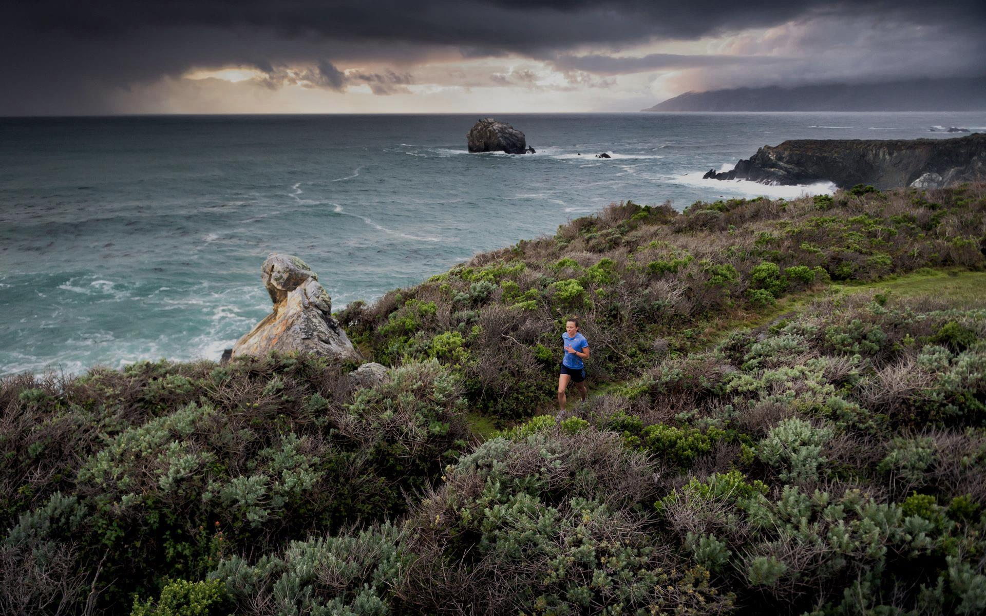
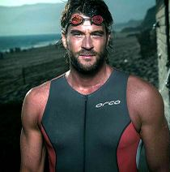
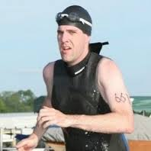

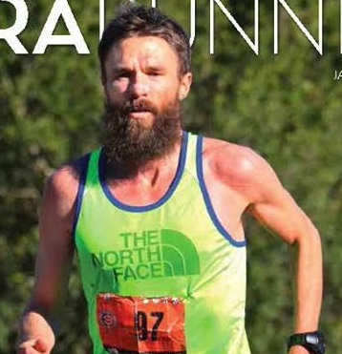
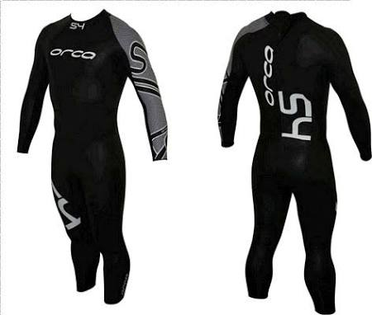
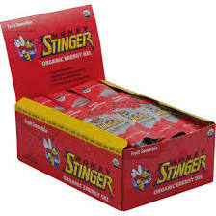
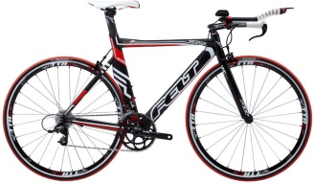





Home page – logged in
TOM FRANKS
My Athletes Find An Athlete About Athlete IQ
t v Ć ć
X

MY ATHLETES
 SHOP BY CATEGORY  YOUR CART 







all 
SEARCH

Athlete
Sport
Nutrition
Gear
Shoes
Clothing
Brand
ROTATING HERO BANNER – 1 of 4
1 – member promo
2 – athlete spotlight
3 – featured review
4 – member spotlight
View Your Cart
0 items $0.00
MY ATHELTES
SEARCH ATHLETES 




MATT SMITH
Pro Triathlete | á 280 Subscribers
LOUIS BOUDREAULT
Pro Triathlete | á 90 Subscribers
MIKE AUSTIN
Triathlon | á 200 Subscribers
ROB KRAR
Ultra- Marathon á 200 Subscribers
 25 Recommendations
 21 Recommendations
 18 Recommendations
 16 Recommendations
 Subscribed
 Subscribed
 Subscribed
 Subscribed
Expand to see all athletes
TOP RECOMMENDATIONS
SEARCH PRODUCTS 




Orca S4 Triathlon Wetsuit
by Hoka One
$180 $144.97
Honey Stinger
Organic Energy Gels
Honey Stinger
$180 $144.97
Felt S22 2012
by Nike
$180 $144.97
Carbo‑Pro Pure Complex Carbohydrates
by Nike
$180 $144.97
Recommended by
Recommended by
Recommended by
Recommended by
ADD TO CART
ADD TO CART
ADD TO CART
ADD TO CART
CONNECT WITH ATHLETE IQ
Keep up to date with Athlete IQ for recommendations
from top athletes and industry insights!
ATHLETE IQ NEWSLETTER SIGNUP
INFORMATION
Search Athletes
Search Recommendations
Sports Categories
Membership Rewards
Become a Member
Privacy Policy
Athlete Inquiry
Brand Inquiry
Contact Us
Your Email
SUBSCRIBE

Slide 3
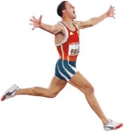
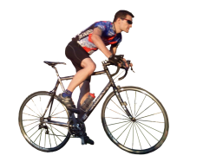
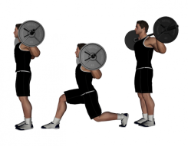
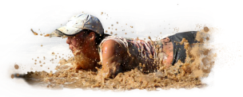
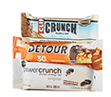
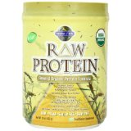
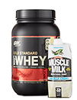
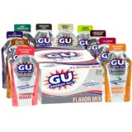
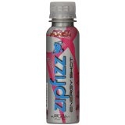
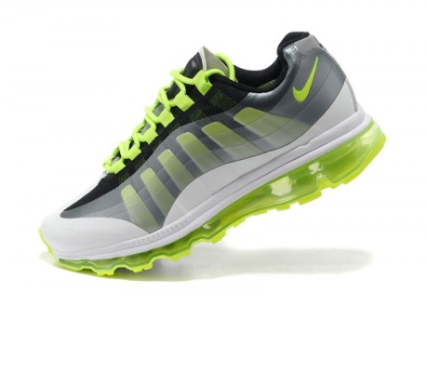
TOM FRANKS
My Athletes Find An Athlete About Athlete IQ
t v Ć ć
X

MY ATHLETES
 SHOP BY CATEGORY  YOUR CART 







all 
SEARCH

Athlete
Sport
Nutrition
Gear
Shoes
Clothing
Brand
SELECT YOUR SPORT
View Your Cart
0 items $0.00
RUNNING
TRAITHLON
CROSSFIT
OCR
 SHOP BY CATEGORY  YOUR CART 







all 
SEARCH

Athlete
Sport
Nutrition
Gear
Shoes
Clothing
Brand
SHOP BY NUTRITION
Athlete Recommendations
BARS 23
CHEWS AND GELS 31
PROTEIN 12
DRINKS 14
SUPPLEMENTS 25
 SHOP BY CATEGORY  YOUR CART 







all 
SEARCH

Athlete
Sport
Nutrition
Gear
Shoes
Clothing
Brand
SHOES
MEN'S SHOES
Running
Track & Field
Trail Running
Cross-Training
Bike
Crossfit
OCR
Socks
WOMEN'S SHOES
Running
Track & Field
Trail Running
Cross-Training
Bike
Crossfit
OCR
Socks

Slide 4
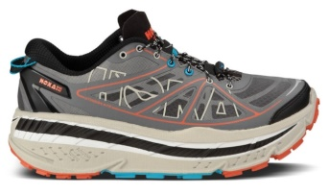
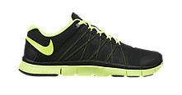
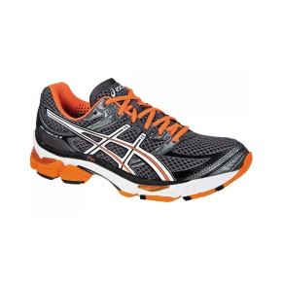
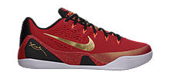




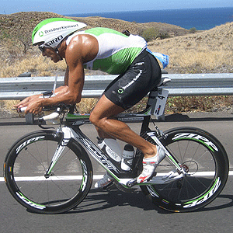
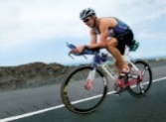
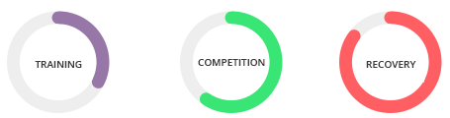

TOM FRANKS
My Athletes Find An Athlete About Athlete IQ
t v Ć ć
X

 SHOP BY CATEGORY  YOUR CART 
Product Search
all 
SEARCH

150 PRODUCTS
30 RECOMMENDATIONS
SPORT +
CATEGORY +
PRICE
Under $25
$25 to $50
$50 to $100
$100 to $200
$200 & Above
Brand
ASICS
Crocs
Converse
New Balance
Skechers
Keen
MY ATHLETES +
SUB CATEGORIES +



ATHLETE RECOMMENDED COMMUNITY APPROVED PRICE $-$$ PRICE $$-$ VIEW ALL
⋅
Running X
Shoes X
Hoka One One Men's M Stinson Atr Running Shoe
by Hoka One
$180 $144.97
Nike Free Hyperfill
by Nike
$180 $144.97
Nike Free Hyperfill
by Nike
$180 $144.97
Recommended by
Recommended by
Recommended by
ADD TO CART
ADD TO CART
ADD TO CART
ADD TO CART
ADD TO CART
5 Recommendations
Hoka One One Men's M Stinson Atr Running Shoe
by Hoka One
$180 $144.97
3 Recommendations
Nike Free Trainer 3.0
by Nike
$180 $144.97
Product Page
SEARCH BY
ATHLETE
ASICS Men's Gel-Cumulus 16 Lite-Show Running Shoe
by ASICS
$109.45 - $139.97
Nike Trial Extreme
by Nike
$180 $144.97
Subscribed athletes
ADD TO CART
ADD TO CART
Click

MATT SMITH  Pro Triathlete | á 280 Subscribers
Have been riding Felt for 5 years. Love it!”
June 17, 2014
Athlete Page
WHY
“I've been riding my trusty my bike for the past two, almost three years. I'm not a BAD climber, but I'm not a good one either. I'm best on rolling courses with power climbs.”
HOW
“I usually stay seated on my bike through there to save energy and because the bike felt so slow and hard to get moving when I'd stand up there. Not so with the Evolver! “
WHEN
“I rode this bike (shout out to Masakazu Tsuboi!) in training for half a week before taking the victory in both the 10 and 8 hour team enduros at the Matrix Suzuka Enduro.”
IN USE
Advice Helpful?
Yes | No
YES
NO
Share:

Slide 5
TOM FRANKS
My Athletes Find An Athlete About Athlete IQ
t v Ć ć
X

 SHOP BY CATEGORY  YOUR CART 
Product Search
all 
SEARCH

150 PRODUCTS
30 RECOMMENDATIONS
SPORT +
CATEGORY +
PRICE
Under $25
$25 to $50
$50 to $100
$100 to $200
$200 & Above
Brand
ASICS
Crocs
Converse
New Balance
Skechers
Keen
MY ATHLETES +
SUB CATEGORIES +



ATHLETE RECOMMENDED COMMUNITY APPROVED PRICE $-$$ PRICE $$-$ VIEW ALL
⋅
Running X
Shoes X
Hoka One One Men's M Stinson Atr Running Shoe
by Hoka One
$180 $144.97
Nike Free Hyperfill
by Nike
$180 $144.97
Nike Free Hyperfill
by Nike
$180 $144.97
Recommended by
Recommended by
Recommended by
ADD TO CART
ADD TO CART
ADD TO CART
ADD TO CART
ADD TO CART
5 Recommendations
Hoka One One Men's M Stinson Atr Running Shoe
by Hoka One
$180 $144.97
3 Recommendations
Nike Free Trainer 3.0
by Nike
$180 $144.97
Product Page
SEARCH BY
ATHLETE
ASICS Men's Gel-Cumulus 16 Lite-Show Running Shoe
by ASICS
$109.45 - $139.97
Nike Trial Extreme
by Nike
$180 $144.97
Subscribed athletes
ADD TO CART
ADD TO CART
Click

MATT SMITH  Pro Triathlete | á 280 Subscribers
Have been riding Felt for 5 years. Love it!”
June 17, 2014
Athlete Page
WHY
“I've been riding my trusty my bike for the past two, almost three years. I'm not a BAD climber, but I'm not a good one either. I'm best on rolling courses with power climbs.”
HOW
“I usually stay seated on my bike through there to save energy and because the bike felt so slow and hard to get moving when I'd stand up there. Not so with the Evolver! “
WHEN
“I rode this bike (shout out to Masakazu Tsuboi!) in training for half a week before taking the victory in both the 10 and 8 hour team enduros at the Matrix Suzuka Enduro.”
IN USE
Advice Helpful?
Yes | No
YES
NO
Share:

Slide 6
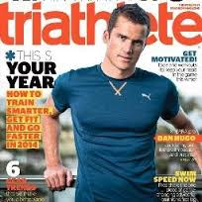
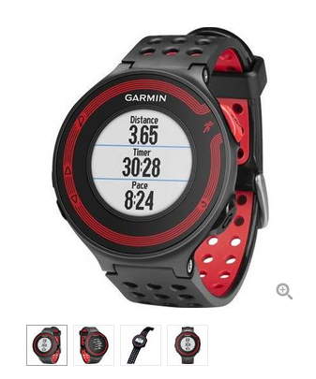



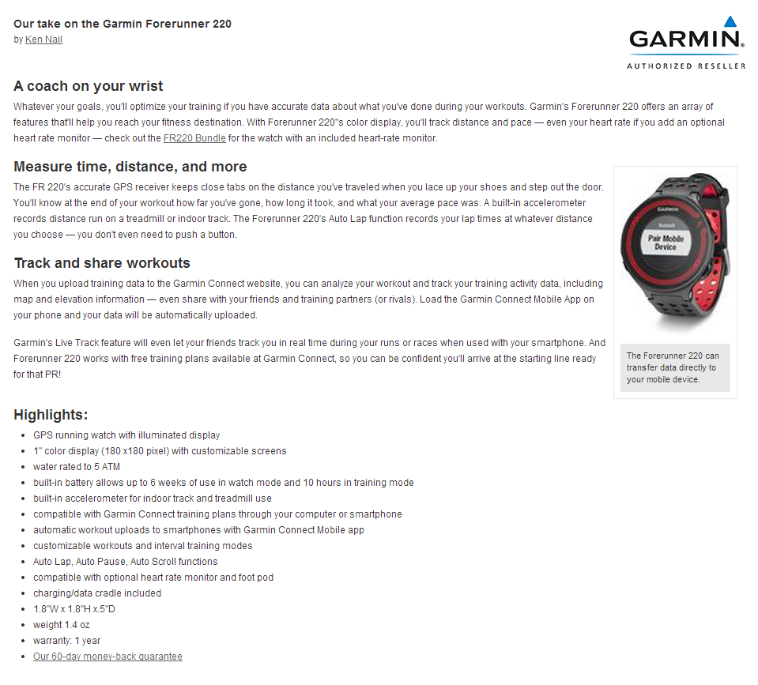
Product Page – from athlete page
TOM FRANKS
My Athletes Find An Athlete About Athlete IQ
t v Ć ć
X

 SHOP BY CATEGORY  YOUR CART 
all 
SEARCH

Recommended by
SAM BLOCH
Pro Triathlete
”Have been using the Garmin Forerunner 220 for 5 years. Love it!”
June 17, 2013
Also Recommended by (5)

GARMIN FORERUNNER 220 - RUNNING GPS WATCH - 1" 180 X 180
GARMIN
$324 $249
ATTRIBUTE 1 
ATTRIBUTE 2 
ADD TO CART
Recommendation overlay
Sam Bloch Also Recommends These Products (14)




Nike Free Hyperfill
by Nike
$180 $144.97
Hoka One One Kailua Trail
by Hoka One
$180 $144.97
Zoggs Predator Flex R
by Zogs
$180 $144.97
Carbo‑Pro Pure Complex Carbohydrates
by Carbo Pro
$180 $144.97
Recommended by
Recommended by
Recommended by
Recommended by
ADD TO CART
ADD TO CART
ADD TO CART
ADD TO CART
Product Page
PRODUCT OVERVIEW PRODUCT REVIEWS (3)
⋅
Recommendation overlay
Review Extension

Slide 7
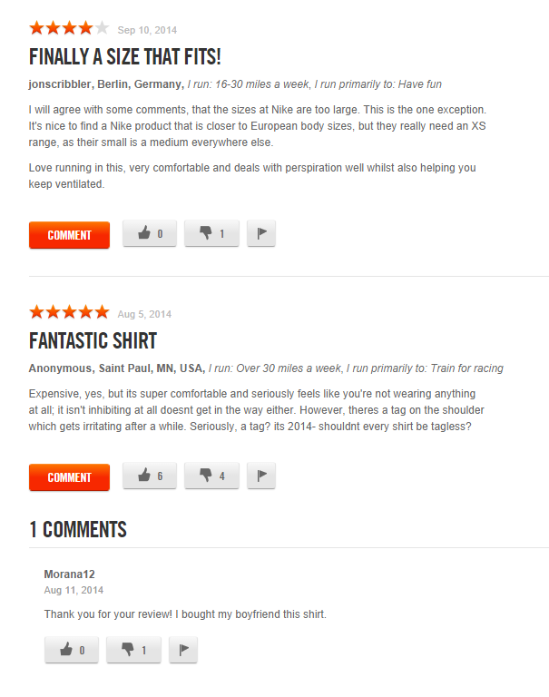

Product Page – with reviews
TOM FRANKS
My Athletes Find An Athlete About Athlete IQ
t v Ć ć
X

 SHOP BY CATEGORY  YOUR CART 
all 
SEARCH

Recommended by
SAM BLOCH
Pro Triathlete
”Have been using the Garmin Forerunner 220 for 5 years. Love it!”
June 17, 2013
Also Recommended by (5)

GARMIN FORERUNNER 220 - RUNNING GPS WATCH - 1" 180 X 180
GARMIN
$324 $249
ATTRIBUTE 1 
ATTRIBUTE 2 
ADD TO CART
Recommendation overlay
Sam Bloch Also Recommends These Products (14)




Nike Free Hyperfill
by Nike
$180 $144.97
Hoka One One Kailua Trail
by Hoka One
$180 $144.97
Zoggs Predator Flex R
by Zogs
$180 $144.97
Carbo‑Pro Pure Complex Carbohydrates
by Carbo Pro
$180 $144.97
Recommended by
Recommended by
Recommended by
Recommended by
ADD TO CART
ADD TO CART
ADD TO CART
ADD TO CART
PRODUCT OVERVIEW PRODUCT REVIEWS (3)
⋅
ADD YOUR REVIEW
ATHLETE
IQ
Expert
ATHLETE
IQ
Guru

Slide 8
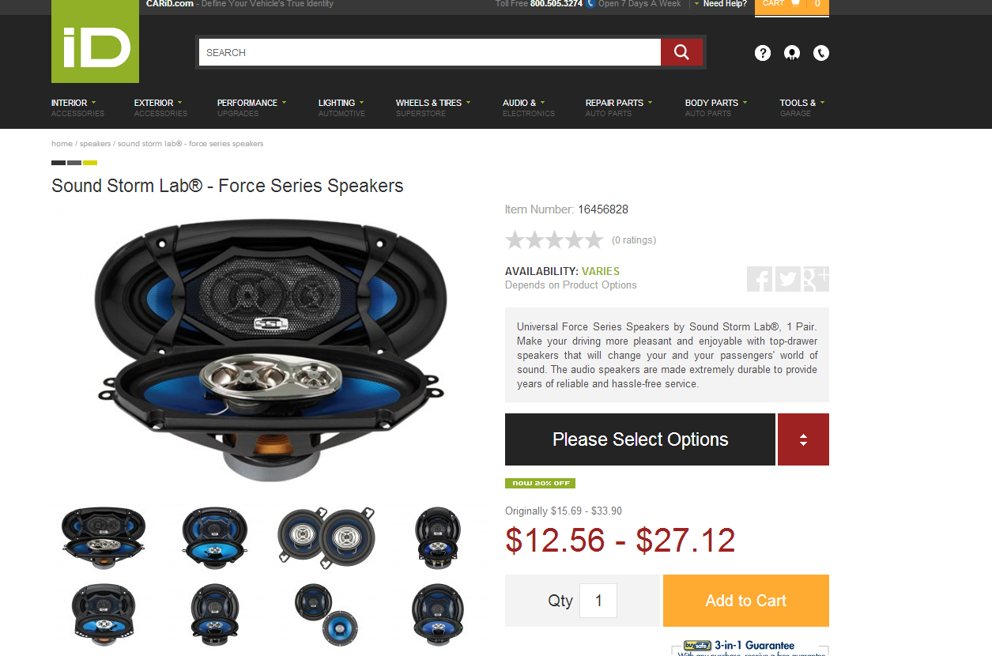

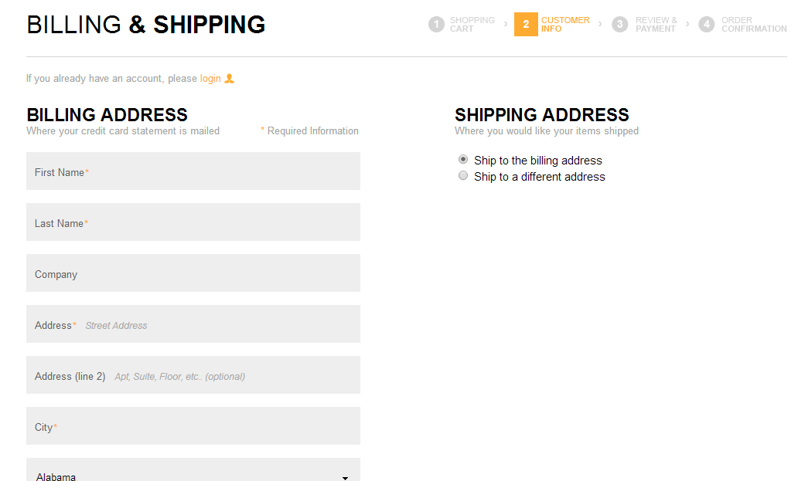



Member Registration
REGISTER WITH ATHLETE IQ
COMPLETE YOUR PROFILE AND EARN YOUR FIRST 25 ATHLETE IQ POINTS
PROFILE PICTURE
YOUR PROFILE
First Name*
Last Name*
New Password*
New Password Again*
REPLACE AVATAR
Country*
⋅
YOUR ACTION PICTURES
Primary Sport*
⋅
COMPLETE REGIESTRATION

Your Sports Action Picture
Complete your profile to boost your Athlete IQ score and qualify for programs and free products!
Level
⋅
GET TO KNOW THE ATHELTE IQ COMMUNITY
Age Group
⋅
Gender
⋅
Your Next Event
Bio
You must agree to the Terms of Service AND our Privacy Policy before enrolling in membership.
I have read and agree to Athlete IQ’s Terms and Conditions
I have read and agree to Athlete IQ’s Privacy Policy
SAVE CHANGES

Slide 9
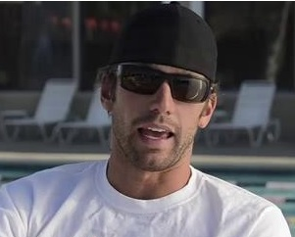

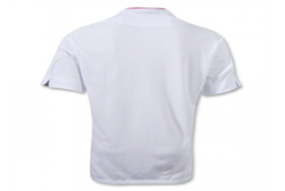
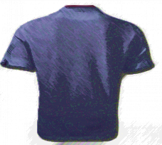
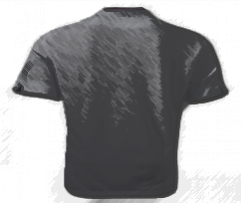
Member Portal
TOM FRANKS
ATHELTE IQ ACCOUNT
X

YOUR PROFILE
YOUR ATHLETE IQ SCORE
34
Points
YOUR ATHELTE IQ BADGE
TOM FRANKS
ATHLETE
IQ
ATHLETE
IQ
ATHLETE
IQ
ATHLETE
IQ
PRIMARY SPORT: TRIATHLON
LEVEL: PRO
AGE GROUP: 30-39
GENDER : MALE
BIO: BIO
Athlete IQ Member
< 150 IQ Points
Athlete IQ Contributor
> 150 IQ Points
Athlete IQ Expert
>500 IQ Points
Athlete IQ
Genius
>1000 IQ Points
EARN POINTS & BADGES
Boost your Athlete IQ score and qualify for programs!
Increase your Athlete IQ Score and you’ll soon be eligible for programs.
EDIT PROFILE



1 Point
Rate recommendations as helpful
10

20
BRAND PROGRAMS
POINTS
POINTS

5 Points
Product Reviews
15 Open Programs
Rating Recommendations
as Helpful
Search and Rate >>
Subscribing to
Athletes (up to 10)
Search Athletes >>
VIEW PROGRAMS

2 Points
Subscribe to athletes


50
30
☞
10 Points
Complete your profile
POINTS
POINTS
Writing a
Product Review
Search Products >>
Social Share of Recommendations
Search and Share >>

3 Points
Sharing Recommendations on Twitter and Facebook
☞

50
15
POINTS
POINTS
Completing
Your Profile
View Profile >>
Tagging a Product
You Use
Search Products >>


◆

10
75
POINTS
POINTS
Sharing Athlete IQ Link with Friend
Share Now >>
Your Friend Signs Up
on Athlete IQ

