Slide 1
Task
Task 1: 1 Large Signboard (horizontal) 2768x975mm
Task 2: 1 Large poster signboard (vertical) – provide 2 different designs using same concept of 3 stacked cups 1450x1730mm n 1450x1595mm
Task 3: 6 wooden panels (consisting of 3 menu board, 3 photo board) 660x670mm

Slide 2
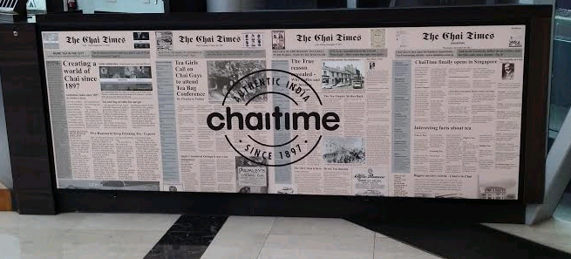

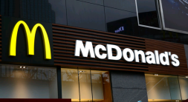
Task 1: Simple Large Poster
Sorry, no dimensions, but wanted to create something like the yellow cup to fit here. Exact same panel that will be replaced (chaitime board)
We want a simple design for this panel. Somewhat mirroring McDonalds signage. Pictures have been provided.
Note that we want this exact cup to be used. (traced out and put to a nice black background, we not asking to make a logo) And Fonts to be like adidas or starbucks font. Perhaps use all Caps. Pls provide the traced out cup so that we can edit if needed.
Task: 1. Trace out Cup
2. Help find a nice textured background that’s black. Or all black
If titanium black, or like AMEX centurion cards. We want it to make it feel expensive.
3. Make the panel to replace that chaitime

Slide 3
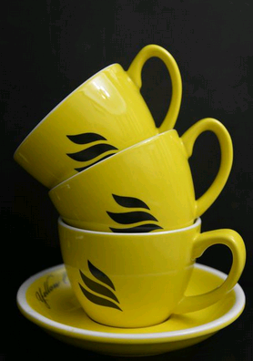
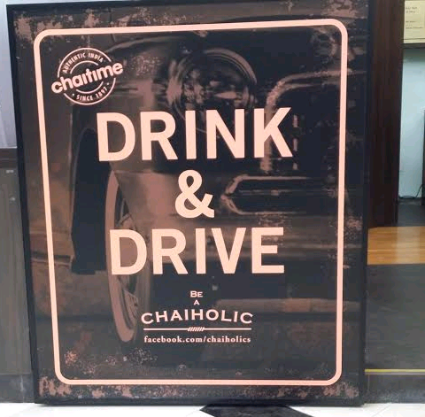
Task: Big Signboard Poster (same dimension as left pic). Use right picture and design alittle nicer the positioning
Task 2: Large Poster 2

Slide 4
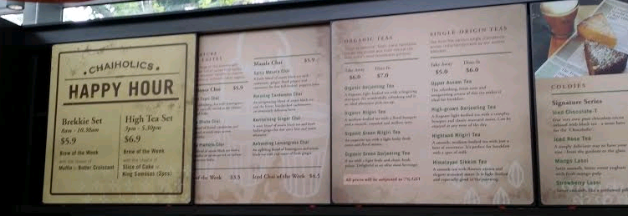
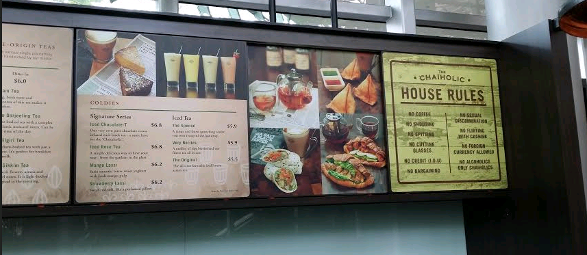
Task 3: 6 Panels: 3 Menu, 3 Photos
We are replacing these 6 boards with photos and menu provided.
Task: to help make the photo fit nicely with minor touch ups. (make nice frame or something, reposition image on stage)
Also, help to re-create the menu. (see next page)

Slide 5

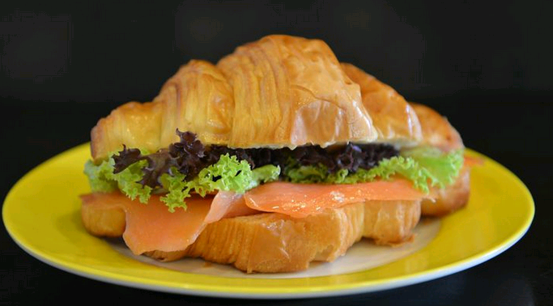
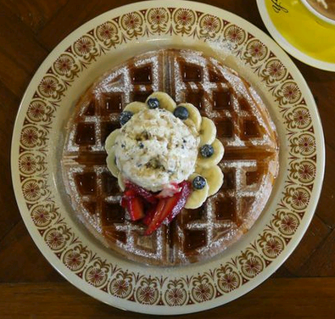
3 pictures for 3 different panel boards
All Black background Theme. Please add frame border if its nicer.
Task 3: 6 Panels: 3 Menu, 3 Photos

Slide 6
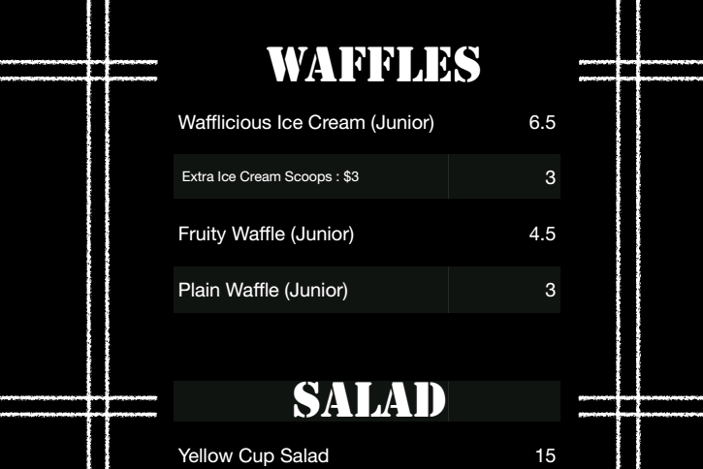
Menu Task: Help recreate the menu file. To 3 boards that is same size as the 3 menu board in the previous slide. Sorry actual size still unknown. Not yet measured by contractor. Could you provide editable file also so that we can change the menu prices in future.
Task 3: 6 Panels: 3 Menu, 3 Photos
Please help to remove that number 3 too.

