Slide 1
John & Jane Doe
Financial Review
July 22, 2014
Niall C. Murphy, CFP, CLU, CHFC
John C. Murphy, CFP
Certified Financial Planners
Notes:
Introductory Page

Slide 2
Common Lifecycle Periods
Lifecycle Periods | Age | Financial Profile
Early Career | 25 – 40 | Debts: Mortgage, etc.
Mid-career | 40 – 50 | Debt Elimination
Accumulation | 50 – 60 | Peak Savings Period
Pre-retirement | 60- 65 | Retirement & Estate Planning
Retirement | Age 65+ | Health and Lifestyle Changes

Slide 3
Financial Planning Process
1
Clarify Your
Present
Situation
2
Identify
Financial &
Personal Goals
3
Identify
Financial
Problems
4
Create a
Written Plan
& Strategies
5
Implement
Strategies &
Solutions
6
Ongoing
Review &
Revision

Slide 4
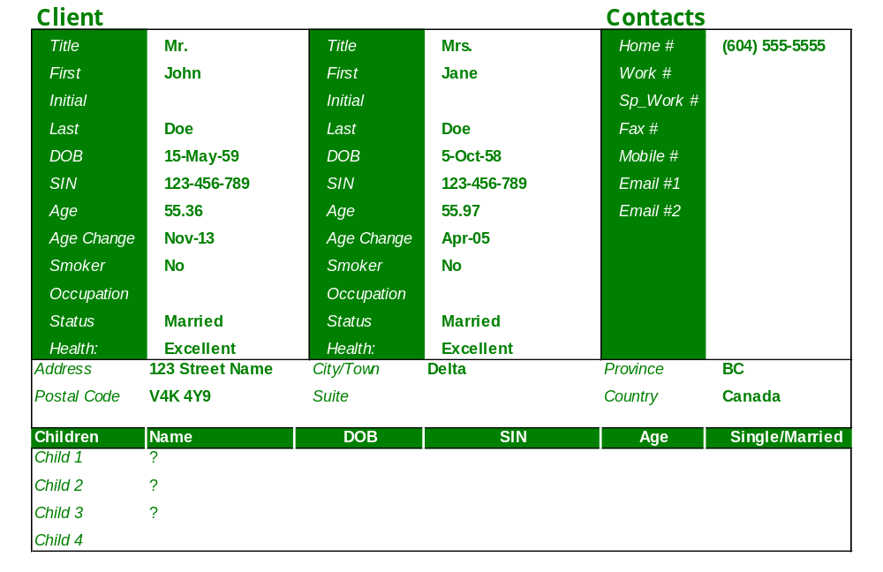
Personal Information

Slide 5
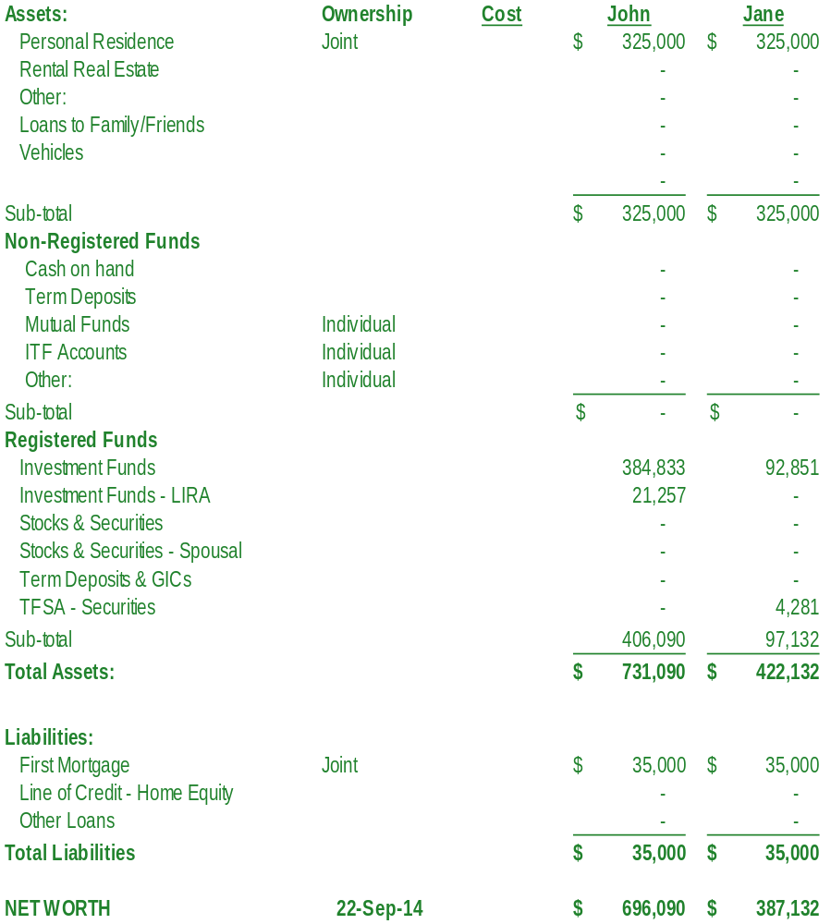
Balance Sheet

Slide 6
Goals & Objectives
Jane to retire at Age 58
John to retire at Age 62
Monthly Income at Retirement of $7,000.00 in Today’s Dollars
Maintain Current Lifestyle in Retirement
Portfolio Management

Slide 7
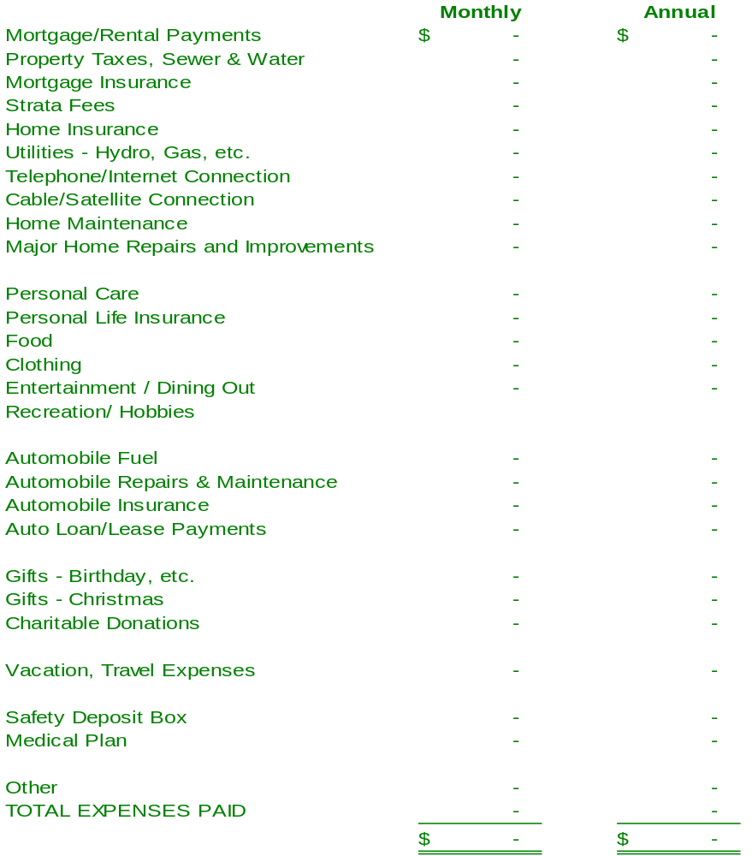
Lifestyle Expenses - Current

Slide 8
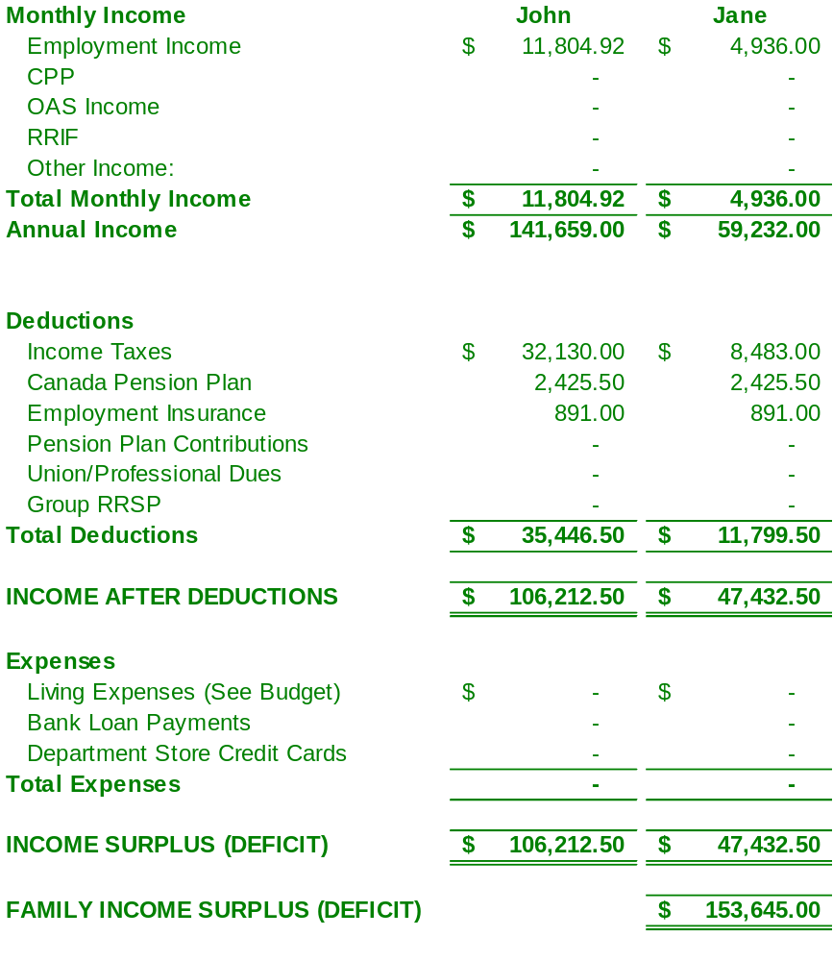
Income & Expenses - Current

Slide 9
Life Expectancy
Age | Male Life Expectancy | Female Life Expectancy
Age 65 | 19.20 Years | 22.00 Years
Age 75 | 11.15 Years | 13.54 Years
Age 85 | 6.35 Years | 7.49 Years
Life Expectancy is increased arbitrarily to Age 90. Therefore by retiring at age 65 you will need sufficient capital to fund your retirement for 25 years
Source: Statistics Canada

Slide 10
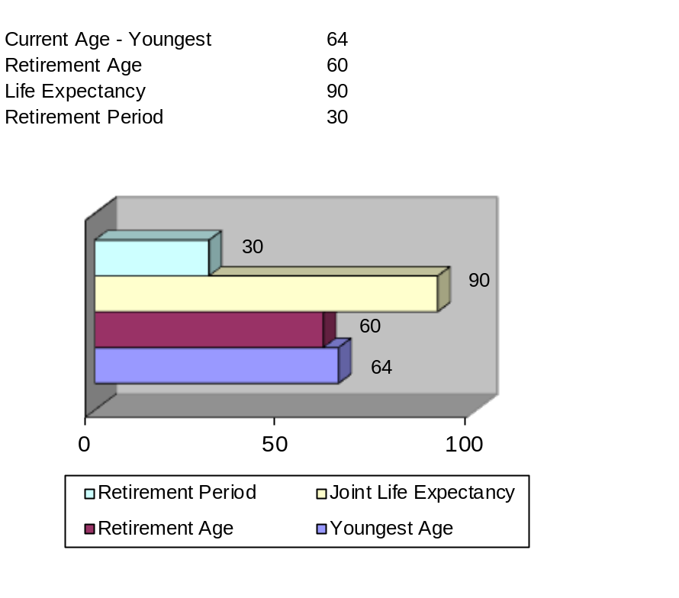
Timeline

Slide 11
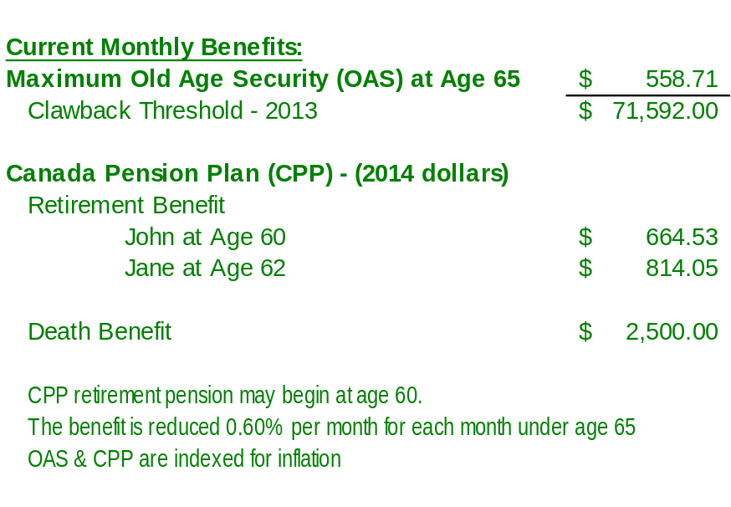
Government Benefits

Slide 12
Pension Projections

Slide 13
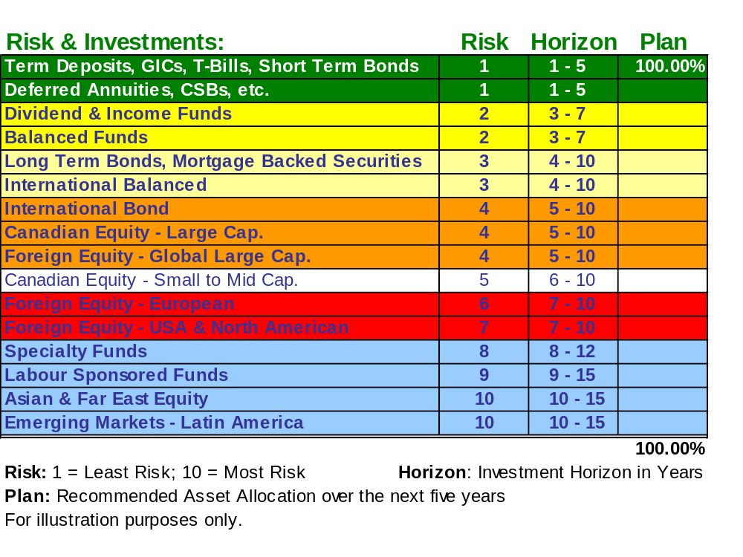
Investment Planning

Slide 14
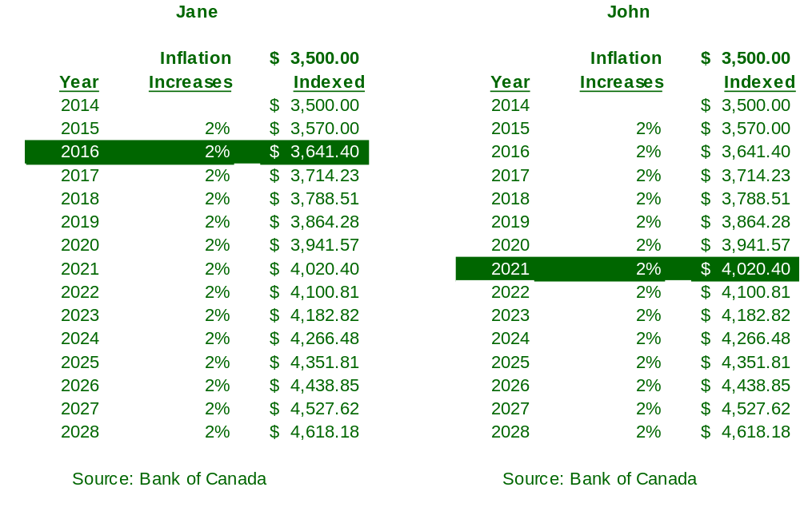
Inflation – Cost of Living

Slide 15
Plan Recommendations
Immediate Action –
No Later Than 90 Days
1 -
2 -
3 -
4 -
5 -

Slide 16
Plan Recommendations
For Your Consideration:
  1 –
  2 –
  3 –

Slide 17
Review & Ongoing Discussion
Review Plan at Least Once a Year
Monitor the Consumer Price Index (CPI) to avoid inflation problems.

Slide 18
