Slide 1
Site Map
Home page
Pricing
Product
About
Documentation
Blog
Company
News
Careers
Contact Us
Support
Renegade Description
White Papers
Clients
Dashboard Login
FAQ
Privacy Policy
Terms of Service
Partners
Program Overview
Partner List

Slide 2



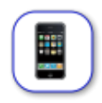
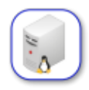
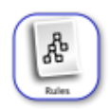
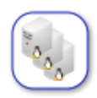

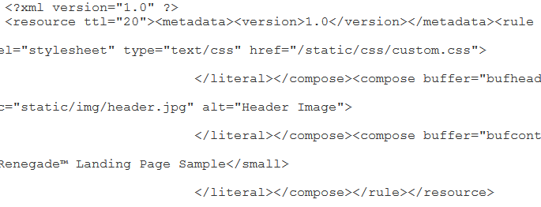









Documentation Pricing Support Contact Us Log In
You Build Cool Websites
and Web Applications
We help you to make them perform SCREAMINGLY fast
Need to find appropriate image for this area
Get Started with Renegade
What is Renegade?
Renegade is an edge-based content delivery platform for developers that provides an easy way to boost the speed and performance of your website and cloud applications. Renegade is fully programmable, scales dynamically and you can integrate it into your current environment with minimal changes. Find out more here.
Purpose Built Performance & Flexibility
Page Load Acceleration
Automatic Scaling
Rules-Based Programming language
Specialized Mobilization Transcoding
Edge Based Content Reassembly
Need better icons
Renegade can deliver up to 10X Speed Improvement with just six lines of code.
Need better graphic
Worldwide Reach
Renegade is highly customizable and can be directed to retrieve content from one or more original sites - then optimizes it, repackages it, accelerates it, and delivers it worldwide by using automatically scalable servers located in 8 different globally distributed data centers.
O
r
i
g
i
n
a
Simple Pricing Model
Renegade’s pricing approach is straight forward. You won’t need a slide rule to figure it out. You pay for traffic and hits that your incur. That’s it. Find out more here.
l
Si
te
Renegade
Renegade
Renegade
Renegade
Renegade
Renegade
Renegade
Renegade
Renegade
Renegade
“We were simply blown away by the power of this platform.”
Joe Smith, CXO Jeanswest
About Us Contact News Blog Partners Terms of Service Privacy Policy
Newsletter
Email Address
subscribe .
© Copyright 2012, Modapt

