Slide 1
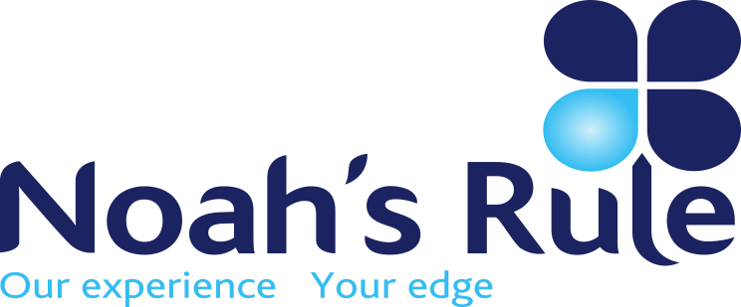

What is Noah’s Rule?
“Predicting rain doesn’t count; building arks does”.
Whatever the
Financial
Forecast…
It pays to
be prepared!
FINANCIAL RISK ADVISORY
DEBT & FUNDING
MARKET RISK
ACTIVE ENGAGEMENT

Slide 2
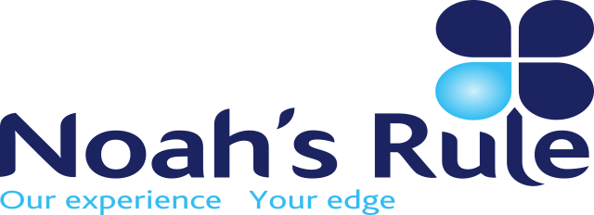
YOU CAN’T OUTSOURCE YOUR RISK,
BUT YOU CAN INSOURCE EXPERTISE
WHO IS NOAH’S RULE?
A team of independent, passionate risk advisors with over 200 years combined experience in financial market risk management, funding & debt advisory.
WHAT CAN WE DO FOR YOU?
We partner with clients to gain a deep understanding of their needs. We then help them solve their risk and funding issues by creating and explaining sustainable treasury policy.
Debt Advisory
Design & Execution of debt funding strategies.
Market Risk Advisory
Design & Execution of hedging strategies
Active Engagement
Fully engaged risk review, reporting, strategy development and execution enhancement.
WHAT IS OUR MEASURE OF SUCCESS?
Our only true measure of success is successful, sustainable clients that stand out from their peers.
INTEGRATION OF MARKET RISK STRATEGY & CORPORATE STRATEGY IS ESSENTIAL
WHAT IT MEANS FOR OUR CLIENTS
Our market experience means our clients receive well considered, completely independent advice and solutions covering:
Commodities
Foreign Exchange
Interest Rates
Project Finance
Treasury Software Solutions
Market Valuations incl. CVA / DVA
Hedge Effectiveness Testing
Compliance Reporting
OUR PRINCIPLES
Aspire to always deliver value to our clients.
Always provide frank, robust advice.
Be fierce but commercial client advocates.
WHAT’S OUR PHILOSOPHY?
Markets are dynamic, so proper Risk Management must also be a dynamic and on-going process. Risk Management is not about “beating the market”, its about “not taking a beating” from adverse market conditions.
When your bottom line is exposed to volatile markets, appropriate preparation is the key to a sustainable business. We help our clients to integrate their risk management objectives with their overall corporate strategy.

