Slide 1


Marketplace Interviews
Interviews with Global Leaders of the Real Estate Profession
2014 / 2015

Slide 2





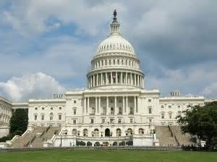


Interviews with Real Estate Icons
Five Market Segment Series 2014 / 15
  Developers and Builders
  Financial Service Providers
  Legal Practitioners and Scholars
  Brokerage and Technology
  Public Sector
Twenty Four Annual Interviews
  Produced bi-weekly
  Content adjusted to market events

Slide 3
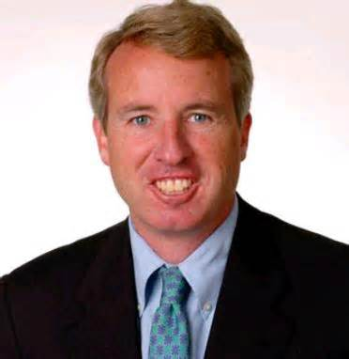
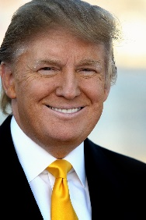

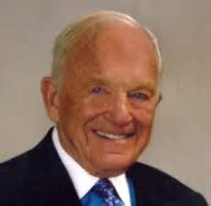
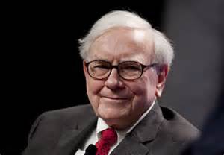
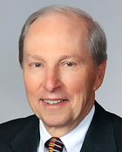
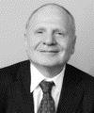
2014 / 2015 – Interview Target Highlights
Christopher G. Kennedy – Chairman Joseph P. Kennedy
Donald Trump – Chairman / President – Trump Organization
John Buck – President – John Buck Company
Marshall Bennett – President – Marshall Bennett Enterprises
Warren Buffet – Chairman – Berkshire Hathaway
Richard S. Mesirow – Vice Chairman – Mesirow Financial
Harry Huzenis – JRG Capital (Co-Founder Jameson Realty)

Slide 4






Interview Subjects – Content - Process
Who’s who of real estate
  Candidate criteria
  Highly selective
Relevant and timely issues
  Real time market data
  Market Trends
  Professional insights
  Private and Public Sector
Conducted on location
  Reporter on-location
  Professional reporting and editing

Slide 5

Interview Candidate Selection Criterion
Must have a significant or unique contribution to the real estate profession
  Private sector
  Public sector
Topic areas
  Development or construction
  Financial services
  Law
  Brokerage
  Academics

Slide 6

Ellen Bremseth – Press Coordinator
  On Camera Host and Personality
    The Frontier – Chicago, IL
    MusikBeats, Miami, FL
    SpinKitchen, Chicago, IL
    Experienced production and on-camera interviewing
    Berklee College of Music – Boston MA

Slide 7



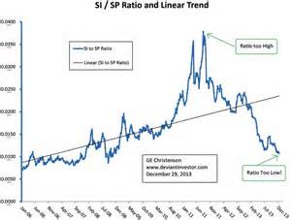
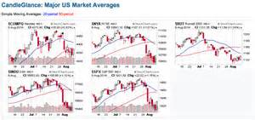



Distribution
On Line Distribution
  24 / 7 viewing availability
  Tracking views
Delivered directly to over 100,000 real estate professionals weekly
  Targeted electronic promotional campaign at time of interview release
  Weekly delivery includes National Real Estate indices

Slide 8
Pre – November 1, 2014 – Sponsorship Opportunities
Gold Sponsor - $25,000 (before November 1, 2014) - $100,000 (After November 1, 2014)
  Single sponsor for six videos in 2014 / 2015
  Single company logo appears on Flash report for six weeks
  National on-line campaign – six weeks
Silver Sponsor - $12,000(before November 1, 2014) - $48,000 (After November 1, 2014)
  Shared sponsor for three videos in 2014 / 2015
  Shared sponsorship logos appears on Flash report for two weeks
  National on-line campaign – three weeks
Bronze Sponsor - $1,500 (before November 1, 2014) - $6,000 (After November 1, 2014)
  Up to eights sponsor for one video in 2014 / 2015
  Logos appears on Flash report for one weeks
  National on-line campaign – one week

Slide 9
Contact Information
RealtyMetrix, LLC
564 W. Randolph Street, Suite 200
Chicago, IL 60661
(866) 662-7638
www.realtymertix.com

