Slide 1
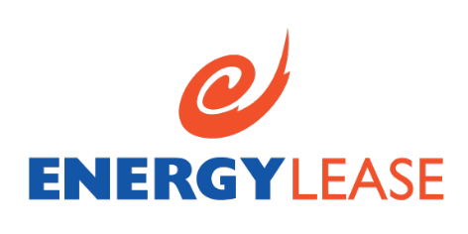
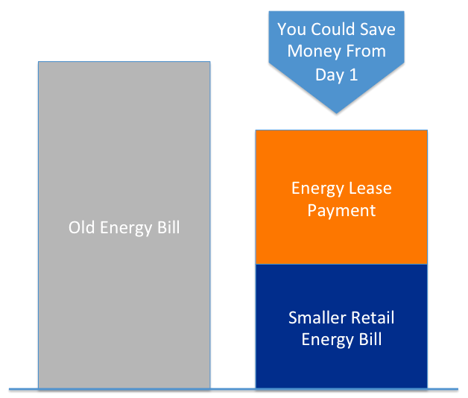
Our finance solution explained
$0 upfront
Immediate savings on your electricity bills
Energy cost of between 18-25 cents per kWh
Power payments may be fully deductible
Installer logo
What is a PPA?
A major reason why many businesses don’t install energy saving equipment on their premises is due to the large upfront cost of the solutions themselves.
So we’ve teamed up with industry specialist Energy Lease to provide our customers with an alternative. We can install a complete Solar solution at no cost to you. You then purchase the power produced by the system from Energy Lease instead of the electricity grid. We can usually give you a price that is lower than the electricity grid to save you money immediately.
The Benefits
No deposit (Includes installation & design)
Immediate savings on your bills
Flexible terms up to 15 years
Instant approval (subject to credit criteria)
Power payments may be fully tax deductible
Option to buy at the end of PPA
Installation and manufacturing warranties (Up to 25 years for Solar PV systems)
How does it work?
PAY VIA SAVINGS GENERATED
Once installed, your lower retail energy bill plus your new solar power payment is in most cases less than your old electricity bill.
You pay for the power your system produces. It’s like paying your usual energy bill, only cheaper.
This way you can often start saving from the first day your system is installed.
So you can now get the benefits of reduced electricity bills for $0 upfront. ​
There are no costs to up front, so get started today!

Slide 2

LOAN VS POWER PURCHASE Agreement
 | Bank (loan) | Power Purchase Agreement
$0 upfront | x Deposit usually required | No deposit required. Just like any other power contract.
Fully deductible repayments | x | Solar power payments are usually fully deductible. Check with your accountant.
Low Doc application | Possibly | No financials for less than $50k (ex GST)
Light security levels | x Business/home assets as collateral against loans | Energy efficient & solar equipment as only security (personal guarantee may be required)
Operations and maintenance | x
Monitoring and fault detection | x
FAQs
Who is Energy Lease? Energy Lease is backed by a number of domestic and international financial institutions. The Energy Lease team possess deep skills in finance, environmental markets, strategy, marketing and sales. We have over ten years experience.
Who is Eligible? To be eligible you must:
Have been in business for over 3 years
Own your property or have a remaining lease term of at least 3 years
Fees and Charges : $250 application fee (payable with first power payment)
When do power payments start? Power payments start once the system is installed and starts producing power (and your energy bill savings start).
What products are eligible
Solar Power Systems including solar generation and storage
What if the system doesn’t work? Power payments depend on the output of your solar systems so we have as much incentive as you to make sure it is working properly. Power payments are an ongoing obligation, even if you do not use the power produced.
Early termination. Fees & charges may apply If you terminate your Power Purchase Agreement early. This depends on the number of power payments remaining & any amounts outstanding at the time of termination. See Agreement for further details.
More questions – call us 1300 795 695
All applications to Energy Lease Pty. Ltd. are subject to normal approval criteria, and terms and conditions apply. No part of this document is to be construed as an offer capable of acceptance or as a solicitation to obtain a financial product. The information is not an expression of opinion or recommendation and does not constitute financial, accounting, taxation, general or personal advice and should not be relied upon as such. The recipient should make its own assessment of any product or service referred to in this document and seek appropriate advice.

