Slide 1
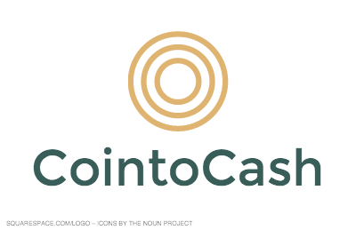
By: Jonathan T. Palan

Slide 2
Overview
Digital Wallet
Line of Credit
Debit Card
Scalable technology
Lower transaction costs
First mover advantage
Global Opportunity

Slide 3
Opportunity
Bitcoin rich, cash poor
Selling Bitcoins for cash is expensive
  Wide Bid/Ask Spreads
  High transaction costs
Significant opportunity cost
  Give away upside in BTC price
No operating leverage
  Inverse relationship between fiat currency/BTC

Slide 4
Solution
Leverages BTC as collateral
+ relationship between BTC and cash
Secured line of credit
CointoCash Debit Card
Operating leverage
Global access to local currency

Slide 5


Cash vs. Coin Relationship
Current Relationship
Buy BTC with Fiat
Sell BTC for Fiat
Greater BTC Holdings
Operatling leverage
Potential Relationship

Slide 6
Market Size
$9.5b
Market Value of BTC
13 million
BTC in circulation
96k
Daily BTC transactions

Slide 7
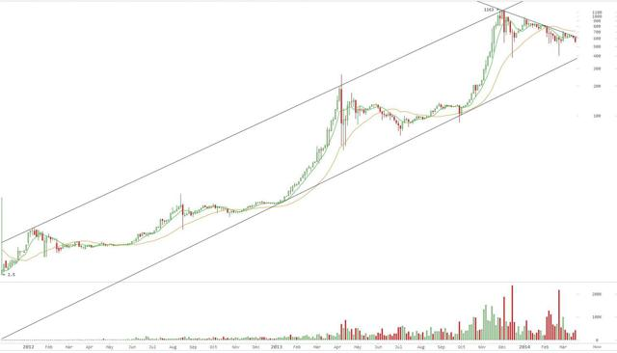
Adoption Rate
Trends point to mass adoption

Slide 8
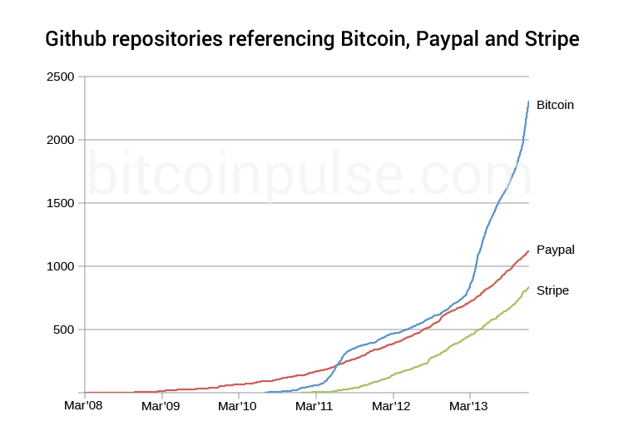
Higher Rate of Innovation

Slide 9
Revenue Model
Origination Fee
4% Origination Fee
Taken upfront from line of credit
Servicing Fee
1% annualized
Taken monthly out of collateral
Annual % Rate
14% Annualized Percentage Rate
Payment taken out of collateral or ACH
Interchange Fees
Market interchange rate
Debit Card Transactions

Slide 10

Competition
Secured line of credit
Unsecured Loan
Installment Loan
Takes weeks to fund
Loan is in BTC
Revolving Line of Credit
Instant access to cash
Line of credit in local currency

Slide 11

CointoCash vs. Others
Digital Wallet | x | x | x
> Purchasing Power | x |  | x
Debit Card |  | x | x
Access to local currency |  |  | x

Slide 12
Customer Acquisition
Organic Channels
Online marketing
Social Media
Digital Wallets
API Integration
Xapo
Crypto Exchanges
API Integration
Kraken
Blockchain
BTC-E
Affiliate Programs

Slide 13
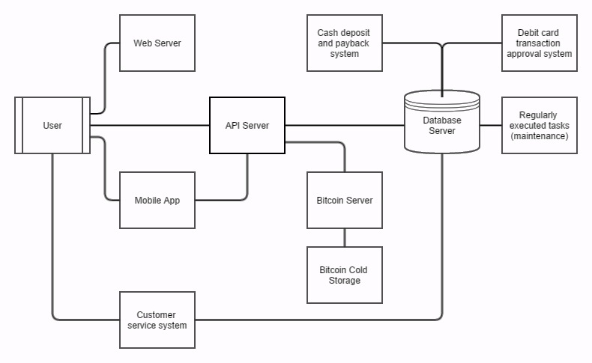
CointoCash Engine

Slide 14
Operational Overview
Consumer
4% Origination Fee
Interchange Fees
Debit Card
BTC Collateral
Line of Credit
14% APR
5:1 Ratio
Escrow
20% Advance Rate

Slide 15
Features
Cash credit for BTC
Global access to local currency
Lower transaction costs
Lower opportunity costs
> Purchasing power
First mover advantage

