Slide 1
Logos I like

Slide 2


Clean and crisp. I like the green and I like the tree motif. The font is classic
Another classic font. Good color, Gryphon/pheonix sends the classical message

Slide 3

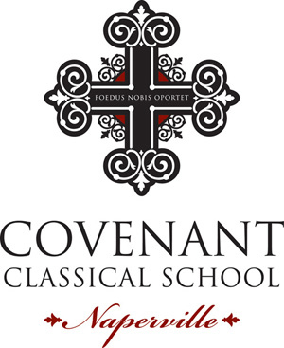
Like the darker green. Like the tree motif (with roots). Probably too wordy for a logo. Don’t like that the logo and font are so integrated (hard to use the logo separately)
Classic font. Like the incorporation of Latin.
Irish-style cross is clean and sends a good vibe. Don’t like the Naperville font…

Slide 4

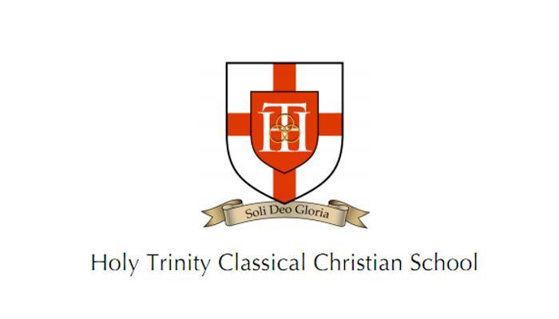
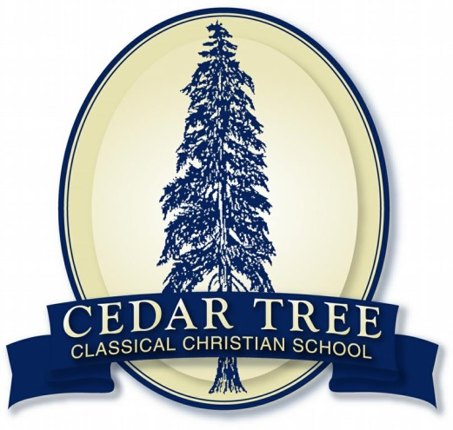
Don’t love this one but plus is that the logo works well as a “stamp” (embossing stuff)
Don’t love the color scheme or the font but is one of the cleaner “shield” logo examples (most others are too busy)
Obviously, I like the tree motif…

Slide 5

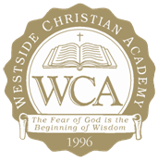
Simple, Irish-style cross. Logo and font are separate which is convenient
Don’t really like this one but I like the “Fear of God…” quote

Slide 6

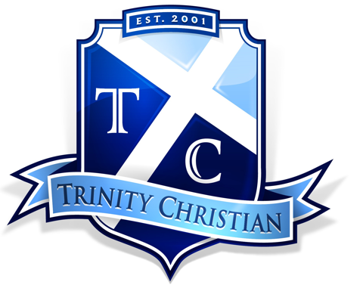
Maybe too modern but not horrible
Don’t like the color scheme but another fairly clean “shield” motif.

Slide 7



Simple and creative with the ichthus in between the D and C. I could see us doing something creative like this with the letters CLC somehow
Obviously, I like these darker green colors for logos. They come off well. This is a well done logo all around in my book. A play on BriarCREST while incorporating the cross

Slide 8
Other logo keys/ideas
Dark green and grey are good colors
Could also do navy, light blue and white (sailing colors)
Like the idea of tree and crest/shield motifs
Like clean, classic looking fonts
Could do some kind of motif to denote Clear Lake (anchor, lake, water, sailboat, etc)
Like the idea of an anchor somehow incorporated in the logo
Could do something clever with CLC letters and the symmetry there: Cl
Might even be able to make an anchor out of the CLC letters somehow.
C

Slide 9
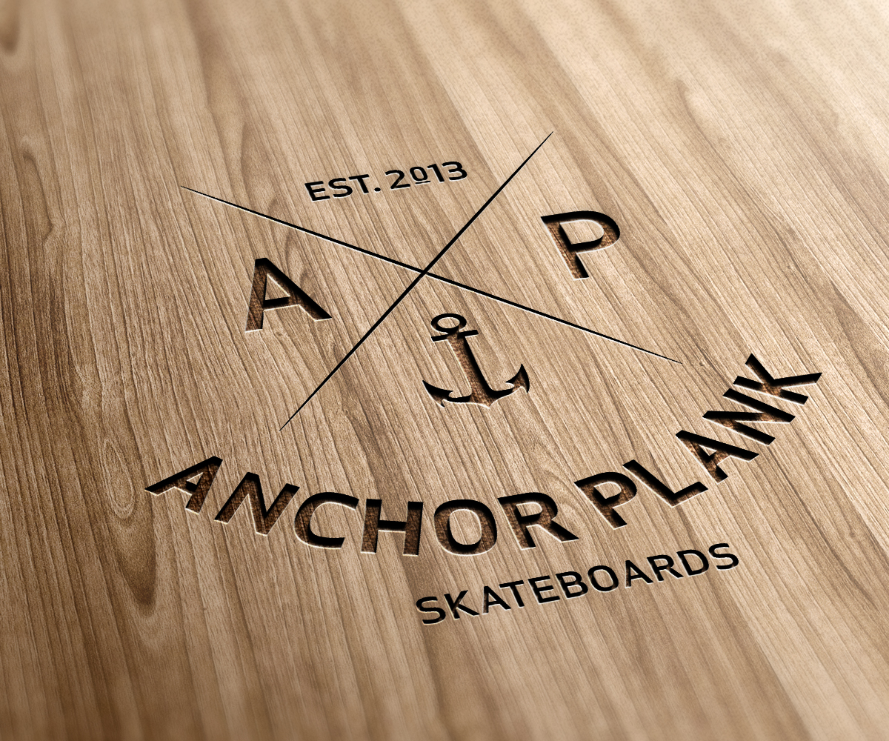
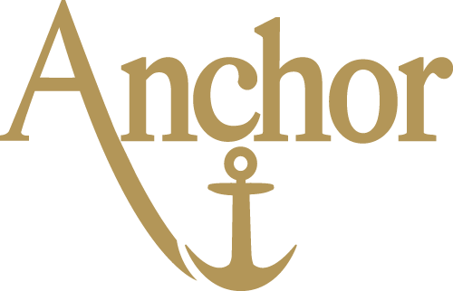
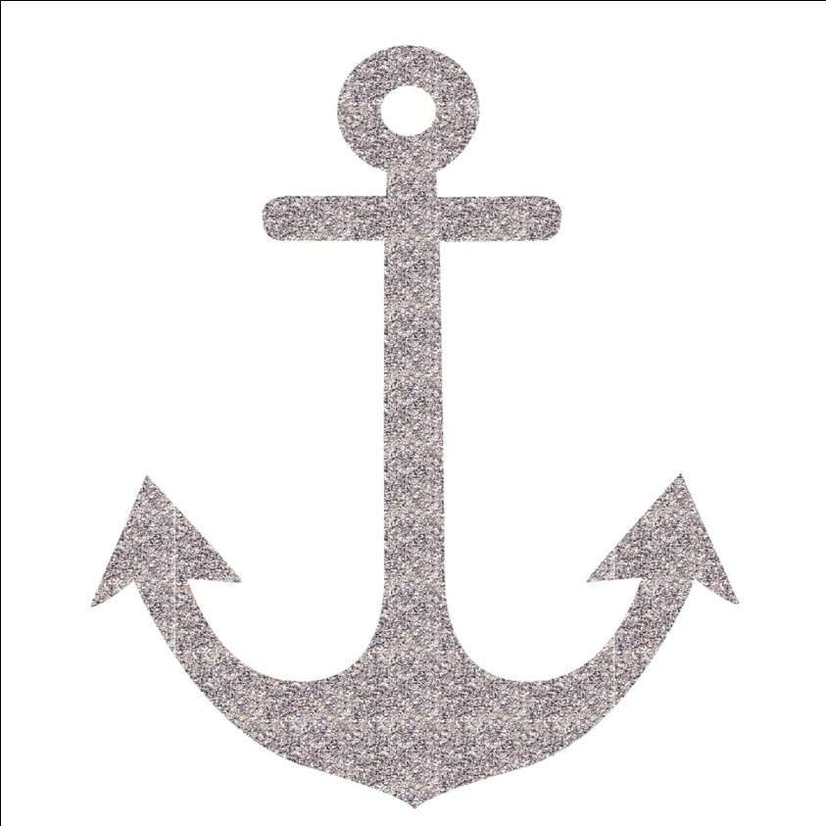
Some anchors that are nice

