Slide 1
Design Brief - Logo
September 2014

Slide 2
The business
The Name: Hot Fox
Main Product: Swimwear - Bikinis
Other Products: Beach towels, beach bags,
Target Market: Females, 18-30. Image and fashion conscious, think of themselves as ‘fashionable’, avid social media users, love to keep fit - gym goers, love to take selfies, high disposable income, love Australian beach life.

Slide 3
The brand
The mission: To be the ultimate one stop beach shop in Australia
The brand values:
PRODUCT:
Quality
Trend aware
Simple & chic
SERVICE:
Delivered quickly
Easy returns
Money back guarantee
PEOPLE:
Friendly
Approachable
Knowledgable
Lovers of outdoors
Lovers of Australia
LOCAL:
Based in Bondi

Slide 4
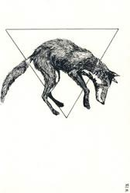

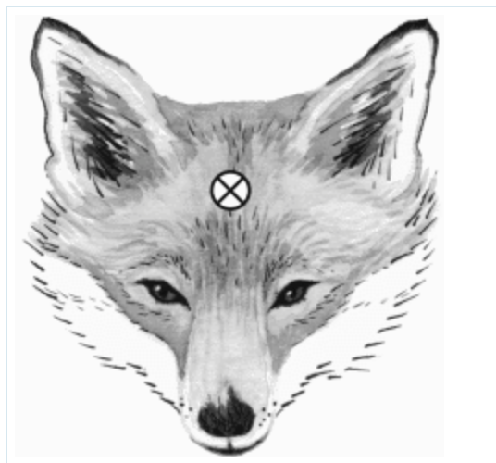



The logo
Colours: Black/White/Teal/Turquoise/ Silver
Iconography ideas: include an outline of a fox. Palm tree or something to symbolise sun.
Preferred shapes are angular e.g. Triangle
Typography: Clean & simple, Capital letters, perhaps use punctuation such as //
Required : 3 versions
  Stacked with ‘Hot Fox’
  Along side with ‘Hot Fox’
  Logo with no words
HOT
FOX
HOT //
FOX
;’

