Slide 1
Web UI face-lift project

Slide 2
Overview
We are a startup building a SaaS application for Freight Forwarders to allow them automate sales and quotation processed. The main purpose of this project is to get a graphical face-lift to a sketched future user interface of a web form and a results page. The product team has restructured the current workflow of the main feature of the application to make it more attractive, intuitive, and effective.

Slide 3
Main workflow
The main workflow consists of filling a fairly interactive form and hit search to get directed to a results page that contains a filtration panel. The process is very similar to modern hotels and airline tickets marketplaces (like Kayak, priceline, hipmunk, etc…).

Slide 4
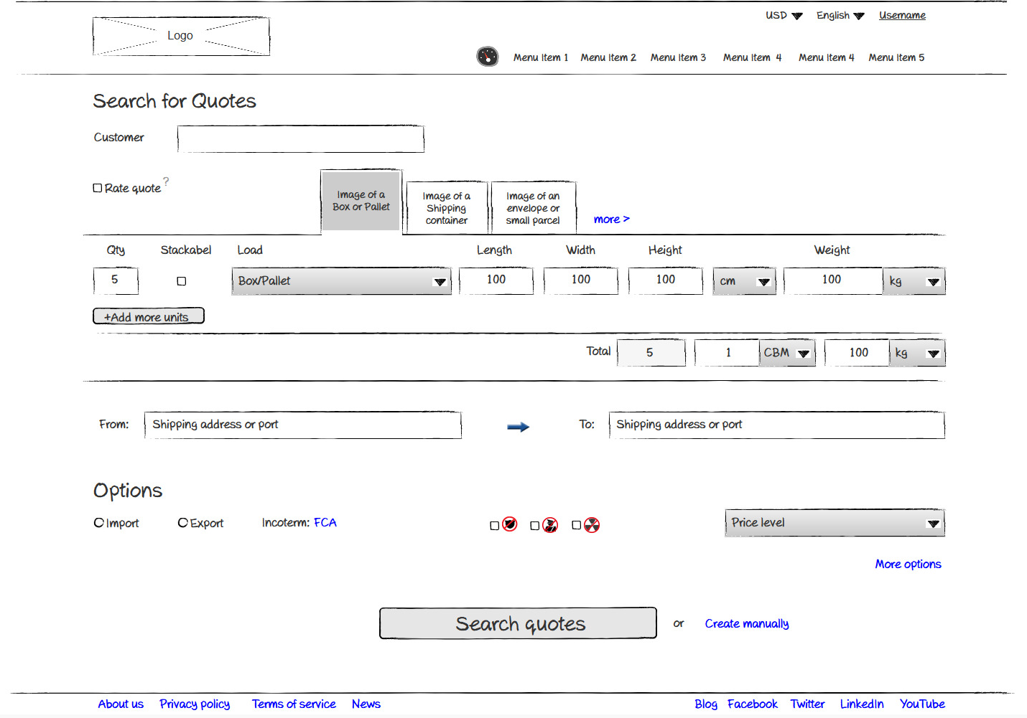
Form structure
User menu
Dashboard
Application menu
Load types (boxes, container, etc..)
This section allows the users to define the cargo being shipped. Based on the above tabs, different set of options are visible
Here we get to define where goods need to be picked up and dropped. Once the user reaches this part, we show a map under the field.
Additional information that user is not obliged to fill to get a result.

Slide 5
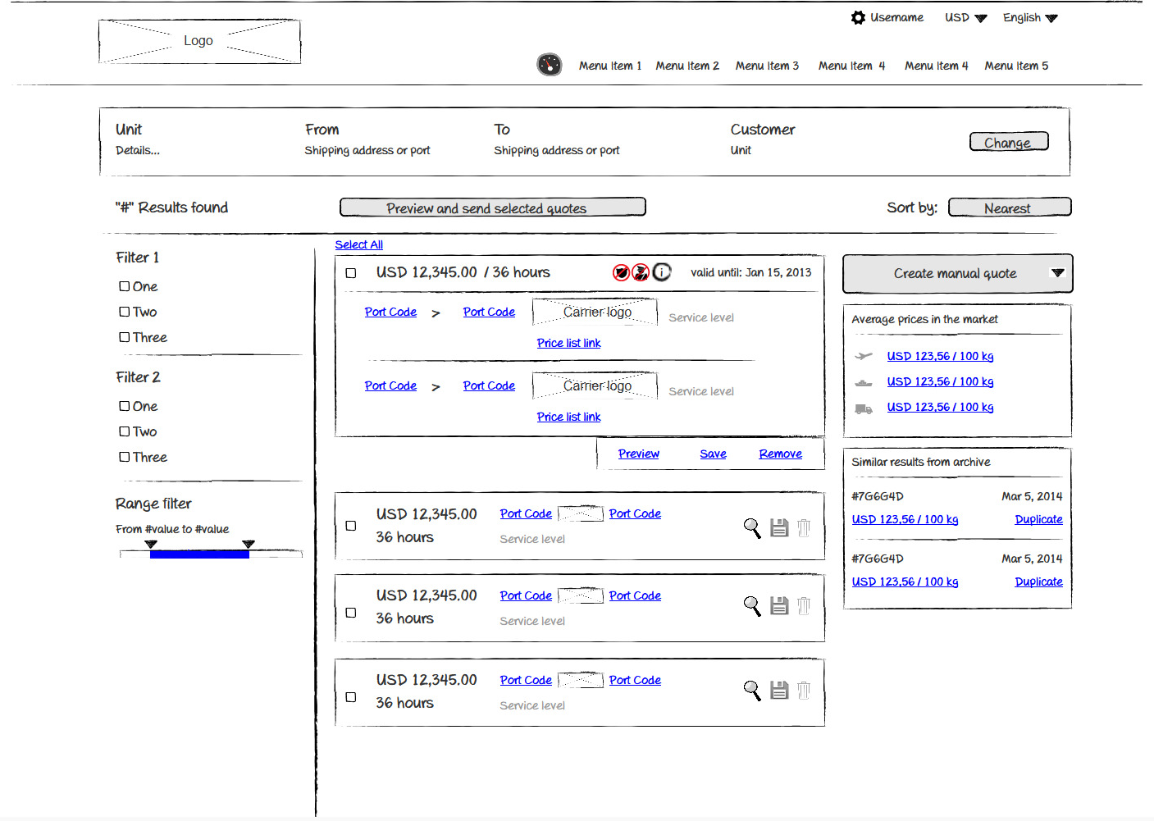
Form structure
Dashboard
Summary of search criteria
Main action button to collect more than one result in a document and move forward
Expanded result tile showing who the cargo is actually moving. First section is leg 1 then leg 2 etc…Each leg shows the carrier and additional details.
Side panel to display additional information like average prices, etc..
Tile in summary mode

Slide 6
Please note
That the design of the form elements (fields, buttons, etc…) will be carried on across the whole system.
A simple page design is required for a form to illustrate how these elements will look like (text field, button, checkbox, combo etc…)
The application is also white-labeled and often styled according to customer’s main colors.

Slide 7
Deliverables
Main search form
Results page
Sample one page web form with basic form elements (Text inputs, buttons, combo boxes, checkbox, radio button, etc…). Sample validation is also required like errors, active, disabled, etc…

