Slide 1
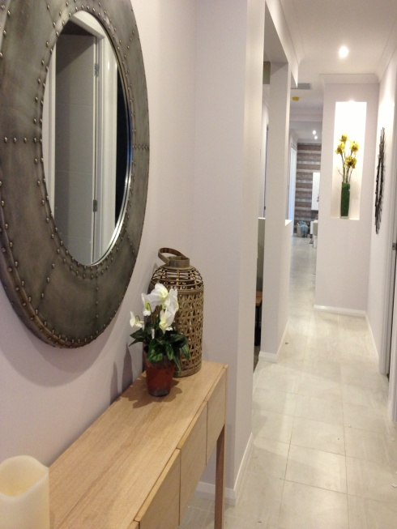
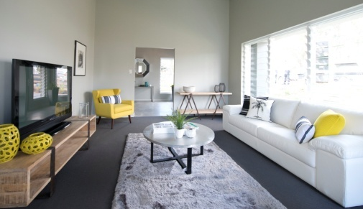
INTERIOR STYLING
WORKSHOP
FIND YOUR STYLE
BE INSPIRED
Would you like to transform your home?
Do you feel OVERWHELMED and CONFUSED as to Where to start?
Are you unsure of a colour scheme, what type of furniture, Soft furnishings, accessories suit your home and lifestyle?
Where to buy? What will suit your budget?
(Image of Lyn & Michelle
Still to be uploaded)
Lyn Hughes and Michelle Davies of COLOUR IMPACT Interior Design understand the frustration and confusion that D.I.Y. home decorators face and will be holding INTERIOR STYLING WORKSHOPS in which you will learn how to create innovative colour schemes and styles from concept to completion in a fun, hands on experience, surrounded by beautiful furniture, fabrics, soft furnishings and homewares that will get your creative juices flowing!

Slide 2
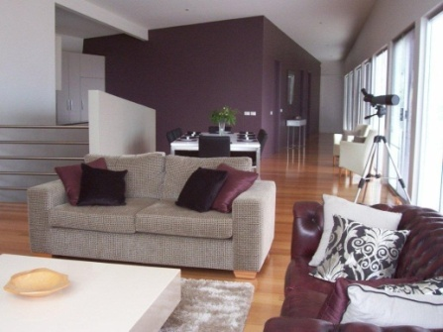
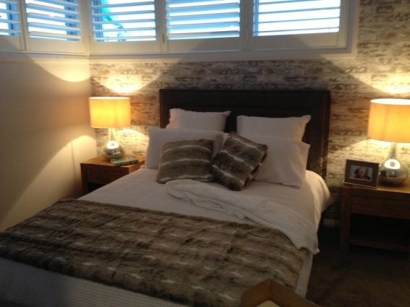
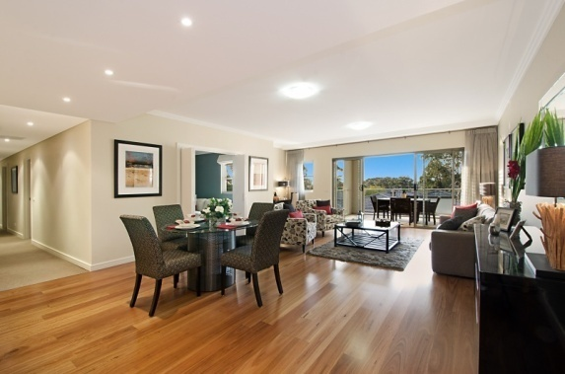
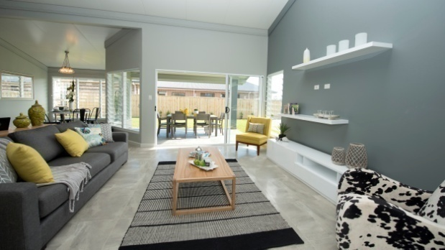
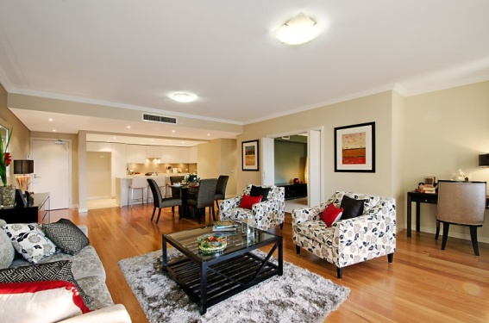
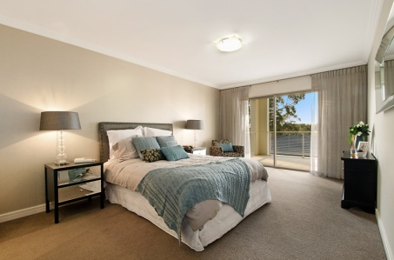
You will learn
  Where and how to use colour, shape, form, and different textures to create a balanced and harmonious environment.
  Current styles and what inspires you.
  Space planning and furniture placement for your room to give a balanced and spacious feel.
  Where to start!
  How to bring it all together with the finishing touches.
  Why Concept plans and mood boards are important.
You will also enjoy making your very own mood board which will give you insight and inspire you to commence your project with confidence.
All Materials and Lunch are provided.
Bookings are essential.
Numbers are limited to 10 per workshop
Cost: $240 (including lunch)
For more information, dates, times and venues of upcoming workshops, please call Lyn on Mob 0408279707, or visit our Website www.colourimpact.com.au

