Slide 1
Brief
INTime is a multi-retailer concept store of luxury and contemporary timepieces. It has 4 stores all over Indonesia. Targetting young executives who are active and working daily; in their early career and have high aspiration. Keywords: Luxury/Premium, Stylish, Quality, Respect and Loyal.
A few brands carried by INTime boutique: Rolex, Tudor, TAG Heuer, Breitling, Baume et Mercier, Bell&Ross, Chopard, Dior, Gucci, Ebel, Hamilton, Corum, Burberry, BALL.
INTime is a retail arm of Time International Group and a sister
www.timeinternational.co.id
The brand color are grey and white. The final design should communicate luxury, modern and fun.

Slide 2
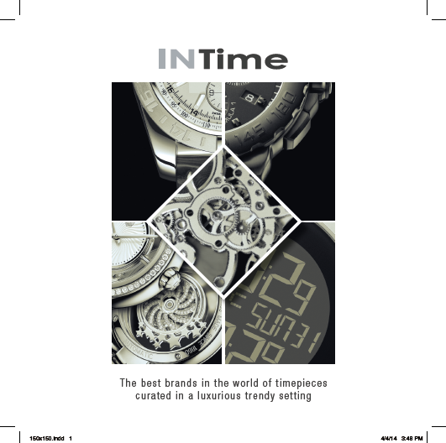
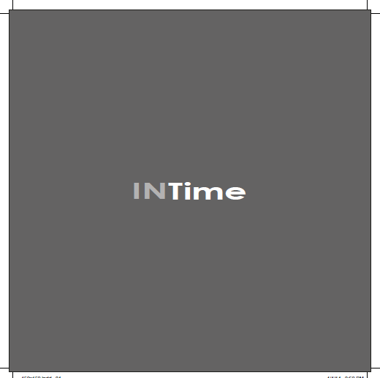

Slide 3
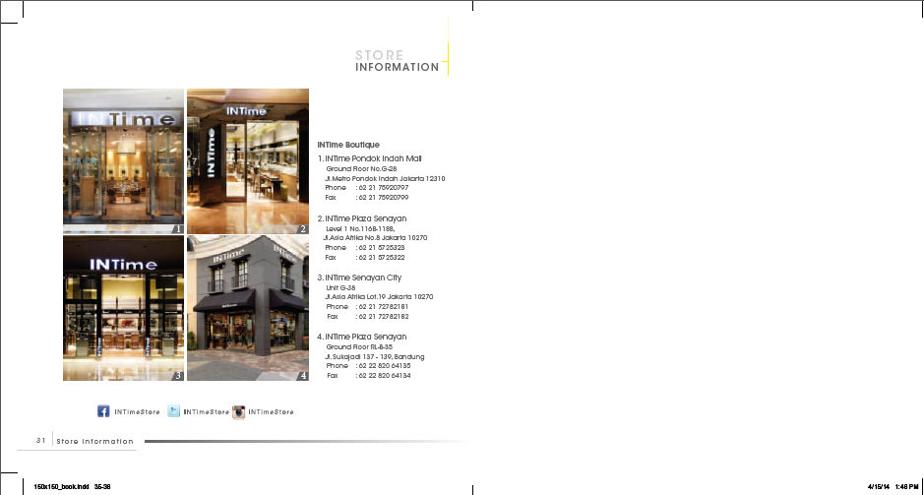

Slide 4
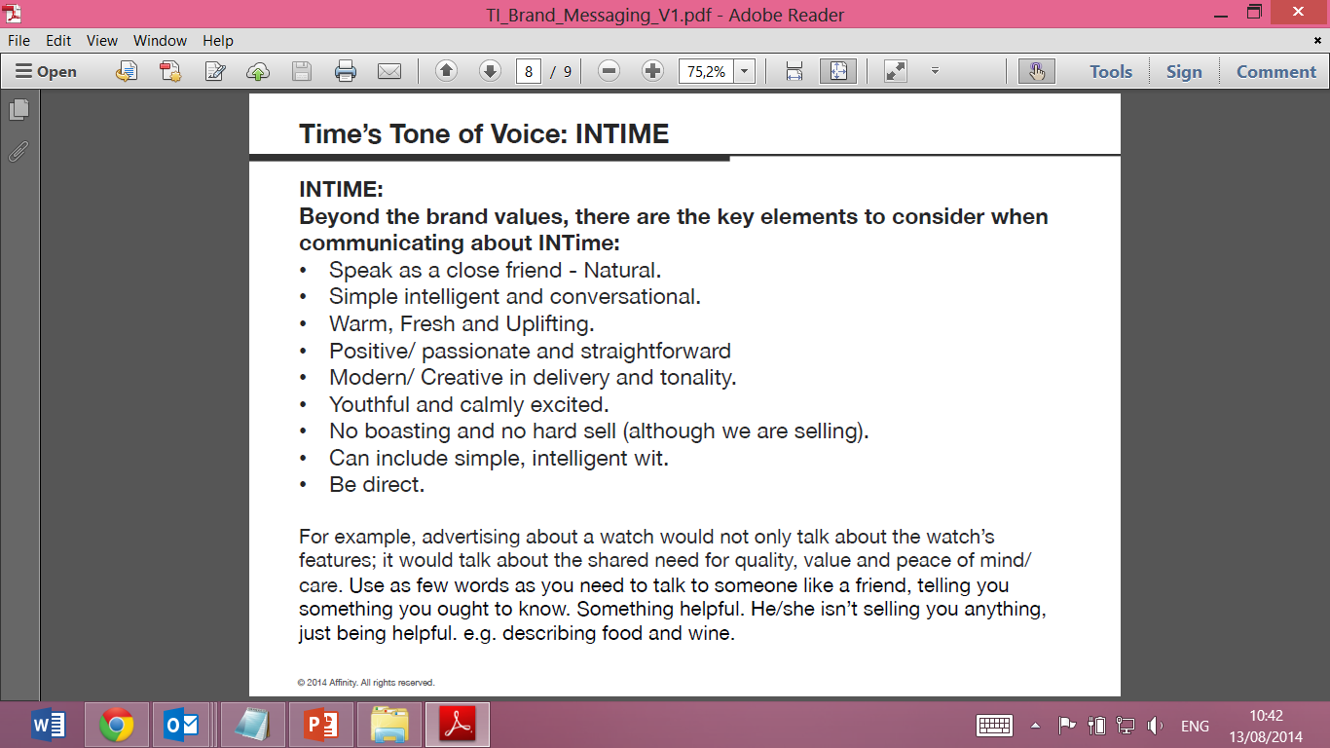

Slide 5
Links
https://www.facebook.com/INTimeStore
https://twitter.com/INTimeStore
http://instagram.com/intimestore
http://www.timeinternational.co.id/intime

