Slide 1
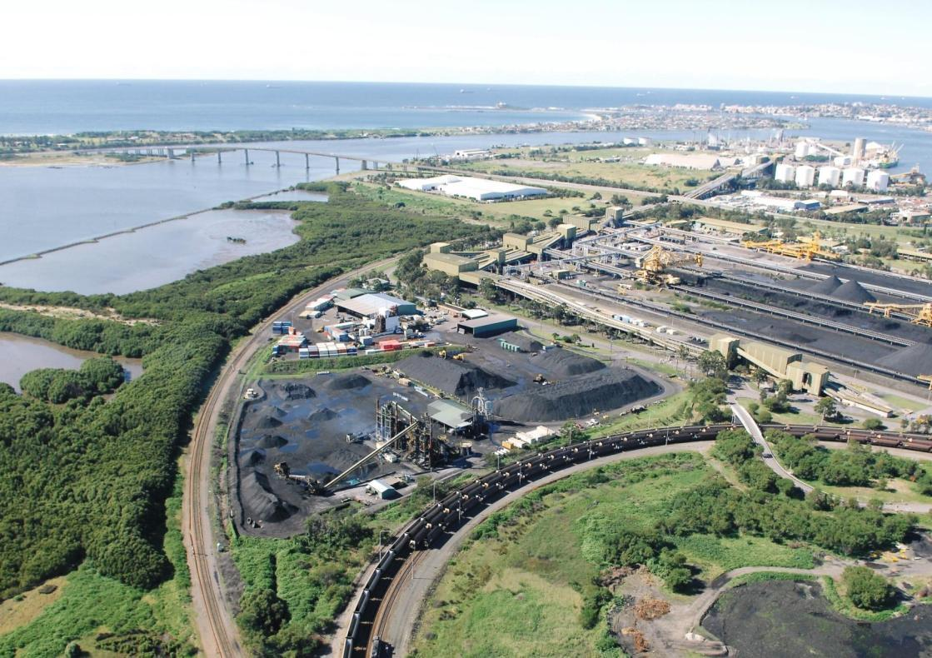

Transport
Intermodal Services
Warehousing
Distribution
Grain Handling

Slide 2

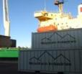
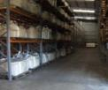
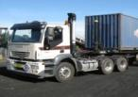
Intermodal Services
Warehousing
Distribution
Company History
Business commenced 1982
Forbes Depot – 1984
Sydney Depot – 1985
Head Office Cardiff – 1990
Head Office, Kooragang Island – 1993
Brisbane & Townsville Depots – Dec 2010
  Louis Dreyfus Grain Supply Chain – 2011
  Narrabri & Newcastle Grain Terminals
Gladstone / Rockhampton Depots – July 2012
Road / Rail freight task >5,000,000 mt p.a

Slide 3




Intermodal Services
Warehousing
Distribution
Board of Directors
Chief Executive Officer Keith Morgan
Commercial Manager
Greg Asher
General Manager
HSE / HR
Wayne Walker
Financial Controller
Tina Gingell
General Manager
Business Development
Kevin Bennett
General Manager
Agricultural Services
Vacant
General Manager
Industrial Services
Paul Darby
General Manager
Intermodal
Paul Smith
General Manager
Transport Operations
Steve Phillips
Fleet
Manager
Mick Barclay
Manager
Queensland
Matt Barnes
Manager Business Development Agriculture
Graham Tancred
Manager
Industrial Services
Grahame Kuter
Supervisor
Intermodal
Phil Carey
Manager
Line Haul
Steve O’Keefe
Maintenance Manager
Manny Kallis
Regional Manager
Central West
Vacant
Supervisor
Kooragang
Athol Blanch
Supervisor
Rail Operations
Craig Maher
Operations
Supervisor
Kevin Bowen
Central Queensland Manager
Martin Minshall
Manager
Forbes Depot
Graeme Cameron
Supervisor
Bulk Grain Storage
Brad Nicholson
Account Manager – National Starch
Graham Welsman
Supervisor
Afternoon Shift
Clem Carr
Manager
Local Transport
Russell Merrick
Operations
Supervisor
Luke Almond

Slide 4
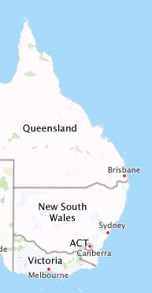

Intermodal Services
Warehousing
Distribution
Townsville
Gladstone / Rockhampton
Brisbane
Narrabri
Warren
Newcastle - Kooragang
Sydney – St Mary’s
Forbes

Slide 5
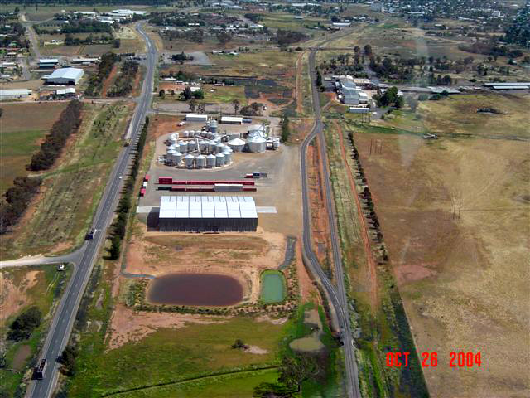
Forbes Depot

Slide 6
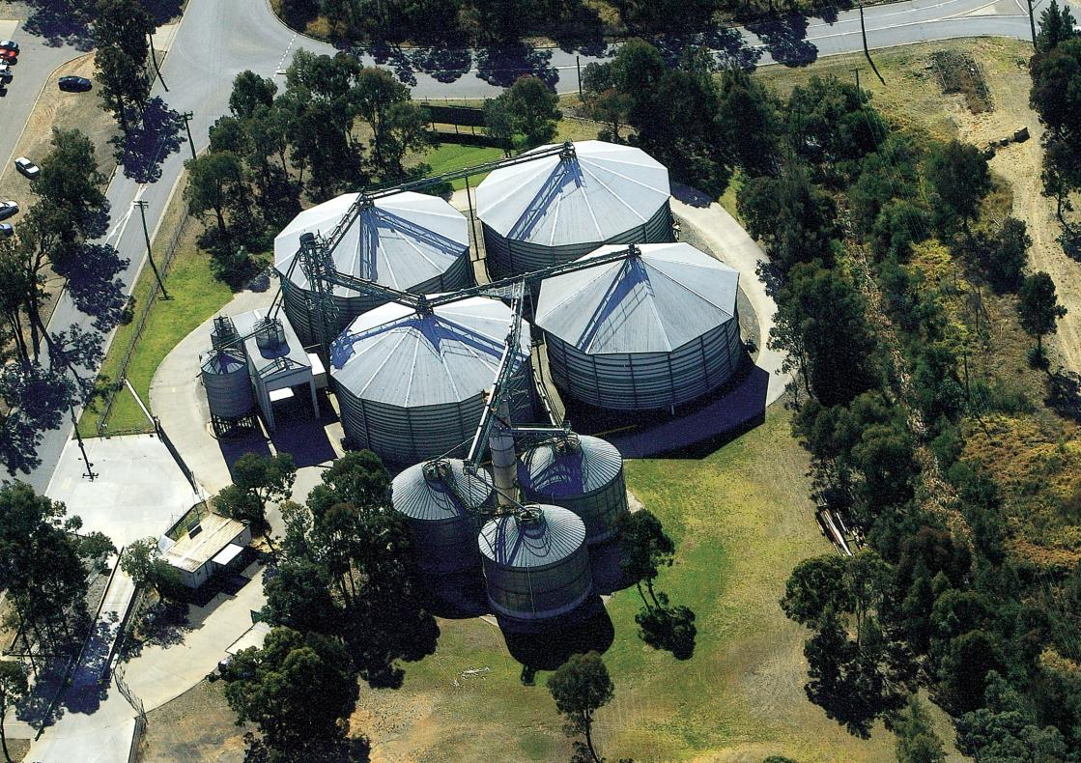
Sydney Depot

Slide 7
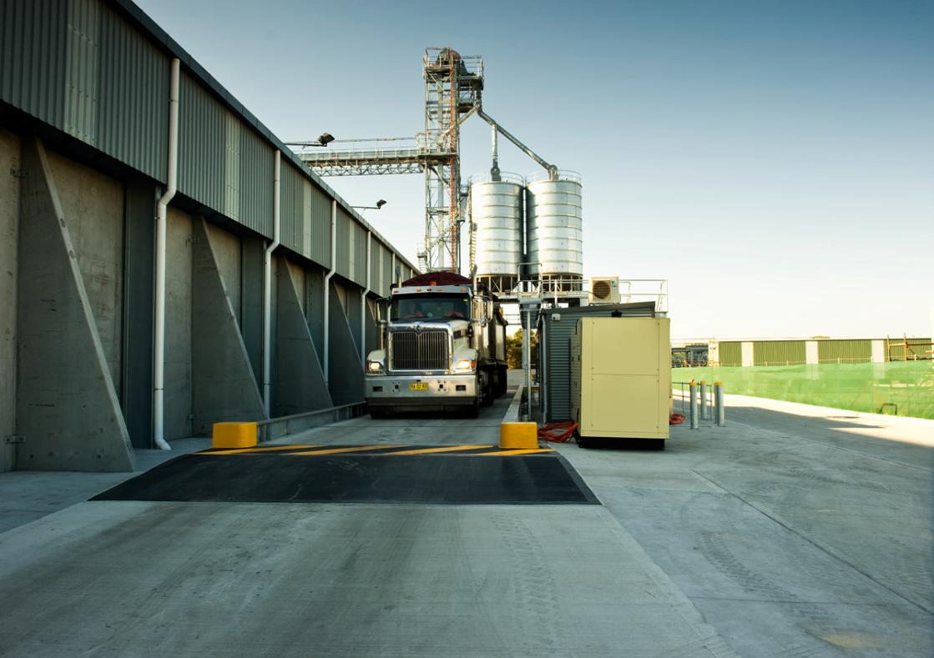
Newcastle Grain Terminal

Slide 8
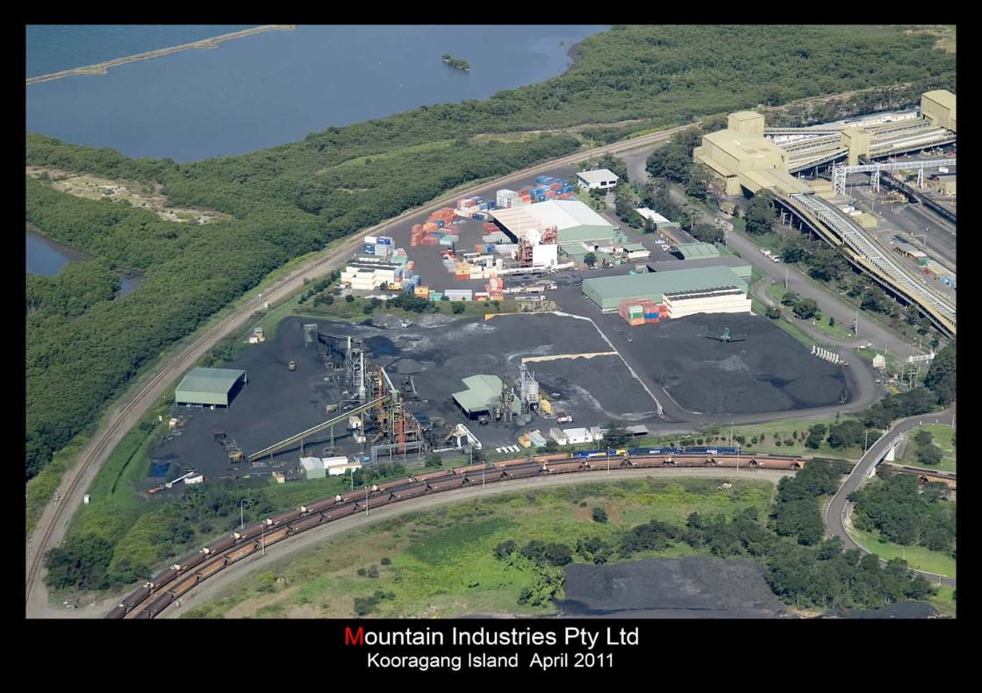
KOORAGANG DEPOT
Newcastle Depot

Slide 9
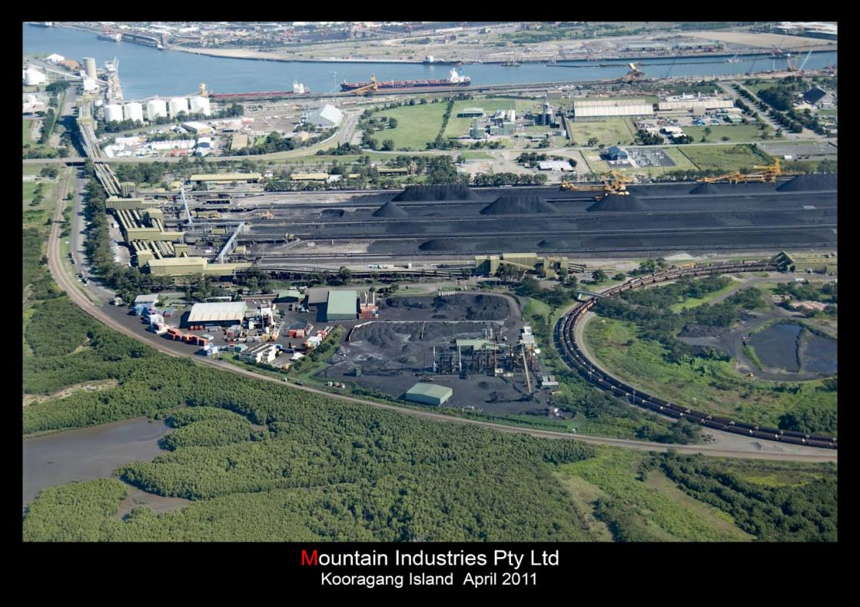
Newcastle Depot & Port Facilities

Slide 10
Intermodal Services
Warehousing
Distribution
Company Structure
        Transport :
        Bulk Tippers
        Tankers
        General Freight (specialising in container movements)
        Queensland Division
        Industrial Services
        Storage:
        Bulk (covered and open)
        Warehousing
        Agricultural Services
        Intermodal Terminals
        Maintenance
        Administration

Slide 11
Geographic Locations
Intermodal Services
Warehousing
Distribution
Head Office: Kooragang Island (Newcastle)
Depots:
  Brisbane
  Townsville
  Gladstone / Rockhampton
  Forbes
  Narrabri
  Warren
  St Marys (Sydney)

Slide 12
Intermodal Services
Warehousing
Distribution
Customer Base – Many are JIT 24 / 7
  The Smiths Snack Food Company (Pepisco)
  Inghams
  Grain Merchants (Lachlan Commodities, Cargills, Queensland Cotton, Arrow Commodities, Standard Commodities, Blue Ribbon Seeds)
  Penrice Soda Ash Holdings
  National Starch (Formally Penford Starches Australia)
  BHP Billiton
  Tomago Smelter
  Werris Creek & Rio Tinto Coal Mines
  National Ceramics Industries Australia Limited
  Pacific Carbon
  Weng-Fu Australia
  Auscott Ltd
  Louis Dreyfus Commodities
  QR
  Visy
  Kara Minerals

Slide 13
Safety Systems
Intermodal Services
Warehousing
Distribution
Trucksafe (National Industry Safety Accreditation)
  Key elements:
    Management commitment,
    Maintenance standards,
    Staff training,
    Employee health, &
    Externally audited.
National Heavy Vehicle Accreditation Scheme
    Mass
    Maintenance
    Fatigue

Slide 14
Safety Systems
Intermodal Services
Warehousing
Distribution
Comprehensive OH&S Policies
    Web portal for client access, Inductions & Training
    Inductions & Work Method Statements – Site Specific
    Drug & Alcohol testing Policy
    Incident Reporting / Investigation
    Fatigue Management Training – Drivers & Ops staff
Vehicle GPS tracking
    “Real time” location / activity
    Provides Fatigue & Speed monitoring
    Accurate data for KPI monitoring

Slide 15
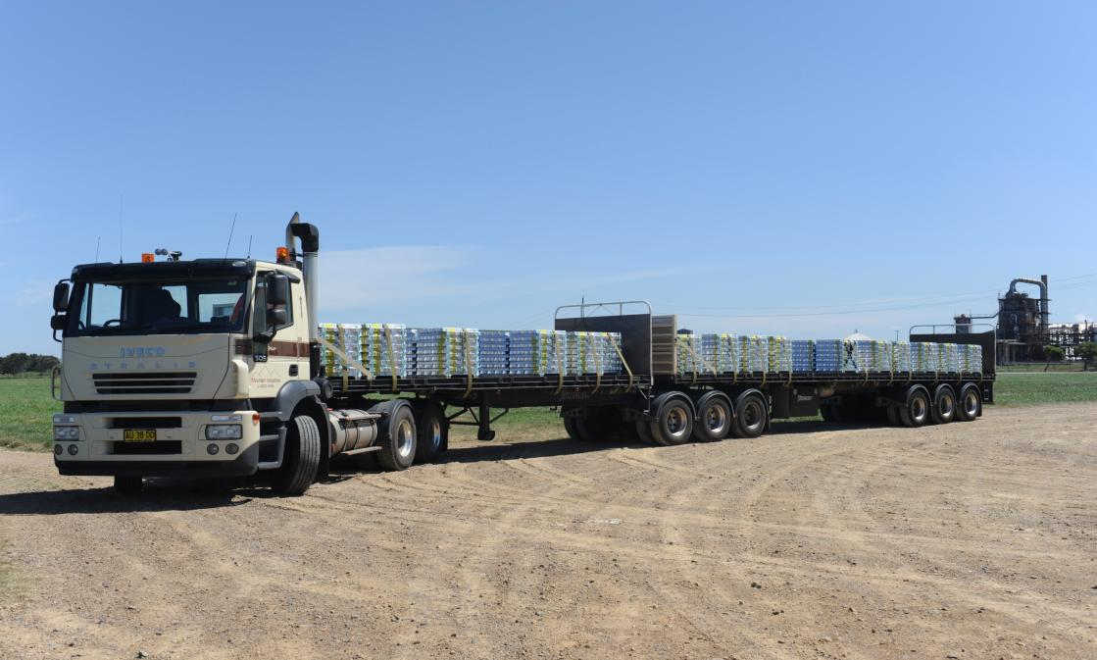
Intermodal Services
Warehousing
Distribution

Slide 16
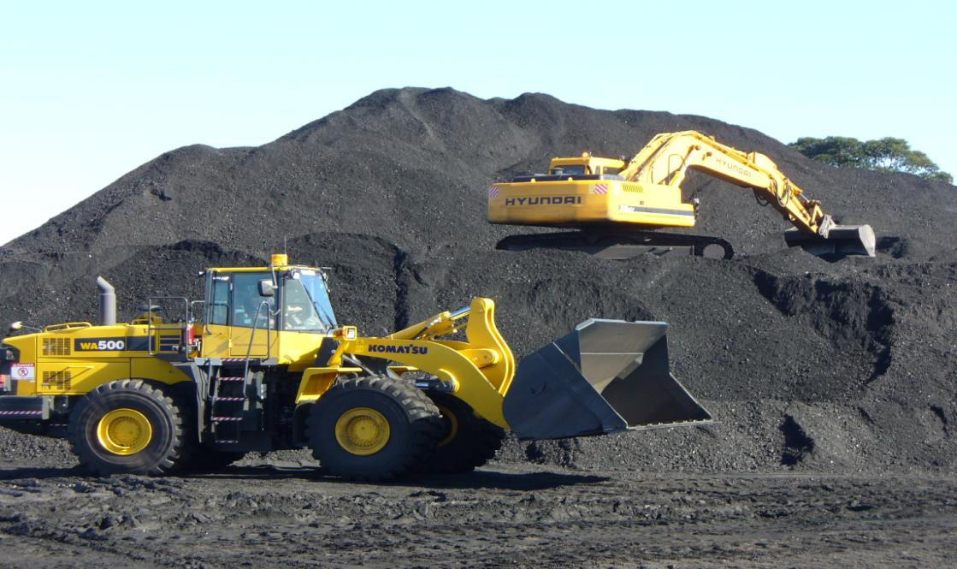
Intermodal Services
Warehousing
Distribution

Slide 17
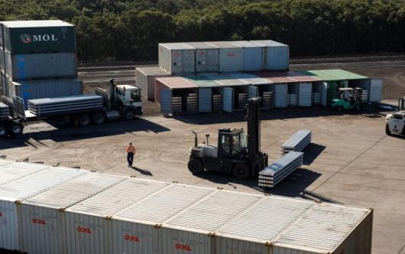
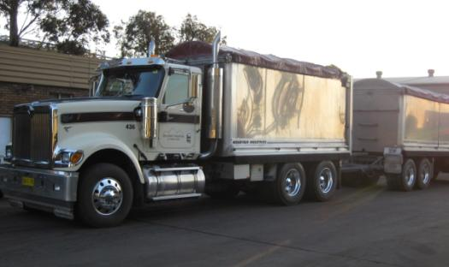
Intermodal Services
Warehousing
Distribution
Located on Kooragang Island in the lower Hunter Valley, Mountain Industries Newcastle depot is positioned centrally to local facilities in an area designated for port related activity.
Mountain Industries Kooragang Depot is strategically placed to link road rail and sea freight effectively and efficiently.
Directly employ approximately 180 people and responsible for the employment of in excess of 100 subcontractors.

Slide 18
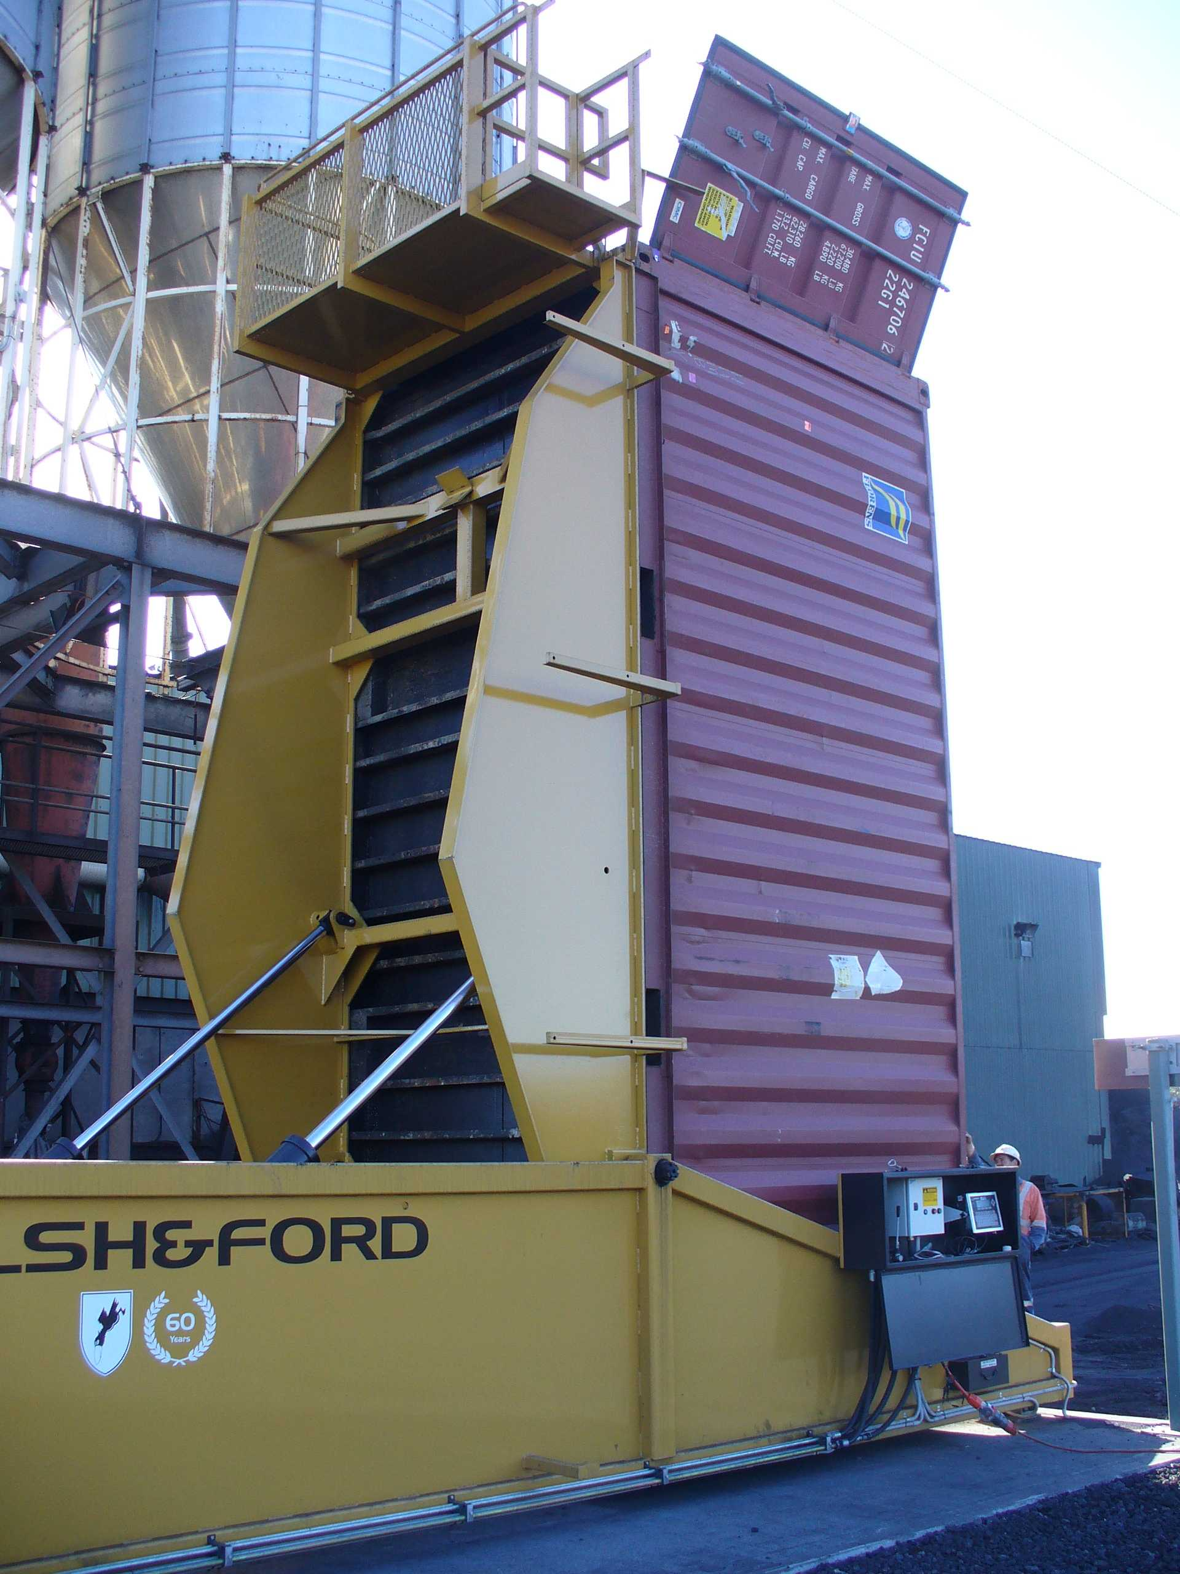
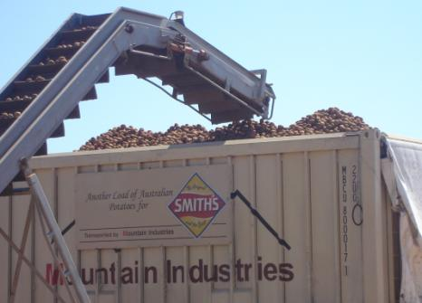
Intermodal Services
Warehousing
Distribution
Comprehensive OH & S policies
Established track record in successful
logistic outcomes for a wide range of
clients
Service clients on a 24/7,
as needs require basis.

Slide 19
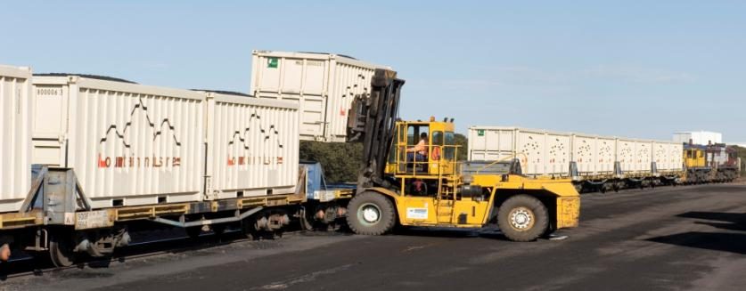
Intermodal Services
Warehousing
Regular rail services co-ordinated to deliver containers of all sizes to/from Port Botany and major container terminals.
Distribution
Over 170m of accessible rail siding, capable of servicing trains of over 700m in length.

Slide 20
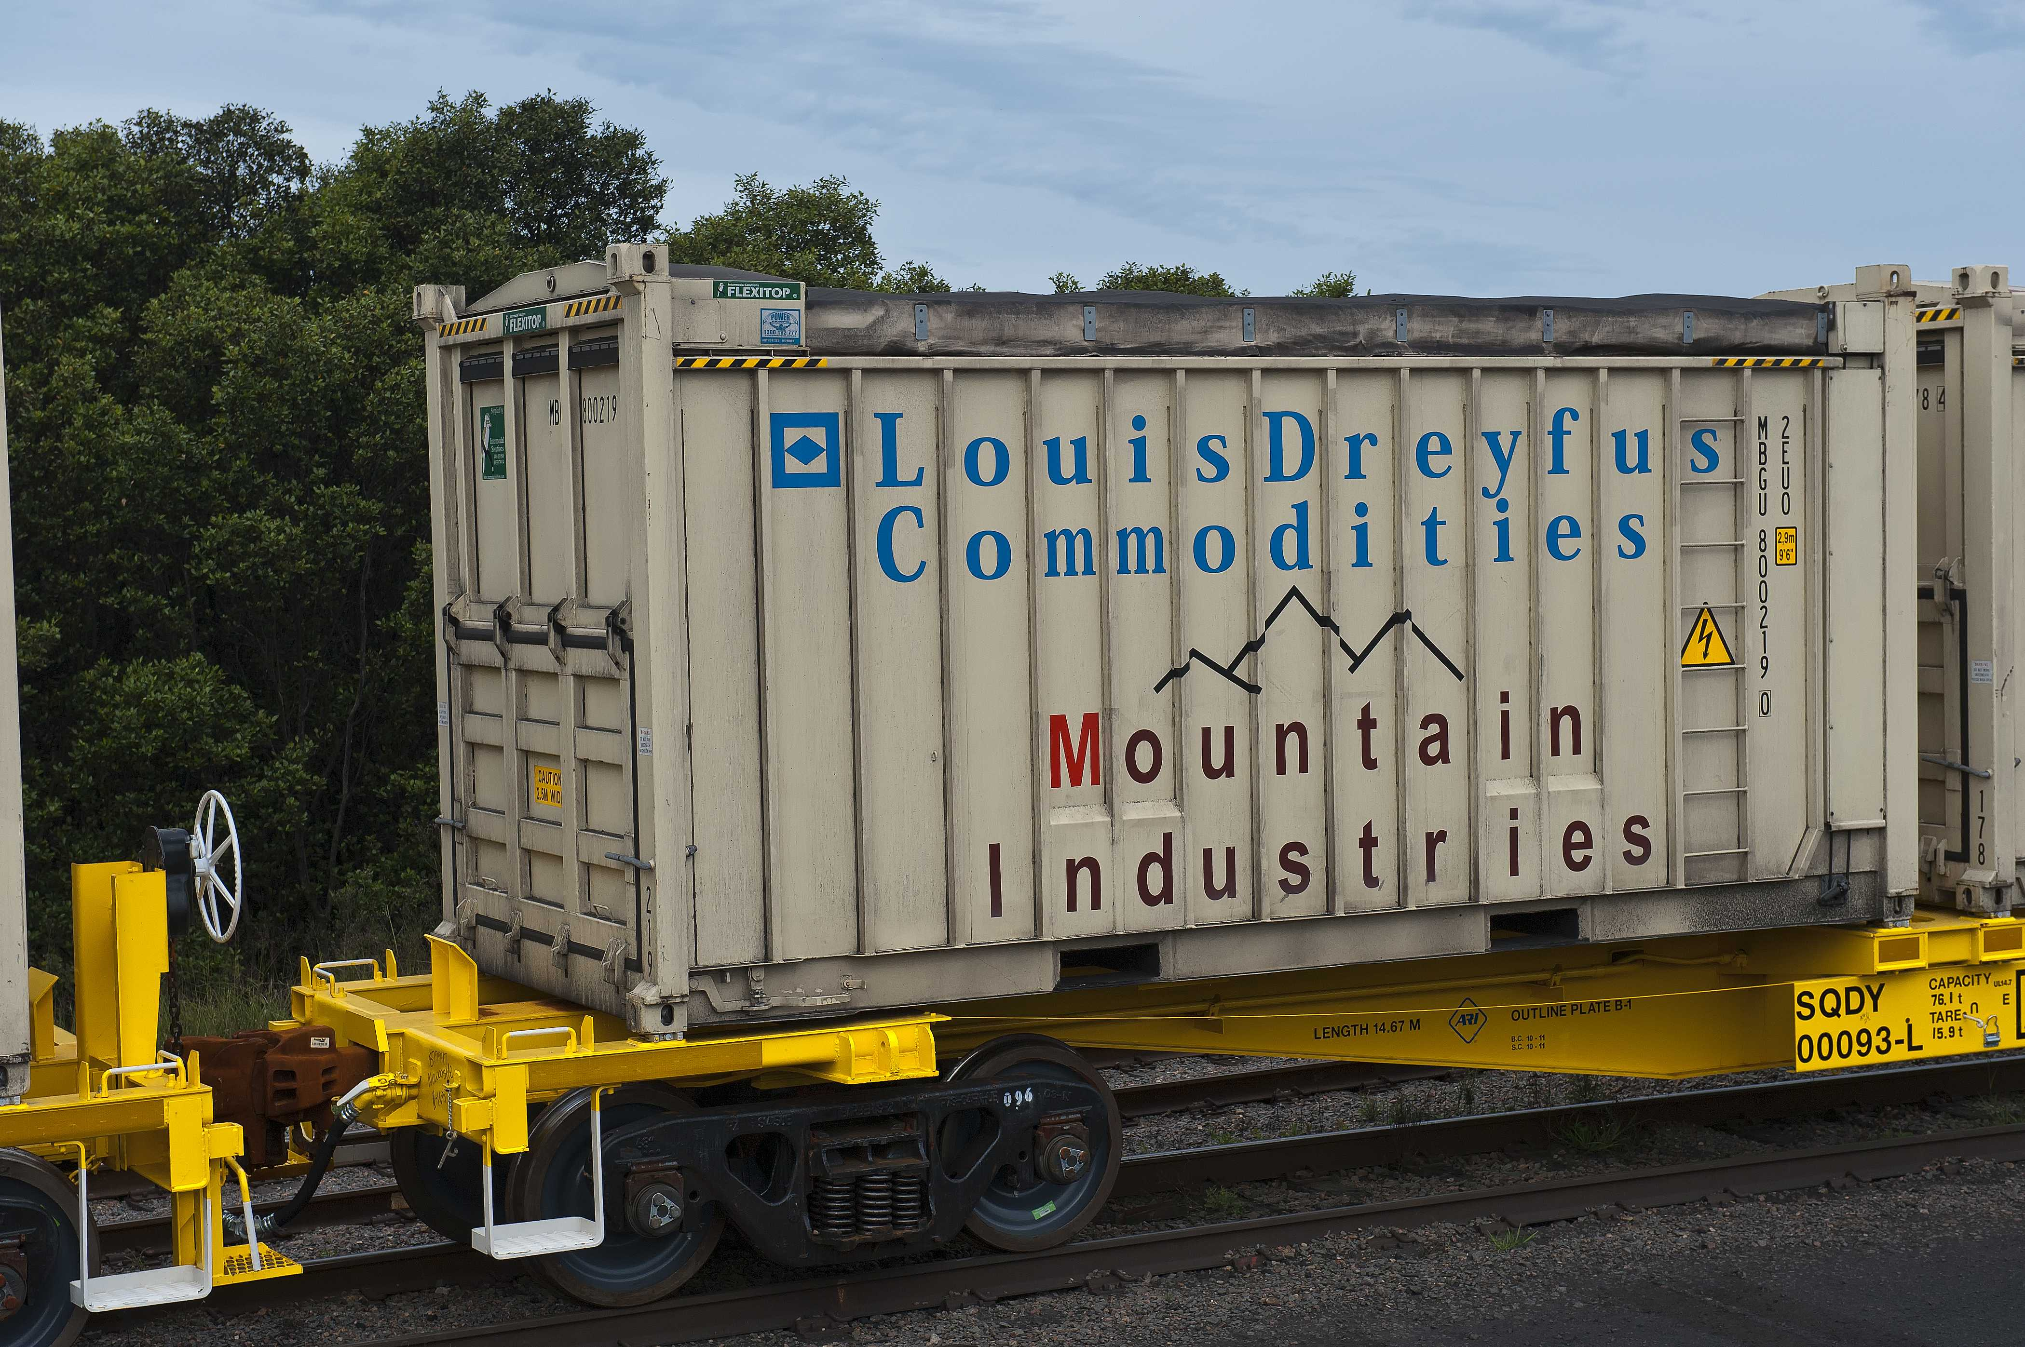

Slide 21
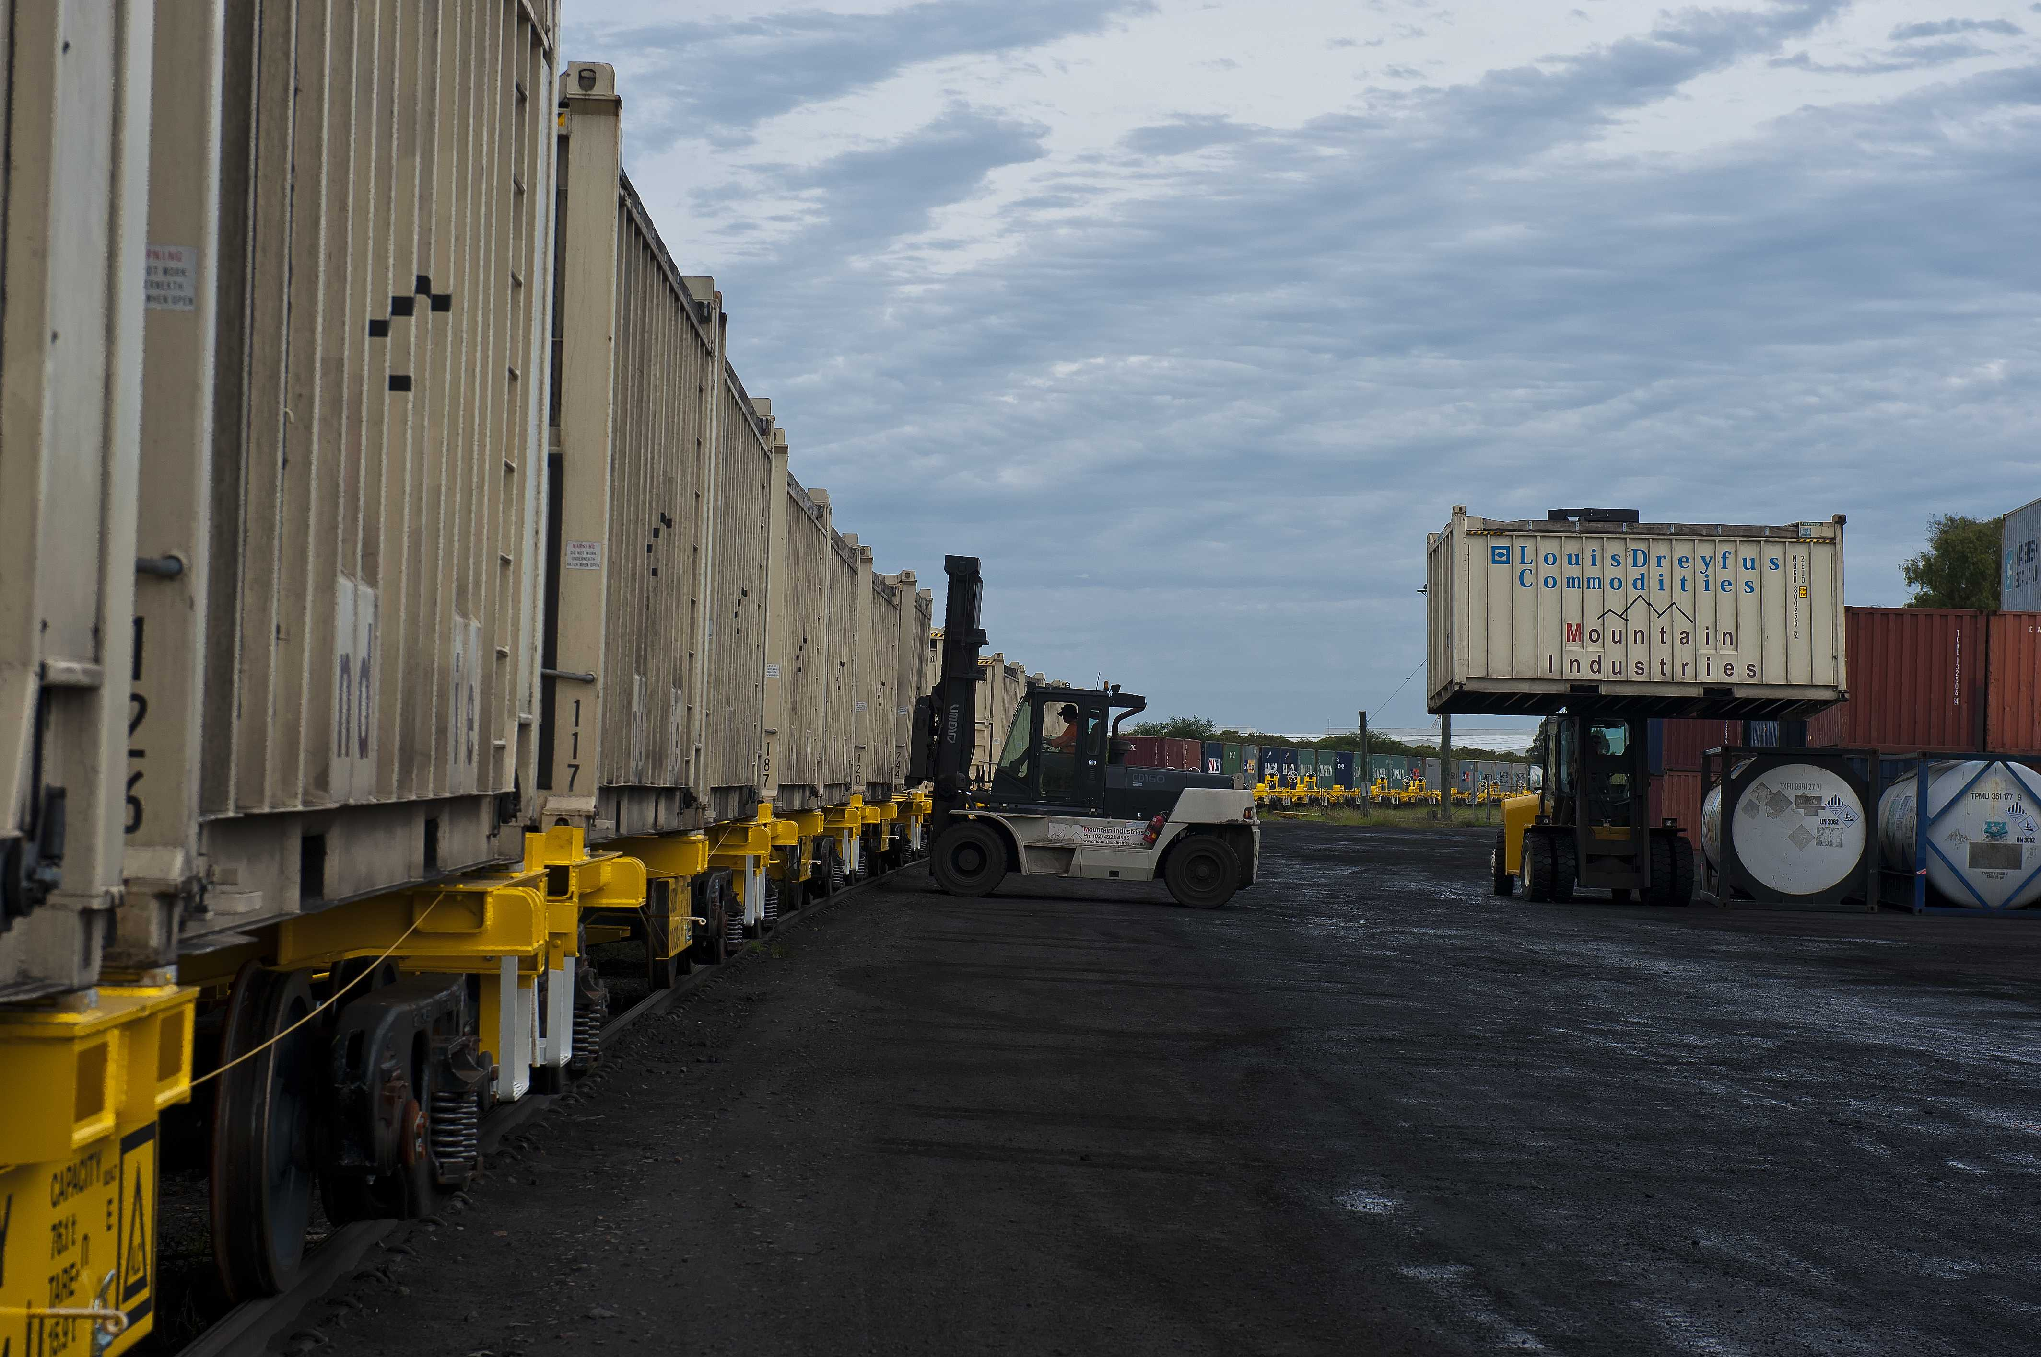

Slide 22
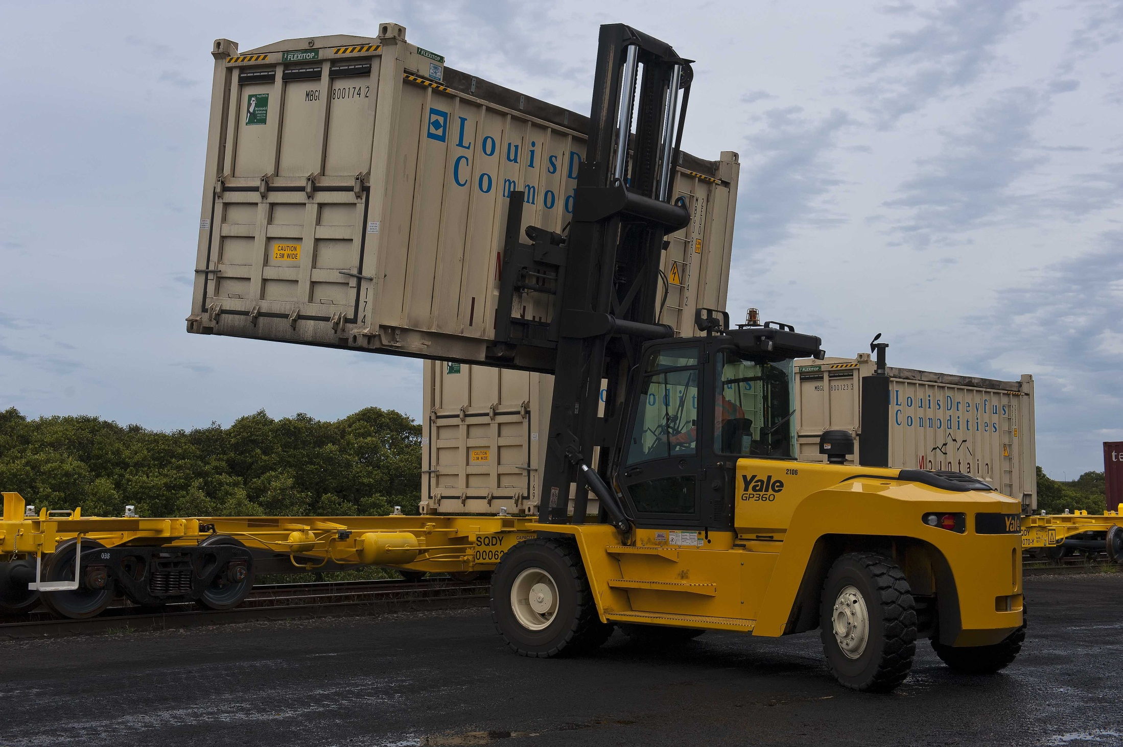
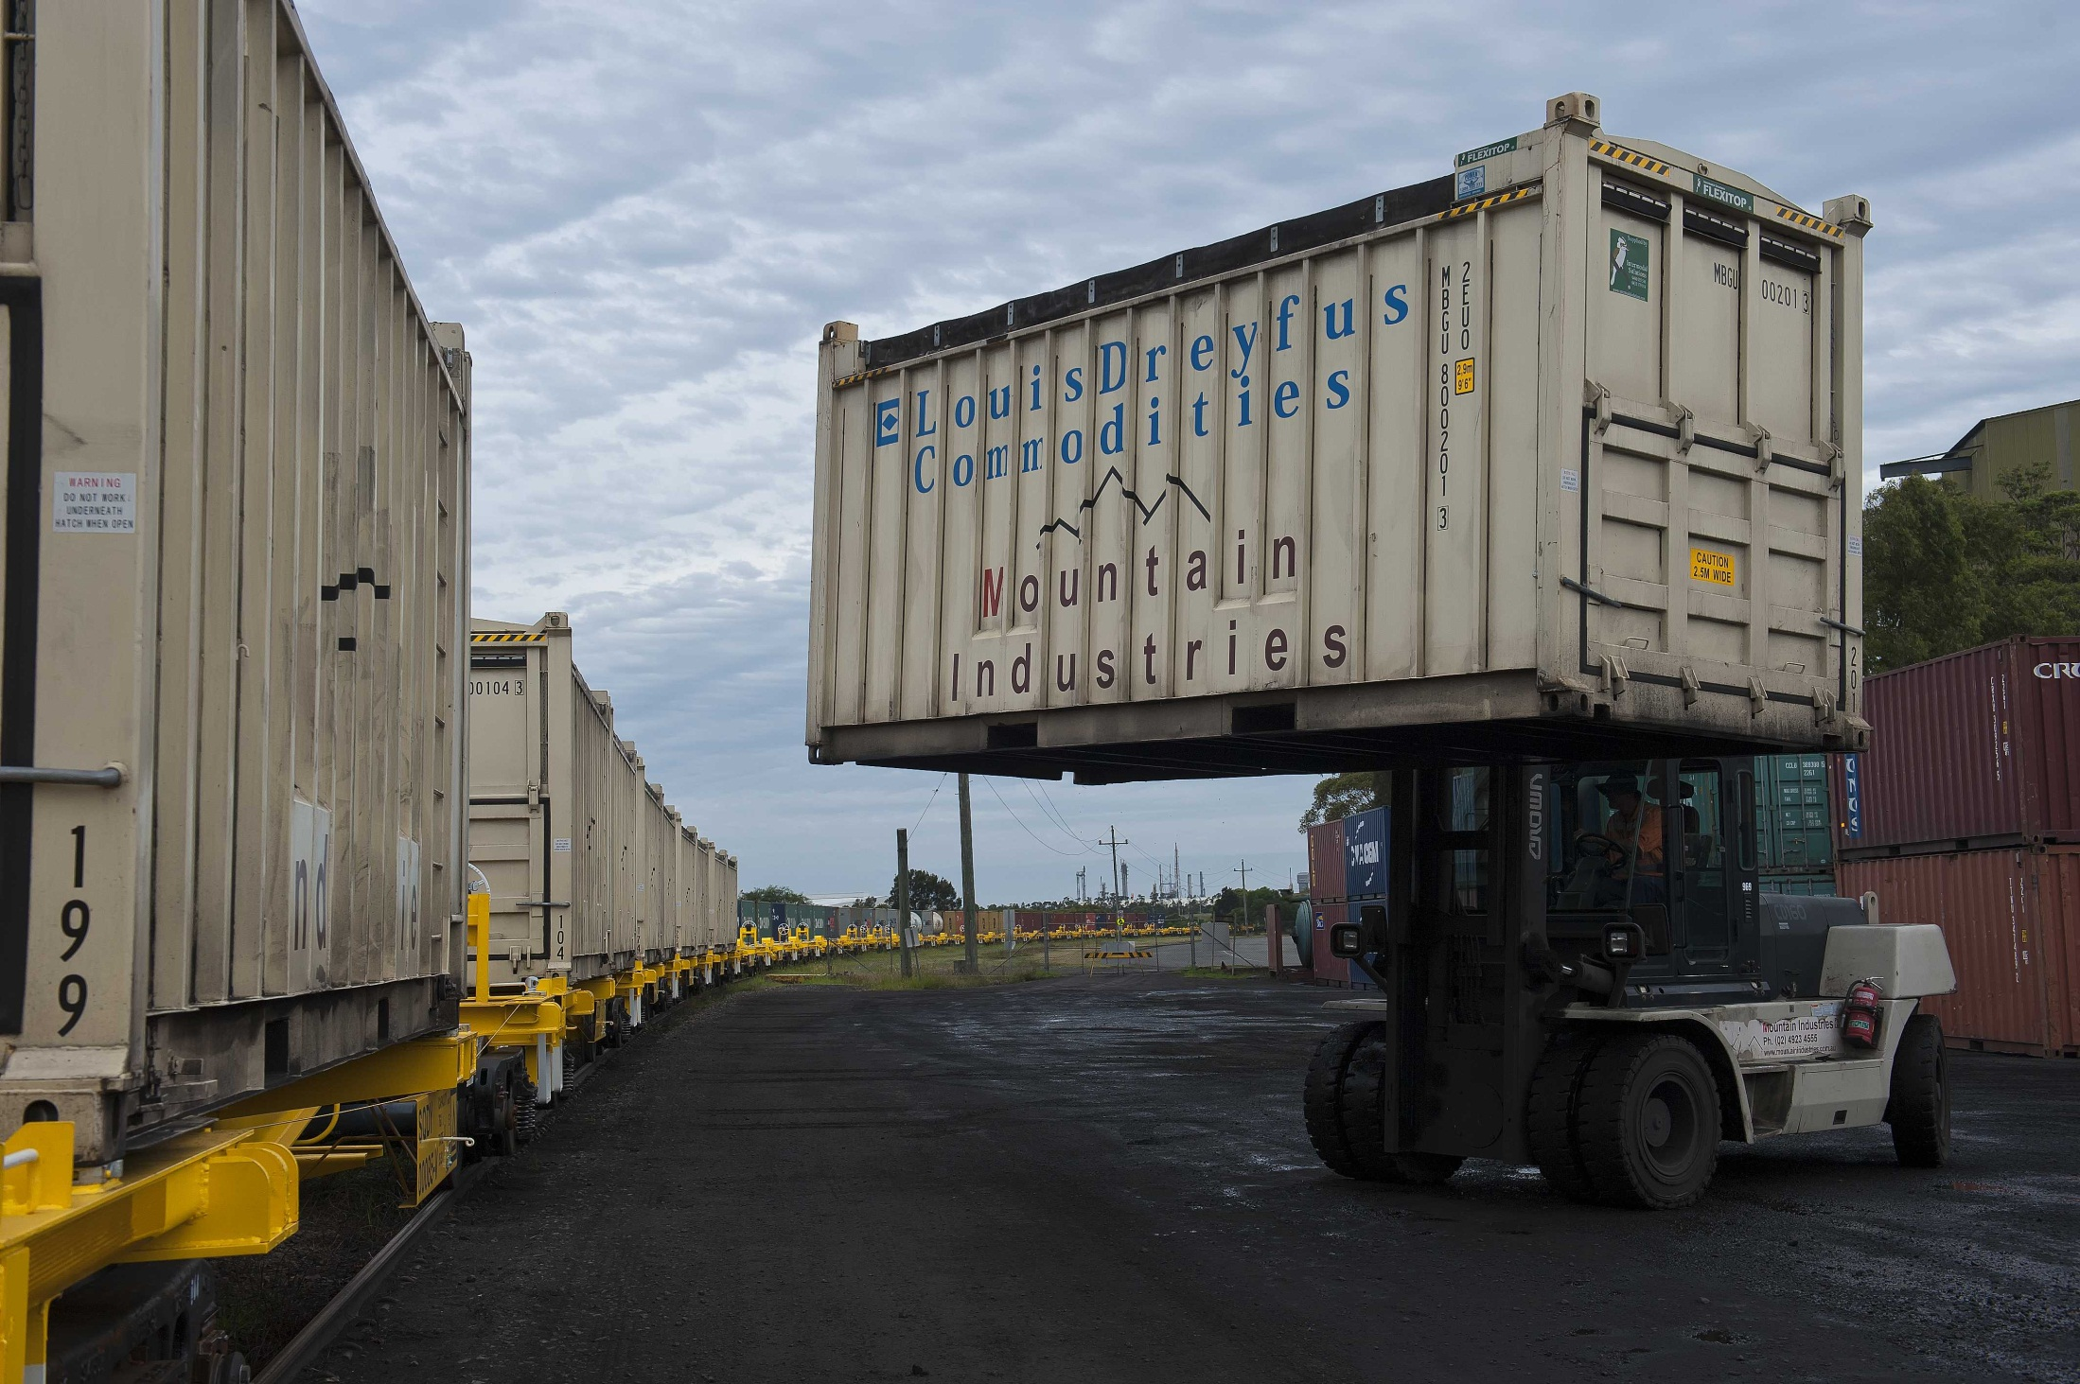

Slide 23
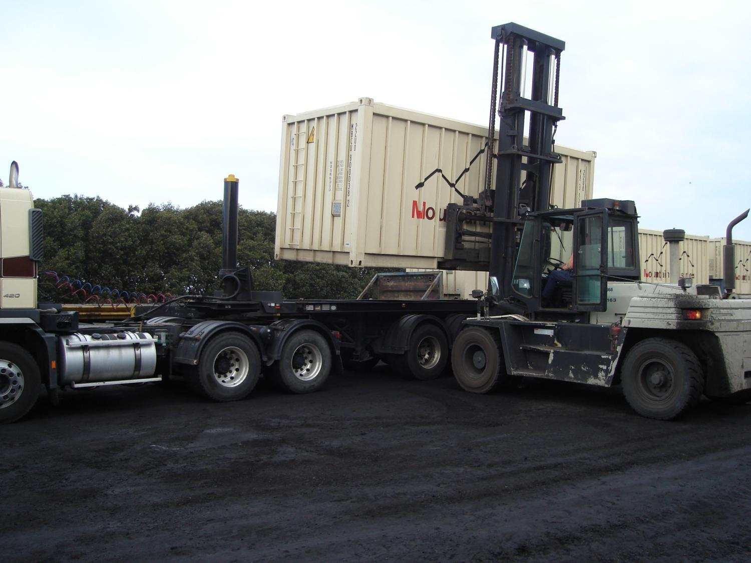

Slide 24
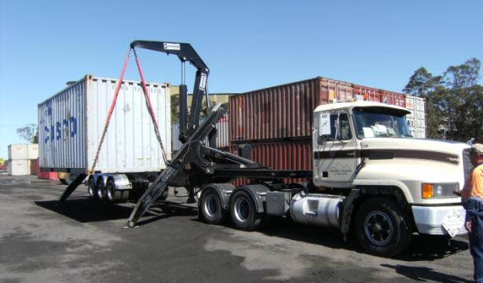
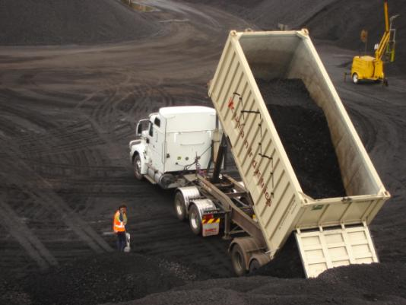
Intermodal Services
Warehousing
Distribution
Specialised equipment for any application
Forklifts, of all sizes
Side loader
Open topped Containers
Container loading augers and conveyors
Front end loaders

Slide 25
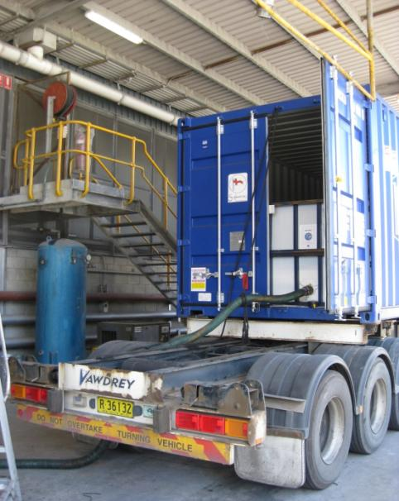
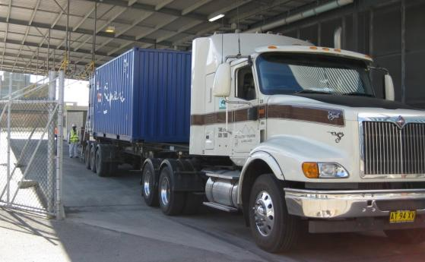
Intermodal Services
Warehousing
Distribution
Liquids
Mountain Industries is experienced in fitting and loading a range of specialised intermodal units.

Slide 26
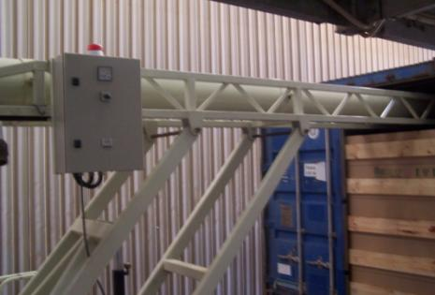
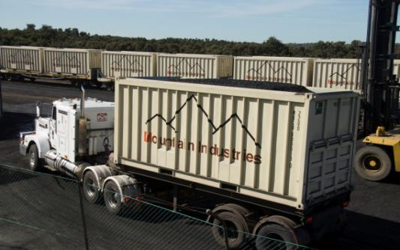
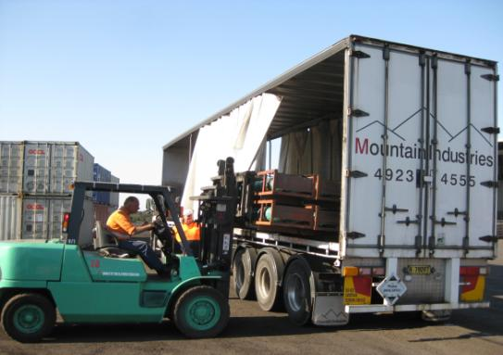
Intermodal Services
Warehousing
Distribution
Grains
Bulk freight
Palletized freight
Specialized
Bagged Commodities
Potatoes

Slide 27
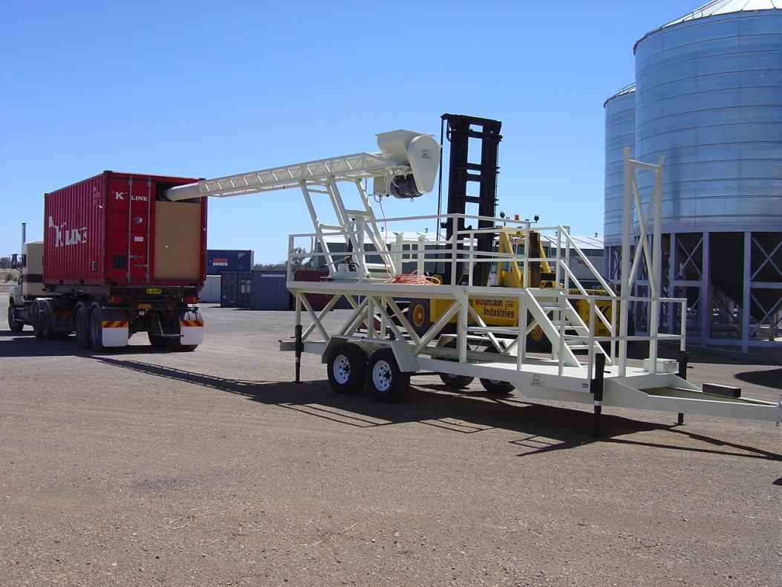
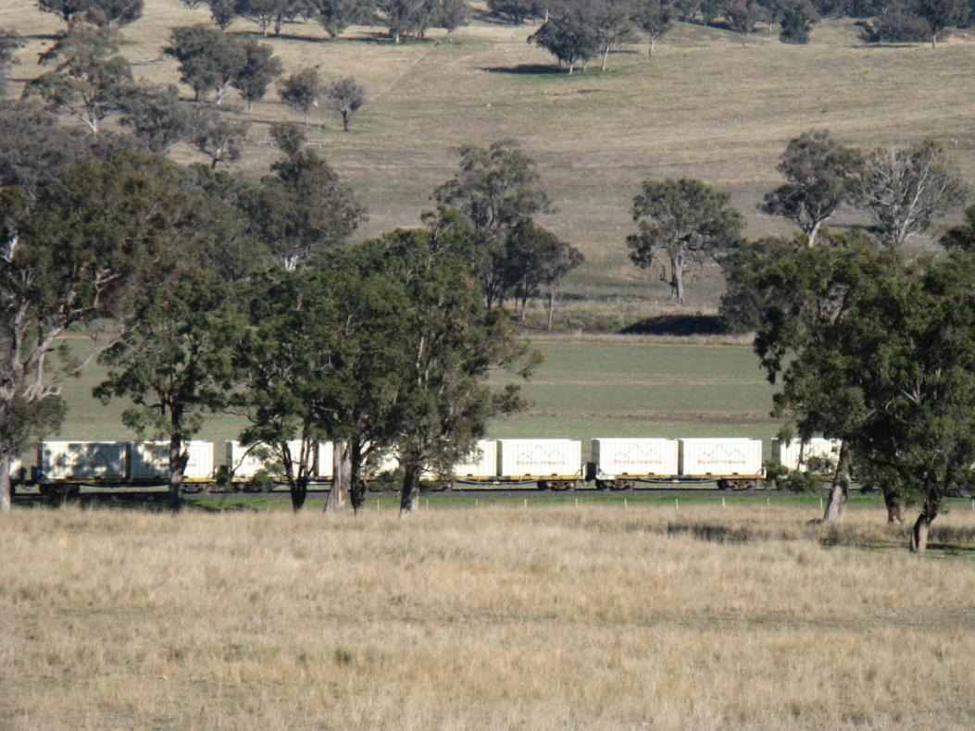
Intermodal Services
Warehousing
Distribution
Specialised Applications
Capital Investment

Slide 28
In Conclusion -
Intermodal Services
Warehousing
Distribution
The Mountain Industries team prides itself in working with clients to provide a transport partnership that delivers complete logistic solutions which encompass efficiency, value, compliance & a service focussed attitude.

