Slide 1

Sarah Al Rashed

Slide 2
The Negative Effects Of Childhood Abuse

Slide 3
Abstract

Slide 4
Childhood abuse is a very important issue that causes a wide variety of damages on the victim’s well-being (e.g., Hovens et al., 2010). Statistics shows that 69% of children are more likely to be abused by their parents or step-parents (Statistics Canada, 2011). Numerous studies have demonstrated that children exposed to domestic violence and/or child abuse are more likely to experience a wide range of adverse psychosocial and behavioral outcomes (e.g., Moretti & Craig, 2013). The effects of being abused persist into adolescence (e.g., Nicholas et al., 2006). The purpose of this essay is to demonstrate that childhood abuse can lead to depression and aggressiveness in the victim’s adolescence years. The literature reviewed suggests that childhood abuse increases the probability of improving depression problems (depressive symptoms or clinical depression) (e.g., Gibb et al., 2008; Hovens et al., 2010) as well as aggressive behaviors (e.g., Cullerton-Sen et al., 2008; Milletich et al., 2010) in adolescence. The association between childhood abuse and its negative psychological and behavioral outcomes are examined, and studies exploring depression and aggressiveness as two significant effects of children maltreatments in adolescence are discussed. Implications for future research are suggested .

Slide 5
Introduction

Slide 6
Child abuse is increasingly being recognized as a worldwide human rights issue and a public health problem that has significant impact on the victim’s physical (e.g., Jewkes et al. 2010) and psychological well-being (e.g., Cullerton-Sen et al., 2008).
A report published by Statistics Canada (2011) specified that children are more likely to be abused by a member of their family than a stranger specifically, 69% of children aged 1 to 3 were abused more often by a parent or a step-parent.
Negative Effects of Child Abuse:
  Psychiatric disorders (e.g., Moylan et al., 2011).
  Negative behavioral consequences (e.g., McGee et al., 1997).

Slide 7
Research studies frequently found depression and aggression to be two major psychological and behavioural outcomes linked with child abuse during adolescence (e.g., Miller-Perrin et al., 2009; Morimoto et al., 2004).
Thesis: Children who were physically and/or psychologically abused by their parents more likely to develop depression problems (depressive symptoms or clinical depression) (e.g., Gibb & Abela, 2008; Haj-Yahia & de Zoysa, 2008; Hovens et al., 2010;) as well as aggressive behaviors (e.g., Cullerton-Sen et al., 2008; Milletich et al., 2010; Vandenberg et al., 2009) in adolescence.

Slide 8
Key Terms

Slide 9
Child abuse is defined as any act, or failure to act, by a parent or adult caregiver, which caused death, serious physical or emotional harm, sexual abuse or exploitation, or an act or failure to act which presents an imminent risk of serious harm toward children (Paavilainen & Tarkka, 2003).
Depression (depressive symptoms or clinical depression) including a variety of emotional, physiological, behavioral, and cognitive symptoms such as sadness, sleep disturbance, loss of energy, and hopelessness (Nolen-Hoeksema & Rector, 2011).
Developing aggressive behavior including any physical or verbal behavior intended to hurt someone (e.g., Cullerton-Sen et al., 2008; Milletich et al., 2010).

Slide 10
Childhood Abuse and Depression

Slide 11
Depression (depressive symptoms or clinical depression) was one of the most commonly reported negative psychological outcomes of childhood abuse among adolescents(e.g., Haj-Yahia et al., 2008; Jewkes et al., 2010).
Children who were physically and/or psychologically abused are more likely to develop depression problems due to the negative impact of abuse on the ability to regulate emotions and to disturbances in neurobiological processes associated with child abuse (e.g., Gonzalez et al., 2012; Kim et al., 2006).

Slide 12
Another explanation was that children maltreatment is associated with increased of negative cognitive style of hopelessness which may affect victims’ expectations of control and self-confidence (e.g., Liu et al., 2009; Nicholas et al., 2006).
Childhood emotional abuse found to be a strong predictor of depressive symptoms in early adolescence (e.g., Gibb & Abela 2008; Kim et al., 2006).
A study by Jewkes et al., (2010) suggested that messages communicated to a child via psychological aggression may be more important in contributing to psychological outcome than the actual occurrence of physical violence toward the child.

Slide 13
Childhood Abuse and Aggression

Slide 14
Another outcome that has been found related to the exposure to childhood abuse among adolescents is aggressiveness (e.g., Arata et al., 2005)
High level of parental abuse was strongly associated with aggressive behavior in adolescents (e.g., Moe et al., 2004).
Displaying aggressive behavior in adolescence may be due to the social learning theory where children who exposed to violence are more likely to learn from their parents to use aggressiveness in their own lives (e.g., Arata et al., 2005).
A study conducted by Ford et al. (2010) suggested that in addition to the social learning theory principle, aggressive behavior was related to the inability to control emotions.

Slide 15
Verbal aggression by the parents is just like physical aggression has a significant effect on contributing the aggressiveness among abused children during adolescent years (e.g., Moe et al., 2004; Murphy, 2011).
Ford, Fraleigh & Connor (2010) suggested that emotional abuse has the most powerful relationship with both outward anger, expressed physically or verbally, and covert anger.
Although the reasons for this relationship have not been made clear, it may be that the denigrating and humiliating nature of verbal aggression causes or exacerbates feelings of intense anger in children, which intensifies if the abuse is chronic in nature (e.g., Miller et al., 2012; Milletich et al., 2010).

Slide 16
Discussion

Slide 17
Experience of child abuse has been associated with detrimental psychological and behavioural effects. Specifically, victims of child abuse develop depression (symptoms or clinical) (e.g., Gibb & Abela, 2008) as well as aggressive behaviors (e.g., Cullerton-Sen et al., 2008) in adolescence.
Collective research on the relationship between child abuse and depression suggested that adolescents who were abused in childhood by their parents were more likely to be suffering from depressive symptoms or diagnosis of depression (e.g., Gonzalez et al., 2012).
Interestingly, research found that psychological abuse in specific was a powerful predictor of improving both depression and aggressiveness outcomes on victims who were abused in their childhood during adolescence (e.g., Miller et al., 2012; Milletich et al., 2010).

Slide 18
Victims of child abuse have also been found to report higher levels of aggressiveness (e.g., Cullerton-Sen et al., 2008). Specifically, victims who exposure to family violence frequently has a high predisposition of approving violence as their strategies for resolving their conflicts and having high risk of displaying violent behavior themselves (e.g., Arata et al., 2005).

Slide 19
Recommendations

Slide 20
First, researchers should attempt to recruit youth victims of childhood abuse from the general population instead of clinical settings and protective service programs. This will help to generalize studies’ results to the majority of adolescents who may be suffering from childhood abuse but who may not have sought professional help from clinicians.
Researchers should measure the frequency and exact time of childhood abuse to provide more accurate association between childhood abuse with depression and aggression.

Slide 21
References

Slide 22
Arata, C. M., Langhinrichsen-Rohling, J., Bowers, D., & O’Farrill-Swails, L. (2005). Single versus multi-type maltreatment: An examination of the long-term effects of child abuse. Journal of Aggression, Maltreatment & Trauma, 11, 29–52. doi:10.1300/ J146v11n04_02
Cullerton-Sen, C., Cassidy, A. R., Murray-Close, D., Cicchetti, D., Crick, N. R., & Rogosch, F. A. (2008). Childhood maltreatment and the development of relational and physical aggression: The importance of a gender-informed approach. Child Development, 79, 1736-1751. doi: 10.1111/j 1467-8624.2008.01222.x
Ford, J., Fraleigh, L., & Connor, D. (2010). Child abuse and aggression among seriously emotionally disturbed children. Journal of Clinical Child and Adolescent Psychology, 39(1), 25–34.
Gibb, B. E., & Abela, J. Z. (2008). Emotional abuse, verbal victimization, and the development of children’s negative inferential styles and depressive symptoms. Cognitive Therapy and Research, 32, 161–176. doi:10.1007/ s10608-006-9106-x
Gonzalez, A., Boyle, M.H., Kyu, H.H., Georgiades, K., Duncan, L., & MacMillan, H.L. (2012). Childhood and family influences on depression, chronic physical conditions, and their comorbidity: findings from the Ontario Child Health Study. Journal of Psychiatric Research 46, 1475–1482. http://dx.doi.org.proxy.library.carleton.ca/10.1016/j.jpsychires.2012.08.004
Haj-Yahia, M. M., & de Zoysa, P. (2008). Rates and psychological effects of exposure to family violence among Sri Lankan university students. Child Abuse & Neglect, 32(10), 994-1002
Herrenkohl, T. I., Mason, W. A., Kosterman, R., Lengua, L. J., Hawkins, J. D., & Abbott, R. D (2004). Pathways from physical childhood abuse to partner violence in young adulthood. Violence and Victims, 19(2), 123–136. doi: 10.1891/vivi.19.2.123.64099
Jewkes, R., Dunkle, K.L., Nduna, M., Jama, N., & Puren, A. (2010). Associations between childhood adversity and depression, substance abuse & HIV & HSV2 incident infections in rural South African youth. Child Abuse & Neglect, 34, 833–841.
Jouriles, E. N., McDonald, R., Slep, A. M., Heyman, R. E., & Garrido, E. (2008). Child abuse in the context of domestic violence: Prevalence, explanations, and practice. Violence and Victims, 23, 221–235. doi:10.1891/0886-6708.23.2.221
Kendra, R., Bell, K. M., & Guimond, J. M. (2012). The impact of child abuse history, PTSD symptoms, and anger arousal on dating violence perpetration among college women. Journal of Family Violence, 27,165–175. doi:10.1007/s10896-012-9415-7
Kim, J., & Cicchetti, D. (2006). Longitudinal trajectories of self-esteem processes and depressive symptoms among maltreated and non maltreated children. Child Development, 77, 624– 639. doi:10.1111/j.1467-8624.2006.00894.x
Liu, R., Alloy, L., Abramson, L., Iacoviello, B., & Whitehouse, W. (2009). Emotional maltreatment and depression: Prospective prediction of depressive episodes. Depression & Anxiety, 26(2), 174-181.
McGee, R. A., Wolfe, D. A., & Wilson, S. K. (1997). Multiple maltreatment experiences and adolescent behavior problems: Adolescents' perspectives. Development and Psychopathology, 9, 131–149. doi:10.1017/S0954579497001107

Slide 23


Slide 24
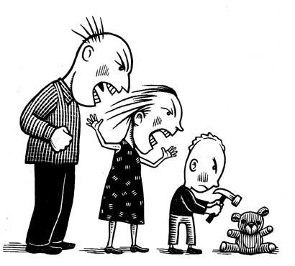

Slide 25
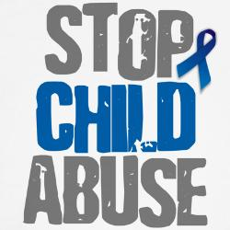

Slide 26
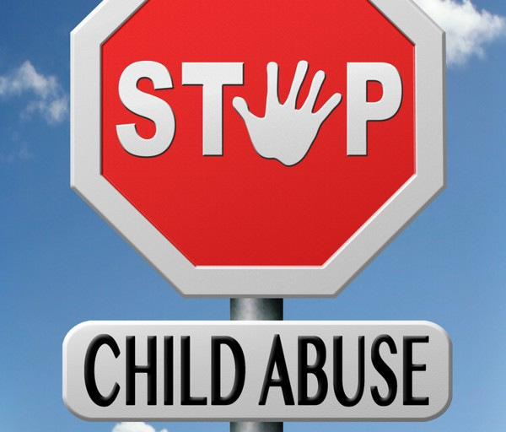

Slide 27
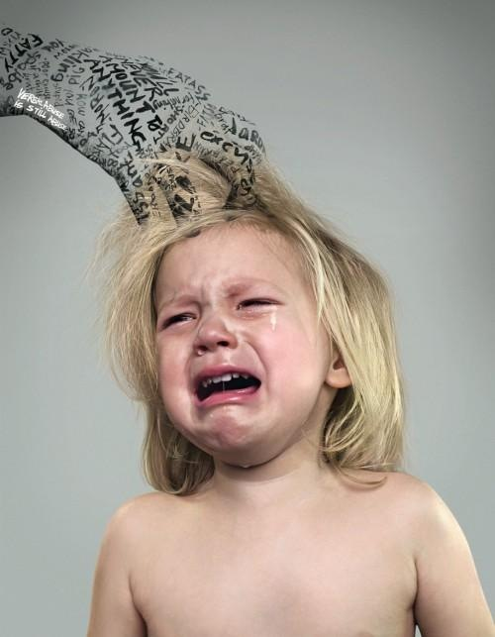

Slide 28
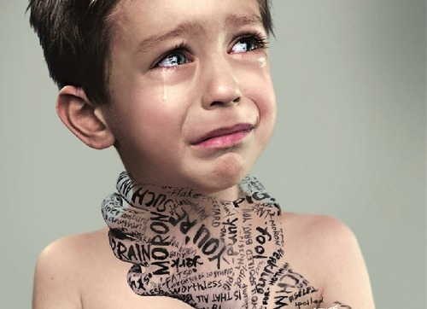

Slide 29
